Slide 1
Early and Late Childhood
PRESENTED BY,
S.YAAZHINEE, MSW., (UGC-NET)
ASSISTANT PROFESSOR,
PG & RESEARCH DEPARTMENT OF SOCIAL WORK,
BON SECOURS COLLEGE FOR WOMEN.

Slide 2
The Early Childhood Stage
[3 to 6 years]

Slide 3
The stage of early childhood extends from 3 to 6 years.
Different names as the toy age, preschool age, troublesome age or the pre-gang age.
Physical development proceeds at a slow rate in early childhood;

Slide 4
This period is also the skill acquiring period as the child easily repeats and picks up skills. Speech development improves quickly as also in comprehension.
Play is important for the overall development of the child. Play is influenced by the motor skills acquired by the child.

Slide 5
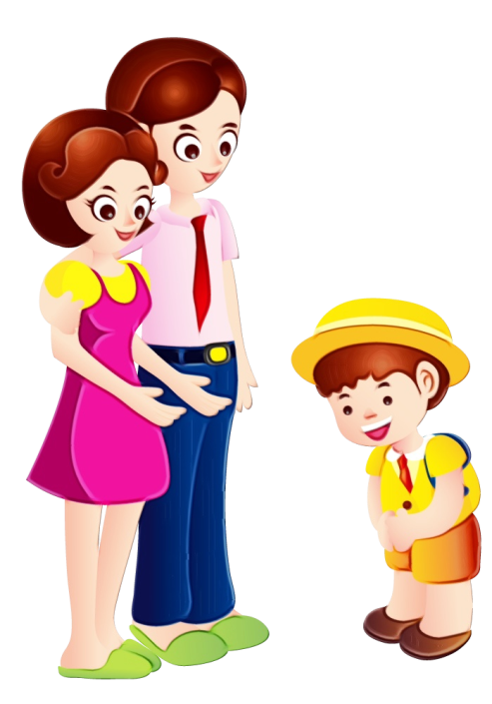
Parents influence children’s behaviour through discipline, ways of teaching.
Parents, companions and different family relationship play an important role in the socialization process and in developing the self-concept of the child.

Slide 6
The Late Childhood Stage [7 to 12 Years]

Slide 7
Late childhood extends from 7 years to 12 years.
This period is before the period when the child is sexually mature

Slide 8
The physical growth in this period is relatively at an even rate and is influenced by health, nutrition, immunization, sex and intelligence.
All areas of speech-pronunciation, vocabulary, and sentence structure improve rapidly.

Slide 9
Older children learn to control the overt expressions of their emotions and to use emotional catharsis to clear pent up emotions caused by social pressures.
Older children are interested in
activities with their peer and want to belong to a group or gang.

Slide 10
These children will often reject parental standards, develop antagonistic attitude towards persons of the opposite sex.
The interests of older children are broader than those of younger children and include many new subjects like clothes, human body, sex, school, future vocation, status symbol and autonomy.

Slide 11
THANK YOU

