Slide 1
WELCOME

Slide 2
OUTPATIENT DEPARTMENT

Slide 3
DEFINITON
OPD is defined as a part of the hospital with allotted physical facilities and medical and other staffs, with regularly scheduled hours, to provide care for patients who are not registered as inpatients.
A hospital department where patients receive diagnosis and / or treatment but do not stay overnight.

Slide 4
OBJECTIVES OF OPD
Objectives
Modern techniques for investigation and treatment
Facilities for total patient satisfaction
Good public relation
Provide quality of care

Slide 5
PROCESS OF OPD
Arrival at OPD
Departure
Reception
Collection of Med
Registration
Waiting
Issue of Taken Number
Token Number
Waiting Room
Arrival at Pharmacy
Consultation with Doctor
Issue of med Chit

Slide 6
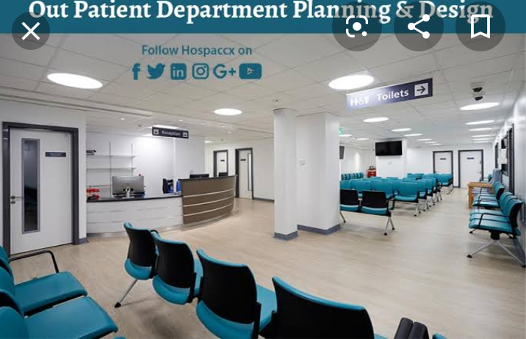
OPD planning and design

Slide 7
FACILITIES OF OPD
The OPD has facilities for screening, counselling, clinical examination, treatment and referral.
It consists of the following:
The Examination Room should be close to the nurses station and the consultation room.
Consultation Room is mostly used when lengthy conversation a involved between the doctor and the patient.
Clinical Department of OPD includes clinics which can use standard accommodation, general medicine, surgery, etc.

Slide 8
Types of clinics: Surgical, orthopaedic, medical, paediatric skin, ophthalmic, ENT, dental, chest, psychiatric, cardiology clinic.
OPD for the surgical department should be located on the ground floor and near the emergency with direct access to it.
Minor Surgery Room may be used as a cast room, ECG room, minor operations. It should have a separate entrance.
Support services includes clinics which can use standard accommodation, general medicine, surgery, etc.,

Slide 9
IMPORTANCE OF OPD
First point of contact.
It is the shop window of the hospital.
Makes or mars the image of the hospital.
A good OPD services can reduce the load on IPD services.
It is the place for implementing preventive and primitive health activities.
It is a stepping stone for health promotion and disease prevention.

Slide 10
FUNCTIONS OF OPD
An OPD enables a hospital to deliver the following functions:
Control disease by early diagnosis and timely treatment.
Investigate and screen cases to confirm whether or not hospitalization is required.
Facilitate screening and investigations for admission to hospital.
Provide effective treatment on ambulatory basis.

Slide 11
Provide follow-up care to discharged patients and their rehabilitation.
Provide a facility for training of medical, Para-medical and nursing staff.
It may also provide avenue for epidemiological and social research.
Control and surveillance of communicable disease diseases to prevent an outbreak of epidemic.

Slide 12
TYPES OF OPD
Centralized outpatient services
Decentralized outpatient services.
Centralized outpatient services: All services are provided in compact area which includes all diagnostic and therapeutics facilities being provided in the same place.
Decentralized outpatient services: Services are provided in the respective departments.

Slide 13
OUTPATIENT DEPARTMENT
Registration
Billing
Consultation
Diagnostics
Day care procedures
Preventive health check.

Slide 14
Thank you

