Slide 1
TYPES OF WINDOW DISPLAY
S.Manohari, MSc., FT.
Assistant professor,
Department of fashion technology and costume designing,
Bon secours college for women,
Thanjavur.

Slide 2
What is Visual merchandising
Visual merchandising is the practice in the retail industry of developing floor plans and three-dimensional displays in order to maximize sales.
Both goods and services can be displayed to highlight their features and benefits. The purpose of such visual merchandising is to attract, engage, and motivate the customer towards making a purchase.
Visual merchandising commonly occurs in retail spaces such as stores.

Slide 3
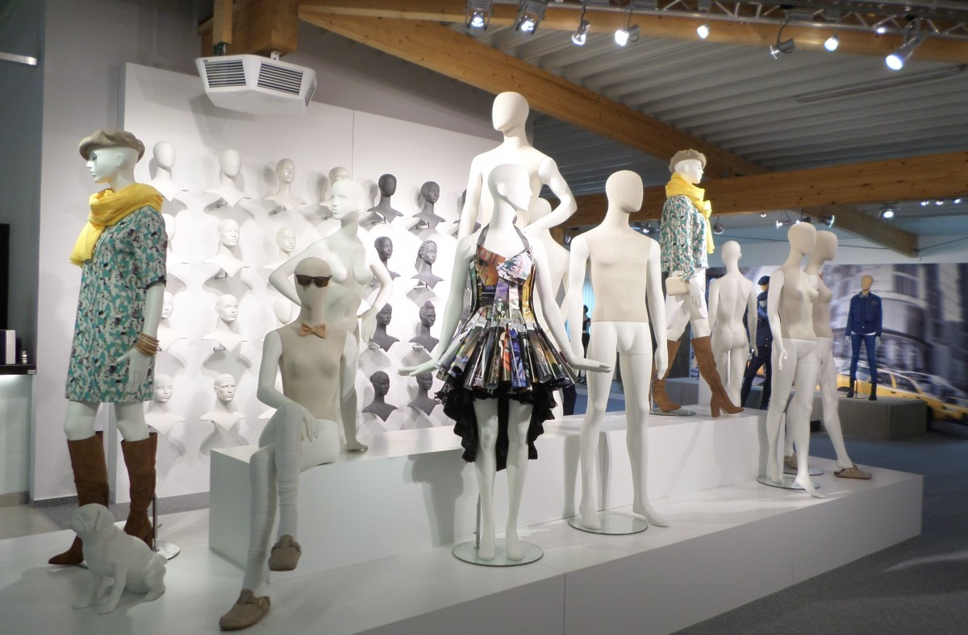
Visual merchandising

Slide 4
What Is Window Display
Designed to attract customers to a store, window displays are described as the dressing of larger windows in the front facade of a shop.
The most basic meaning of a window display is that a window display is the arrangement of items in a way that, attracts customers.

Slide 5
TYPES OF WINDOW DISPLAY
1. Closed Window Displays
2. Open Back Window Displays
3. Angled Window Displays
4. Corner window Displays
5. Shadowbox Displays
6. Windowless Displays
7. Island Window Displays
8. Elevated Window Displays

Slide 6
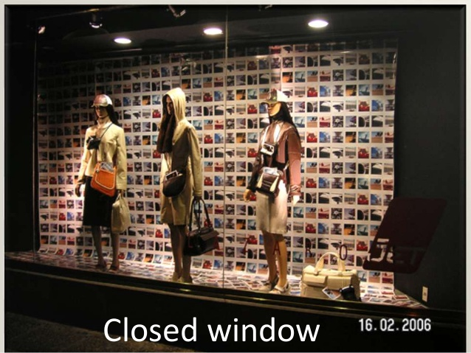
Closed back window
It has a large pan of glass at the front and a solid back wall and two sides with their hide and door access the window

Slide 7
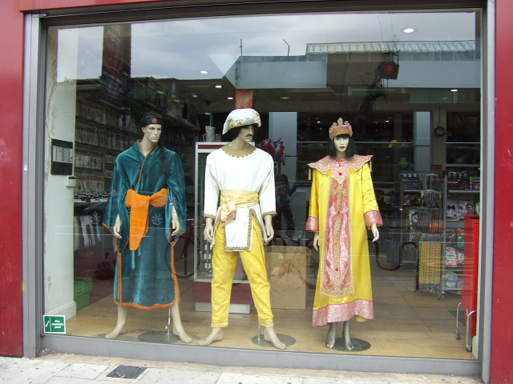
Open back window
These have side walls but no back wall allowing the interior of the shop to be seen from the street

Slide 8
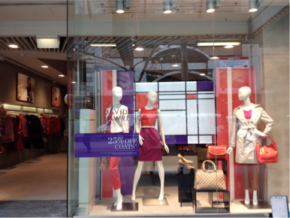
Angled window
It’s much like this right front in that its follows a true line but the monotony is relieved by angles away from the sidewalk contour.

Slide 9
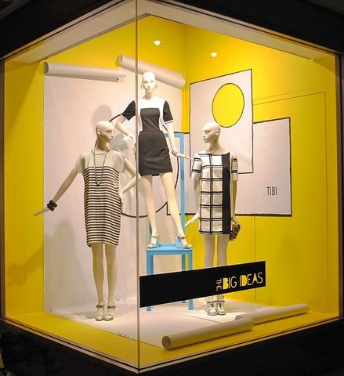
Corner window
The window wrapped around the corner list of the placement of stock is important because it will be visible from both directions.

Slide 10
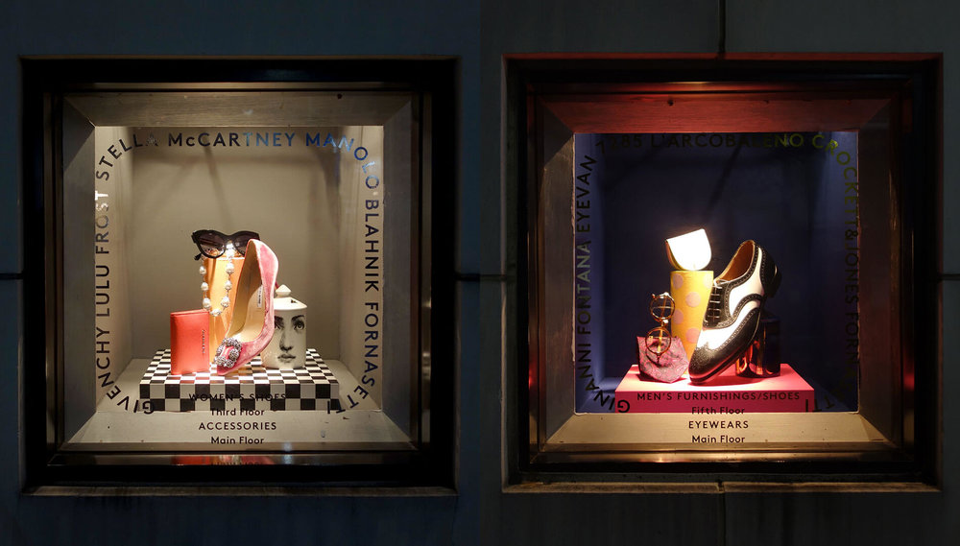
Shadow Box Window Display
Shadow boxes are small entities usually found near the entry of a store. It is perfect display in luxury items like jewellery and watches. Shadow box requires individual lighting.

Slide 11
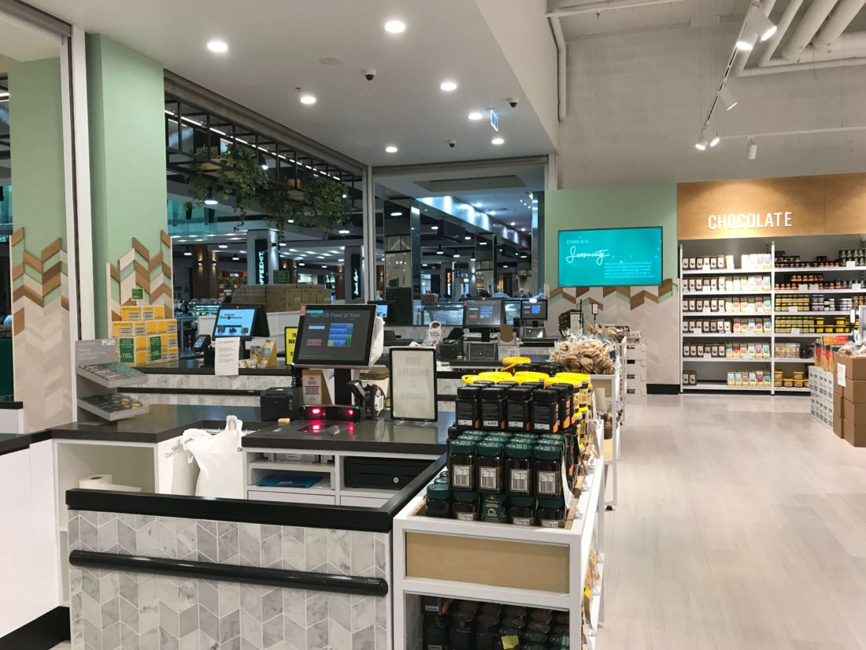
Windowless
It is wide opening at the friend of this store will bring customers into the shop for merchandise easily visible to the passer by.

Slide 12
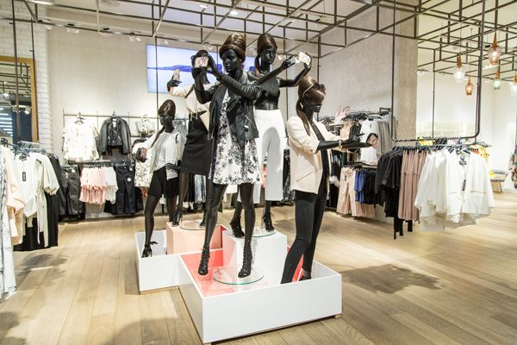
Island window display
Island window displays can only be seen in the large department and flagship stores. such a window display request shoes space. retailers use this type of window display to create a sense of focus on the latest products or promotions

Slide 13
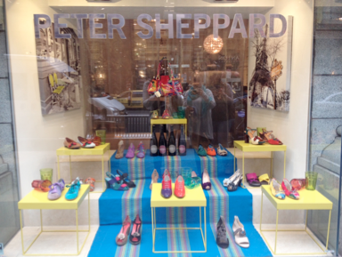
Elevated windows
This type of elevated display is used to rise featured products enough to catch the eye , usually combined with a graphic display or method of displaying the item itself to raise awareness even further. It can either be closed or open window that is located in a higher level.

Slide 14
THANK YOU

