Slide 1
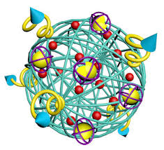
BIOMEDICAL NANOTECHNOLOGY
PRESENTED BY
DR.M. GAYATHRI
ASSISTANT PROFESSOR
DEPARTMENT OF BOTANY
BON SECOURS COLLEGEFOR WOMEN
THANJAVUR

Slide 2
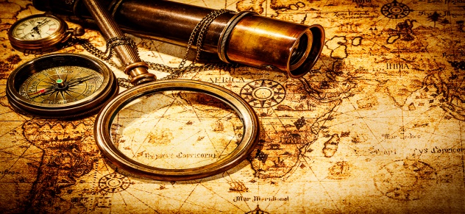
Nanotechnology-History

Slide 3
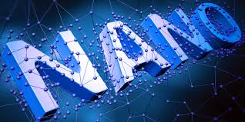
What is a nanoparticle?
Nano” – derived from a Greek word “Nanos” meaning
DWARF or small
The dimension of the particle ranges from 1-100 nm
A nanometer is one billionth of a meter 10⁻⁹ m.

Slide 4
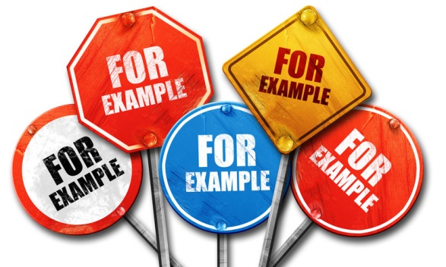
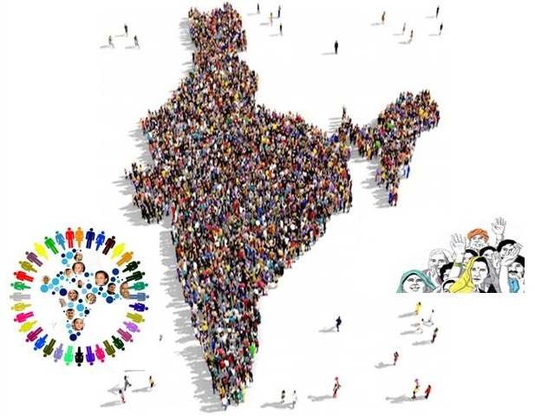
Nano- Simple Example
The population of India is one billion or 100 crores. Each Indian – you or me is nano in comparison with the total population of India.

Slide 5
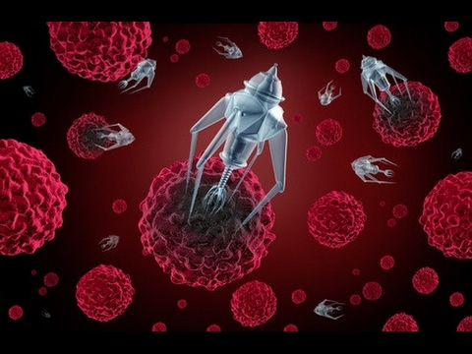
An Intro to Biomedical Nanotechnology
A cross-disciplinary - science, engineering and medicine - molecular imaging, molecular diagnosis and targeted therapy

Slide 6
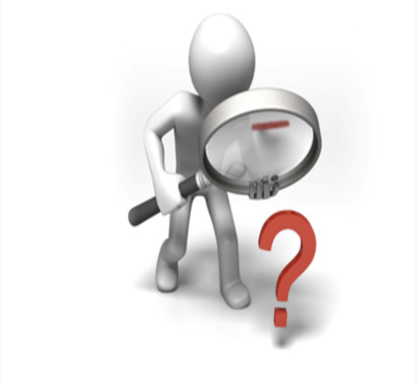
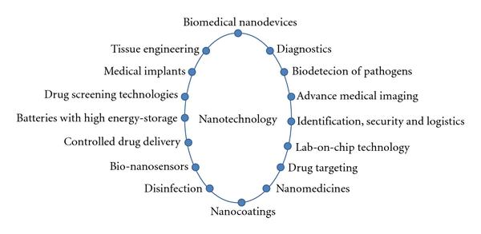
Applications of Nanotechnology in Biomedical Field

Slide 7
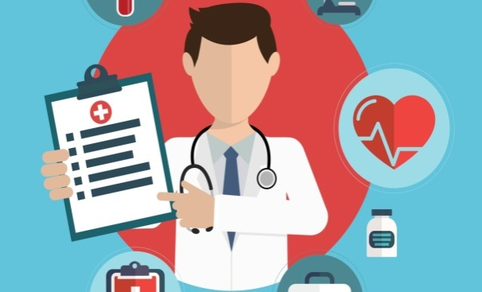
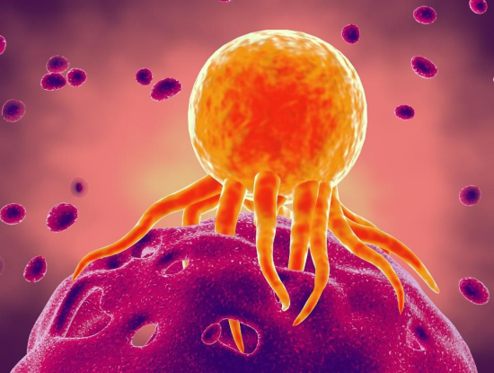
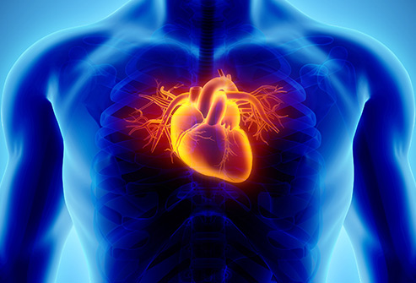
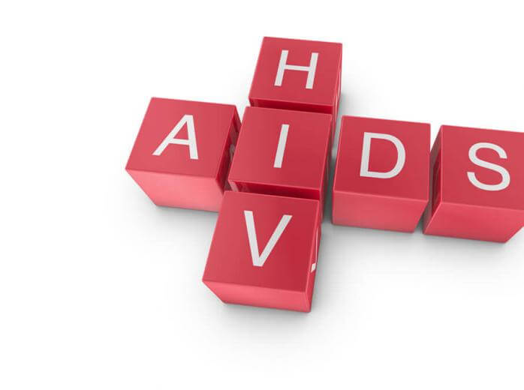
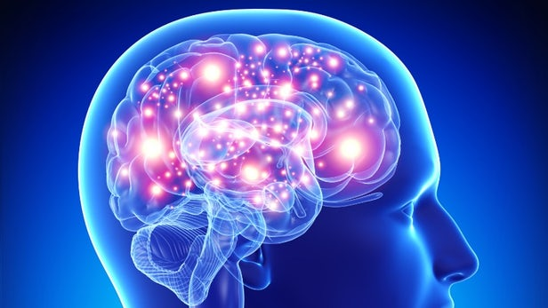
Nanotechnology for Medical Diagnosis
Biomarkers help in the early detection of cancer, cardiovascular disease, diabetes, Alzheimer’s and AIDS

Slide 8
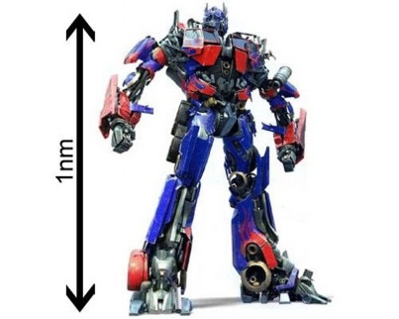
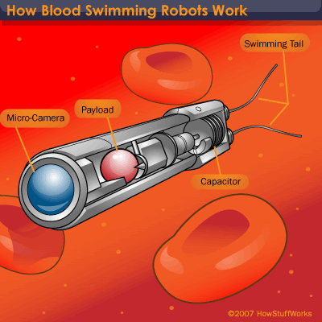
Nanodevice/Nanorobots
Nanomedicine - make use of these nanorobots –body - to repair or detect damages and infections

Slide 9
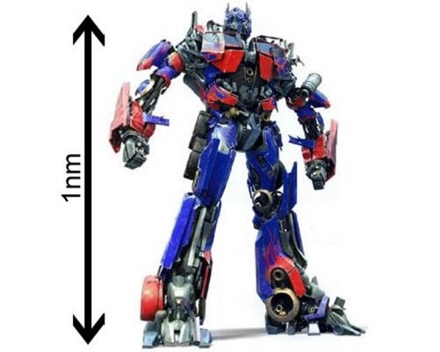
Nanorobots

Slide 10
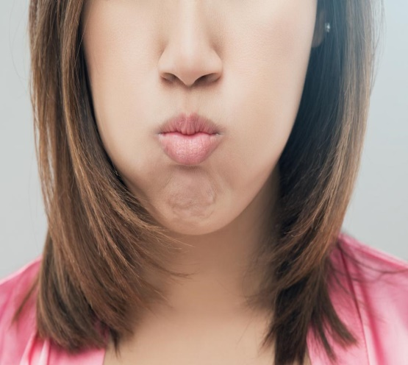
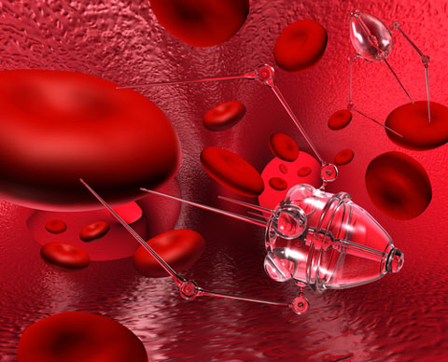
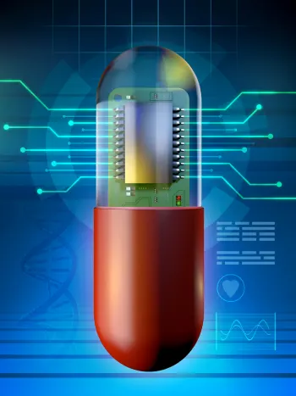
Fields of Applications

Slide 11
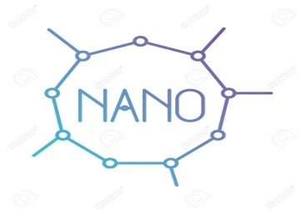
Nanoparticle drug delivery in cancer therapy
Nanoparticles (NPs) are the new identified tools by which we can deliver drugs into tumor cells with minimum drug leakage into normal cells
Conjugation of NPs with ligands of cancer specific tumor biomarkers is a potent therapeutic approach to treat cancer diseases with the high efficacy

Slide 12
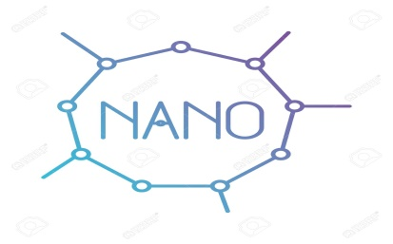
Cantilevers
Tiny levers - anchored at one end - bind to molecules that represent some of the changes associated with cancer

Slide 13
Nanopores
Tiny holes - DNA to pass through one strand at a time - DNA sequencing more efficient

Slide 14
Nanotubes
Detect - altered genes in DNA - pinpoint exact location of those changes

Slide 15
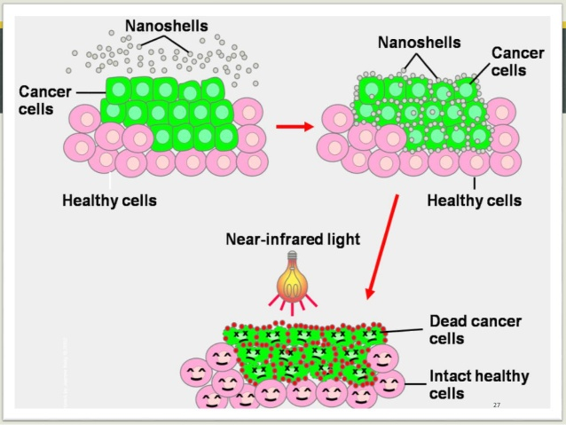
Nanoshells
Nanoshells, scientists can design these beads to absorb specific wavelengths of light

Slide 16
Dendrimers
Dendrimers are man-made molecules about the size of an average protein, and have a branching shape

Slide 17
Quantum dots
Quantum dots are tiny crystals that glow when they are stimulated by ultraviolet light

Slide 18
Process for Tissue Bioprinting
Create a blueprint of an organ with its vascular architecture
Generate a bioprinting process plan
Isolate stem cells
Differentiate the stem cells into organ specific cells
Prepare bioink reservoirs with organ specific cells,
blood vessel cells, and support medium and load them
into the printer;
Bioprint and
Place the bioprinted organ in a bioreactor prior to transplantation

Slide 19
Bioprinting 3D tissues

Slide 20
Artificial cell technology
Engineered artificial cells can be used to replace dysfunctional cells in the human body and may be used in the future to treat anemia, renal failure, bone defects, and many other health problems.
Macro dimensions : For genetically engineered cells, stem cells, other cells, tissues,microorganisms, etc.
Micron dimensions : For enzymes, genetically engineered microorganisms and other microorganisms, peptides, etc.
Nano dimensions : For blood substitutes, enzymes, peptides, magnetic materials, drugs, etc.

Slide 21
Artificial cells

Slide 22
Tissue engineering-Overview
Expand number in culture
Remove cells
from the body
Seed onto an appropriate scaffold with suitable growth factors and cytokines
Re-implant engineered tissue repair damaged site
Place into culture

Slide 23
FUTURE OF NANOTECHNOLOGY
Researchers aim eventually to create nanodevices that do much more than to diagnose and deliver treatment seperately
The goal is to create a single nanodevice that will do many things:
Assist in imaging inside the body

Slide 24
Cont…
Recognize precancerous or cancerous cells
Release a drug that targets only those cells
Report back on the effectiveness of the treatment

Slide 25
Conclusion
It has been proved that nanotechnology is a promising area of scientific and technological advancement
In nanotechnology, big things are expected from really small things
For nanotechnology to prosper there needs to be a true unification of sciences, which will require a multidisciplinary approach.

Slide 26
References
Abdou P, Wang Z, Chen Q, Chan A, Zhou DR, Gunadhi V, et al. Advances in engineering local drug delivery systems for cancer immunotherapy. Wiley Interdiscip Rev Nanomed Nanobiotechnol 2020 Apr 7;e1632.
Aggarwal N, Qamar Z, Rehman S, Baboota S, Ali J. ORALLY ADMINISTERED NANOTHERAPEUTICS FOR PARKINSON DISEASE: AN OLD DELIVERY SYSTEM YET MORE ACCEPTABLE. Curr Pharm Des 2020 Apr 5.
Ahmadian E, Samiei M, Hasanzadeh A, Kavetskyy T, Jafari S, Alipour M, et al. Monitoring of drug resistance towards reducing the toxicity of pharmaceutical compounds: Past, present and future. J Pharm Biomed Anal 2020 Mar 19;186:113265.
Bai X, Wang Y, Song Z, Feng Y, Chen Y, Zhang D, et al. The Basic Properties of Gold Nanoparticles and their Applications in Tumor Diagnosis and Treatment. Int J Mol Sci 2020 Apr 3;21(7).
Baldassarre A, Mucci N, Lecca LI, Tomasini E, Parcias-do-Rosario MJ, Pereira CT, et al. Biosensors in Occupational Safety and Health Management: A Narrative Review. Int J Environ Res Public Health 2020 Apr 3;17(7).
Hasan A, Paray BA, Hussain A, Qadir FA, Attar F, Aziz FM, et al. A review on the cleavage priming of the spike protein on coronavirus by angiotensin-converting enzyme-2 and furin. J Biomol Struct Dyn 2020 Apr 10;1-13.
Montane X, Bajek A, Roszkowski K, Montornes JM, Giamberini M, Roszkowski S, et al. Encapsulation for Cancer Therapy. Molecules 2020 Mar 31;25(7).
Teixeira MC, Carbone C, Sousa MC, Espina M, Garcia ML, Sanchez-Lopez E, et al. Nanomedicines for the Delivery of Antimicrobial Peptides (AMPs). Nanomaterials (Basel) 2020 Mar 20;10(3).

