Slide 1
Merchandising process
Ms.S.Priya,
Asst.Prof.Dept of Fashion Technology,
Bon Secours College for women,
Thanjavur.
Reporter: Nuke 2019.9.20

Slide 2
1
Enter title
4
Enter title
CONTENTS
2
Enter title
5
Enter title
3
Enter title

Slide 3
1
PART
Enter title

Slide 4
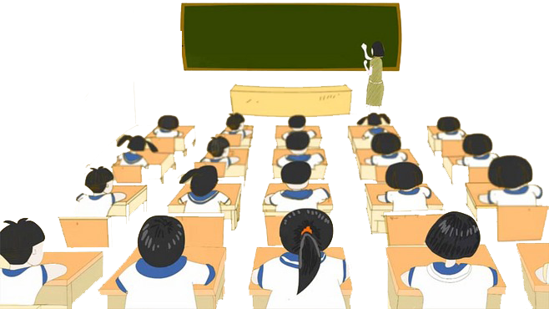
Click here to add content of the text，and briefly explain your point of view.
Click here to add content of the text，and briefly explain your point of view.
Enter text

Slide 5
Click here to add content of the text，and briefly explain your point of view.
01
Click here to add content of the text，and briefly explain your point of view.
02
03
Click here to add content of the text，and briefly explain your point of view.

Slide 6
2
PART
Enter title

Slide 9
Click here to add content of the text，and briefly explain your point of view.
01Enter title
添加标题
Enter subtitle
Click here to add content of the text，and briefly explain your point of view.
02Enter title
Enter subtitle

Slide 10
3
PART
Enter title

Slide 11
Click here to add content of the text，and briefly explain your point of view.
Click here to add content of the text，and briefly explain your point of view.

Slide 12
1
2
3
4
Click here to add content of the text，and briefly explain your point of view. Click here to add content of the text，and briefly explain your point of view.

Slide 13
4
PART
Enter title

Slide 14
Click here to add content of the text，and briefly explain your point of view. Click here to add content of the text，and briefly explain your point of view.
1
Click here to add content of the text，and briefly explain your point of view. Click here to add content of the text，and briefly explain your point of view.
2

Slide 15
Click here to add content of the text，and briefly explain your point of view. Click here to add content of the text，and briefly explain your point of view.
1
Click here to add content of the text，and briefly explain your point of view. Click here to add content of the text，and briefly explain your point of view.
2

Slide 16
THANK YOU

