Slide 1
SOURCING
Ms.S.Priya, Assistant professor,
Department of Fashion Technology And Costume Designing,
Bon Secours College for women,
Thanjavur.

Slide 2
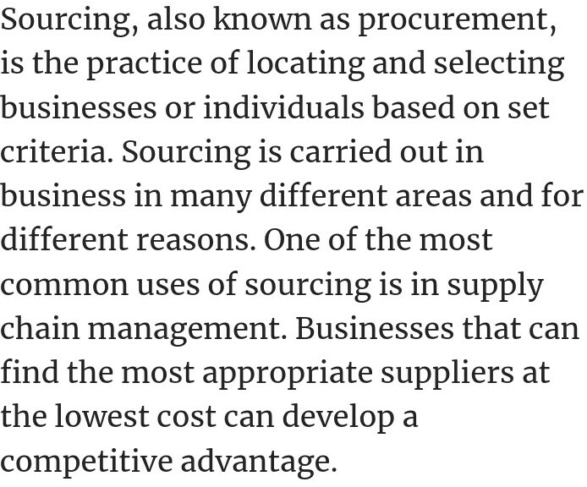

Slide 4
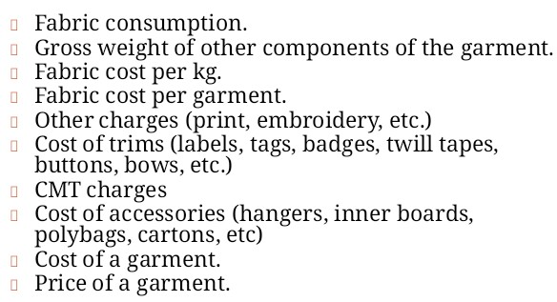
COSTING

Slide 5
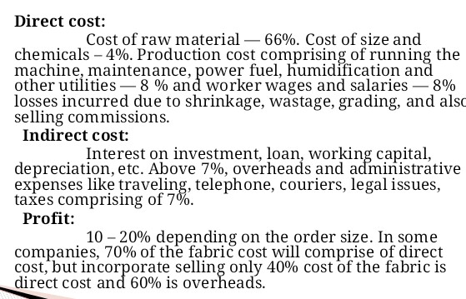
COSTING TYPES

Slide 6
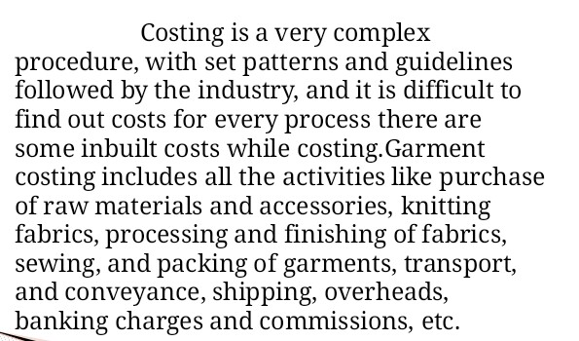
GARMENT COSTING

Slide 7
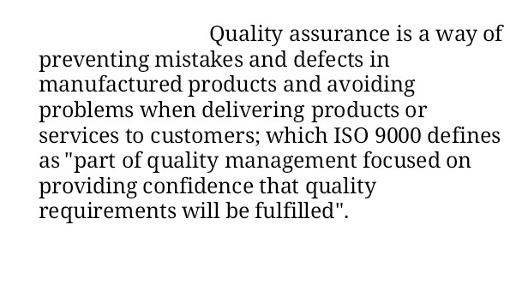
QUALITY ASSURANCE

Slide 8
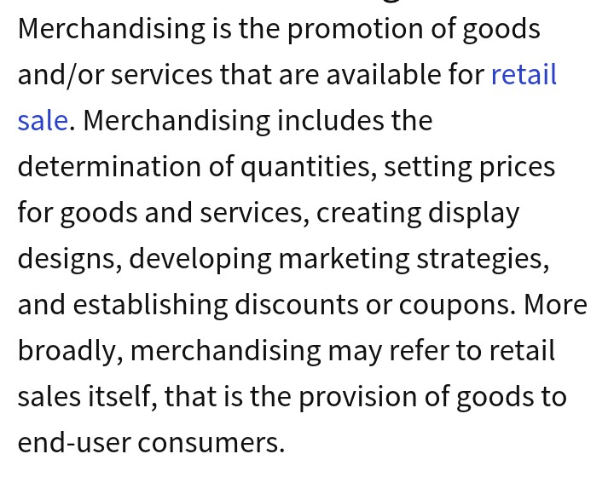
MERCHANDISING

Slide 9
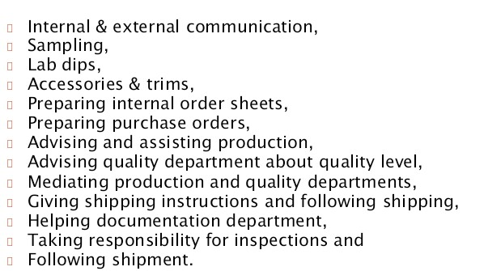
RESPONSIBILITIES OF MERCHANDISER

Slide 10
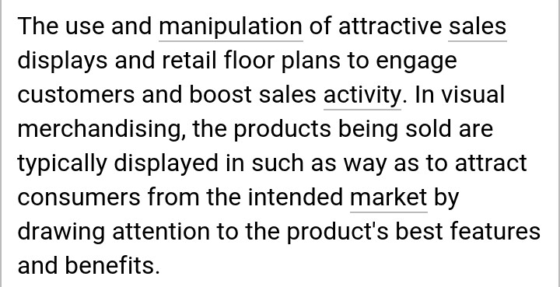
VISUAL MERCHANDISING

Slide 11
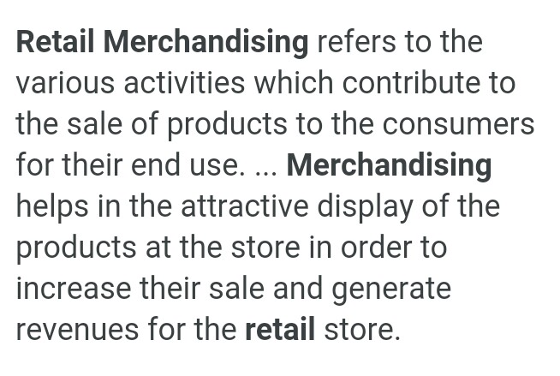
RETAIL MERCHANDISING

Slide 12
Thank you

