Slide 1
Consumer Behaviour
Ms.S.Priya, Assistant Professor,
Dept. Of Fashion Technology,
Bon Secours College for women,
Thanjavur.

Slide 2
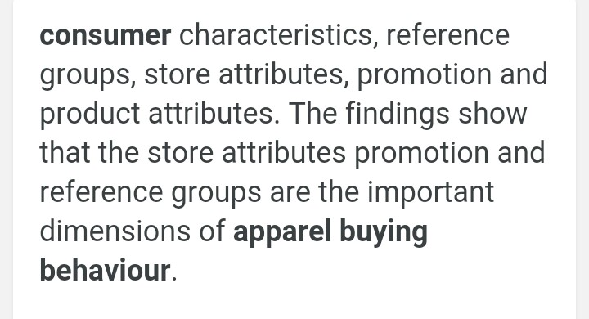
Consumer behaviour in apparel

Slide 3
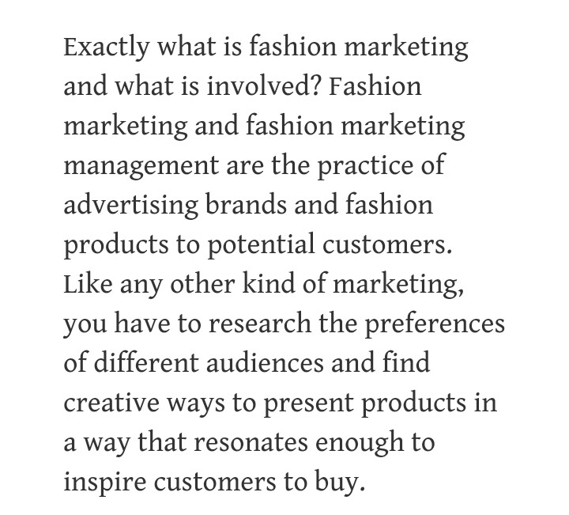
Fashion market

Slide 4
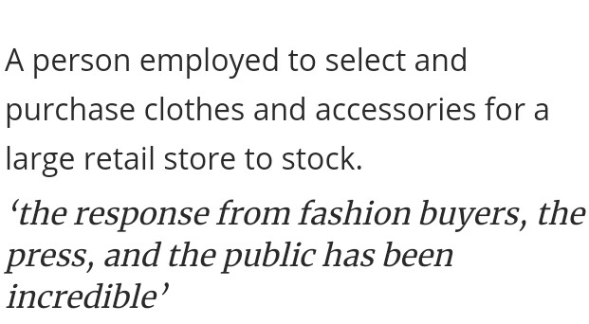
Fashion buyer

Slide 5
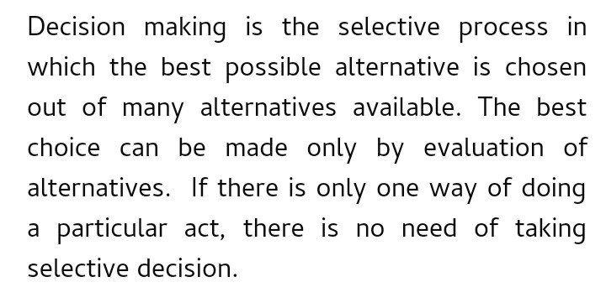
Decision making

Slide 6
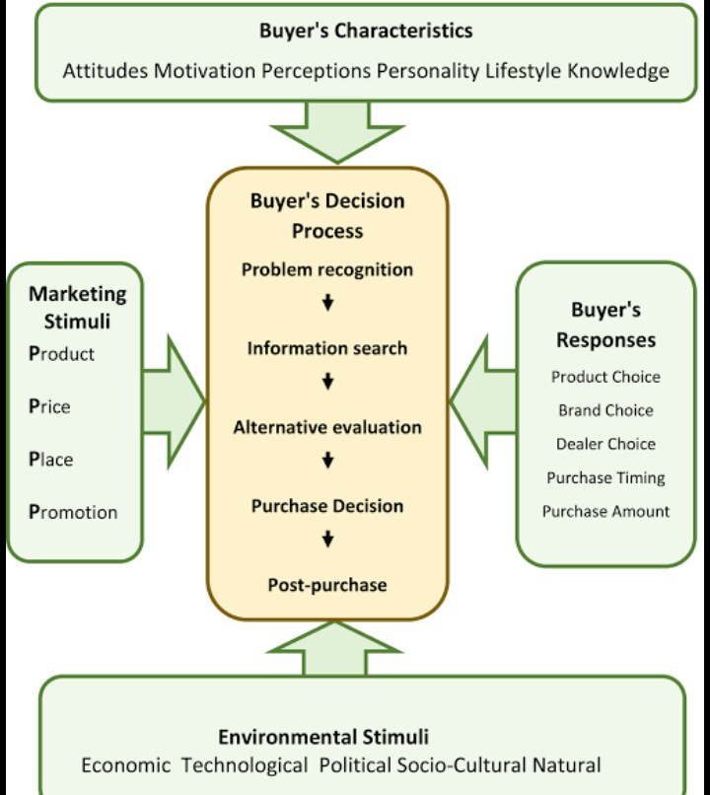

Slide 8
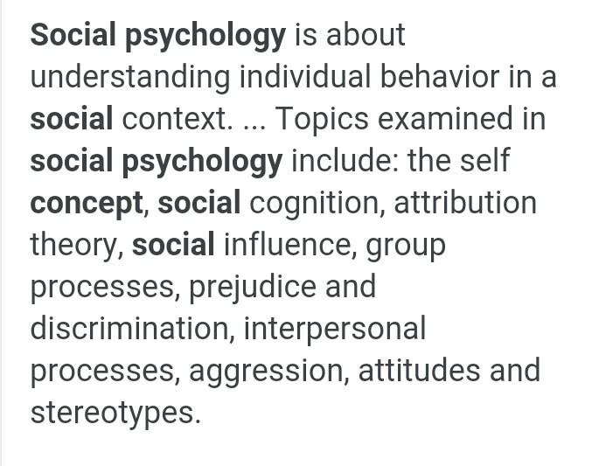
Psychological and sociological aspects

Slide 9
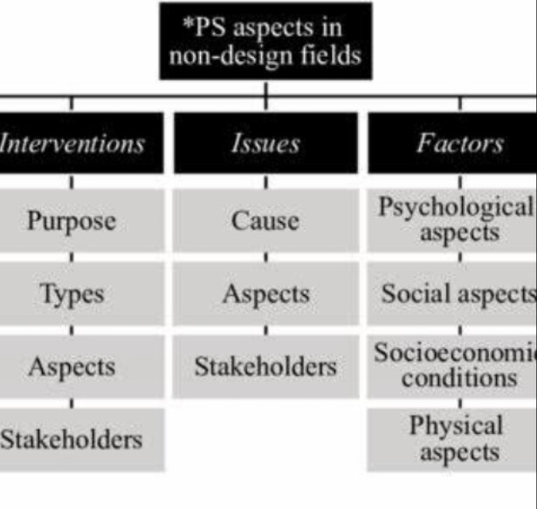

Slide 10
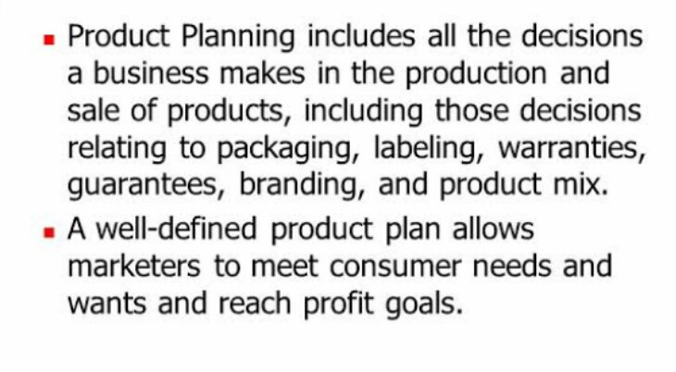
Product planning and development

Slide 11
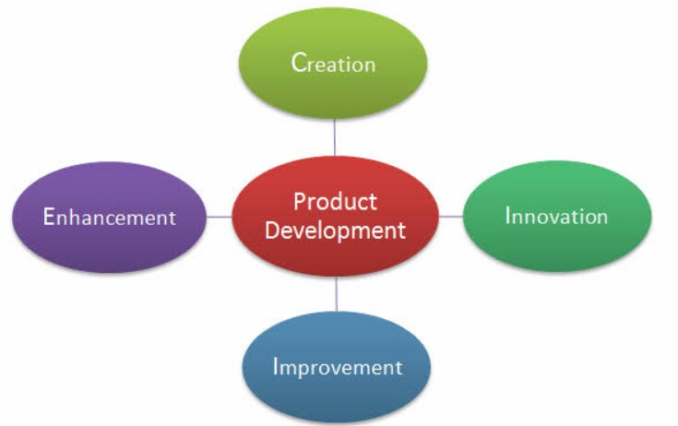

Slide 12
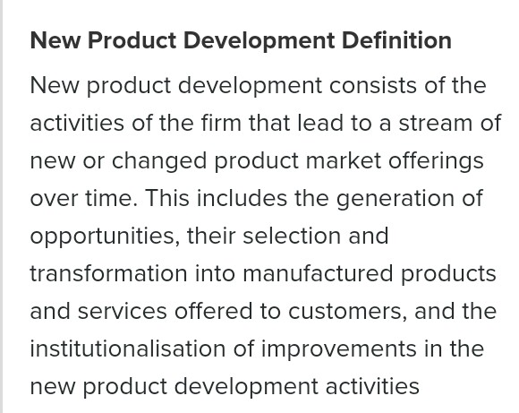

Slide 14
Fashion market practices and procedures

Slide 16
Thank you

