Slide 1
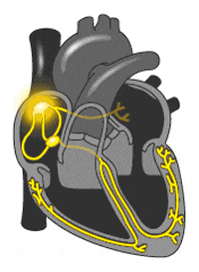
PACEMAKER
M. KARTHIKA
Asst Professor,
Dept of Physics,
Bon Secours College FOR WOMEN, Thanjavur

Slide 2
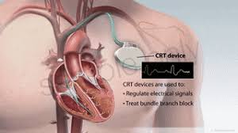
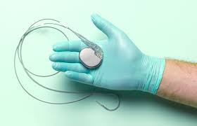
PACEMAKER????
A pacemaker is a small device that's placed in the chest or abdomen to help control abnormal heart rhythms. This device uses electrical pulses to prompt the heart to beat at a normal rate.

Slide 3
CARDIAC PACEMAKER

Slide 4
WORKING OF PACEMAKER

Slide 5
Heart Rhythm
SINUS RHYTHM
The normal cardiac rhythm is called sinus rhythm.
ARRHYTHMIA
Change in normal sinus rhythm is called Arrhythmia.
BRADYCARDIA
Heart blocks occur when the conduction system b/w atria and ventricles fails. If the blockage is not complete some impulses get through from atria but the heart rate will fall.(slow heart rate)

Slide 6
Types of Heart blocks
There are three basic types of AV nodal block:
First-degree AV block.
Second-degree AV block. Type I second-degree AV block (Mobitz I), also known as Wenckebach block. Type 2 second-degree AV block (Mobitz II) - due to a block in or below the bundle of His.
Third-degree AV block (complete heart block)

Slide 7
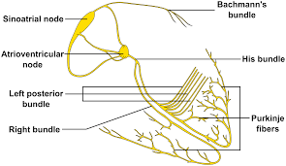
The bundle of His
The bundle of His is an important part of the electrical conduction system of the heart, as it transmits impulses from the atrioventricular node, located at the anterior-inferior end of the interatrial septum, to the ventricles of the heart.

Slide 8
Brief History of Pacemakers

Slide 9
PARTS OF PACEMAKER

Slide 10
OUTPUT REQUIREMENTS & ELECTRODES
RECTANGULAR PHASE
1mS
10mA
RESISTANCE 500 OHM
POWER= I*I*R
AVERAGE POWER= 50 MICROWATT
Pt, Ag, titanium, stainless steel electrodes

Slide 11
TYPES OF PACEMAKERS
EXTERNAL
Cardiac Surgery
Temporary Heart Arrhythmia
INTERNAL
Implanted With Pulse Generator
Pass Through The Cephalic Vein

Slide 12
CATEGORIES OF PACEMAKER

Slide 13
TYPICAL PACEMAKER

Slide 14
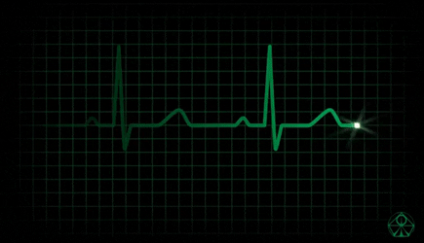
HEART WAVEFORMS

Slide 15
COMPETITIVE PACEMAKER
More-recent devices are synchronous, or demand, pacemakers that trigger heart contractions only when the normal beat is interrupted. Most pacemakers of this type are designed to generate a pulse when the natural heart rate falls below 68 to 72 beats per minute.

Slide 16
NON-COMPETITIVE
Non-Competitive Atrial Pacing (NCAP) is intended to prevent triggering of atrial tachycardias by delaying the scheduled atrial pace from occurring within the atrium's relative refractory period.
Tachycardias – FAST HEART BEAT RATE

Slide 17
THANK YOU

