Slide 1
COLLECTIVE BEHAVIOUR
S.DELPHINA MARY,
ASST.PROFESSOR
BON SECOURS COLLEGE FOR WOMEN
DEPARTMENT OF SCIAL WORK

Slide 2
Introduction
The term ‘collective behaviour’ is commonly used in a generic or in wide sense to include all the facts and phenomena of associated life (or group life). In literal sense, it would incorporate all behaviours involving more than one person. From this viewpoint, practically, all group activity can be thought of as collective behaviour.

Slide 3
Definition
N.J. Smelser (1962), a sociologist who specializes in this field of study, has defined collective behaviour as the ‘relatively spontaneous and unstructured behaviour of a group of people who are reacting to a common influence in an ambiguous situation’. Mob, crowd, panics are prime examples of collective behaviour. Publics, lynchings, crazes, fashions, social unrest, social movements, and revolutions are other manifestations of collective behaviour.

Slide 4
Nature of collective behavior
Spontaneous and episodic:
Collective behaviour is spontaneous and takes place occasionally rather than regularly and routinely.
Unstable:
It tends to be short-lived as long as the centre of attraction exists. It has no stable goals, values and expectations like institution­alized behaviour.
Irrational:
Usually such behaviour is guided by unreasoning, beliefs, hopes, fears and hatreds. In such situations, decisions are not generally made on the basis of logical or rational discussion.

Slide 5
Nature of collective behavior
Unstructured:
It has not set rules or procedures to follow like a regular and routine behaviour. Generally, it is loosely structured.
Unpredictable:
The direction and outcome of such behaviour cannot be foretold.
Emotional:
Sometimes such behaviour is emotional and based on considerable personal interaction.

Slide 6
Manifestation of collective behavior
Some manifestation of collective behavior are
Crowds
Riot
Panic and crazes
Rumor
Fads and Fashion

Slide 7
Crowds
The crowd is defined as a relatively large number of people in close proximity to each other (this is sometimes referred to as localized collectivises). The crowd reacts at once to a common focus or concern.

Slide 8
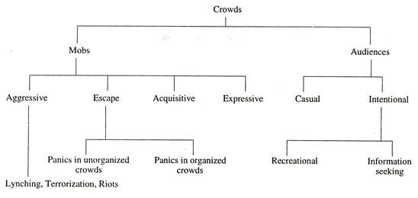

Slide 9
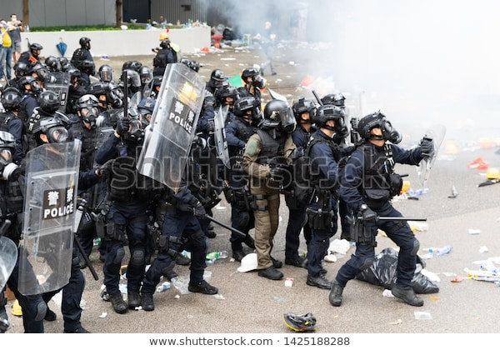
Riot
A riot is a form of mob which is violently aggressive and destructive. It may lead to violent acts against any object or person who happens to be in the wrong area at the wrong time.
The incident that triggers a riot can be relatively trivial, as sometimes exchange of some hot words between the members of two castes, races or communities about something may lead to a riot

Slide 10
Panic and crazes
Panics and crazes both represent responses to some generalized belief which may and may not be accurate. For example, when a fire breaks out in the theatre, every individual is so overcome by dread that each cares for his/her own safety and loses all consideration for others.

Slide 11
Rumour
A rumour is a piece of information gathered informally which is used to interpret an ambiguous situation. It arises in such a situation where people want some verifiable information but do not get or cannot get it. Rumours are frequently, but not always, false.
It can cause riot.

Slide 12
Fads and Fashions:
Fads and fashions are specific types of collective mass behaviour that people enthusiastically pursue. They refer to periodic changes in styles and patterns of our behaviour.
Jewellery, clothing, music, recreation, hair style, etc., catch the fancy of people more than anything else.

Slide 13
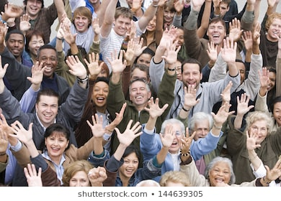
Conclusion
Collective behaviour is performed by a great number of individuals facing one unusual common issue. The members are connected directly or indirectly.

Slide 14
THANK YOU

