Slide 1
DISTRIBUTED TECHNOLOGIES
Beneficiaries:
STUDENTS OF M.SC. COMPUTER SCIENCE AND INFORMATION TECHNOLOGY
AND
OTHERS WHO ARE INTERESTED IN DISTRIBUTED COMPUTING
AUTHOR:
MRS. VIJI PARTHASARATHY
ASST.PROFESSOR,DEPARMENT OF COMPUTER SCIENCE,
SHRIMATHI INDIRA GANDHI COLLEGE,
TIRUCHIRAPPALLI
620002

Slide 2
THIS PPT COVERS FOLLOWING TOPICS
DEFININTION OF DISTRIBUTED COMPUTING
CHALLENGES
STRATEGIES
PRACTISES THROUGH DOT NET

Slide 3
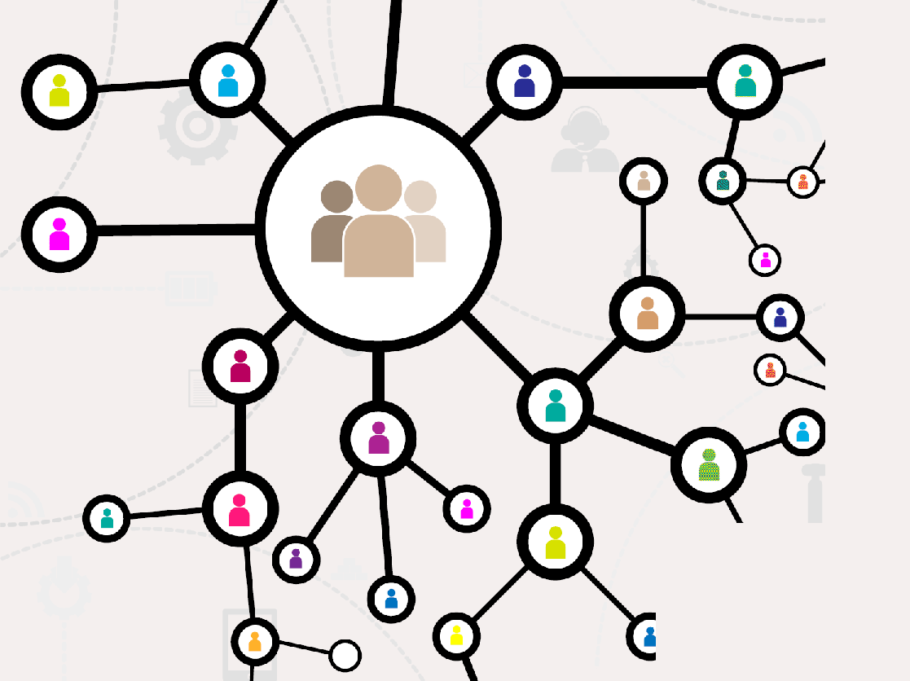
DEFINITION:
Distributed computing is a computation in which
networked computers communicate and coordinate the
work through message passing to achieve a common goal.

Slide 4
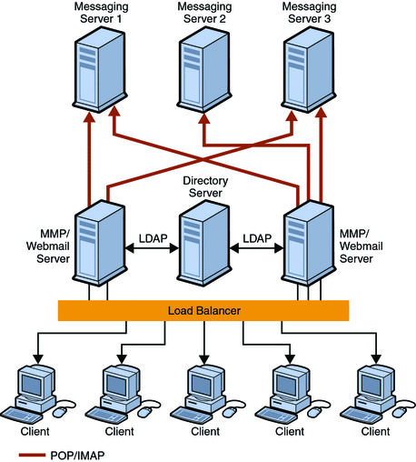
DISTRIBUTED COMPUTING

Slide 5
In distributed computing, each processor has its own private memory (distributed memory).
Information is exchanged by passing messages between the processors.
The processors in a typical distributed system run concurrently in parallel.
EXAMPLES:
Internet
ATM (bank) machines
Intranets

Slide 6
CHALLENGES INVOLVED IN DISTRIBUTED COMPUTING
1)HETEROGENITY
2)RESOURCE SHARING
3) OPENNESS
4)CONCURRENCY
5) SCALABLE
6)FAULT TOLERANCE
7)TRANSPARANCY

Slide 7
DIFFERENT TYPES OF TRANSPARENCY
ACCESS
LOCATION
REPLICATION
FAILURE
MIGRATION
CONCURRENCY
PERFORMANCE
SCALING

Slide 8
STRATEGIES INVOLVED IN
REMOTE COMPUTING SYSTEMS
WHAT IS RCS?
Remote access enables users to connect to the systems when they are physically far away.
Remote process (access) services provide the means for dispersed applications to communicate across a computer network.

Slide 9
REMOTE COMPUTING SYSTEMS
Remote access enables remote users to access files and other system resources on any devices or servers that are connected to the network at any time. (Increasing employee productivity and enabling them to better collaborate with colleagues around the world).

Slide 10
The Goal of the Remote Computation System (CS)
RCS is to provide easy access to modern parallel algorithms on supercomputers for the
inexperienced user.
It is to make high performance computing accessible to scientists and engineers without the need for extensive training in parallel computing and allowing them to use resources best suited for a particular phase of the computation.

Slide 11
In user's view , the RCS is an ordinary software library.
The user calls RCS library routines (e.g. to solve a system of linear equations) within his program running on a workstation.
RCS can be called asynchronously .
The Remote Computation System consists of two components:
➢ A library of interface routines.
➢ The run time system.

Slide 12
RCS provides an easy-to-use mechanism for using computational resources remotely.
Before running a RCS application, the user has to start up the RCS run time system.
➢ RCS is a single user system but multiple RCS applications are allowed per user to run concurrently.
➢ The server is the core of the RCS. Its task is to accept requests from user's application and to start an appropriate solver on a host in the pool.
➢ If the remote host is not specified by the user, the server selects the solver-host pair such that the response time is minimized .

Slide 13
To use Remote Desktop,users need:
➢ A computer ("host" computer) running Windows XP Professional with Service Pack 2 or Windows Server 2003 with Service Pack 2 ("remote" computer) with a connection to a local area network (LAN) or the Internet.
➢ A second computer ("client" computer) with access to the LAN via a network connection, modem, or virtual private network (VPN) connection. This computer must have Remote Desktop Connection installed.
➢ Appropriate User Accounts and Permissions

Slide 14
.net Networking
It is an application programming interface Remote means any object which executes outside the application domain.
It provides an inter-process communication between Application Domains by using Remoting Framework.
A remote object is confined to the application domain where it is created.

Slide 15
In . NET remoting, a client doesn't call the methods directly; instead a proxy object is used to invoke methods on the remote object.
Every public method that we define in the remote object class is available to be called from clients.

Slide 16
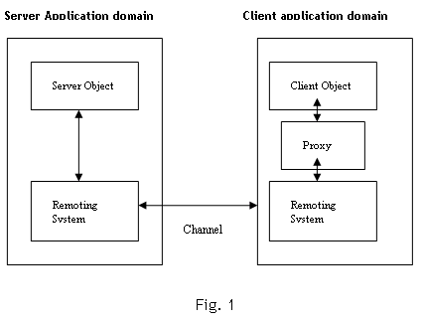

Slide 17
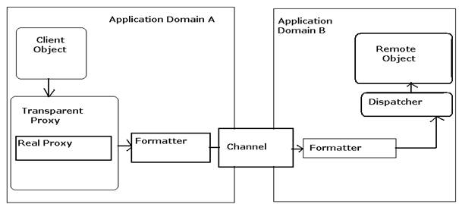
AppDomain is an isolated environment for executing Managed code.
Objects within same AppDomain are considered as local whereas object in a different AppDomain is called Remote object.
Microsoft .Net Remoting comes into picture when an application requires communication between different AppDomains.

Slide 18
List of Objects
Remote Object
Proxy Object
Two types of Remote objects :
Client activated object
Server activated object.
There are two types of server activated objects:
Singlecall.
Singleton.

Slide 19
FORMATTERS
.Net Framework provides
SOAP and Binary formatter.
It also supports custom formatters (IRemotingFormatter) developed by programmers.
They encode and decode the message between client application and Remote object.
Binary Formatter: System.Runtime.Serialization.Formatters.Binary
SOAP Formatter: System.Runtime.Serialization.Formatters.Soap

Slide 20
Channels
They are responsible for transmitting the message over the network.
.Net Framework provides
HTTPChannel and TCPChannel.
It also supports custom channels (IChannel) developed by programmers.
HTTPChannel: System.Runtime.remoting.Channels.Http
TCPChannel:
System.Runtime.remoting.Channels.Tcp
By default HTTP Channel uses SOAP Formatter and
TCP Channel uses Binary Formatter.

Slide 21
THANK YOU

