Slide 1
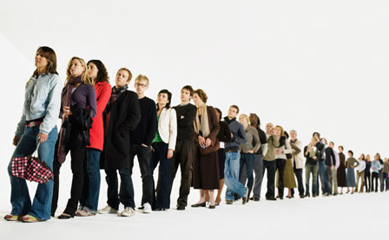
QUEUEING THEORY
PRESENTED BY
V.PRABA
ASSISTANT PROFESSOR
DEPARTMENT OF MATHEMATICS
SHRIMATI INDIRA GANDHI COLLEGE
TRICHIRAPALLI-2
MASTER OF BUSINESS ADMINSTRATION
SUBJECT NAME : OPERATIONS RESEARCH
SUBJECT CODE :P 16 MBA 7
SEMESTER : II TOPIC :QUEUEING THEORY

Slide 2
QUEUEING THEORY
WHAT IS QUEUEING THEORY ?
A Queueing Theory Is The Mathematics Of Waiting Lines.
Queueing Theory Is The Mathematical Study Of The Congestion And Delays Of Waiting In Line.
Queueing Theory Examines Every Component Of Waiting In Line To Be Served, Including The Arrival Process, Service Process, Number Of Servers, number Of System Places And The Number Of Customers.

Slide 3
QUEUEING THEORY
As A Branch Of Operations Research, Queueing Thoery Can Help Users Make Informed Business Decisions On How To Build Efficient And Cost-effective Workflow System.
Real Life Applications Of Queueing Theory Cover Wide Range Of Applications , Such As How To Provide Faster Customer Service , Improve Traffic Flow, Efficiently Ship Orders From Warehouses, And Design Of Telecommunication Systems From Data Networks To Call Centers.

Slide 4
APPLICATION OF QuEUEING THEORY
Telecommunications
Determine The Sequence Of Computer Operations
Predicting Computer Performance
One Of The Key Modelling Techniques For Computer System / Networks In General
Traffic Control
Airport Traffic And Airline Ticket Sales
Layout Of Manufacturing System
Health Services ( Example : Control Of Hospital Bed Assignments)

Slide 5
BENEFITS OF QUEUEING THEORY
1. By Applying Queueing Theory, A Business Man Can Develop More Efficient Queueing Systems, Processes, Pricing Mechanisms, Staffing Solutions, And Arrival Management Strategies To Reduce Customer Wait Times And Increase The Number Of Customers That Can Be Served.
2.Queueing Theory As An Operations Management Technique Is Commonly Used To Determine And Streamline Staffing Needs, Scheduling, And Inventory, Which Helps To Improve Overall Customer Service.
3. Queueing Theory Is Used By Six Sigma Practitioners To Improve Processes.

Slide 6
DIFFERENT SITUATATIONS WHERE QUEUEING THORY IS APPLIED
Supermarket , Ration Shop, Restaurant
Parking Lot
Toll Booths
Traffic Lights
Call Centers Of An Insurance Company
Hospitals and Ships in Harbor waiting to be Unloaded
Railway Station Booking-Office and Cinema Theatre Booking -Counter
Banking and Bank ATM”S
Library Management
Data Communication [Computer System}
Production System
Mobile Communication Network
Telecommunication

Slide 7
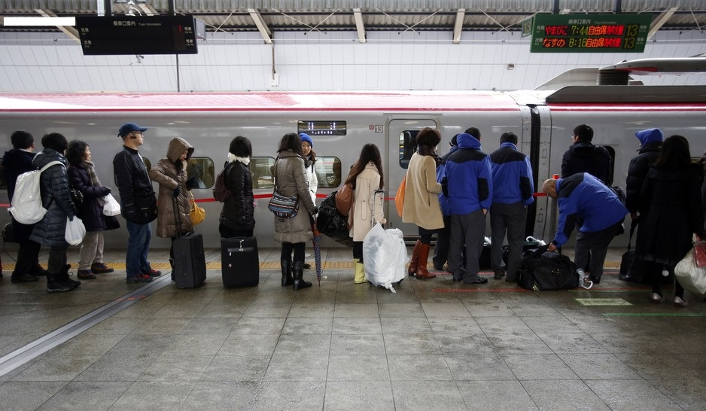
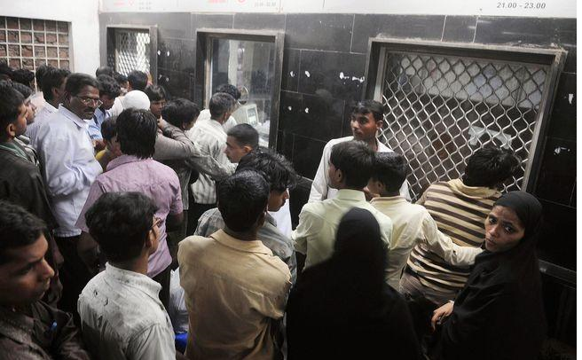
Queue in railway station

Slide 8
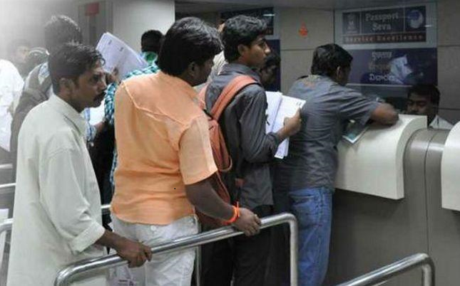
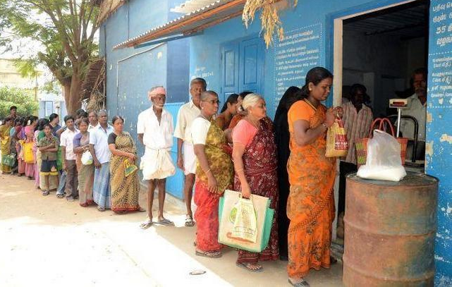
Queue in Ration shop and government office

Slide 9
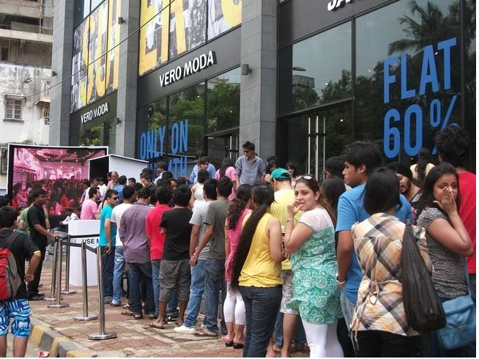
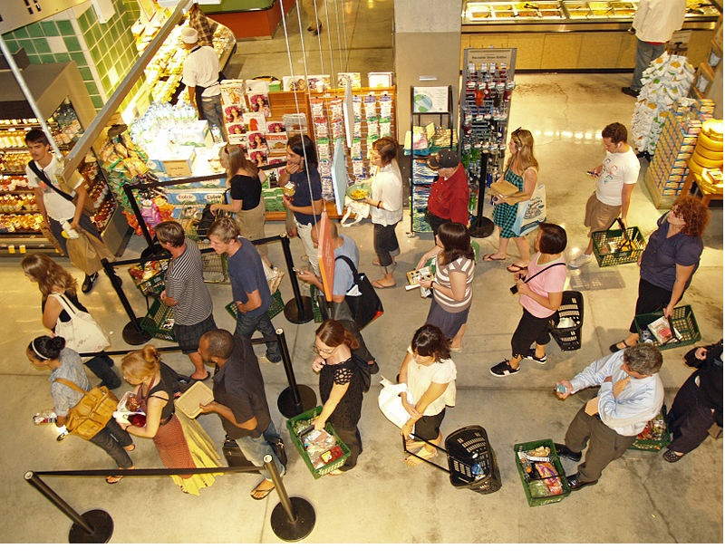
QUEUE IN MALL AND SUPERMARKET

Slide 10
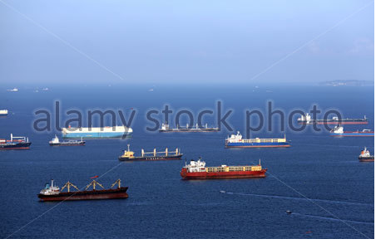
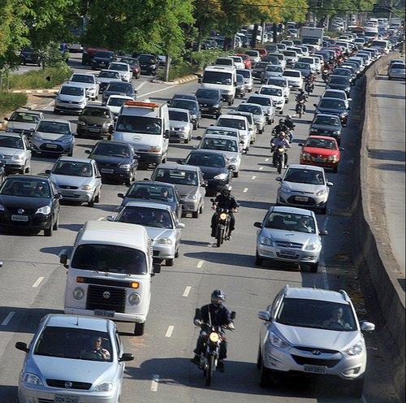
queue of SHIPS IN HARBOR TO UNLOAD and vehicle in parking lot

Slide 11
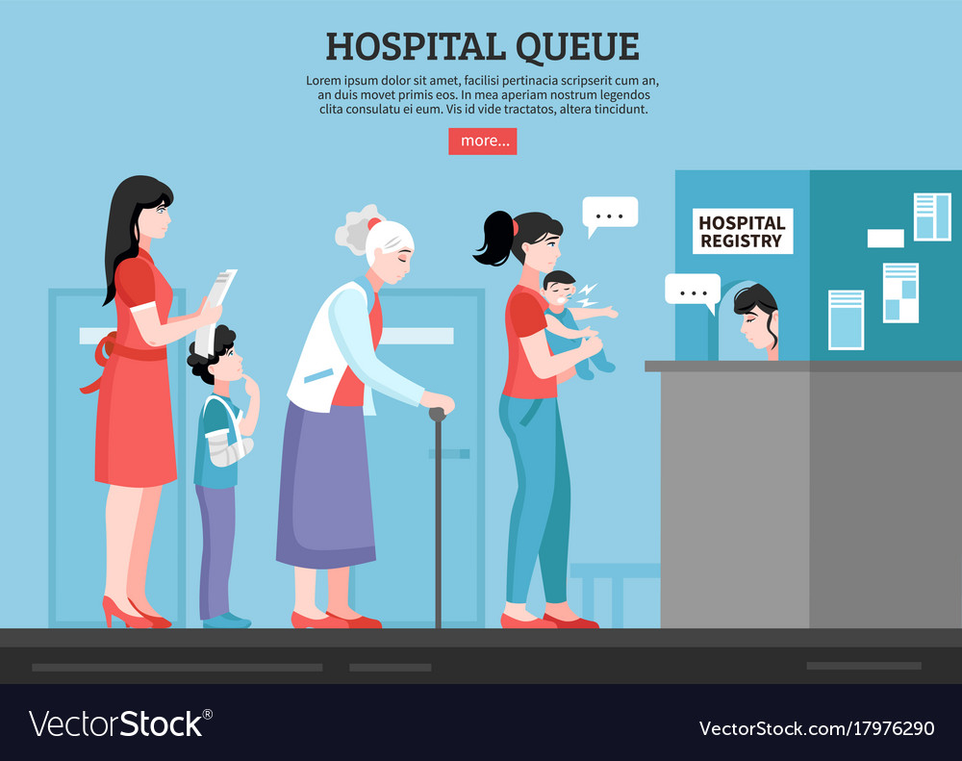
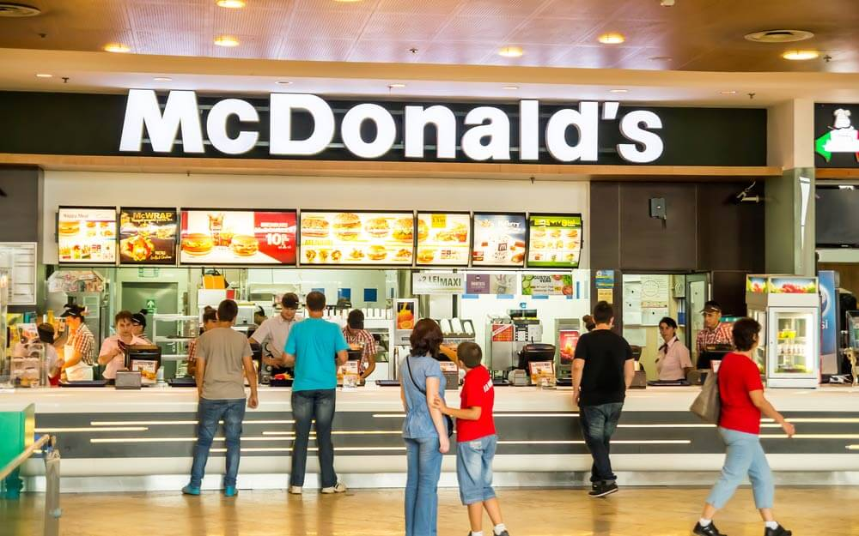
QUEUES IN HOSPITAL and RESTURANT SHIPS IN HARBOR TO UNLOAD

Slide 12
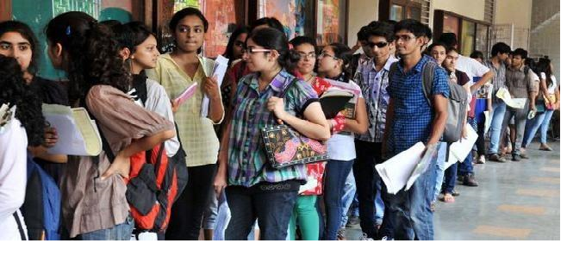
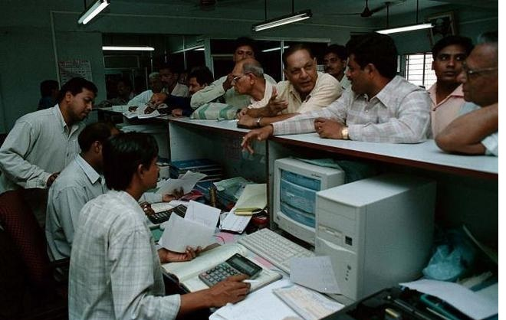
Queue in college admission and bank

Slide 13
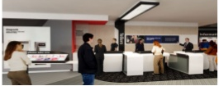

WHEN WILL QUEUEING PROBLEM ARISE
THERE ISTOO MUCH DEMAND ON THE FACILITIES
THERE IS LESS DEMAND
MUCH WAITING TIME OR INADEQUATE NUMBER OF SERVICE FACILITIES
MUCH IDLE TIME OR MORE NUMBER OF SERVICE FACILITIES

Slide 14
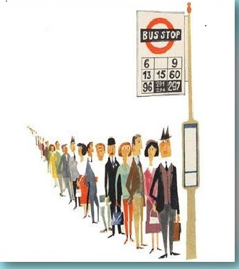
Introduction of queueing system
A.K.Erlang (1878-1929) Danish Engineer Who Is Called The Father Of Queuing Theory Developed This In Order To Analyze Telephone Traffic Congestion.
Queues Are Formed Due To The Inefficiency Of The Service System To Render Immediate Services To The Customer When They Arrive.
Examples ; People Waiting To Deposit The Electricity Bills, Flow Of Automobile Traffic Through A Road Network, Queues Formed At The Railway Reservation Counter, People Waiting To Make Deposits Or Withdrawals At Bank, Machines Waiting To Get Repaired In The Workshops, Etc.

Slide 15
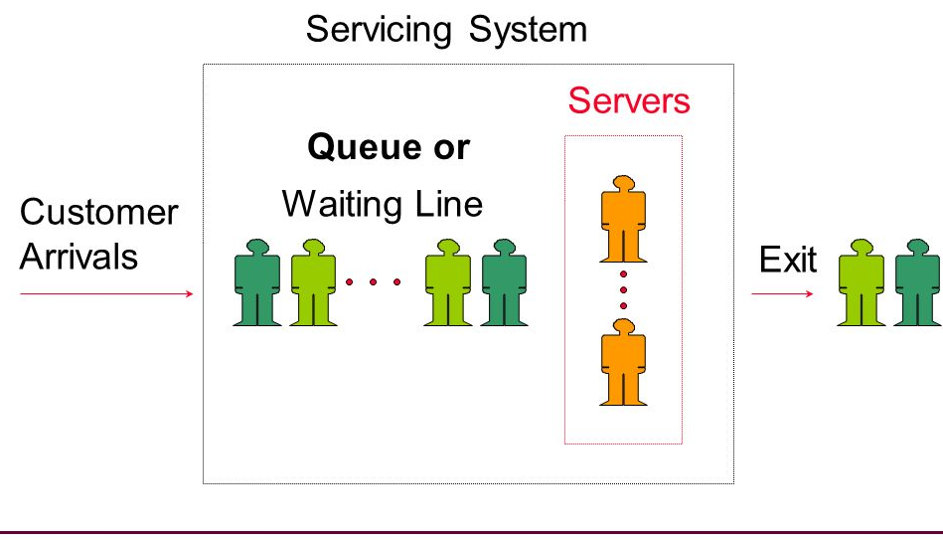
queueing system

Slide 16
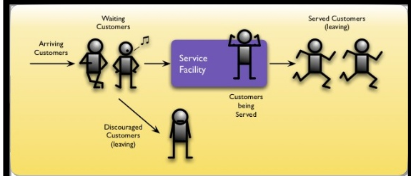
Queueing system
A basic queuing system described as one which is composed of customers arriving for service, waiting for service if it is not immediate, and if having waited for service, leaving the system after being served.
.

Slide 17
Examples of queueing SYSTEM
SYSTEM | CUSTOMER | SERVER
RECEPTION DESK | PEOPLE | RECEPTIONIST
HOSPITAL | PATIENTS | NURSES
AIRPORT | AIRPLANES | RUNWAY
ROAD NETWORK | CARS | TRAFFIC LIGHT
COMPUTER | JOBS | CPU, DISK, CD
TELEPHONE | CALLS | EXCHANGE
GARAGE | TRUCKS | MECHANIC
NETWORK | PACKETS | ROUTER
TICKET COUNTER | PEOPLE | CLERK

Slide 18
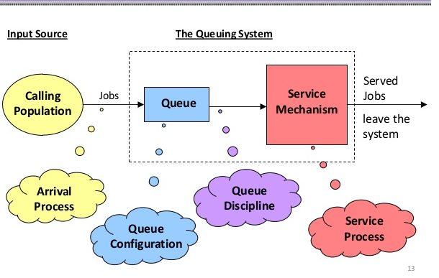
Basic Elements of queueing system

Slide 19
Basic components of queueing model
CALLING POPULATION
A waiting line process or queuing process is defined by two important elements:
(1). the population source of its customers and (2). the process or service system. The customer population can be considered as finite or infinite.
The customer population is finite when the number of customers affects potential new customers for the service system already in the system.
When the number of customers waiting in line does not significantly affect the rate at which the population generates new customers, the customer population is considered infinite.

Slide 20
Basic components of queueing model
ARRIVAL PROCESS [INPUT PROCESS]
How customers arrive e.g. singly or in groups (batch or bulk arrivals)
How the arrivals are distributed in time (e.g. what is the probability distribution of time between successive arrivals (the inter-arrival time distribution))
Whether there is a finite population of customers or an infinite number
The simplest arrival process is one where we have completely regular arrivals (i.e. the same constant time interval between successive arrivals)
A Poisson stream of arrivals corresponds to arrivals at random and in this stream successive customers arrive after intervals which are independent and so are exponentially distributed and it is the average arrival rate.
Other important arrival processes are scheduled arrivals; batch arrivals; and time dependent arrival rates (i.e. the arrival rate varies according to the time of day).

Slide 21
Basic components of queueing model
ATTITUDE OF CUSTOMERS AND CUSTOMER’S BEHAVIOUR
Patient Customer: Customer arrives at the service system, stays in the queue until served, no matter how much he has to wait for service.
Impatient Customer: Customer arrives at the service system, waits for a certain time in the queue and leaves the system without getting service due to some reasons like long queue before him.
Balking: Customer decides not to join the queue by seeing the number of customers already in service system
Reneging: Customer after joining the queue, waits for some time and leaves the service system due to delay in service.
Jockeying: Customer moves from one queue to another thinking that he will get served faster by doing so.

Slide 22
Basic components of queueing model
SERVICE PROCESS :
The service mechanism is a description of resources required for Service.
If there are infinite number of servers, then there will be no queue.
If the number of servers is finite, then the customers are served according to a specific order.
The time taken to serve a particular customer is called the service time. The service time is a statistical variable and can be studied either as the number of services completed in a given period of time or the completion period of a service.
Mean value of service rate is represented by µ.

Slide 23
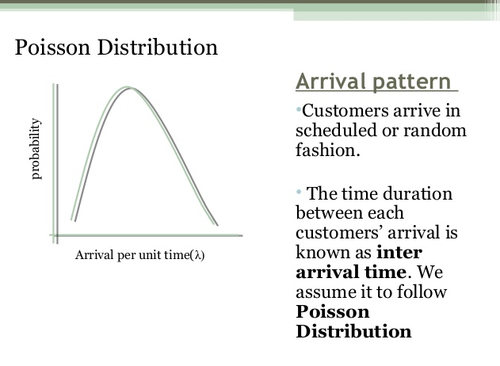
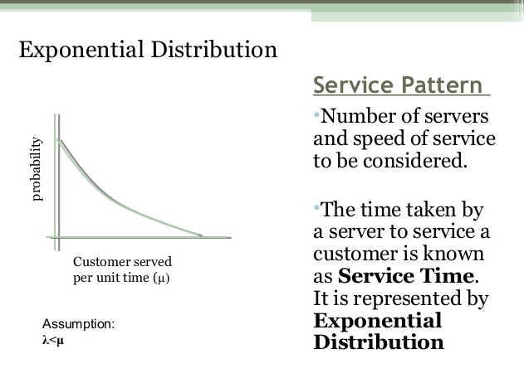
Probability distribution of arrival and service pattern

Slide 24
Basic components of queueing model
Queue Discipline:
The most common queue discipline is the “First Come First Served” (FCFS) or “First-in, First- out” (FIFO). Situations like waiting for a haircut, ticket-booking counters follow FCFS discipline.
Other disciplines include “Last In First Out” (LIFO)where last customer is serviced first.
“Service In Random Order” (SIRO) in which the customers are serviced randomly irrespective of their arrivals.
“Priority service” is when the customers are grouped in priority classes based on urgency.
“Preemptive Priority” is the highest priority given to the customer who enters into the service, immediately, even if a customer with lower priority is in service. “Non-preemptive priority” is where the customer goes ahead in the queue, but will be served only after the completion of the current service.

Slide 25
Basic components of queueing model
The Number of Service Channels:
The more the number of service channels in the service facility, the greater the overall service rate of the facility. The combination of arrival rate and service rate is critical for determining the number of service channels. When there are number of service channels available for service, then the arrangement of service depends upon the design of the system’s service mechanism.
Parallel channels means, a number of channels providing identical service facilities so that several customers may be served simultaneously.
Series channel means a customer go through successive ordered channels before service is completed

Slide 26
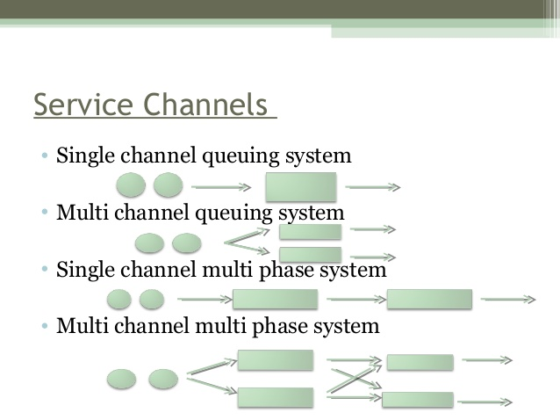
Different types service facilities of queueing system

Slide 27
STATE OF THE QUEUEING SYSTEM
(1).TRANSIENT STATE : A Queuing System Is Said To Be In Transient State When Its Operating Characteristics, Arrivals, Waiting Time And Service Time Of The Customers Are Dependent On Time.
(2). STEADY STATE : A Queuing System Is Said To Be In A Steady State When Its Operating Characteristics, Arrivals, Waiting Time And Service Time Of The Customers Are Independent On Time
(3).EXPLOSIVE STATE : If The Arrival Rate Of The System Is More Than Its Servicing Rate, The Length Of The Queue Will Go On Increasing With The Time And Will Tend To Infinity.

Slide 28
Single server queue model

Slide 29
Multi server queue model

Slide 30
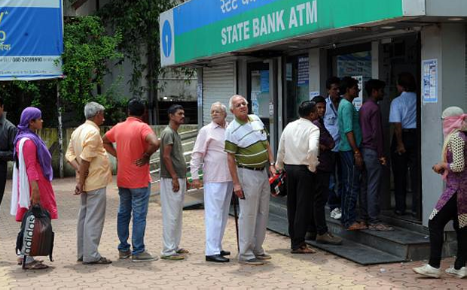
SINGLE SERVER FIRST IN FIRST OUT MODEL

Slide 31
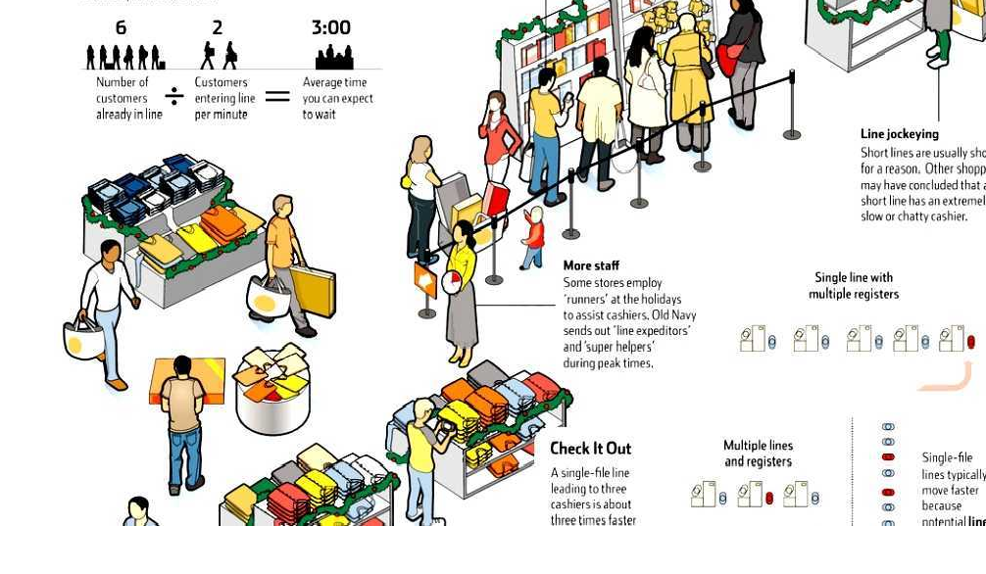
Different types of queueing model

Slide 32
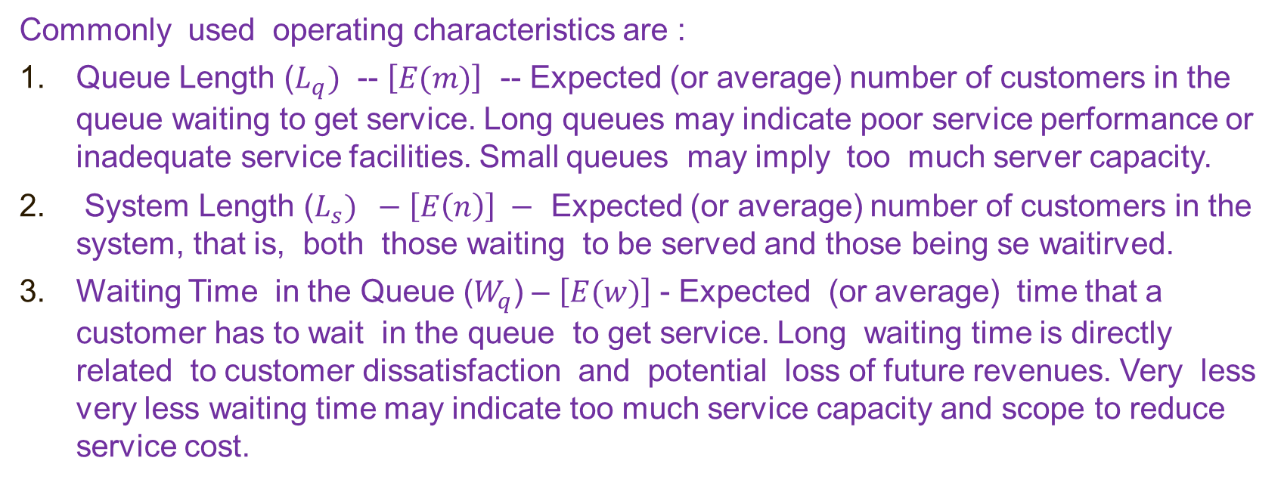
OPERATING CHARACTERISTICS OF QUEUEING SYSTEM
Commonly used operating characteristics are :
Queue Length ($L_{q})$ -- $\left[E(m)\right]$ -- Expected (or average) number of customers in the queue waiting to get service. Long queues may indicate poor service performance or inadequate service facilities. Small queues may imply too much server capacity.
System Length ($L_{s}) −\left[E\left(n\right)\right] −$ Expected (or average) number of customers in the system, that is, both those waiting to be served and those being se waitirved.
Waiting Time in the Queue ($W_{q}$) – $\left[E(w)\right]$ - Expected (or average) time that a customer has to wait in the queue to get service. Long waiting time is directly related to customer dissatisfaction and potential loss of future revenues. Very less very less waiting time may indicate too much service capacity and scope to reduce service cost.

Slide 33
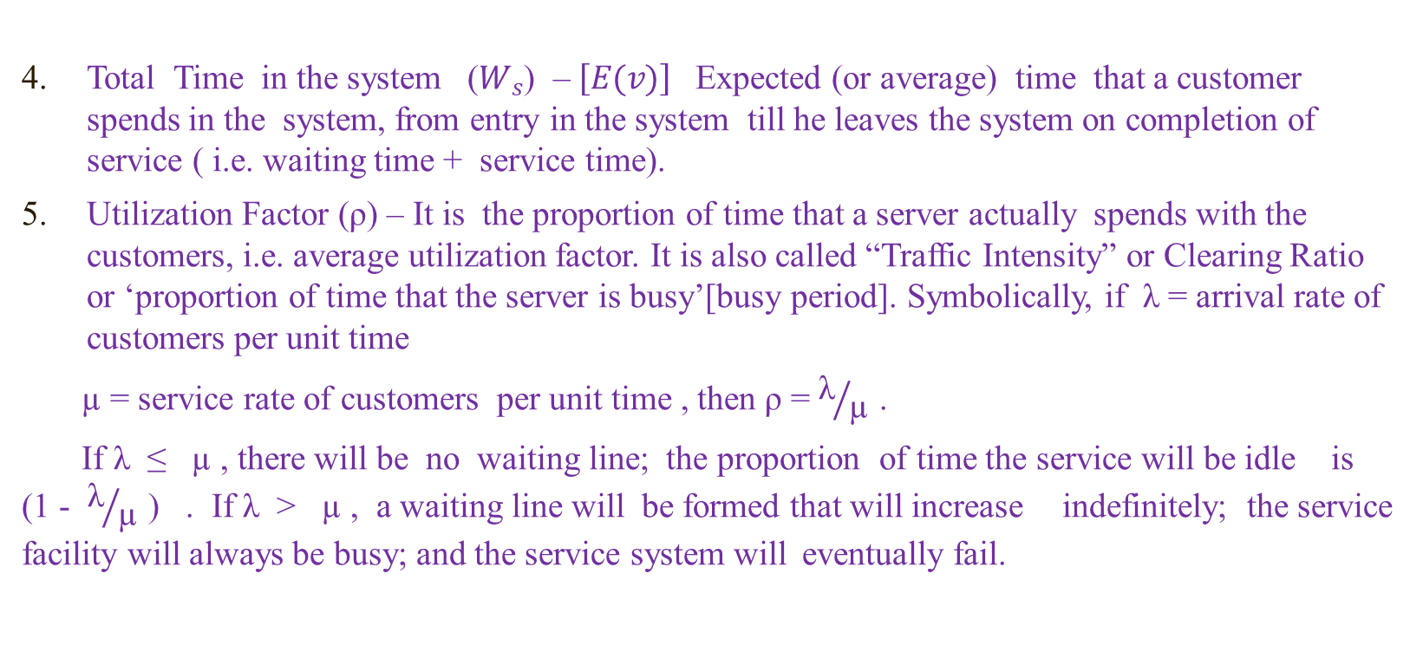
OPERATING CHARACTERISTICS OF QUEUEING SYSTEM
Total Time in the system ($W_{s}$) – $\left[E(v)\right]$ Expected (or average) time that a customer spends in the system, from entry in the system till he leaves the system on completion of service ( i.e. waiting time + service time).
Utilization Factor (ρ) – It is the proportion of time that a server actually spends with the customers, i.e. average utilization factor. It is also called “Traffic Intensity” or Clearing Ratio or ‘proportion of time that the server is busy’[busy period]. Symbolically, if λ = arrival rate of customers per unit time
µ = service rate of customers per unit time , then ρ = ${\text{λ}}/{\text{µ} }$.
If λ ≤ µ , there will be no waiting line; the proportion of time the service will be idle is (1 - ${\text{λ}}/{\text{µ} }$) . If λ > µ , a waiting line will be formed that will increase indefinitely; the service facility will always be busy; and the service system will eventually fail.

Slide 34
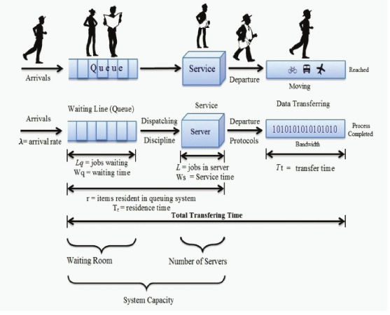
OPERATING CHARACTERISTIC OF DIFFERENT QUEUEING MODEL

Slide 35
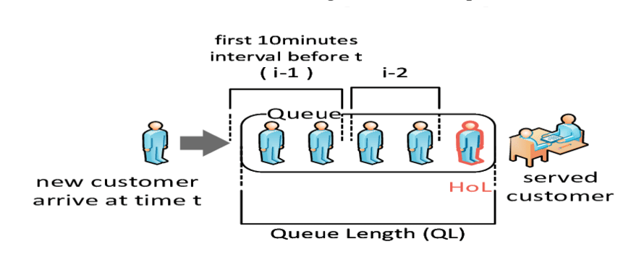
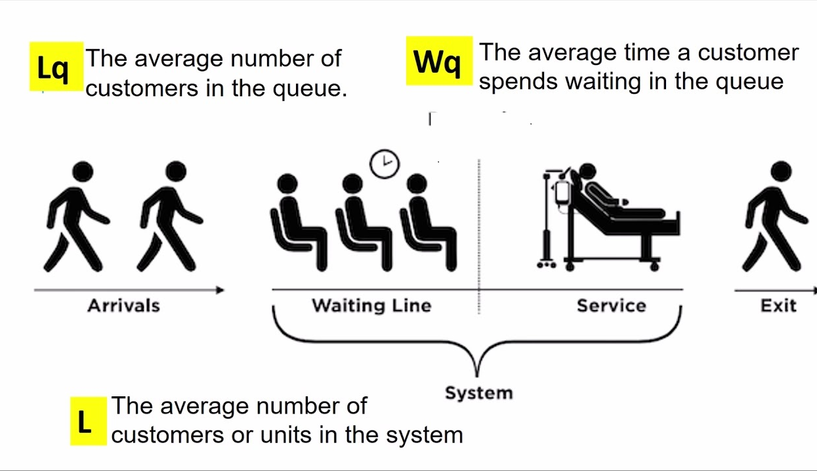
Operating characteristic of queueing model

Slide 36
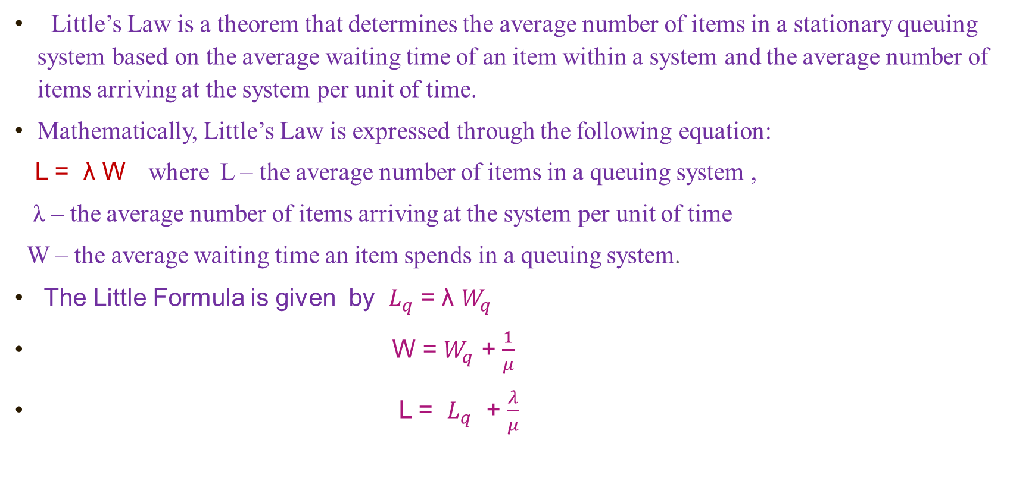
LITTLE FORMULA
Little’s Law is a theorem that determines the average number of items in a stationary queuing system based on the average waiting time of an item within a system and the average number of items arriving at the system per unit of time.
Mathematically, Little’s Law is expressed through the following equation:
L = λ W where L – the average number of items in a queuing system ,
λ – the average number of items arriving at the system per unit of time
W – the average waiting time an item spends in a queuing system.
The Little Formula is given by $L_{q}$ = λ $W_{q}$
W = $W_{q}$ + $\frac{1}{μ}$
L = $L_{q}$ + $\frac{λ}{μ}$

Slide 37
CLASSIFICATION OF QUEUING MODELS
Different models in queuing theory are classified by using special (or standard) notations described initially by D.G Kendall in 1953 in the form (A/B/C). Later A.M.Lee in 1966 added the symbols D and E to the Kendall notation. In the literature of queuing theory the standard format used to describe the main characteristics of different queueing model are as follows:
{(A/B/C) : (D/E)}
Where
A = arrivals distribution
B = service time (or departures) distribution
C = number of service channels (servers)
D = maximum number of customers allowed in the system (in queue plus in service)
E = queue (or service) discipline.

Slide 38
CLASSIFICATION OF QUEUING MODELS
Certain descriptive notations are used for the arrival and service time distribution (i.e. to replace notation A and B) as following:
M = exponential (or Markovian) inter-arrival times or service-time distribution (or equivalently Poisson or Markovian Arrival or Departure distribution)
D = constant or deterministic inter-arrival-time or service-time.
G = service time (departures) distribution of general type, i.e. no assumption is made about the type of distribution.
GI = Inter-arrival time (arrivals) having a general probability distribution such as as normal, uniform or any empirical distribution.
E_{k} = Erlang-k distribution of inter-arrival or service time distribution with parameter k (i.e. if k= 1, Erlang is equivalent to exponential and if k = large , Erlang is equivalent to deterministic).

Slide 39
SINGLE Server QUEUEING MODEL (M/M/1):(∞/FIFO)
In this system the customers arriving in the single queue are served by a single server. The assumption made in this model are as follows :
Infinite Calling Population or the number of arrivals per unit time.
The arrival process is Poisson with an expected arrival rate λ.
The queue configuration is a single queue with the possibly infinite length i.e., No reneging or balking.
The queue discipline is FIFO – FIRST IN FIRST OUT
The service mechanism consists of a single server with exponentially distributed service times.
The waiting space for the customers in queue is infinite .
Mean arrival rate ( λ) < Mean service rate (µ).

Slide 40
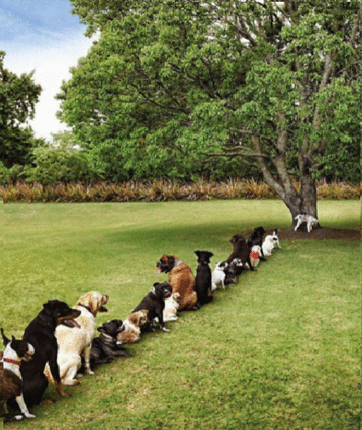
WE can reduce q but we cannot avoid q

