Slide 1
WWW Overview
WWW stands for World Wide Web.
A technical definition of the World Wide Web is : all the resources and users on the Internet that are using the Hypertext Transfer Protocol (HTTP).
A broader definition comes from the organization that Web inventor Tim Berners-Lee helped found, the World Wide Web Consortium (W3C).
The World Wide Web is the universe of network-accessible information, an embodiment of human knowledge.
In simple terms, The World Wide Web is a way of exchanging information between computers on the Internet, tying them together into a vast collection of interactive multimedia resources.

Slide 2
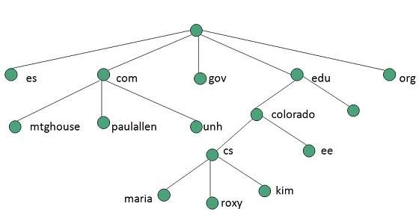
Definition - What does World Wide Web (WWW) mean?
The World Wide Web (WWW) is a network of online content that is formatted in HTML and accessed via HTTP. The term refers to all the interlinked HTML pages that can be accessed over the Internet. The World Wide Web was originally designed in 1991 by Tim Berners-Lee while he was a contractor at CERN.
The World Wide Web is most often referred to simply as "the Web."
Internet and Web is not the same thing: Web uses internet to pass over the information.

Slide 3
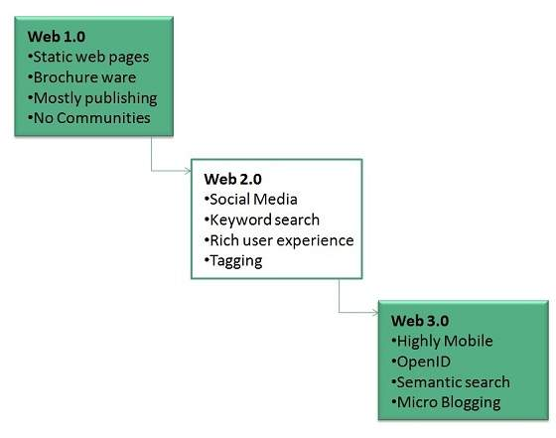
Evolution
World Wide Web was created by Timothy Berners Lee in 1989 at CERN in Geneva.
World Wide Web came into existence as a proposal by him, to allow researchers to work together effectively and efficiently at CERN. Eventually it became World Wide Web.
The following diagram briefly defines evolution of World Wide Web:

Slide 4
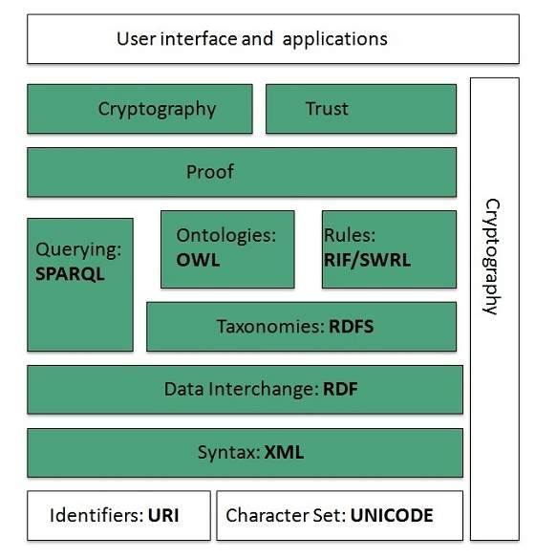
WWW Architecture
WWW architecture is divided into several layers as shown in the following diagram

Slide 5
Identifiers and Character Set
Uniform Resource Identifier (URI) is used to uniquely identify resources on the web and UNICODE makes it possible to built web pages that can be read and write in human languages.
Syntax
XML (Extensible Markup Language) helps to define common syntax in semantic web.
Data Interchange
Resource Description Framework (RDF) framework helps in defining core representation of data for web. RDF represents data about resource in graph form.
Taxonomies
RDF Schema (RDFS) allows more standardized description of taxonomies and other ontological constructs.
Ontologies
Web Ontology Language (OWL) offers more constructs over RDFS. It comes in following three versions:
OWL Lite for taxonomies and simple constraints.
OWL DL for full description logic support.
OWL for more syntactic freedom of RDF

Slide 6
Rules
RIF and SWRL offers rules beyond the constructs that are available from RDFs and OWL. Simple Protocol and RDF Query Language (SPARQL) is
SQL like language used for querying RDF data and OWL Ontologies.
Proof
All semantic and rules that are executed at layers below Proof and their result will be used to prove deductions.
Cryptography
Cryptography means such as digital signature for verification of the origin of sources is used.
User Interface and Applications
On the top of layer User interface and Applications layer is built for user interaction.

Slide 7
WWW Operation
WWW works on client- server approach. Following steps explains how the web works:
User enters the URL (say, http://www.tutorialspoint.com) of the web page in the Address bar of web browser.
Then browser requests the Domain Name Server for the IP address corresponding to www.tutorialspoint.com.
After receiving IP address, browser sends the request for web page to the web server using HTTP protocol which specifies the way the browser and web server communicates.
Then web server receives request using HTTP protocol and checks its search for the requested web page. If found it returns it back to the web browser and close the HTTP connection.
Now the web browser receives the web page, It interprets it and display the contents of web page in web browser’s window.

Slide 8
Future
There had been a rapid development in field of web. It has its impact in
almost every area such as education, research, technology, commerce, marketing etc. So the future of web is almost unpredictable. Apart from huge development in field of WWW, there are also some technical issues that W3 consortium has to cope up with.

Slide 9
User Interface
Work on higher quality presentation of 3-D information is under development. The W3 Consortium is also looking forward to enhance the web to full fill requirements of global communities which would include all regional languages and writing systems.
Technology
Work on privacy and security is under way. This would include hiding information, accounting, access control, integrity and risk management.
Architecture
There has been huge growth in field of web which may lead to overload the internet and degrade its performance. Hence more better protocol are required to be developed.

Slide 10
Web Pages
Introduction
Web page is a document available on world wide web. Web Pages are stored on web server and can be viewed using a web browser.A web page can contain huge information including text, graphics, audio, video and hyper links. These hyper links
are the link to other web pages. Collection of linked web pages on a web server is known as website. There is unique Uniform Resource Locator (URL) is associated with each web page.
Meaning
A document which can be displayed in a web browser such as Firefox, Google Chrome, Opera, Microsoft Internet Explorer or Edge, or Apple's Safari. These are also often called just "pages."

Slide 11
Definition of Web page
A web page can be defined as a solitary page of a website. When a user wants to access a webpage, it can be accessed by using a single URL, and that page can be copied and shared. Viewing a webpage doesn’t require any navigation, unlike a website. It can contain text, graphics, audio, video, downloadable hyperlink to other pages, etc. Web browsers are used to display the contents of the webpage through connecting to the
server so that the remote files can be displayed. These are created by using a programming language such as HTML, PHP, Python and Perl etc. The HTML pages
have a simple appearance and are not that interactive but consume less time to load and
browse.
A web page is a simple document displayable by a browser. Such documents are written in the HTML language (which we look into in more detail in other articles). A web page can embed a variety of different types of resources such as:

Slide 12
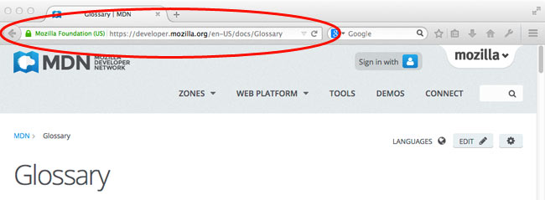
style information — controlling a page's look-and-feel
scripts — which add interactivity to the page
media — images, sounds, and videos.
(Note: Browsers can also display other documents such as PDF files or images, but the term web page specifically refers to HTML documents. Otherwise, we only use the term document.)
All web pages available on the web are reachable through a unique address. To access a page, just type its address in your browser address bar:

Slide 13
Types of web pages:
There are two types of web page – Static web page and dynamic webpage. In the
static web page designing, when a product acquires any change in information, the
change must reflect on the website. At that time, a person must incorporate the
change on every web page manually, and this is time consuming and tiresome
process. Where in the dynamic web page, a central database is used to store the
product information. The database-driven approach, just need the change to be
applied at a single place. So that through extracting the relevant information from
the particular database, several web pages can be created dynamically that contain
this information.

Slide 14
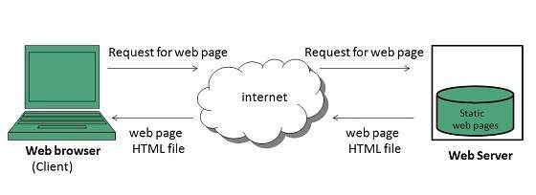
Static Web page
Static web pages are also known as flat or stationary web page. They are loaded on the client’s browser as exactly they are stored on the web server. Such web pages contain only static information. User can only read the information but can’t do any modification or interact with the information. Static web pages are created using only HTML. Static web pages are only used when the information is no more required to be modified.

Slide 15
Dynamic Web page
Dynamic web page shows different information at different point of time. It is
possible to change a portion of a web page without loading the entire web page.
It has been made possible using Ajax technology.
Server-side dynamic web page
It is created by using server-side scripting. There are server-side scripting
parameters that determine how to assemble a new web page, which also includes
setting up of more client-side processing.
Client-side dynamic web page
It is processed using client side scripting such as JavaScript. And then passed in
to Document Object Model (DOM).

Slide 16
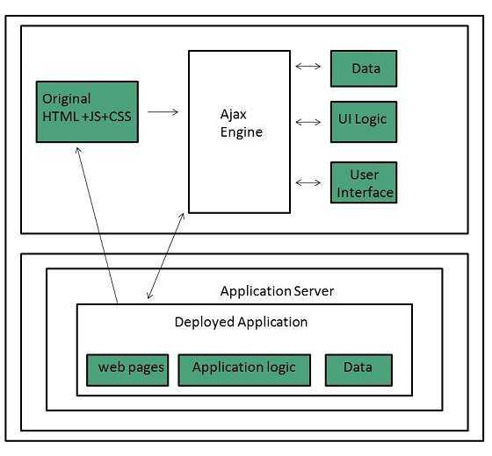
Scripting Languages
Scripting languages are like programming languages that allow us to write programs in form of script. These scripts are interpreted not compiled and executed line by line. Scripting language is used to create dynamic web pages.
Client-side Scripting
Client-side scripting refers to the programs that are executed on client-side. A client-side script contains the instruction for the browser to be executed in response to certain user’s action. Client-side scripting programs can be embedded into HTML files or also can be kept as separate files.

Slide 17
Following table describes commonly used Client-Side scripting languages:
S.N. | Scripting Language Description
1. | JavaScript It is a prototype based scripting language. It inherits its naming conventions from java. All java script files are stored in file having extension.
2. | ActionScript It is an object oriented programming language used for the development of websites and software targeting Adobe flash player.
3. | Dart It is an open source web programming language developed by Google. It relies on source-to-source compiler to JavaScript.
4. | VBScript It is an open source web programming language developed by Microsoft. It is superset of JavaScript and adds optional static typing class-based object oriented programming.

Slide 18
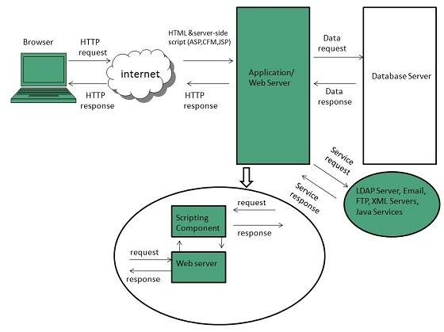
Server-side Scripting
Sever-side scripting acts as an interface for the client and also limit the user access the resources on web server. It can also collect the user’s characteristics in order to customize response.

Slide 19
Following table describes commonly used Server-Side scripting languages:
S.N. | Scripting Language Description
1. | ASP: Active Server Pages (ASP)is server-side script engine to create dynamic web pages. It supports Component Object Model (COM) which enables ASP web sites to access functionality of libraries such as DLL.
2. | Active VFP: It is similar to PHP and also used for creating dynamic web pages. It uses native Visual FoxPro language and database.
3 | ASP.net: It is used to develop dynamic websites, web applications, and web services.
4 | Java: Java Server Pages are used for creating dynamic web applications. The Java code is compiled into byte code and run by Java Virtual Machine (JVM).
5 | Python: It supports multiple programming paradigms such as object-oriented, and functional programming. It can also be used as non-scripting language using third party tools such as Py2exe or Pyinstaller.
6 | Web DNA: It is also a server-side scripting language with an embedded database system.

Slide 20
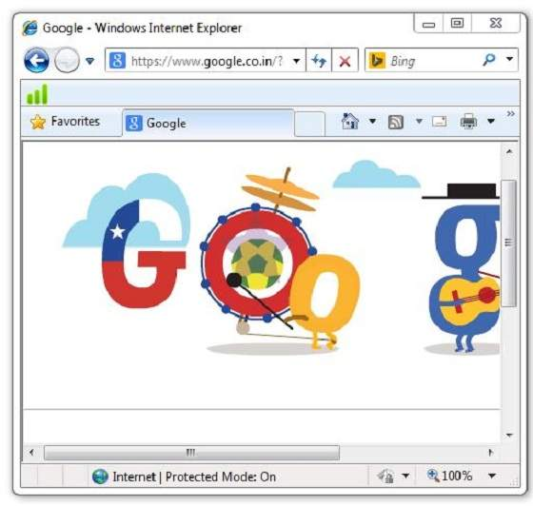
Accessing Web Page
Accessing web page is very simple. Just enter the URL in the address bar as
shown the following diagram:

Slide 21
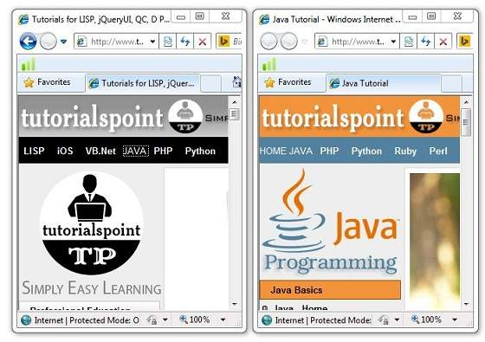
Navigation
A web page may contain hyperlinks. When we click on these links other web page is opened. These hyperlinks can be in form of text or image. When we take the
mouse over an hyperlink, pointer change its shape to hand.

Slide 22
Key Points
In case, you have accessed many web pages and willing to see the previous webpage
then just click back button.
You can open a new web page in the same tab, or different tab or in a new window.
Saving Webpage
You can save web page to use in future. In order to save a webpage, follow the
steps given below:
Click File > Save As. Save Webpage dialog box appears.
Choose the location where you want to save your webpage from save in: list box.
Then choose the folder where you want to save the webpage.
Specify the file name in the File name box.
Select the type from Save as type list box.
Webpage, complete
Web Archive
Webpage HTML only
Text File
From the encoding list box, choose the character set which will be used with your webpage. By default, Western European is selected.
Click save button and the webpage is saved.

Slide 23
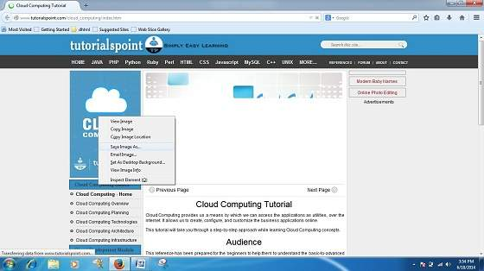
Saving Web Elements
Web elements are the pictures, links etc. In order to save these elements follow the
steps given below:
Right click on the webpage element you want to save. Menu options will appear. These
options may vary depending on the element you want to save.
Save Picture As: This option let you save the picture at specific location with
its name. When you click this option, a dialog box is opened where you can specify its
name and location.

Slide 24
Favorites
The Favorites option helps to save addresses of the WebPages you visited often. Hence you need not to remember long and complex address of websites you visit often.
In order to open any webpage, you just need to double click on the webpage that you
have marked from bookmarks list.
Adding a web page to your Favorites
In ordered to add website to your favorite list, follow the steps given below:
Open webpage that you want to add to your favorite.
Click on favorite menu and then click on Add to Favorites option. Add favorites
dialog box appears.
You can also click Favorites button available in the toolbar. Favorite’s panel will open in the left corner of the internet explorer window. Click add button, Add Favorites dialog box will appear.

Slide 25
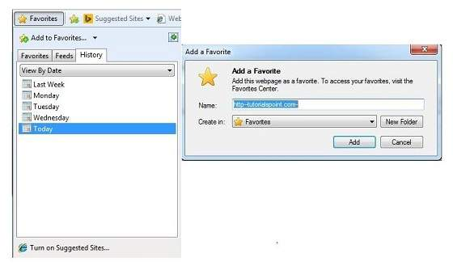
In Add Favorites dialog box, the Name: text box will contains the name of the web page that you want to add to favorites.
Click the Create in button, Favorites folder will appear. Move to the folder where you want to store the favorites by clicking on the folder name.
Now click OK button to save the favorites.

Slide 26
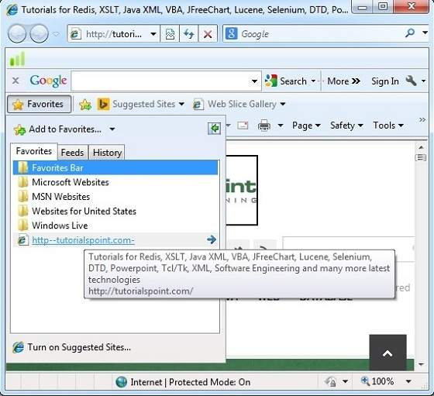
Opening Favorites
In order to open favorites, follow the steps given below:
In the Favorite Panel, take the mouse over the site that you want to open. Now click on the address to open that site.

Slide 27
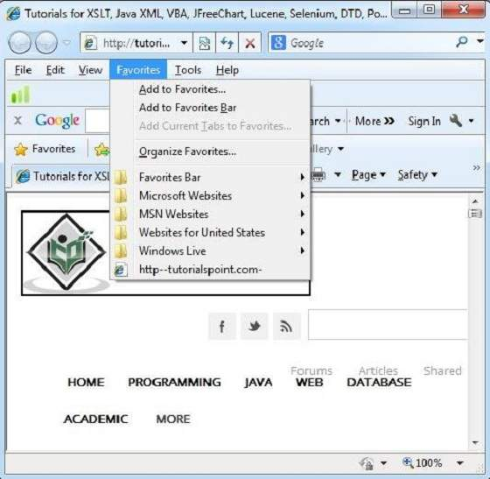
Favorite can also be opened from the Favorites menu by selecting the appropriate one.

Slide 28
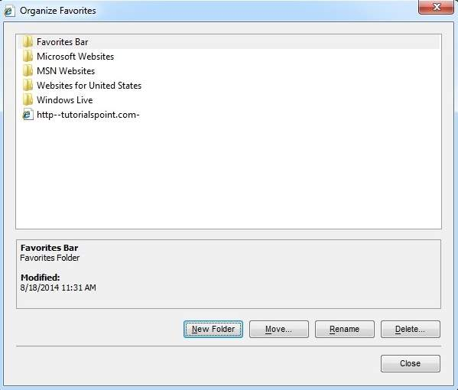
Organizing Favorites
Favorites can be organized by categorizing web pages, creating folder for each category and then storing web pages into them. In order to organize favorites, follow the steps given below:
Click Favorites menu > Organize Favorites. Organize favorites dialog box will appears.
In order to organize the WebPages, drag the individual webpage to the respective folder. Similarly to delete a favorite, click on delete button.

Slide 29
Website
A website is a collection of linked web pages (plus their associated resources) that share a unique domain name. Each web page of a given website provides explicit links—most of the time in the form of clickable portion of text—that allow the user to move from one page of the website to another.
To access a website, type its domain name in your browser address bar, and the browser will display the website's main web page, or homepage (casually referred as "the home"):
Meaning:
A collection of web pages which are grouped together and usually connected together in various ways. Often called a "web site" or simply a "site."

Slide 30
Definition of Website
A website is the group of web pages which are placed in a location on the internet under a domain. For example, a company website can have various web pages such as home, about us, contact us, products, services and other. It is accessible through a web address. The website can be designed using static web pages or dynamic web pages. Contents on a website are globally viewed, remains same for the different individuals.
A website can be industry-specific, product specific or services specific etc.; these websites are intended to educate their site visitors about their industry, products or services information. A website must be hosted on a server at first so that it can be accessed on the internet.
Websites cannot be indexed. Search engine crawlers crawl web pages and index web pages rather than a website. A website is navigated from one webpage to another.

Slide 31
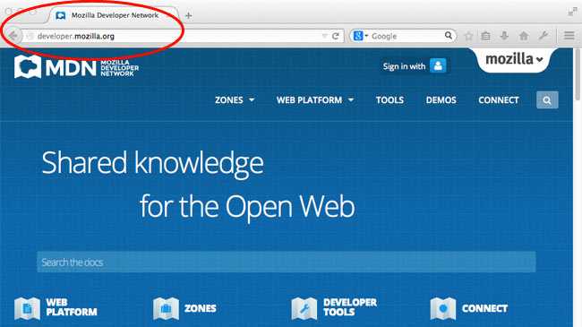
The ideas of a web page and a website are especially easy to confuse for a
website that contains only one web page. Such a website is sometimes called a
single-page website.

Slide 32
Website Monetization
Website monetization refers to making money from the website. It is done by
converting existing traffic to a particular website into revenue.
Methods of Monetization
Display Advertising
It refers to the banners and text ads. This method is good for the websites that have significant traffic, valuable audience, relevant and active advertisers.
Affiliate Marketing
It refers to steering the visitors to products and services of a third party merchant. It is good for the websites that are product centric and have easy integration into content.
Lead generation
It refers to capturing the customer information and selling it to a third party.
Email rental It refers to renting out your email lists to third parties. In this you will send an email on their behalf to your distribution list.

Slide 33
Web page and Website
Web page and Website are relevant but distinct words. A web page can be considered as a single entity whereas a website is a combination of web pages. Web pages are accessed through a browser while in website HTTP, and DNS protocols are used to access it.
Web pages have the navigational links to connect a web page to another on the website. The content in a website changes according to the web page while a web page contains more specific information.
Comparison Chart: Web page Vs Website
BASIS FOR COMPARISON | WEB PAGE | WEBSITE
Basic | Web page is a part of website which comprises links to other web pages. | Website is a cluster of related web pages addressed to a typical URL.
Presented by | Multiple web pages can have the same name if they reside in different documents. | By a unique URL.
Use | It is a content that is to be displayed on a website. | It is a place used to display the content.
Extension | The web page URL has an extension. | There is no extension used in the URL of a website.
Address dependency | Web page address depends on website address. | Website address doesn't rely upon web page address.
Development period | Requires less time to develop as it is a part of a website. | Usually, take more time as compared to a web page.

Slide 34
Differences between Web page and Website
A webpage is an independent part of a website that contains the links to other web
pages on the website. On the other hand, a website is a collection of relevant web pages
that is addressed to a Uniform Resource Locator.
2. Each website must have a unique URL whereas multiple web pages can have the
same name until they reside in different documents.
3. Website is a location used to display the content. In contrast, a webpage is a content
that is to be displayed on the website.
4. A web page URL has an extension like html, htm, php, etc. As against, website URL
doesn’t has any extension.
5. Web page address has an integral part of the domain name in it, and it depends upon a
website. On the contrary, a website does not have any relation to web page address.
6. Designing and Development of the webpage takes less time as compared to a website
as a website contain a lot of web pages.

Slide 35
Conclusion
A website represents all the contents that have placed online and involved each type of file. The web page is a part of a website which drives a website and holds it together.
Web Browser
web Browser is an application software that allows us to view and explore information on the web. User can request for any web page by just entering a URL into address bar.
Web browser can show text, audio, video, animation and more. It is the responsibility of a web browser to interpret text and commands contained in the web page.
Earlier the web browsers were text-based while now a days graphical-based or voice-based web browsers are also available. Following are the most common web browser available today:

Slide 36
Browser | Vendor
Internet Explorer | Microsoft
Google Chrome | Google
Mozilla Firefox | Mozilla
Netscape Navigator | Netscape Communications Corp.
Opera | Opera Software
Safari | Apple
Sea Monkey | Mozilla Foundation
K-meleon | K-meleon

Slide 37
Architecture
There are a lot of web browser available in the market. All of them interpret and display information on the screen however their capabilities and structure varies depending upon implementation. But the most basic component that all web browser must exhibit are listed below:
Controller/Dispatcher
Interpreter
Client Programs
Controller: works as a control unit in CPU. It takes input from the keyboard or mouse, interpret it and make other services to work on the basis of input it receives.
Interpreter: receives the information from the controller and execute the instruction line by line. Some interpreter are mandatory while some are optional For example, HTML interpreter program is mandatory and java interpreter is optional.
Client Program: describes the specific protocol that will be used to access a particular service. Following are the client programs tat are commonly used:
HTTP
SMTP
FTP
NNTP
POP

Slide 38
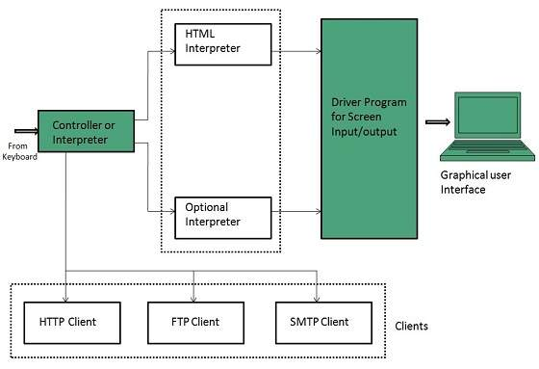
Starting Internet Explorer
Internet explorer is a web browser developed by Microsoft. It is installed by default with the windows operating system however, it can be downloaded and be upgraded.

Slide 39
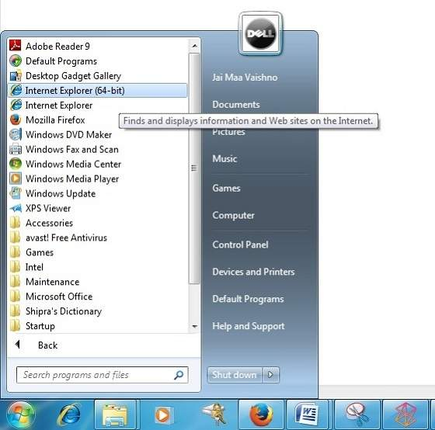
To start internet explorer, follow the following steps:
Go to Start button and click Internet Explorer.
The Internet Explorer window will appear as shown in the following diagram:

Slide 40
Web Server
Overview
Web server is a computer where the web content is stored. Basically web
server is used to host the web sites but there exists other web servers also such as
gaming, storage, FTP, email etc.
Web site is collection of web pages while web server is a software that
respond to the request for web resources.
Web Server Working
Web server respond to the client request in either of the following two ways:
Sending the file to the client associated with the requested URL.
Generating response by invoking a script and communicating with database

Slide 41
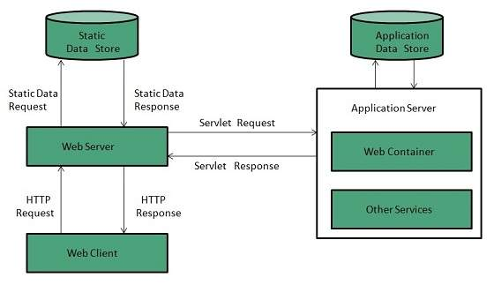
Key Points
When client sends request for a web page, the web server search for the requested page if requested page is found then it will send it to client with an HTTP response.
If the requested web page is not found, web server will the send an HTTP
response: Error 404 Not found.
If client has requested for some other resources then the web server will contact
to the application server and data store to construct the HTTP response.

Slide 42
Architecture
Web Server Architecture follows the following two approaches:
Concurrent Approach
Single-Process-Event-Driven Approach.
Concurrent Approach
Concurrent approach allows the web server to handle multiple client requests at the same time. It can be achieved by following methods:
Multi-process
Multi-threaded
Hybrid method.
Multi-processing
In this a single process (parent process) initiates several single-threaded child processes and distribute incoming requests to these child processes. Each of the child processes are responsible for handling single request. It is the responsibility of parent process to monitor the load and decide if processes should be killed or forked.

Slide 43
Multi-threaded
Unlike Multi-process, it creates multiple single-threaded process.
Hybrid
It is combination of above two approaches. In this approach multiple process are created and each process initiates multiple threads. Each of the threads handles one connection. Using multiple threads in single process results in less load on system resources.
Examples
Following table describes the most leading web servers available today:
S.N. | Web Server Description
1 | Apache HTTP Server: This is the most popular web server in the world developed by the Apache Software Foundation. Apache web server is open source software and can be installed on almost all operating systems including Linux, UNIX, Windows, Free BSD, Mac OS X and more. About 60% of the web server machines run the Apache Web Server.
2. | Internet Information Services (IIS): The Internet Information Server (IIS) is a high performance Web Server from Microsoft. This web server runs on Windows NT/2000 and 2003 platforms (and may be on upcoming new Windows version also). IIS comes bundled with Windows NT/2000 and 2003; Because IIS is tightly integrated with the operating system so it is relatively easy to administer it.

Slide 44
3. | Lighttpd: The lighttpd, pronounced lighty is also a free web server that is distributed with the FreeBSD operating system. This open source web server is fast, secure and consumes much less CPU power. Lighttpd can also run on Windows, Mac OS X, Linux and Solaris operating systems.
4. | Sun Java System Web Server: This web server from Sun Microsystems is suited for medium and large web sites. Though the server is free it is not open source. It however, runs on Windows, Linux and UNIX platforms. The Sun Java System web server supports various languages, scripts and technologies required for Web 2.0 such as JSP, Java Servlets, PHP, Perl, Python, and Ruby on Rails, ASP and Coldfusion etc.
5. | Jigsaw Server: Jigsaw (W3C's Server) comes from the World Wide Web Consortium. It is open source and free and can run on various platforms like Linux, UNIX, Windows, and Mac OS X Free BSD etc. Jigsaw has been written in Java and can run CGI scripts and PHP programs.

Slide 45
Proxy Server
Overview
Proxy server is an intermediary server between client and the internet. Proxy
servers offers the following basic functionalities:
Firewall and network data filtering.
Network connection sharing
Data caching
Proxy servers allow to hide, conceal and make your network id anonymous by hiding your IP address.
Purpose of Proxy Servers
Following are the reasons to use proxy servers:
Monitoring and Filtering
Improving performance
Translation
Accessing services anonymously
Security

Slide 46
Monitoring and Filtering
Proxy servers allow us to do several kind of filtering such as:
Content Filtering
Filtering encrypted data
Bypass filters
Logging and eavesdropping
Improving performance
It fasten the service by process of retrieving content from the cache which was saved when previous request was made by the client.
Translation
It helps to customize the source site for local users by excluding source content or substituting source content with original local content. In this the traffic from the global users is routed to the source website through Translation proxy.

Slide 47
Accessing services anonymously
In this the destination server receives the request from the anonymzing proxy server and thus does not receive information about the end user.
Security
Since the proxy server hides the identity of the user hence it protects from spam and the hacker attacks.
Type of Proxies
Following table briefly describes the type of proxies:
Forward Proxies
In this the client requests its internal network server to forward to the internet.

Slide 48
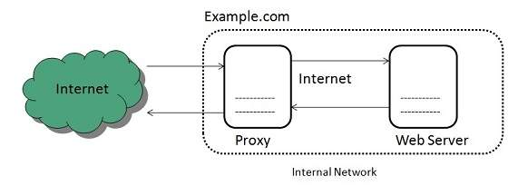
Open Proxies
Open Proxies helps the clients to conceal their IP address while browsing the web.
Reverse Proxies
In this the requests are forwarded to one or more proxy servers and the response from the proxy server is retrieved as if it came directly from the original Server.

Slide 49
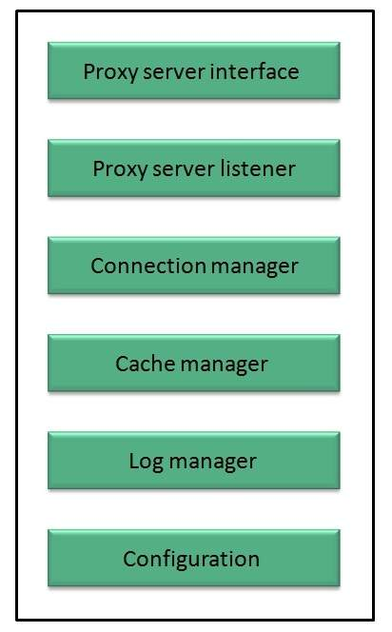
Architecture
The proxy server architecture is divided into several modules as shown in the following diagram:

Slide 50
Proxy user interface
This module controls and manages the user interface and provides an easy to use graphical interface, window and a menu to the end user. This menu offers the following functionalities:
Start proxy
Stop proxy
Exit
Blocking URL
Blocking client
Manage log
Manage cache
Modify configuration
Proxy server listener
It is the port where new request from the client browser is listened. This module also performs blocking of clients from the list given by the user.

Slide 51
Connection Manager
It contains the main functionality of the proxy server. It performs the following functions:
It contains the main functionality of the proxy server. It performs the following functions:
Read request from header of the client.
Parse the URL and determine whether the URL is blocked or not.
Generate connection to the web server.
Read the reply from the web server.
If no copy of page is found in the cache then download the page from web server else will check its last modified date from the reply header and accordingly will read from the cache or server from the web.
Then it will also check whether caching is allowed or not and accordingly will cache the page.

Slide 52
Cache Manager
This module is responsible for storing, deleting, clearing and searching of web pages in the cache.
Log Manager
This module is responsible for viewing, clearing and updating the logs.
Configuration
This module helps to create configuration settings which in turn let other modules to perform desired configurations such as caching.
Search Engines
Introduction
Search Engine refers to a huge database of internet resources such as web pages, newsgroups, programs, images etc. It helps to locate information on World Wide Web. User can search for any information by passing query in form of keywords or phrase. It then searches for relevant information in its database and return to the user.

Slide 53
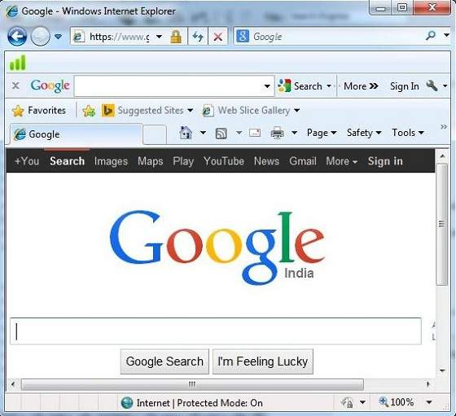
Search Engine refers to a huge database of internet resources such as web pages, newsgroups, programs, images etc. It helps to locate information on World Wide Web. User can search for any information by passing query in form of keywords or phrase. It then searches for relevant information in its database and return to the user.
Search engine
A web service that helps you find other web pages, such as Google, Bing, Yahoo, or DuckDuckGo. Search engines are normally accessed through a web browser (e.g. you can perform search engine searches directly in the address bar of Firefox, Chrome, etc.) or through a web page (e.g. bing.com or duckduckgo.com).

Slide 54
Search Engine Components
Generally there are three basic components of a search engine as listed below:
Web Crawler
Database
Search Interfaces
Web crawler
It is also known as spider or bots. It is a software component that traverses the web to gather information.
Database
All the information on the web is stored in database. It consists of huge web resources.
Search Interfaces
This component is an interface between user and the database. It helps the user to search through the database.

Slide 55
Search Engine Working
Web crawler, database and the search interface are the major component of a search engine that actually makes search engine to work. Search engines make use of Boolean expression AND, OR, NOT to restrict and widen the results of a search. Following are the steps that are performed by the search engine:
The search engine looks for the keyword in the index for predefined database instead of going directly to the web to search for the keyword.
It then uses software to search for the information in the database. This software component is known as web crawler.
Once web crawler finds the pages, the search engine then shows the relevant web pages as a result. These retrieved web pages generally include title of page, size of text portion, first several sentences etc.
These search criteria may vary from one search engine to the other. The retrieved information is ranked according to various factors such as frequency of keywords, relevancy of information, links etc.
User can click on any of the search results to open it.

Slide 56
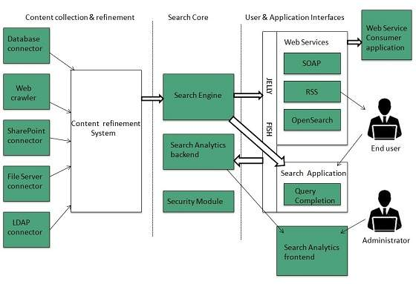
Architecture
The search engine architecture comprises of the three basic layers listed below:
Content collection and refinement.
Search core
User and application interfaces

Slide 57
Search Engine Processing
Indexing Process
Indexing process comprises of the following three tasks:
Text acquisition
Text transformation
Index creation
Text acquisition
It identifies and stores documents for indexing.
Text Transformation
It transforms document into index terms or features.
Index Creation
It takes index terms created by text transformations and create data structures to suport fast searching.
Query Process
Query process comprises of the following three tasks:
User interaction
Ranking
Evaluation
User interaction
It supports creation and refinement of user query and displays the results.
Ranking
It uses query and indexes to create ranked list of documents.

Slide 58
Evaluation
It monitors and measures the effectiveness and efficiency. It is done offline.
Examples
Following are the several search engines available today:
Search Engine | Description
Google | It was originally called BackRub. It is the most popular search engine globally.
Bing | It was launched in 2009 by Microsoft. It is the latest web-based search engine that also delivers Yahoo’s results.
Ask | It was launched in 1996 and was originally known as Ask Jeeves. It includes support for match, dictionary, and conversation question.
AltaVista | It was launched by Digital Equipment Corporation in 1995. Since 2003, it is powered by Yahoo technology.
AOL.Search | It is powered by Google.
LYCOS | It is top 5 internet portal and 13th largest online property according to Media Matrix.
Alexa | It is subsidiary of Amazon and used for providing website traffic information.

Slide 59
Search Engine Optimization
What is SEO
Search Engine Optimization refers to set of activities that are performed to increase number of desirable visitors who come to your site via search engine. These activities may include thing you do to your site itself, such as making changes to your text and HTML code, formatting text or document to communicate directly to the search engine.
Types of SEO
SEO can be classified into two types: White Hat SEO and Black Hat or Spamdexing
White Hat SEO
An SEO tactic, technique or method is considered as White Hat if it follows the followings
If it conforms to the search engine's guidelines.
If it does not involves any deception.
It ensures that the content a search engine indexes and subsequently ranks is the same content a user will see.
It ensures that a Web Page content should have been created for the users and not just for the search engines.
It ensures the good quality of the web pages.
It ensures the useful content available on the web pages.

Slide 60
Always follow a White Hat SEO tactic and don't try to fool your site visitors. Be honest and definitely you will get something more.
Black Hat or Spamdexing:
An SEO tactic, technique or method is considered as Black Hat or Spamdexing if it follows the followings:
Try to improve rankings that are disapproved of by the search engines and/or involve deception.
Redirecting users from a page that is built for search engines to one that is more human friendly.
Redirecting users to a page that was different from the page the search engine ranked.
Serving one version of a page to search engine spiders/bots and another version to human visitors. This is called Cloaking SEO tactic.
Using Hidden or invisible text or with the page background color, using a tiny font size or hiding them within the HTML code such as "no frame" sections.
Repeating keywords in the Meta tags, and using keywords that are unrelated to the site's content. This is called Meta tag stuffing.

Slide 61
Calculated placement of keywords within a page to raise the keyword count, variety, and density of the page. This is called Keyword stuffing.
Creating low-quality web pages that contain very little content but are instead stuffed with very similar key words and phrases. These pages are called Doorway or Gateway Pages
Mirror web sites by hosting multiple web sites all with conceptually similar content but using different URLs.
Mirror web sites by hosting multiple web sites all with conceptually similar content but using different URLs.
Creating a rogue copy of a popular web site which shows contents similar to the original to a web crawler, but redirects web surfers to unrelated or malicious web sites. This is called Page hijacking.

Slide 62
Key Elements to ethical SEO
Keyword research
It allows you to see which keywords users actually employ to find products and services within your chosen market, instead of making guesses at the keywords you believe are the most popular.
Content development
Content development involves:
Navigational flow and menu structure
Site copy or articles
Headings and sections
Web development
Web development involves:
Text-based site development wherever possible.
Clean and logical site structure.
Proper markup of key page elements.

Slide 63
Link Building
Building links will make up about 60% of your work. There are ways to automate this process using shortcuts, workarounds, and submission services.
Internal linking is also very important. Treat the way you link to your own content same as you would link from an external site.
Webmaster Tools
Webmaster dashboard is provided by both Google and Bing that gives insight into activity by the search engine on any site that has been registered and verified via dashboard.
Dashboards offer a number of tools which allow us to understand how the search engine sees your site. These are the only way to identify crawling, indexing, and the ranking issue with your site.

Slide 64
SEO Do’s and Do’nts
DO's
There are various other tips which can help you to optimize your web site for many Search Engines:
Create logs of pages and each page should however contain a minimum of about 200 visible words of text to maximize relevance with Google.
Create a Sitemap, Help, FAQ, About Us, Link to Us, Copyright, Disclaimer, and Privacy Policy pages on mandatory basis.
Create a home page link to each and every web page and provide easy navigation through all the pages.
Pay attention to your dynamic page URLs. Google can crawl and index dynamic pages as long as you don't have more than 2 parameters in the URL.
Check your complete site for broken links. Broken links will reduce your other pages rank as well.

Slide 65
Do'nts
Here is the list of Do'nts that one should keep in mind all the times:
Don't keep hidden text on your web pages.
Don't create alt image spamming by putting wrong keywords.
Don't use Meta tags stuffing.
Don't use frames and flash on your site.
Don't exchange your links with black listed sites.
Don't try to fool your site visitors by using miss spelled keywords.
Don't send spam emails to thousand of email IDs.
Don't use too much graphics on your site.
Don't create too many doorway pages.
Don't try to create duplicate content of pages.
Don't submit your website many times in a single search engine.
Don't use sub-directory depth more than 1-2.
Don't create too many dynamic pages. Try to convert them into static pages.
Don't bloat your pages with code.Don't nest your pages.

