Slide 1
Course : MSW(SOCIAL WORK) Semester : II Course Detail : Core Course V(cc-v) Course Title : Community Organization And Social Action Unit : Social Action

Slide 4
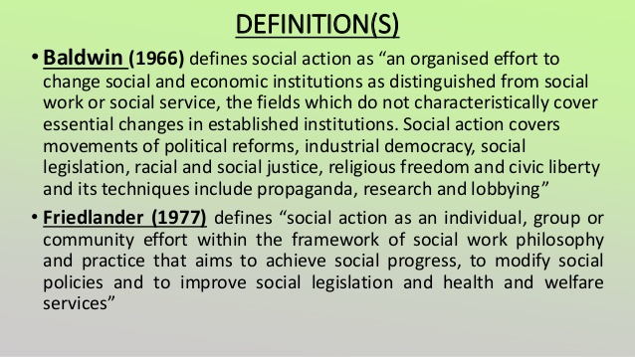

Slide 5
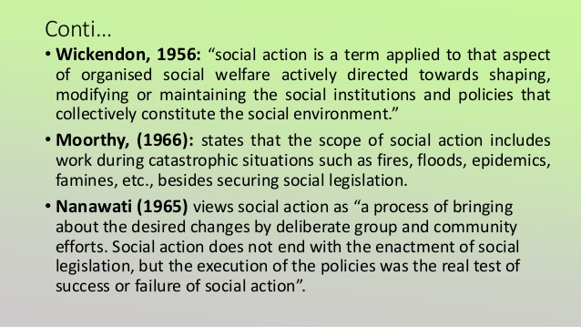

Slide 6
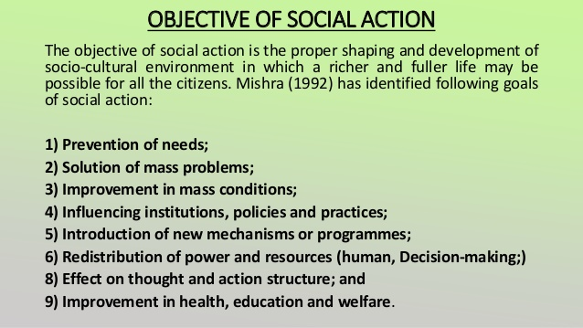

Slide 17
