Slide 1
Course : Msw(Social Work) Semester : IV
Course Detail : Elective Coures EC-IV
Course Title : Disaster Management
Unit : Policies And Role Of
Government Sectors

Slide 2
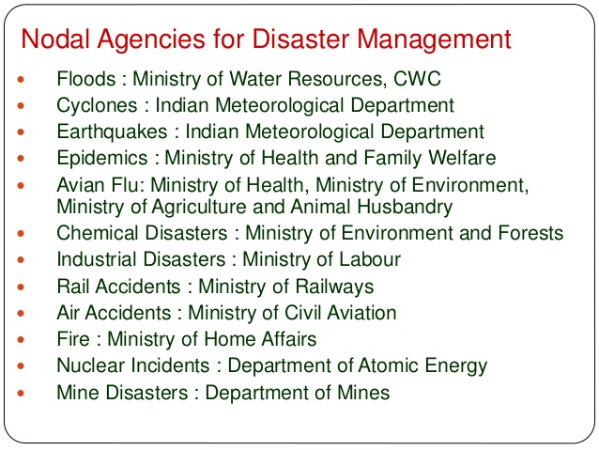

Slide 3
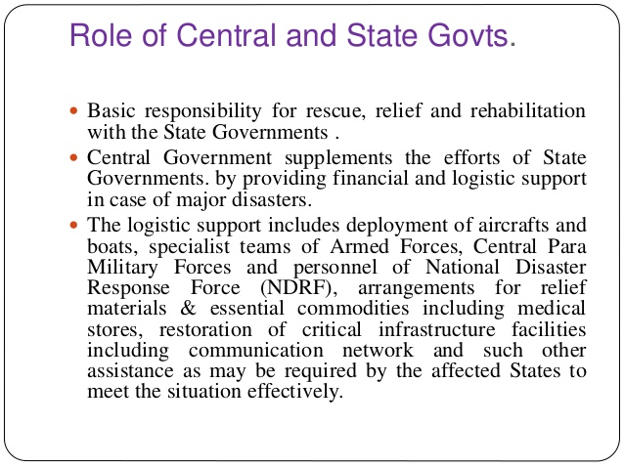

Slide 4
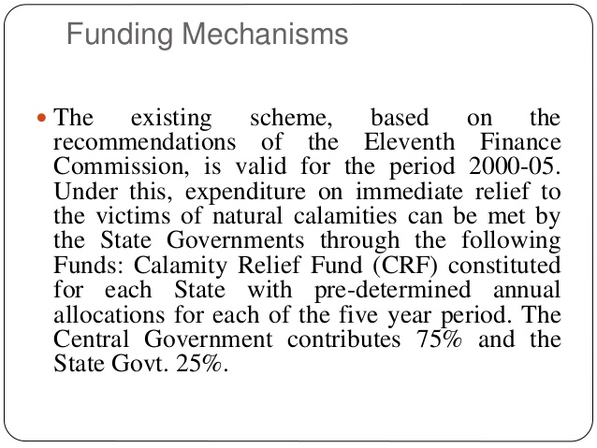

Slide 6
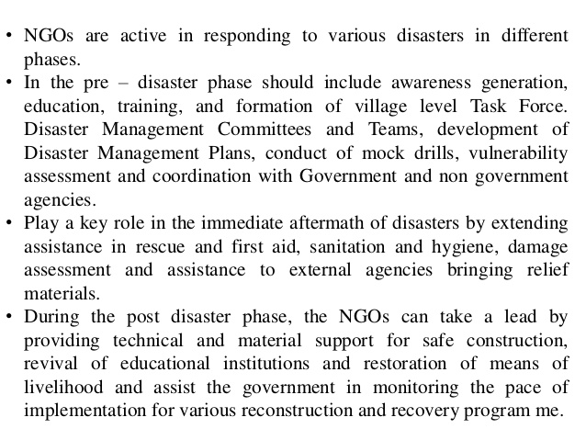

Slide 7
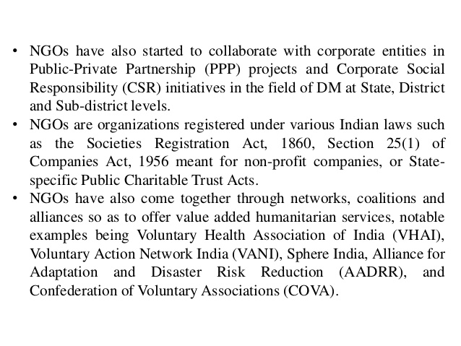

Slide 8
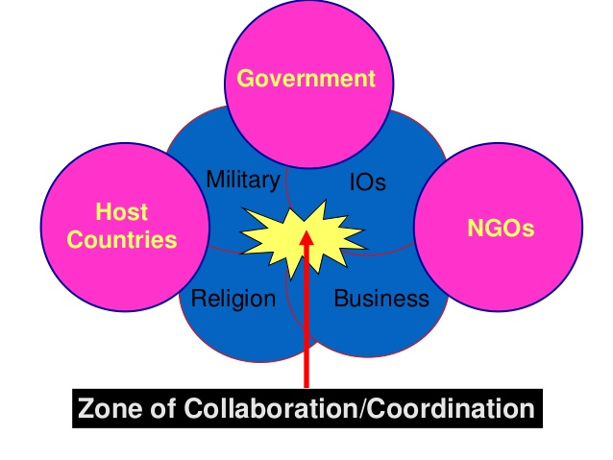

Slide 12
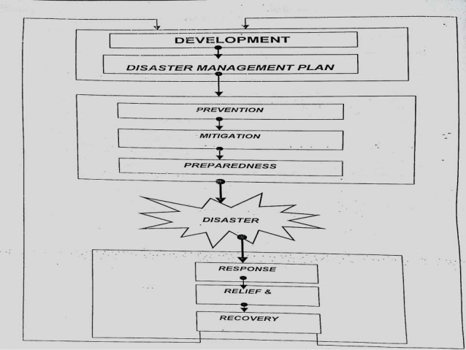

Slide 13
THANK YOU
Mrs.M.Vanitha
Assistant Professor,
Dept of MSW,
Adaikalamatha College.

