Slide 1
WELCOME

Slide 2
DEPARTMENT OF NUTRITION AND DIETETICS
FOOD SERVICE FACILITY
II M.Sc FOOD SERVICE MANAGEMENT AND DIETETICS
SUBJECT INCHARGE: V.ANITHA

Slide 3
PEST CONTROL
Notes:
PEST CONTROL

Slide 4
PEST CONTROL:
The term pest control refers to the practice of regulating or managing different pest species that cause great damage to human, animals and plants. There are various pest control methods that are used to control pest infestation or keep them at manageable levels.
Notes:
PEST CONTROL:The term pest control refers to the practice of regulating or managing different pest species that cause great damage to human, animals and plants. There are various pest control methods that are used to control pest infestation or keep them at manageable levels.

Slide 5
IMPORTANCE OF PEST CONTROL:
Pest control is necessary because rodents and insects carry diseases, infest your kitchens and bedrooms, and bite you or your pets. The purpose of removing any kind of pest from your home, garage, or yard is to keep you safe and healthy. For example, rodents can leave feces on or near food they find in your kitchen.
Notes:
IMPORTANCE OF PEST CONTROL:
Pest control is necessary because rodents and insects carry diseases, infest your kitchens and bedrooms, and bite you or your pets. The purpose of removing any kind of pest from your home, garage, or yard is to keep you safe and healthy. For example, rodents can leave feces on or near food they find in your kitchen.

Slide 6
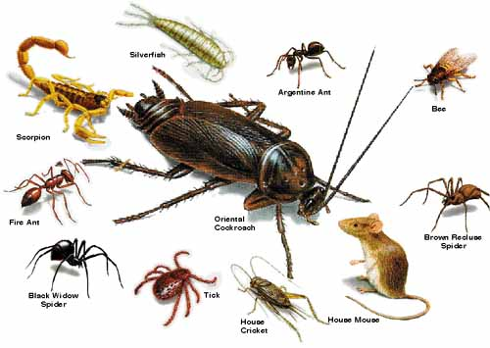
TYPES OF PESTS:
Ants
Bats
Bed bugs
Bees
Beetles
Flies
Mosquitoes
Roaches
Rodents
Scorpions
Snakes
Spiders
Termites
Notes:
TYPES OF PESTS:
Ants
Bats
Bed bugs
Bees
Beetles
Flies
Mosquitoes
Roaches
Rodents
Scorpions
Snakes
Spiders
Termites

Slide 7
TYPES OF PESTICIDES:
Insecticides
Herbicides
Fungicides
Rodenticides
Notes:
TYPES OF PESTICIDES:
Insectisides
Herbicides
Fungicides
Rodenticides

Slide 8
Insecticides
Insecticides are pesticides that are formulated to kill, harm, repel or mitigate one or more species of insect. Insecticides work in different ways. Some insecticides disrupt the nervous system, whereas others may damage their exoskeletons, repel them or control them by some other means. They can also be packaged in various forms including sprays, dusts, gels, and baits. Because of these factors, each insecticide can pose a different level of risk to non-target insects, people, pets and the environment.
Notes:
Insecticides are pesticides that are formulated to kill, harm, repel or mitigate one or more species of insect. Insecticides work in different ways. Some insecticides disrupt the nervous system, whereas others may damage their exoskeletons, repel them or control them by some other means. They can also be packaged in various forms including sprays, dusts, gels, and baits. Because of these factors, each insecticide can pose a different level of risk to non-target insects, people, pets and the environment.
Keep these tips in mind:

Slide 9
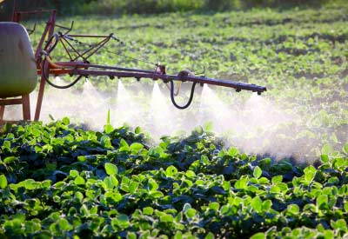
Herbicides
A herbicide is a pesticide used to kill unwanted plants. Selective herbicides kill certain targets while leaving the desired crop relatively unharmed. Some of these act by interfering with the growth of the weed and are often based on plant hormones.
Notes:
A herbicide is a pesticide used to kill unwanted plants. Selective herbicides kill certain targets while leaving the desired crop relatively unharmed. Some of these act by interfering with the growth of the weed and are often based on plant hormones.

Slide 10
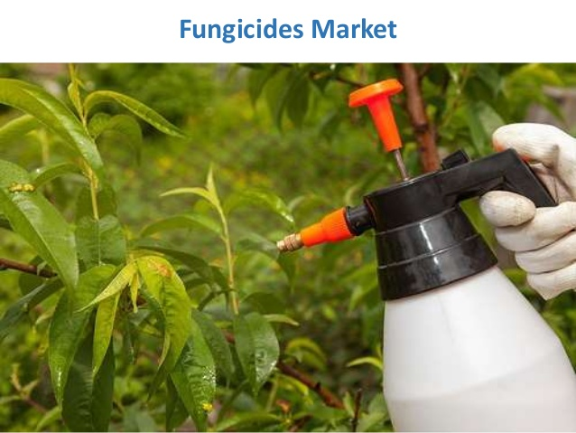
Fungicides
Fungicides are biocidal chemical compounds or biological organisms used to kill parasitic fungi or their spores. A fungistatic inhibits their growth. Fungi can cause serious damage in agriculture, resulting in critical losses of yield, quality, and profit.
Notes:
Fungicides are biocidal chemical compounds or biological organisms used to kill parasitic fungi or their spores. A fungistatic inhibits their growth. Fungi can cause serious damage in agriculture, resulting in critical losses of yield, quality, and profit.

Slide 11
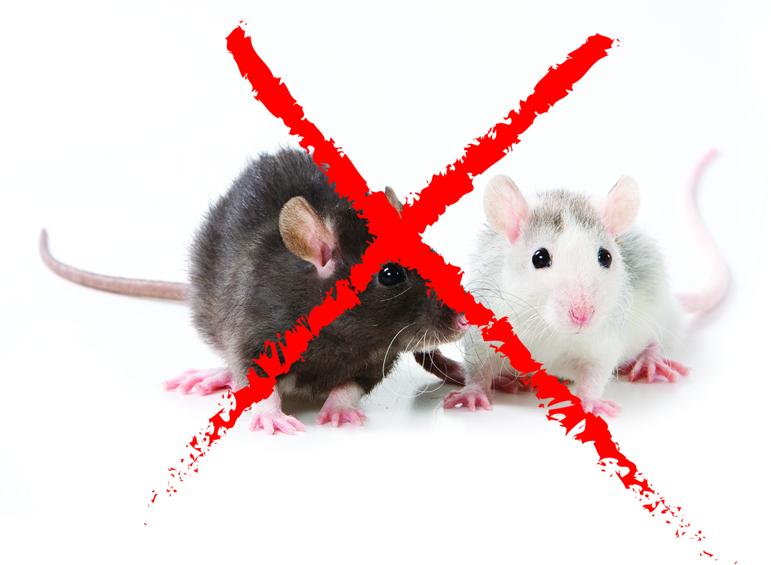
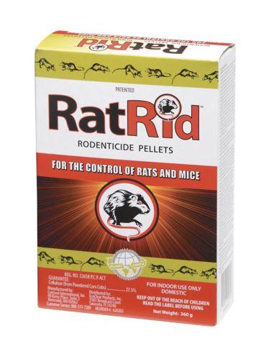
Rodenticides
Rodenticides are pesticides that kill rodents. Rodents include not only rats and mice, but also squirrels, woodchucks, chipmunks, porcupines, nutria, and beavers. Although rodents play important roles in nature, they may sometimes require control.
Notes:
Rodenticides are pesticides that kill rodents. Rodents include not only rats and mice, but also squirrels, woodchucks, chipmunks, porcupines, nutria, and beavers. Although rodents play important roles in nature, they may sometimes require control.

Slide 12
Pest Control Equipment
B&G sprayers.
Bee Control.
Backpack Sprayers.
Dusters.
Pest Control Hose Reels.
Pest Control Spray Hoses.
Bed Bug Steamers.
Pest Control Granulators.
Notes:
Pest Control Equipment
B&G sprayers.
Bee Control.
Backpack Sprayers.
Dusters.
Pest Control Hose Reels.
Pest Control Spray Hoses.
Bed Bug Steamers.
Pest Control Granulators.

Slide 13
THANK YOU
Notes:
THANK YOU

