Slide 1
MATRICES
BY
SUMATHI. V

Slide 2

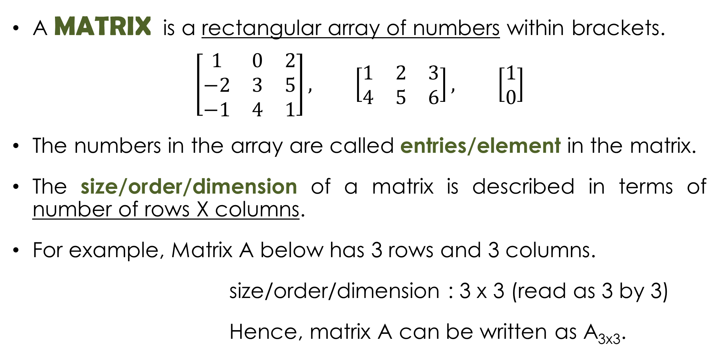
DEFINITION
A MATRIX is a rectangular array of numbers within brackets.
$$\left[\begin{matrix}1 & 0 & 2 \\ −2 & 3 & 5 \\ −1 & 4 & 1\end{matrix}\right], \left[\begin{matrix}1 & 2 & 3 \\ 4 & 5 & 6\end{matrix}\right], \left[\begin{matrix}1 \\ 0\end{matrix}\right]$$
The numbers in the array are called entries/element in the matrix.
The size/order/dimension of a matrix is described in terms of number of rows X columns.
For example, Matrix A below has 3 rows and 3 columns.
size/order/dimension : 3 x 3 (read as 3 by 3)
Hence, matrix A can be written as A_{3x3}.
$$A=\left[\begin{matrix}1 & 0 & 2 \\ −2 & 3 & 5 \\ −1 & 4 & 1\end{matrix}\right]$$

Slide 3
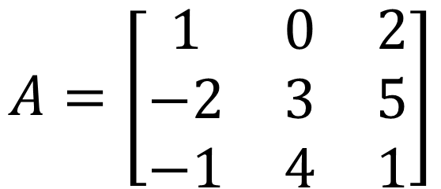
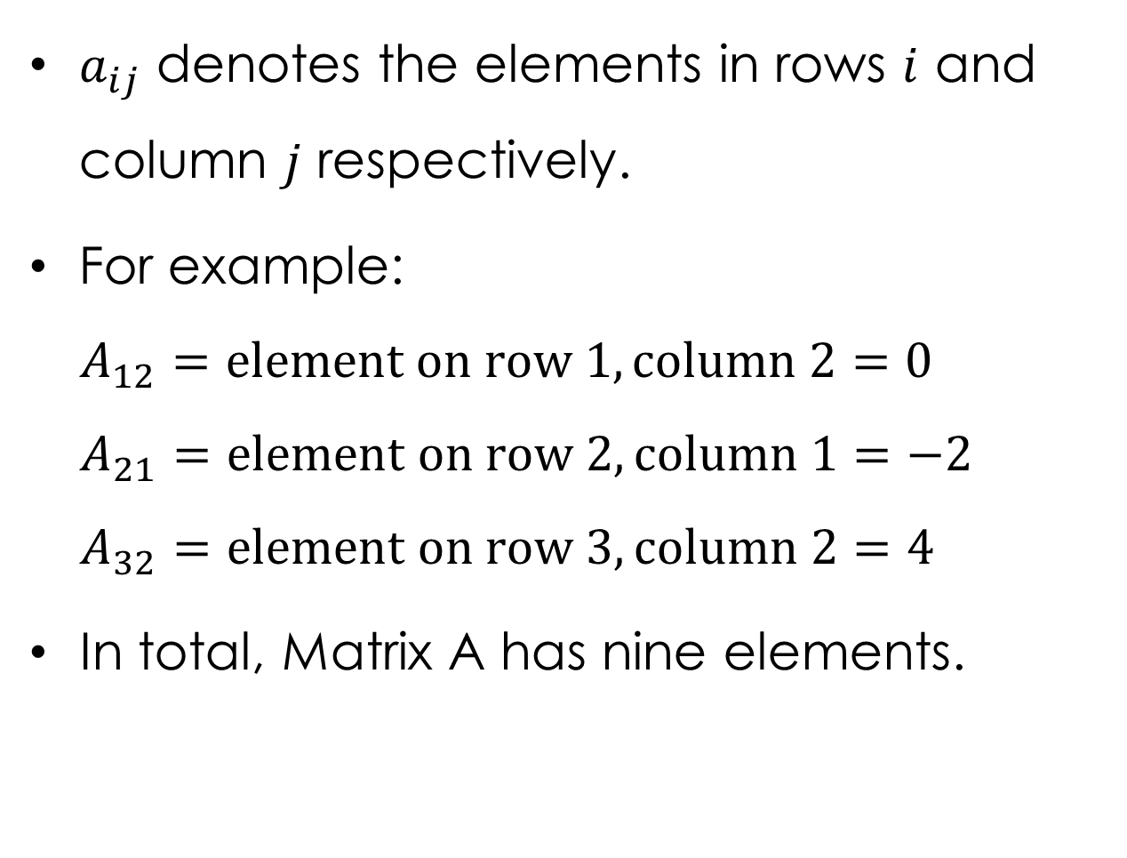
DEFINITION
$a_{ij}$ denotes the elements in rows $i$ and column $j$ respectively.
For example:
$$A_{12}=element on row 1, column 2=0$$
$$A_{21}=element on row 2, column 1=−2$$
$$A_{32}=element on row 3, column 2=4$$
In total, Matrix A has nine elements.
$$A=\left[\begin{matrix}1 & 0 & 2 \\ −2 & 3 & 5 \\ −1 & 4 & 1\end{matrix}\right]$$

Slide 4
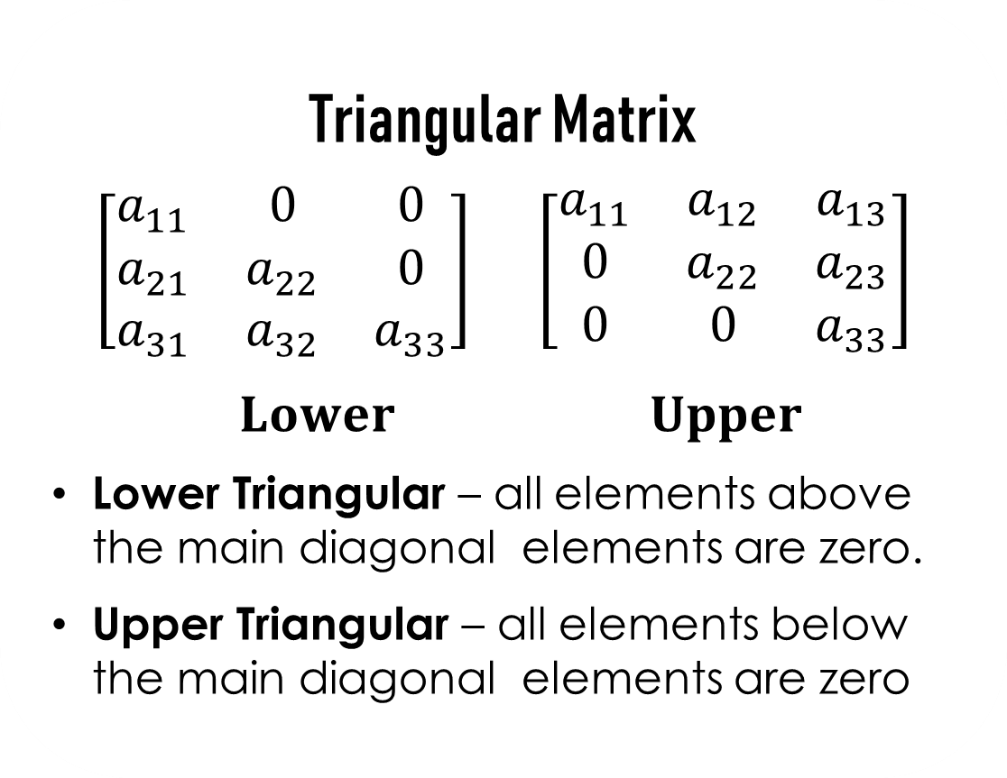
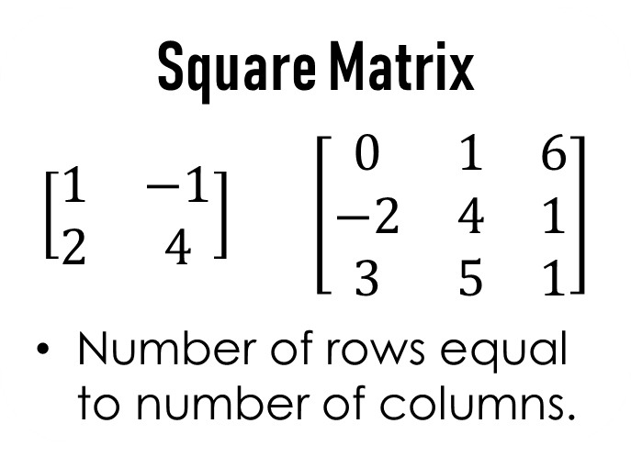
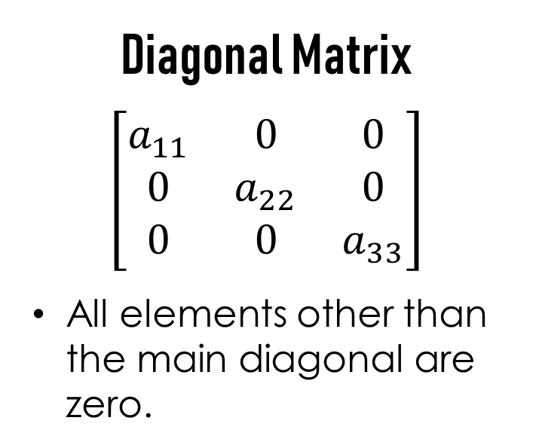
Square Matrix
$$\left[\begin{matrix}1 & −1 \\ 2 & 4\end{matrix}\right] \left[\begin{matrix}0 & 1 & 6 \\ −2 & 4 & 1 \\ 3 & 5 & 1\end{matrix}\right]$$
Number of rows equal to number of columns.
Triangular Matrix
$$\left[\begin{matrix}a_{11} & 0 & 0 \\ a_{21} & a_{22} & 0 \\ a_{31} & a_{32} & a_{33}\end{matrix}\right] \left[\begin{matrix}a_{11} & a_{12} & a_{13} \\ 0 & a_{22} & a_{23} \\ 0 & 0 & a_{33}\end{matrix}\right]$$
$$Lower Upper$$
Lower Triangular – all elements above the main diagonal elements are zero.
Upper Triangular – all elements below the main diagonal elements are zero
Diagonal Matrix
$$\left[\begin{matrix}a_{11} & 0 & 0 \\ 0 & a_{22} & 0 \\ 0 & 0 & a_{33}\end{matrix}\right]$$
All elements other than the main diagonal are zero.

Slide 5
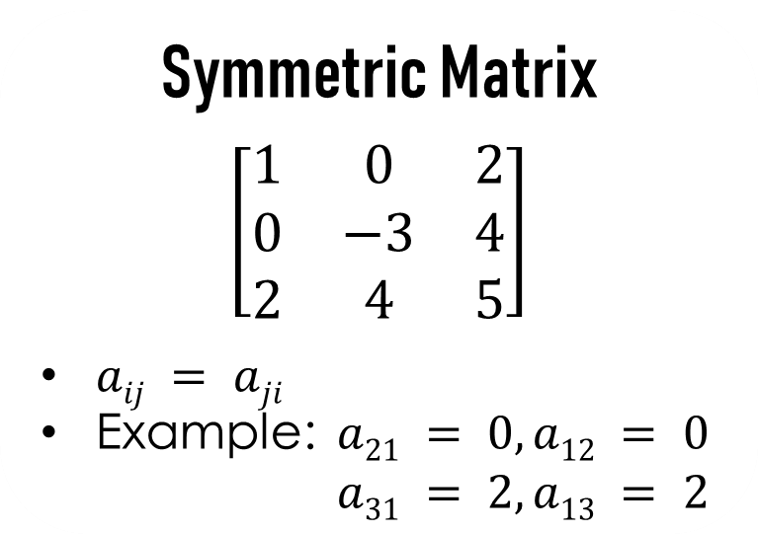
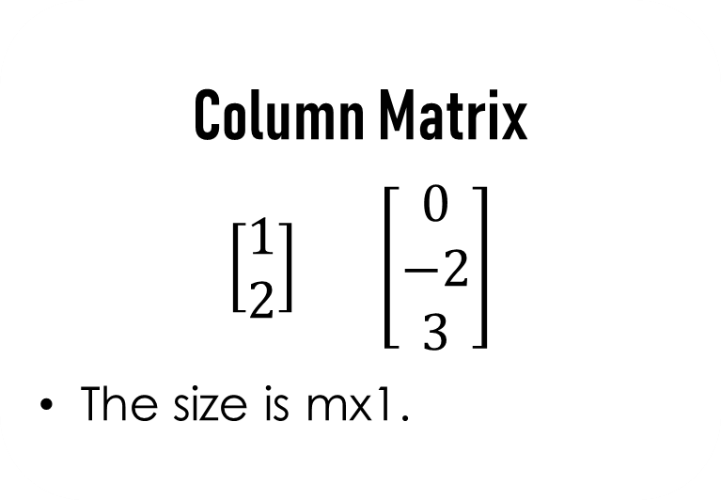
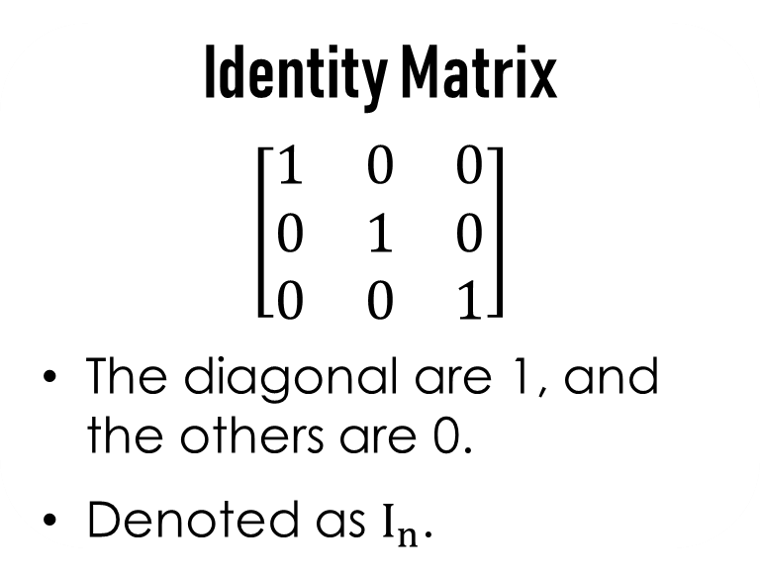
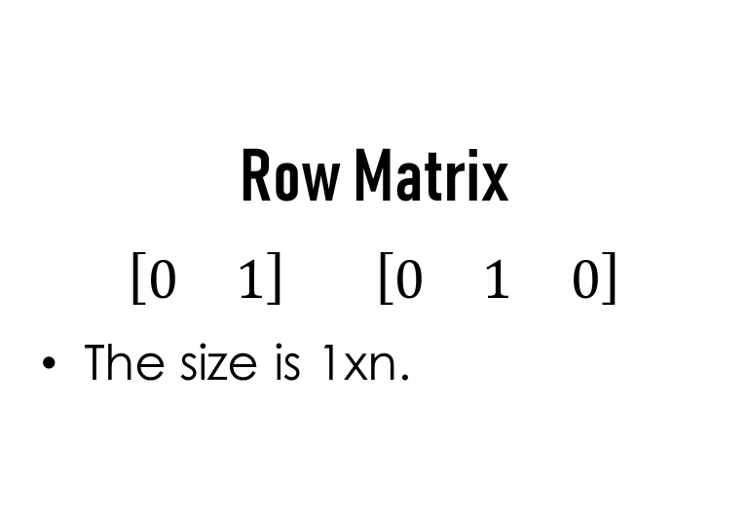
Column Matrix
$$\left[\begin{matrix}1 \\ 2\end{matrix}\right] \left[\begin{matrix}0 \\ −2 \\ 3\end{matrix}\right]$$
The size is mx1.
Row Matrix
$$\left[\begin{matrix}0 & 1\end{matrix}\right] \left[\begin{matrix}0 & 1 & 0\end{matrix}\right]$$
The size is 1xn.
Symmetric Matrix
$$\left[\begin{matrix}1 & 0 & 2 \\ 0 & −3 & 4 \\ 2 & 4 & 5\end{matrix}\right]$$
$aij = aji$
Example: $a21 = 0, a12 = 0$
$a31 = 2, a13 = 2$
Identity Matrix
$$\left[\begin{matrix}1 & 0 & 0 \\ 0 & 1 & 0 \\ 0 & 0 & 1\end{matrix}\right]$$
The diagonal are 1, and the others are 0.
Denoted as $I_{n}$.

Slide 6
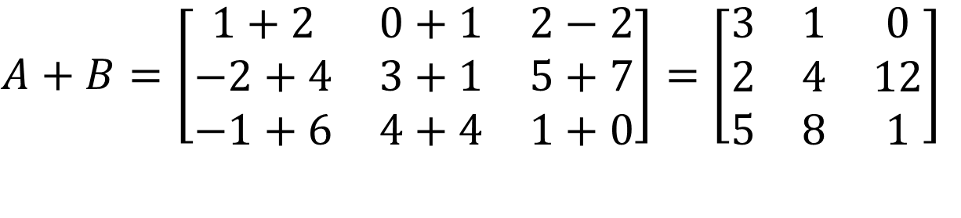
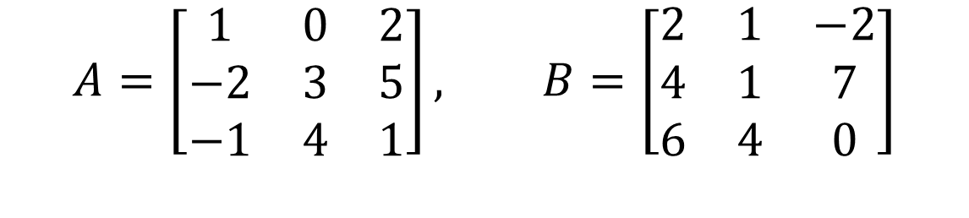
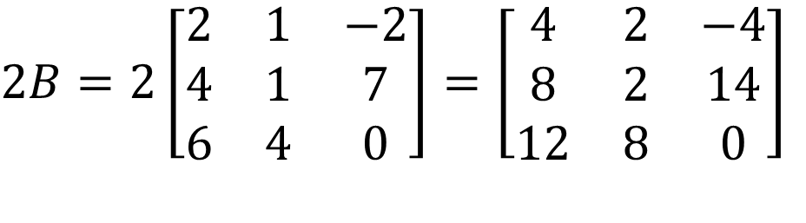
Basic Operation
Ex. 1
$$A=\left[\begin{matrix}1 & 0 & 2 \\ −2 & 3 & 5 \\ −1 & 4 & 1\end{matrix}\right], B=\left[\begin{matrix}2 & 1 & −2 \\ 4 & 1 & 7 \\ 6 & 4 & 0\end{matrix}\right]$$
$$A+B=\left[\begin{matrix}1+2 & 0+1 & 2−2 \\ −2+4 & 3+1 & 5+7 \\ −1+6 & 4+4 & 1+0\end{matrix}\right]=\left[\begin{matrix}3 & 1 & 0 \\ 2 & 4 & 12 \\ 5 & 8 & 1\end{matrix}\right]$$
Addition/
Subtraction
$$2B=2\left[\begin{matrix}2 & 1 & −2 \\ 4 & 1 & 7 \\ 6 & 4 & 0\end{matrix}\right]=\left[\begin{matrix}4 & 2 & −4 \\ 8 & 2 & 14 \\ 12 & 8 & 0\end{matrix}\right]$$
Scalar
multiplication

Slide 7


Basic Operation
In mathematics,
A MATRIX IS CONFORMABLE if its dimensions are suitable for defining some operation.
Reference: Wikipedia
If two matrices have the same dimensions (numbers of rows and numbers of columns), they are CONFORMABLE for addition.

Slide 8
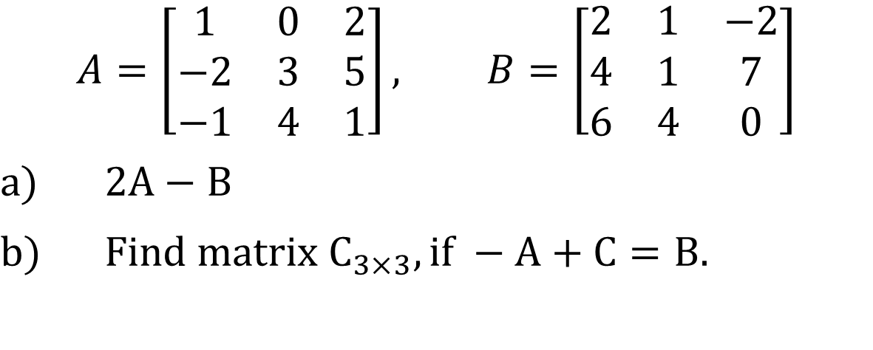
Basic Operation
Ex. 2
Based on the matrices below, answer the following questions.
$$A=\left[\begin{matrix}1 & 0 & 2 \\ −2 & 3 & 5 \\ −1 & 4 & 1\end{matrix}\right], B=\left[\begin{matrix}2 & 1 & −2 \\ 4 & 1 & 7 \\ 6 & 4 & 0\end{matrix}\right]$$
$2A−B$
$Find matrix C_{3×3}, if −A+C=B.$

Slide 9
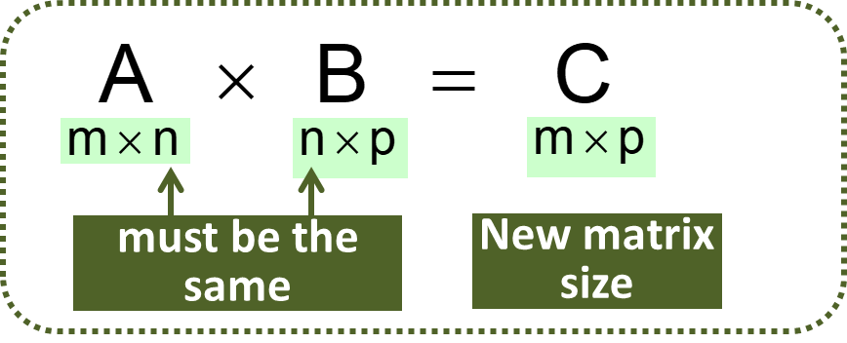
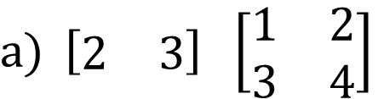
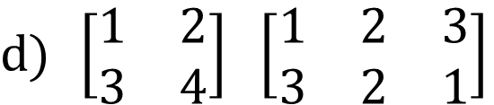
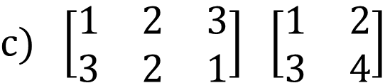
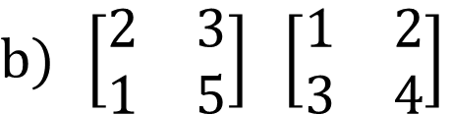
Basic Operation
Matrix Multiplication
Ex. 3
Determine the size of the matrix obtained from the matrix multiplication(if defined).
$\left[\begin{matrix}2 & 3\end{matrix}\right] \left[\begin{matrix}1 & 2 \\ 3 & 4\end{matrix}\right]$
$\left[\begin{matrix}2 & 3 \\ 1 & 5\end{matrix}\right] \left[\begin{matrix}1 & 2 \\ 3 & 4\end{matrix}\right]$
$\left[\begin{matrix}1 & 2 & 3 \\ 3 & 2 & 1\end{matrix}\right] \left[\begin{matrix}1 & 2 \\ 3 & 4\end{matrix}\right]$
$\left[\begin{matrix}1 & 2 \\ 3 & 4\end{matrix}\right] \left[\begin{matrix}1 & 2 & 3 \\ 3 & 2 & 1\end{matrix}\right]$

Slide 10


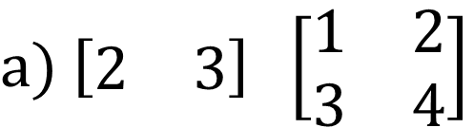



Basic Operation
Matrix Multiplication
Ex. 4
Calculate the following matrix multiplication.
$$1×2$$
$$2×2$$
$$1×2$$
$\left[\begin{matrix}2 & 3\end{matrix}\right] \left[\begin{matrix}1 & 2 \\ 3 & 4\end{matrix}\right]$
$$=\left[\begin{matrix}2\left(1\right)+3\left(3\right) & 2\left(2\right)+3\left(4\right)\end{matrix}\right]$$
$$=\left[\begin{matrix}11 & 14\end{matrix}\right]$$
$a_{11}=$ multiply all element in row 1(1st matrix) with corresponding element in column 1 (2nd matrix)
$a_{12}=$ multiply all element in row 1(1st matrix) with corresponding element in column 2 (2nd matrix)

Slide 11
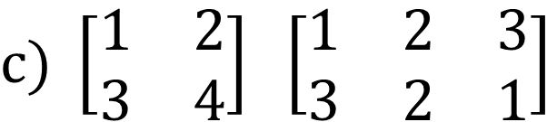


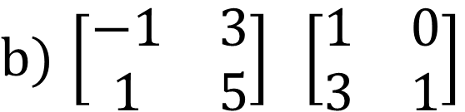



Basic Operation
Matrix Multiplication
Ex. 4
Calculate the following matrix multiplication.
$$2×2$$
$$2×2$$
$$2×2$$
$\left[\begin{matrix}−1 & 3 \\ 1 & 5\end{matrix}\right] \left[\begin{matrix}1 & 0 \\ 3 & 1\end{matrix}\right]$
$$2×2$$
$$2×3$$
$$2×3$$
$\left[\begin{matrix}1 & 2 \\ 3 & 4\end{matrix}\right] \left[\begin{matrix}1 & 2 & 3 \\ 3 & 2 & 1\end{matrix}\right]$

Slide 12

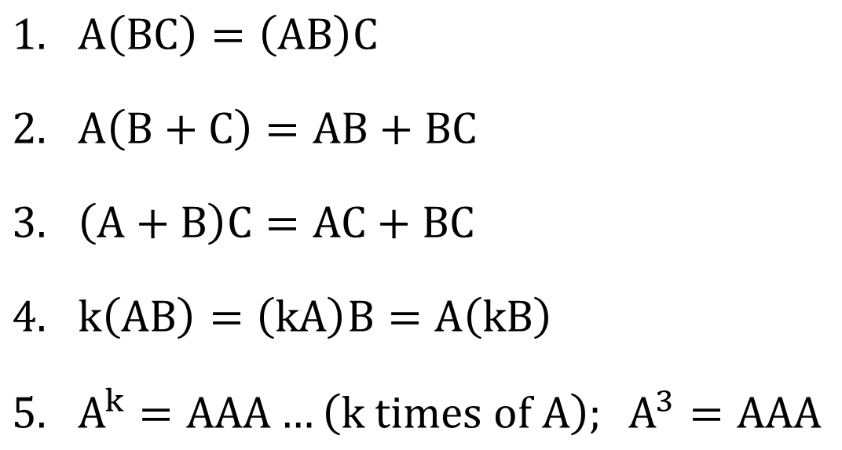
Basic Operation
Matrix Multiplication
THEOREM
$A\left(BC\right)=\left(AB\right)C$
$A\left(B+C\right)=AB+BC$
$\left(A+B\right)C=AC+BC$
$k\left(AB\right)=\left(kA\right)B=A\left(kB\right)$
$A^{k}=AAA…\left(k times of A\right); A^{3}=AAA$

Slide 13
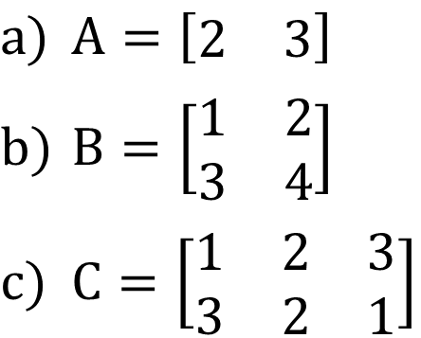

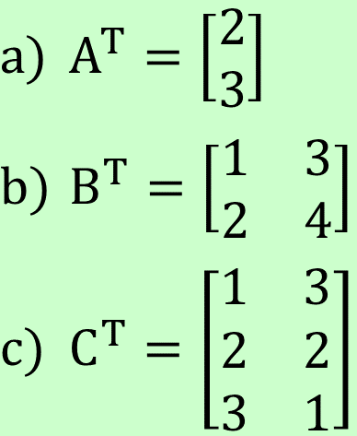
Basic Operation
Transposition
$$A_{ij}→A_{ji}$$
- The transpose of matrix A is denoted as A^{T}.
Ex. 5
Find the transpose for the following matrix.
$A=\left[\begin{matrix}2 & 3\end{matrix}\right]$
$B=\left[\begin{matrix}1 & 2 \\ 3 & 4\end{matrix}\right]$
$C=\left[\begin{matrix}1 & 2 & 3 \\ 3 & 2 & 1\end{matrix}\right]$
$A^{T}=\left[\begin{matrix}2 \\ 3\end{matrix}\right]$
$B^{T}=\left[\begin{matrix}1 & 3 \\ 2 & 4\end{matrix}\right]$
$C^{T}=\left[\begin{matrix}1 & 3 \\ 2 & 2 \\ 3 & 1\end{matrix}\right]$

Slide 14
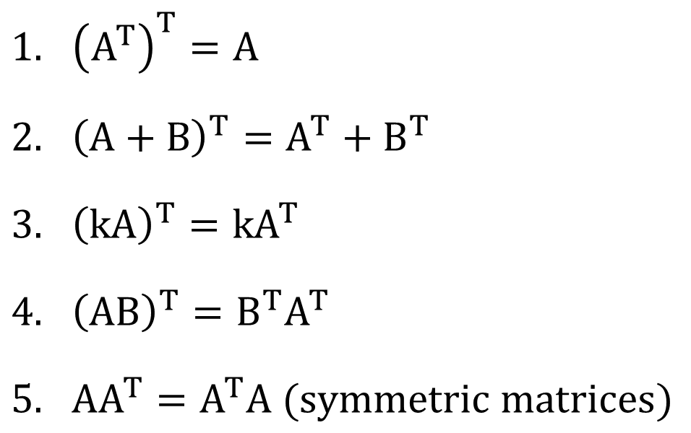
Basic Operation
Transposition
THEOREM
${\left(A^{T}\right)}^{T}=A$
${\left(A+B\right)}^{T}=A^{T}+B^{T}$
${\left(kA\right)}^{T}=kA^{T}$
${\left(AB\right)}^{T}=B^{T}A^{T}$
$AA^{T}=A^{T}A (symmetric matrices)$

Slide 15

Basic Operation
EXERCISE SET 1.3 (H. Anton & C. Rorres, Elementary linear algebra 10th edition. Page 64)
3. Consider the matrices
In each part, compute the given expression (where possible).

Slide 16

DETERMINANT
Only square matrices have determinant
Determinant of A is noted as det(A) or |A|
Determinant of A is a NUMBER, NOT A MATRIX!
Matrix size : 1x1
Matrix size : 2x2

Slide 17

DETERMINANT
Example 1
Find the determinant for the following matrices.
This method is called as
COFACTOR/LAPLACE EXPANSION

Slide 18
DETERMINANT
Matrix size : 3x3
1st Row
How do we decide the sign
2nd Row

Slide 19
DETERMINANT
REMEMBER!
Cofactor expansion also can be done along the j^{th} column.
Example 2
1st Row

Slide 20

PROPERTIES OF
DETERMINANT
A has zero rows or zero column
Two or more rows/columns in A are the same
A row/column is a multiple of another row/column

Slide 21

INVERSE MATRICES
If A is a square matrix, and if a matrix B of the same size can be found such that ,
then,
A is said to be INVERTIBLE
and
B is called as inverse of A.
Inverse of
Matrix A is
denoted by
I is an identity matrix with the same size as A.

Slide 22
INVERSE MATRICES
NOTE
A non square matrix is not invertible, but not all square matrices is invertible
Inverse of 2x2 matrix
The matrix
is invertible if and only if

Slide 23

INVERSE MATRICES
Example 1
Find the inverse of M, given that
How can I check my answer?

Slide 24
INVERSE MATRICES
Inverse of 3x3 matrix
Elementary row operation
Adjoint Method
Find determinant
Find Minor and Cofactor
Find Adjoint
Find inverse

Slide 25
INVERSE MATRICES
Given that A is a square matrix with i row and j column
Minor of entry a_{ij}
Example 2
Find the minor of entry
is denoted by M_{ij}
is defined to be the determinant of the submatrix
that remains after the i^{th} row and j^{th} column are deleted from A.
a₁₁ and a₂₁, given that

Slide 26
INVERSE MATRICES
Example 3
Find the minor for all entry given that,

Slide 27
INVERSE MATRICES
Given that A is a square matrix with i row and j column
is denoted by C_{ij}
is defined as (–1)^{i+j} M_{ij}
Cofactor of entry a_{ij}
Example 4
Find the cofactor matrix of matrix A from the previous example 3 (slide 40).

Slide 28
INVERSE MATRICES
Example 5
Find the minor and the cofactor for all entry given that,

Slide 29
INVERSE MATRICES
Inverse of 3x3 matrix
Adjoint Method
Example 6
Find the inverse of matrix A given that,
1. Find determinant
3. Find Adjoint of A
2. Find Minor and Cofactor

Slide 30
INVERSE MATRICES
Inverse of 3x3 matrix
Adjoint Method
Example 6
Find the inverse of matrix A given that,
4. Find inverse of A

Slide 31
INVERSE MATRICES
Inverse of 3x3 matrix
Adjoint Method
Example 7
Find the inverse of matrix B given that,

Slide 32
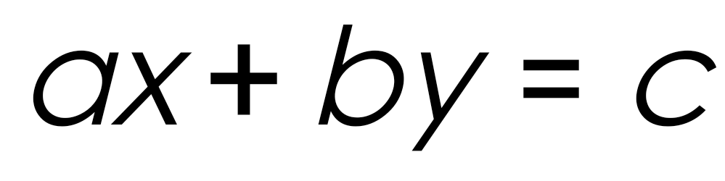
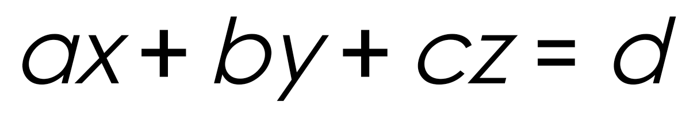
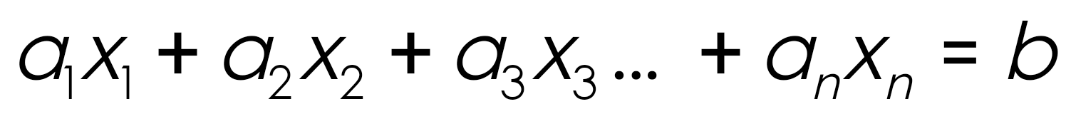
Linear equations in xy-coordinate system → 2 variables/unknowns
Linear equations in xyz-coordinate system → 3 variables/unknowns
Linear equations in the n variables, x₁ , x₂ , x₃ , … , x_{n} to be one that can be expressed in the form:

Slide 33
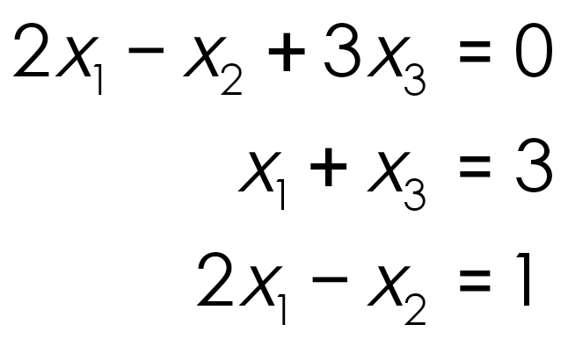
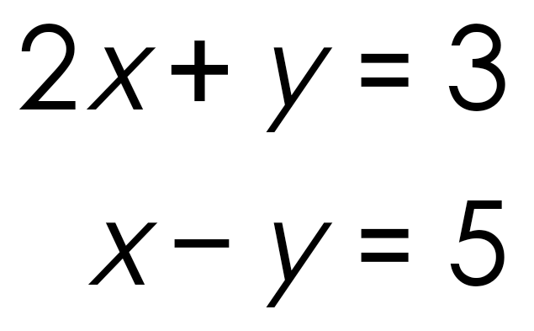
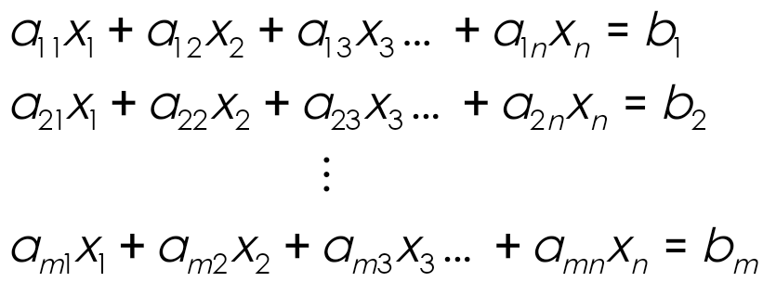
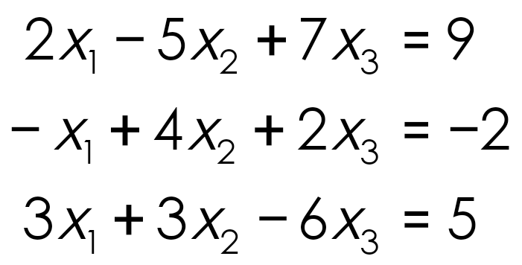
A system of linear equations is a finite set of linear equation.
→ 2 variables/unknown
→ 3 variables/unknown
A system of linear equations with m equations and n variables can be written as:
Example

Slide 34
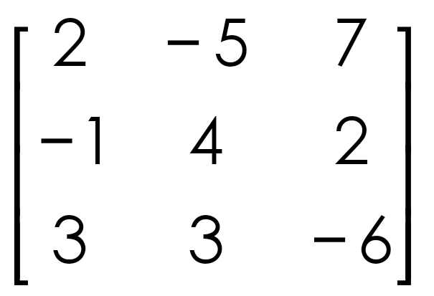
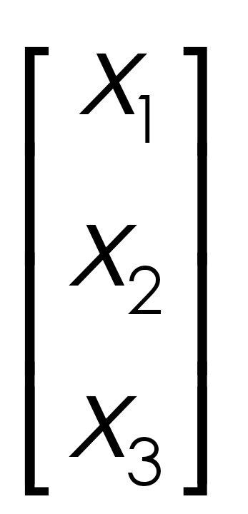
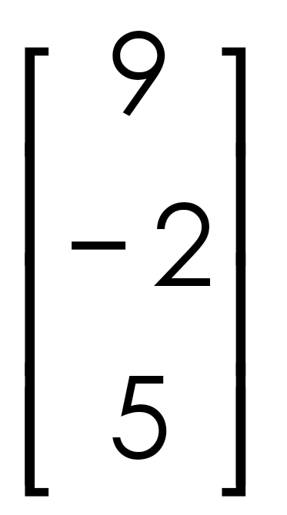
System of linear equations in matrix notation is written in the form of AX = B
Coefficient
variable
constant
A
x
B

Slide 35
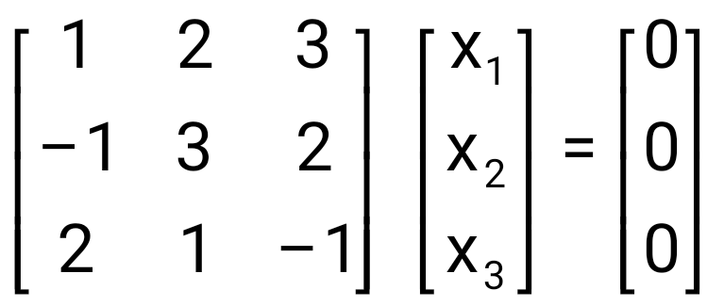
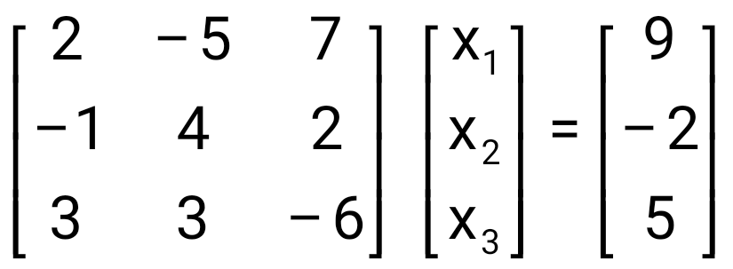
Homogenous
Non Homogenous
At least one constant is not zero
All constant are zero
System of Linear Equations | Set of solution
Consistent | Unique solution
 | Infinitely many solutions
Inconsistent | No solution

Slide 36
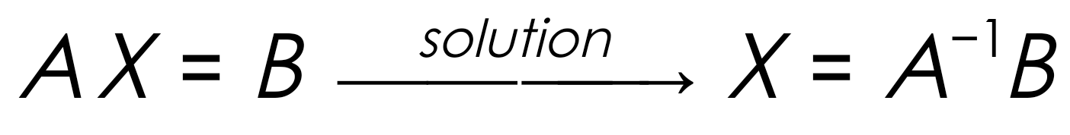
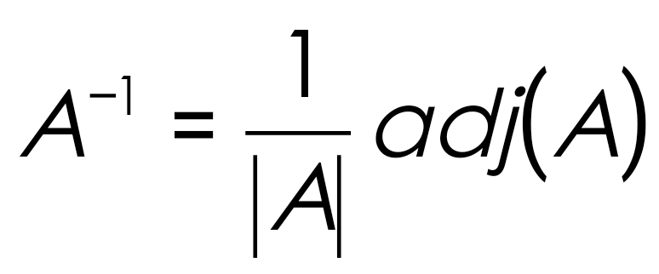
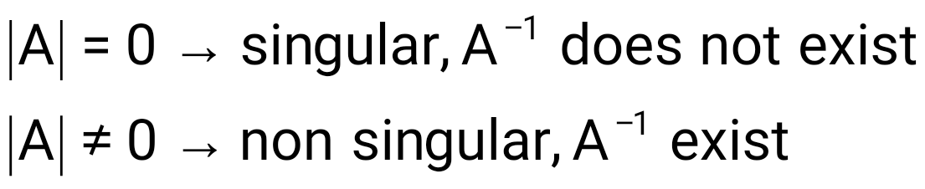
SOLUTION : INVERSION METHOD
Step 1: Find A^{–1}
Step 2: Solve by using X = A^{–1} B

Slide 37
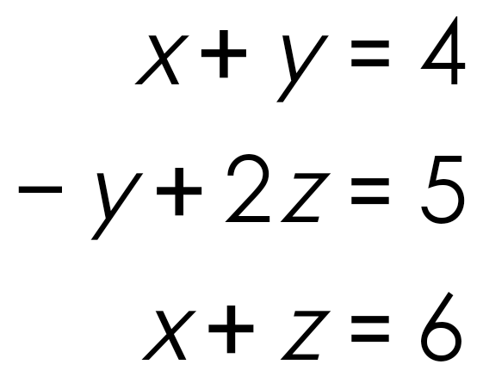
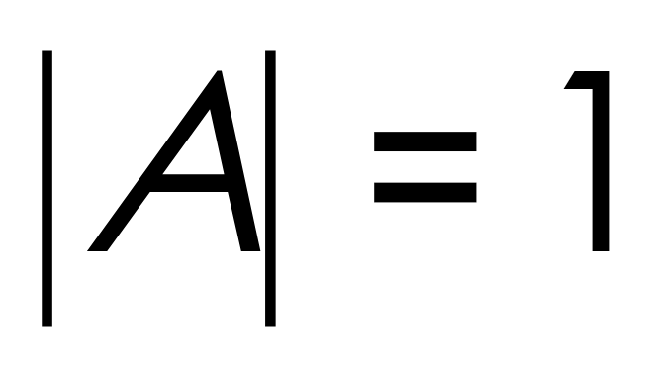
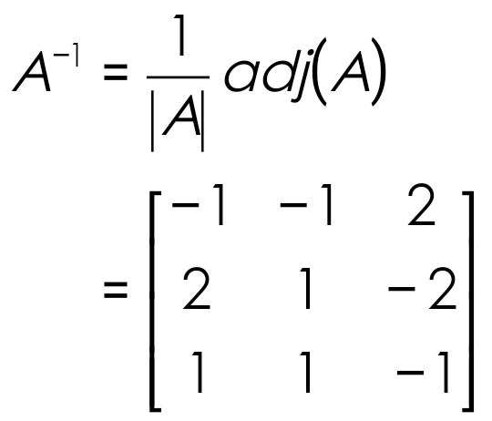
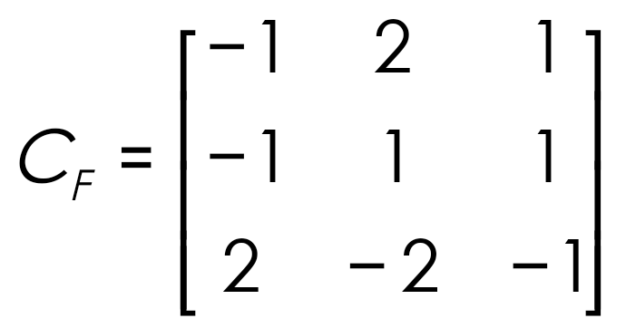
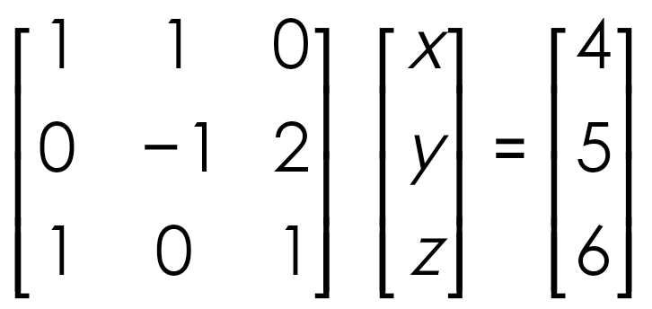
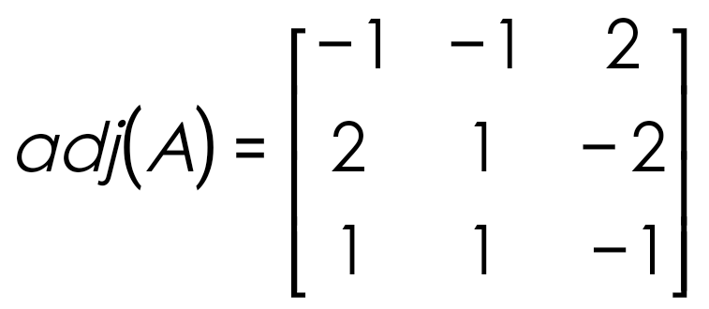



SOLUTION : INVERSION METHOD
Example 1
Solve the following system of linear equations by using inversion method.
Step 1: Find A^{–1}
4
1
2
3

Slide 38
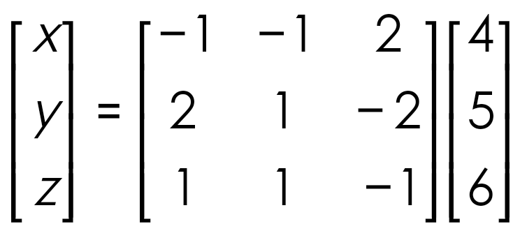
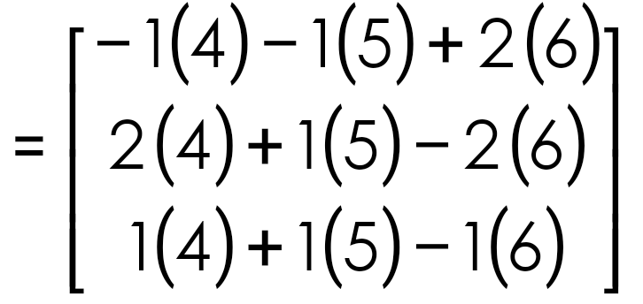

SOLUTION : INVERSION METHOD
Example 1
Solve the following system of linear equations by using inversion method.
Step 2: Solve by using X = A^{–1} B

Slide 39
SYSTEM OF LINEAR EQUATIONS
SOLUTION : INVERSION METHOD
If AX = B is system of linear equation and , then the system has solution.
Step 1: Find |A|
Step 2: Find A₁ by replacing 1st column of A with constant matrix B
Step 3: Find | A₁ |
Step 4: Find x₁
Step 5: Repeat Step 2, 3 and 4 for the other unknown, x_{n}
Cramer’s rule only can solve system with |A|≠ 0

Slide 40
SYSTEM OF LINEAR EQUATIONS
SOLUTION : INVERSION METHOD
Example 2
Step 1: Find |A|
Solve the following system of linear equations by using Cramer’s Rule.
Step 2: Find A₁ by replacing 1st column of A with constant matrix B
Step 3: Find | A₁|
Step 4: Find x₁

