Slide 1
Subject :Nutrition Through Life Cycle
Subject Code :16SCCND4

Slide 2
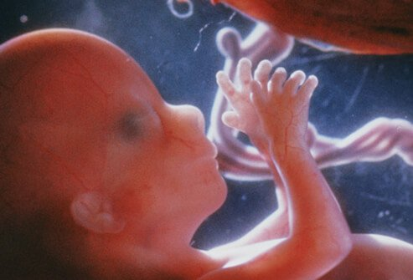
STAGES OF PREGNANCY
UNIT 1

Slide 3
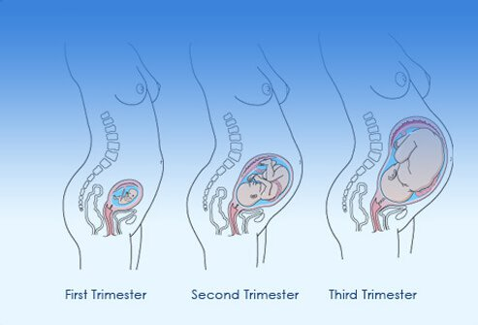
The Three Stages of Pregnancy
(1st, 2nd, and 3rd Trimester)

Slide 4
A typical pregnancy lasts 40 weeks from the first day of your last menstrual period (LMP) to the birth of the baby.
It is divided into three stages, called trimesters:
first trimester,
second trimester, and
third trimester.

Slide 5
Prenatal Development:
Three Stages
• Germinal stage – Zygote
• Embryonic stage – Embryo
• Fetal stage – Fetus

Slide 6
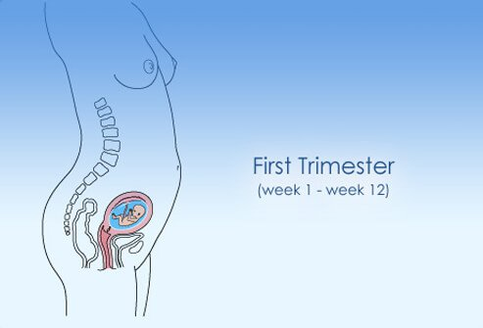
conception to about the 12th week of pregnancy marks the first trimester.
The second trimester is weeks 13 to 27, and the
Third trimester starts about 28 weeks and lasts until birth
First Trimester

Slide 7
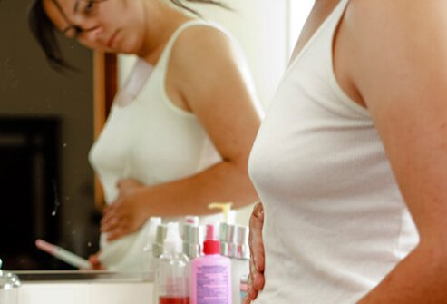
First Trimester: Early Changes in a Woman's Body
First Trimester: Week 1 (conception) – Week 12
A missed period may be the first sign you are pregnant.

Slide 8

First Trimester: Physical and Emotional Changes a Woman May Experience

Slide 9
Hormonal changes will affect almost every organ in the body.
Some signs of early pregnancy include:
Extreme Fatigue
Tender, swollen breasts. Nipples may protrude.
Nausea with or without throwing up
Cravings or aversion to certain foods
Mood swings
Constipation
Frequent urination
Headache
Heartburn
Weight gain or loss

Slide 10
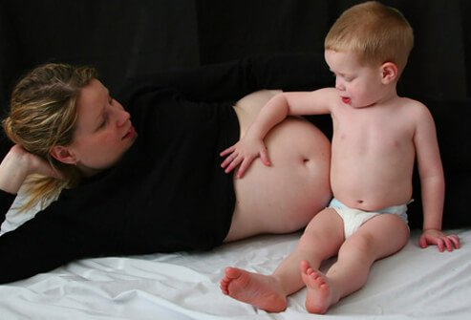
First Trimester: Changes in a Woman's Daily Routine

Slide 11
Some of the changes you experience in your first trimester may cause you to revise your daily routine.
You may need to go to bed earlier or eat more frequent or smaller meals.
Some women experience a lot of discomfort, and others may not feel any at all.
Each pregnancy is different and even if you've been pregnant before you may feel completely different with each subsequent pregnancy.

Slide 12
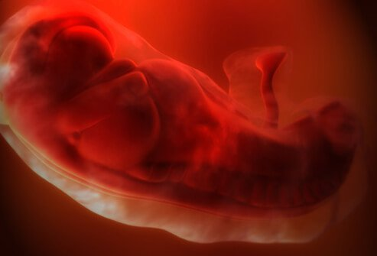
First Trimester: The Baby at 4 Weeks

Slide 13
At 4 weeks, your baby is developing:
The nervous system (brain and spinal cord) has begun to form.
The heart begins to form.
Arm and leg buds begin to develop.
Your baby is now an embryo and ¹⁄₂₅ of an inch long.

Slide 14
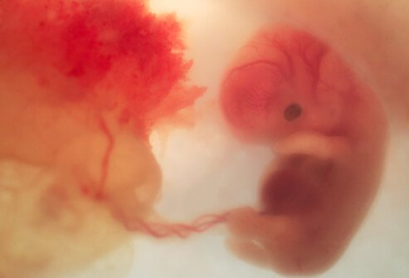
First Trimester: The Baby at 8 Weeks

Slide 15
At 8 weeks, the embryo begins to develop into a fetus:
All major organs have begun to form.
The baby's heart begins to beat.
The arms and legs grow longer.
Fingers and toes have begun to form.
Sex organs begin to form.
The face begins to develop features.
The umbilical cord is clearly visible
At the end of 8 weeks, your baby is a fetus, and is nearly 1 inch long, weighing less than ⅛ of an ounce (3.544 grams). 1 ounce - 28.35 grams

Slide 16
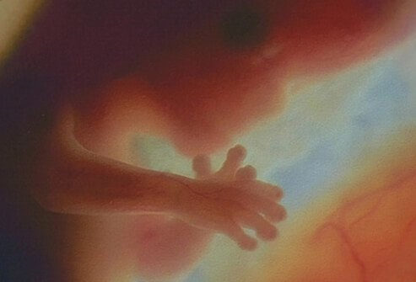
First Trimester: The Baby at 12 Weeks

Slide 17
The end of the first trimester is at about week 12, at this point in your baby's development:
The nerves and muscles begin to work together. Your baby can make a fist.
The external sex organs show if your baby is a boy or girl.
Eyelids close to protect the developing eyes. They will not open again until week 28.
Head growth has slowed, and your baby is about 3 inches long, and weighs almost an ounce.

Slide 18
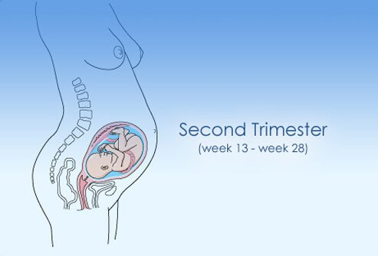
Second Trimester

Slide 19
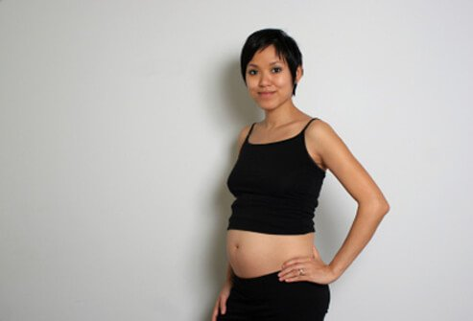
Second trimester: Week 13 – Week 28
Second Trimester: Changes a Woman May Experience

Slide 20
Once you enter the second trimester you may find it easier than the first.
nausea (morning sickness) and fatigue may lessen or go away completely.
However, you will also notice more changes to your body. That "baby bump“(enlarged abdomen of a pregnant women) will start to show as your abdomen expands with the growing baby.
By the end of the second trimester you will even be able to feel your baby move!

Slide 21
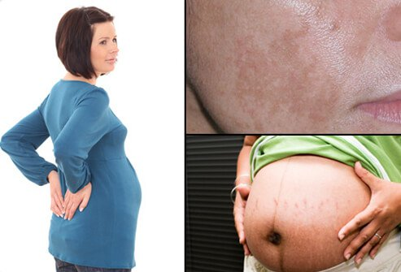
Second Trimester: Physical and Emotional Changes in a Woman

Slide 22
Some changes you may notice in your body in the second trimester include:
Back, abdomen, groin, or thigh aches and pains
Stretch marks on your abdomen, breasts, thighs, or buttocks
Darkening of the skin around your nipples
A line on the skin running from belly button to pubic hairline (linea nigra)

Slide 23
Patches of darker skin, usually over the cheeks, forehead, nose, or upper lip. This is sometimes called the mask of pregnancy (melasma, or Chloasma facies).
Numb or tingling hands (carpal tunnel syndrome)
Itching on the abdomen, palms, and soles of the feet.
Swelling of the ankles, fingers, and face.

Slide 24
Second Trimester: The Baby at 16 Weeks

Slide 25
As your body changes in the second trimester, your baby continues to develop:
The musculoskeletal system continues to form.
Skin begins to form and is nearly translucent.
Meconium develops in your baby's intestinal tract. This will be your baby's first bowel movement.
Your baby begins sucking with the mouth (sucking reflex).
Your baby is about 4 to 5 inches long and weighs almost 3 ounces

Slide 26
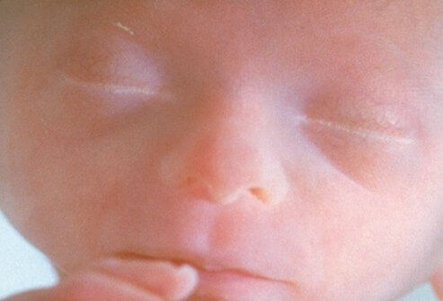
Second Trimester: The Baby at 20 Weeks

Slide 27
At about 20 weeks in the second trimester, your baby continues to develop:
Your baby is more active. You might feel movement or kicking.
Your baby is covered by fine, feathery hair called lanugo and a waxy protective coating called vernix.
Eyebrows, eyelashes, fingernails, and toenails have formed. Your baby can even scratch itself.
Your baby can hear and swallow.
Now halfway through your pregnancy, your baby is about 6 inches long and weighs about 9 ounces.

Slide 28
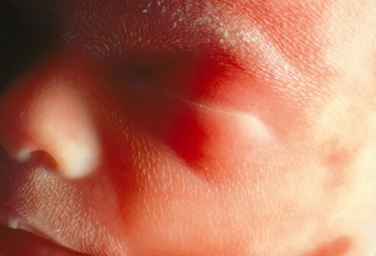
Second Trimester: The Baby at 24 Weeks

Slide 29
By 24 weeks, even more changes occur for your growing baby:
The baby's bone marrow begins to make blood cells.
Taste buds form on your baby's tongue.
Footprints and fingerprints have formed.
Hair begins to grow on your baby's head.
The lungs are formed, but do not yet work.
Your baby has a regular sleep cycle.
If your baby is a boy, his testicles begin to descend into the scrotum. If your baby is a girl, her uterus and ovaries are in place, and a lifetime supply of eggs has formed in the ovaries.
Your baby stores fat and weighs about 1½ pounds(453.592 grams), and is 12 inches long.

Slide 30
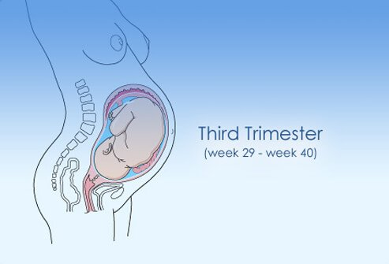
Third Trimester
Third Trimester: Week 29 – Week 40 (birth)

Slide 31
Third Trimester women may Experience Changes
The third trimester is the final stage of pregnancy.
Discomforts that started in the second trimester will likely continue, along with some new ones.
As the baby grows and puts more pressure on your internal organs, you may find you have difficulty breathing and have to urinate more frequently.
This is normal and once you give birth these problems should go away.

Slide 32
Third Trimester: Emotional and Physical Changes a Woman May Experience

Slide 33
In the third and final trimester you will notice more physical changes, including:
Swelling of the ankles, fingers, and face.
Tender breasts, which may leak a watery pre-milk called colostrum
Your belly button may protrude
The baby "dropping," or moving lower in your abdomen
Contractions, which can be a sign of real or false labor
Other symptoms you may notice in the third trimester include shortness of breath, heartburn, and difficulty sleeping

Slide 34
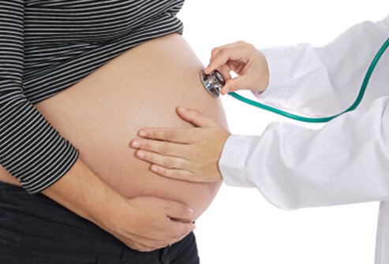
Third Trimester: Changes as the Due Date Approaches

Slide 35
Other changes are happening in your body during the third trimester that you can't see
. As your due date approaches, your cervix becomes thinner and softer in a process called effacement that helps the cervix open during childbirth.
Your doctor will monitor the progress of your pregnancy with regular exams, especially as you near your due date.

Slide 36
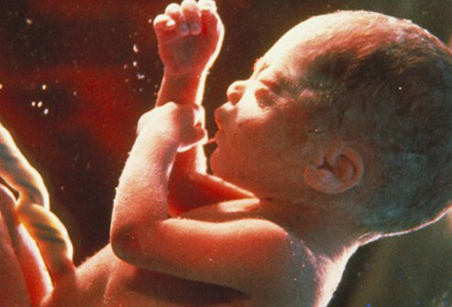
Third Trimester: The Baby at 32 Weeks

Slide 37
At 32 weeks in the third trimester, your baby's development continues:
Your baby's bones are soft but fully formed.
Movements and kicking increase.
The eyes can open and close.
Lungs are not fully formed, but practice "breathing" movements occur.
Your baby's body begins to store vital minerals, such as iron and calcium.
Lanugo (fine hair) begins to fall off.
Your baby is gaining about ½ pound a week, weighs about 4 to 4½ pounds, and is about 15 to 17 inches long.

Slide 38
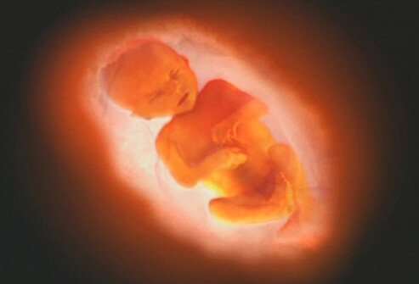
Third Trimester: The Baby at 36 Weeks

Slide 39
At 36 weeks, as your due date approaches, your baby continues development:
The protective waxy coating (vernix) thickens.
Body fat increases.
Your baby is getting bigger and has less space to move around. Movements are less forceful, but you will still feel them.
Your baby is about 16 to 19 inches long and weighs about 6 to 6½ pounds

Slide 40
Finally, from 37 to 40 weeks the last stages of your baby's development occur:
By the end of 37 weeks, your baby is considered full term.
Your baby's organs are capable of functioning on their own.
As you near your due date, your baby may turn into a head-down position for birth.

Slide 41
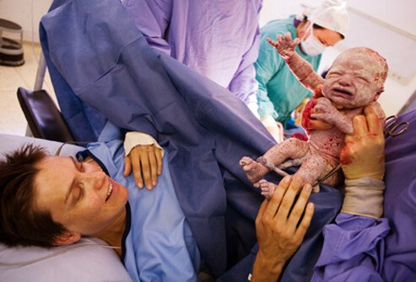
Third Trimester: The Baby at 37 to 40 Weeks

