Slide 1
BUSINESS Environment Presentation by R. PRABAKARAN., MA., MA(Soci.). MBA., M.PHIL., PGDCA., ASSITANT PROFESSOR OF COMMERCE ARC VISVANATHAN COLLEGE

Slide 13
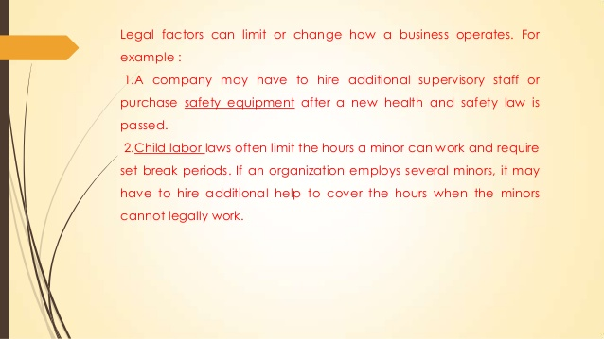

Slide 18
Thank you

