Slide 1
Presentation
by
R. PRABAKARAN., MA., MA(Soci.). MBA., M.PHIL., PGDCA.,
ASSITANT PROFESSOR OF COMMERCE
ARC VISVANATHAN COLLEGE

Slide 5
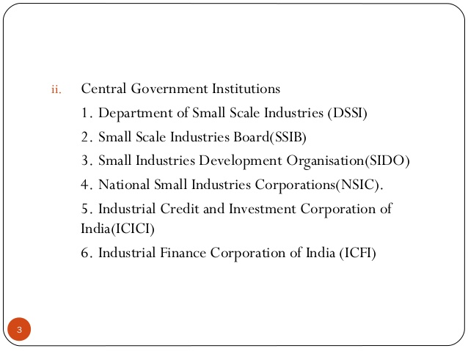

Slide 8
DIC MEANING
The industrial Policy 1977 contained the concept of District Industries Centres (DIC). DIC program was initiated on 1st May 1978 as a centrally sponsored scheme. It was a landmark measure in development of cottage and small industries in smaller towns in India. DIC’s were started with a view to provide integrated administrative framework at the district level for industrial promotion.

Slide 10
OBJECTIVES OF DISTRICT INDUSTRIES CENTERS (DICS)
The following are the main objectives of DICs:
To identify the new entrepreneurs and providing assistance to them regarding their own startup’s.
To provide financial and other facilities to smaller
blocks.
To rise the complete efforts for industrialization at district level.
To enhance the rural industrialization and
also the development of handicrafts.
To reach economic equality in multiple areas of the district.
To allow various government schemes to the new entrepreneurs.
To desize the regional imbalance of development.
To make all the necessary facilities to come under one roof.

Slide 18
ACTIVITIES OF DISTRICT INDUSTRIES CENTRE (DICs)
The DIC’s performs the following activities primarily:
Economic Investigation.
Plant and Machinery
Research, education and training
Raw materials
Credit facilities
Marketing assistance
Cottage industries

Slide 19
TAMIL NADU INDUSTRIAL INVESTMENT CORPORATION (TIIC) LIMITED

Slide 20
TAMIL NADU INDUSTRIAL INVESTMENT CORPORATION (TIIC) LIMITED
The Tamil Nadu Industrial Investment Corporation was set up as a public joint-stock company on March 26, 1949 under the Indian Companies Act, 1949. It
obtained the certificate of commencement of business on April 19, 1949 and the
office began to function from September 1, 1949.
The original name of the Corporation was the “Madras State Financial Corporation”. Later, this was changed to “Madras Industrial Investment Corporation”. In 1970, this was again
changed as Tamil Nadu Industrial Investment Corporation (TIIC).
At present the area of operations of TIIC are limited to the state of Tamil Nadu and the Union Territory of Pondicherry.

Slide 21
Objectives of TIIC
The main objectives of TIIC are
a)To assist the development of existing and new industries in Tamil Nadu and Pondicherry.
b) To provide long-term and medium-term loans to the industrial units for the purpose of creating fixed assets in the shape of land, building, machinery and the like.
c)To provide guarantee for foreign exchange loans.
d)To underwrite the public share capital issue.
e)To provide assistance for the development of small-scale industries and for helping technocrats.
f)To provide financial assistance for rural medical practitioners to set up independent practice.
g)To provide assistance in the form of both Indian rupee and foreign currency under the World Bank line of credit and
h)To provide financial assistance on concessional terms to set up industrial projects in notified backward areas.

Slide 22
Management of TIIC
TIIC is managed by a Board of Directors. The Board
consists of 15 directors as stated below.
i)Six directors are nominated by the Tamil Nadu State Government.
ii) One director is nominated by the Reserve Bank of India.
iii) One director is nominated by the Industrial Development Bank of India.
iv) One director is nominated by the Small Industries Development Bank
of India (SIDBI).
v) Four directors are selected by the financial institutions like Small
Industrial Development Corporation (SIDCO), State Industrial Promotion
Corporation of Tamil Nadu (SIPCOT), Electronics Corporation of Tamil Nadu
(ELCOT) and Tamil Nadu State Industrial Association(TANSTIA).
vi) The Chairman
vii) The Managing Director.

Slide 23
Financial Resources of TIIC
Financial resources of TIIC consist of
i) Share Capital
ii) Reserve Funds
(a)Reserve Fund b)Reserve for Bad and Doubtful Debts and
iii) Borrowings
Sources of borrowings of TIIC include
a)Borrowings from RBI
b)Borrowings from IDBI/SIDBI
c)Borrowings from the Government of Tamil Nadu
d)Issue of bonds and debentures
e)Fixed deposits
f)Loan in lieu of capital
g)Loans from IRBI and
h)Loans from other sources

Slide 24
FUNCTIONS
TIIC as a State Level Financial Institution, offers long and medium term financial assistance to various industries including service sector in the following forms:
Term Loans
Term Loan and Working Capital Term Loans under the Single Window Scheme.
Special types of assistance like Bill Financing Scheme, etc.

Slide 45
