Slide 1
Templates
  A template is a simple and yet very powerful tool in C++
  Templates enable us to define generic classes and exception handling .
  To identify and manage certain “disastrous” error conditions during the execution of a program.
  Note : Generic classes are classes which take a type as a parameter. They are particularly useful for collection of classes.
  We can define templates for both classes and functions.
  A template can be considered as a kind of macro

Slide 2
CLASS TEMPLATES
The class template definition is very similar to an ordinary class definition except the prefix template<class T> and the use of type T. This prefix tells the compiler that we are going to declare a template and use T as a type name in the declaration.
The general format of a class template is :
template <class T>
class classname
{
//…….
// class member specification
//with anonymous type T
//wherever appropriate
//………
};
A class created from a class template is called a template class

Slide 3
FUNCTION TEMPLATES
To create a family of functions with different argument types. The general format of a function template is :
template<class T>
returntype functionname(arguments of type T)
{
//…………….
//Body of function
//with type T
//wherever appropriate
//………………
}

Slide 4
We must use the template parameter T as and when necessary in the function body and in its argument list.
The following example declares a swap() function template that will swap two values of a given type of data.
template<class T>
void swap(T&x, T&y)
{
T temp = x;
x = y;
y = temp;
}

Slide 5
template function
What is template function ?
A function generated from a function template is called a template function.

Slide 6
MEMBER FUNCTION TEMPLATES
Member function of the template classes themselves are parameterized by the type argument(to their template classes) and therefore these functions must be defined by the function templates. It takes the following general form:
Template<class T>
return type class name<T> || function name(arglist)
{
//……………..
//Function body
//……………….
}

Slide 7
TEMPLATE ARGUMENTS
A Template can have multiple arguments. That is, in addition to the type argument T, we can also use other arguments such as strings, function names, constant expressions and built-in type. Consider the following example.
template <class T, int size>
class array
{
T a[size]; //automatic array initialization
//……..
//………
};

Slide 8
EXCEPTION HANDLING
Exception refer to unusual conditions in a program
They could be errors that cause the program to fail or certain conditions that lead to errors.
Exceptions are of two kinds :
1. synchronous exceptions
2. asynchronous exception

Slide 9
Synchronous & asynchronous exception
synchronous exception : Errors such as “out-of-range index” and “over-flow” belong to the synchronous type exception.
asynchronous exception : The errors that are caused by events beyond the control of the program(such as keyboard interrupts) are called asynchronous exception

Slide 10
error handling code
The error handling code basically consists of two segments, one to detect errors and to throw exceptions and the other to catch the exceptions and to take appropriate actions.
The purpose of the exception handling mechanism is to provide means to detect and report an “exceptional circumstance” so that appropriate action can be taken. The mechanism suggests a separate error handling code that performs the following tasks:
Find the problem ( Hit the exception)
Inform that an error has occurred (Throw the exception)
Receive the error information (Catch the exception)
Take corrective actions (Handle the exception).

Slide 11
SYNTAX OF EXCEPTION HANDLING CODE
C++ uses three new keywords namely, throw, try and catch to handle exceptions.
The keyword throw implements this “return” activity.
The keyword try prefaces a block of statements which may generate exceptions.
catch block defined by the keyword catch ‘catches’ the exceptions ‘thrown’ by throw and handles them appropriately

Slide 12
RETHROWING AN EXCEPTION
A handler may decide to rethrow the exception caught without processing it. Such situations, we may simply invoke throw without any arguments as shown below:
throw;
This causes the current exception to be thrown to the next enclosing try/catch sequence and is caught by a catch statement listed after that enclosing try block.

Slide 13
SPECIFYING EXCEPTIONS
It is possible to restrict a function to throw only certain specified exceptions. This is achieved by adding a throw list cause to the function definition. The general form of using exception specification is :
type function(arg-list) throw (type-list)
{
………….
………….. Function body
………….
}
The type-list specifies the type of exceptions that may be thrown. If we wish to prevent a function from throwing any exception, we may do so by making the type-list empty. That is, we must use
throw(); // Empty list
in the function header line.

Slide 14
Standard Template Library
A collection of generic classes and functions is called the Standard Template Library (STL)
Set of C++ template classes, to provide common programming data structures and functions . such as lists, stacks, arrays etc.,
Software library for the C++ programming language.
STL can save considerable time and effort.
STL components are defined in the namespace std.
using namespace std;
to inform the compiler that we intend to use the standard C++ library

Slide 15
STL Components
Containers :
Algorithms
iterators

Slide 16
Containers
It is an object that actually stores data.
They are implemented by template classes.

Slide 17
Algorithms
It is a procedure
Used to process the container’s data
STL includes many different kinds of Algorithms to provide support to tasks such as
initializing
searching
copying
sorting
merging
Algorithms are implemented by template functions.

Slide 18
iterator
It is an object (like a pointer) that points to an element in a container.
To move through the contents of containers.
iterators connect algorithms with containers and play a key role in the container’s data manipulation

Slide 19
Containers supported by the STL
vector - A dynamic array
list - A bidirectional linear list
deque - A double ended queue
set - An associate container for storing unique sets
multiset – An associate container for storing non-unique sets
map - An associate container for storing unique key value pairs (one-to-one mapping)
mutimap – (one-to-many mapping) – one key may be associated with more than one value.
Stack - A standard stack (LIFO)
Queue - A standard queue (FIFO)
Priority-queue – The first element out is always the highest priority element.

Slide 20
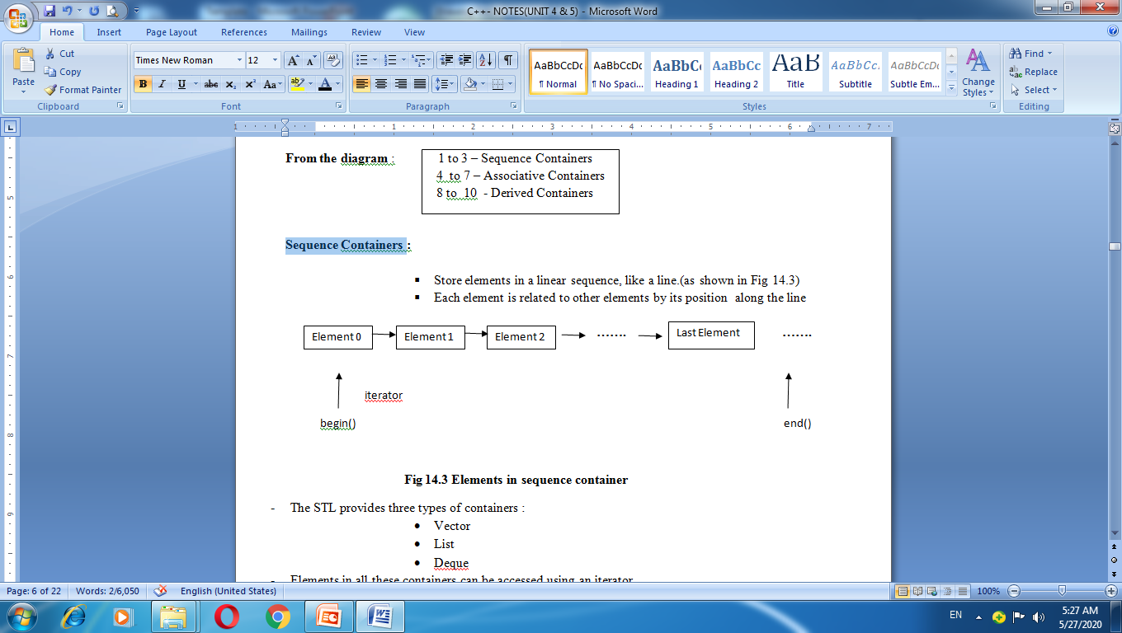
Sequence Containers

Slide 21
Three types of containers
The STL provides three types of containers :
Vector
List
Deque
Elements in all these containers can be accessed using an iterator.
The difference between the three of them is related to only their performance.

Slide 22
Vector, List & Deque
Vector :
Random Access – Fast
insertion or deletion in the middle – Slow
insertion or deletion in the ends - Fast at back
list :
Random Access – Slow
insertion or deletion in the middle – Fast
insertion or deletion at the ends - Fast at front
deque :
Random Access – Fast
insertion or deletion in the middle – Slow
insertion or deletion at the ends – Fast at both the ends

Slide 23
Associative Containers
Designed to support direct access to elements using keys.
They are not sequential.
Four types of associative containers :
1. Set 2. Multiset 3. Map 4. Multimap

Slide 24
Set & Multiset
Containers set and multiset can store a number of items and provide operations for manipulating them using the values as the keys.
The main difference between a set and a multiset is that a multiset allows duplicate items while a set doest not.

Slide 25
map & multimap
Containers map and multimap are used to store pairs of items.
The values are sometimes called mapped values.
The main difference between a map and a multimap is that a map allows only one key for a given value to be stored while multimap permits multiple keys.

Slide 26
Derived Containers
The STL provides three derived containers namely stack, queue and priority-queue
These are also known as container adaptors.
Stacks, queues and priority queues can be created from different sequence containers.
The derived containers do not support iterators and therefore we cannot use them for data manipulation.
However, they support two member functions pop() and push() for implementing deleting and inserting operations.

Slide 27
Algorithms
Algorithms are functions that can be used generally across a variety of containers for processing their contents.
By using these algorithm, programmers can save a lot of time and effort.
To have access to the STL algorithms, we must include <algorithm> in our program.
STL algorithms, based on the nature of operations they perform, may be categorized as under :
  Retrieve or nonmutating algorithms
  Mutating algorithms
  Sorting algorithms
  Set algorithms
  Relational algorithms

Slide 28
Nonmutating algorithms
adjacent_find() Finds adjacent pair of objects that are equal
count() Counts occurrence of a value in a sequence
count_if() Counts number of elements that matches a predicate
equal() True if two ranges are the same
find() Finds first occurrence of a value in a sequence

Slide 29
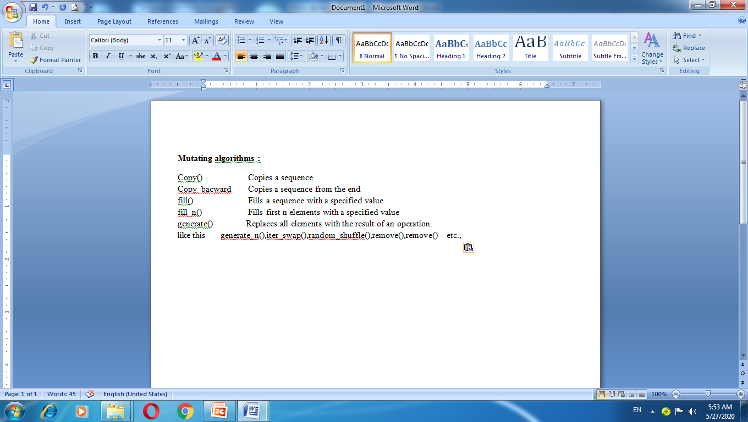
Mutating algorithms

Slide 30
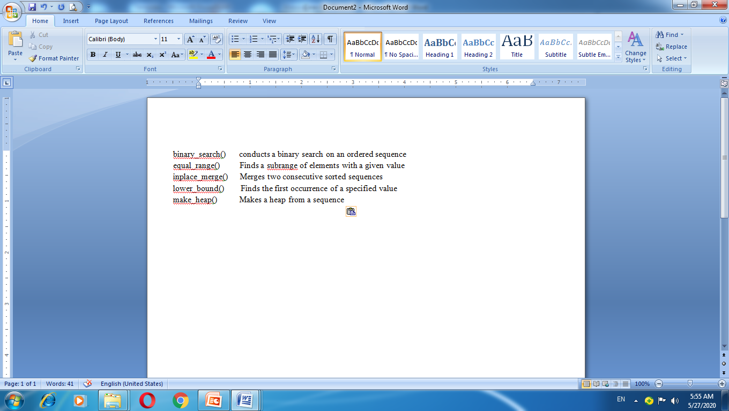
Sorting algorithms

Slide 31
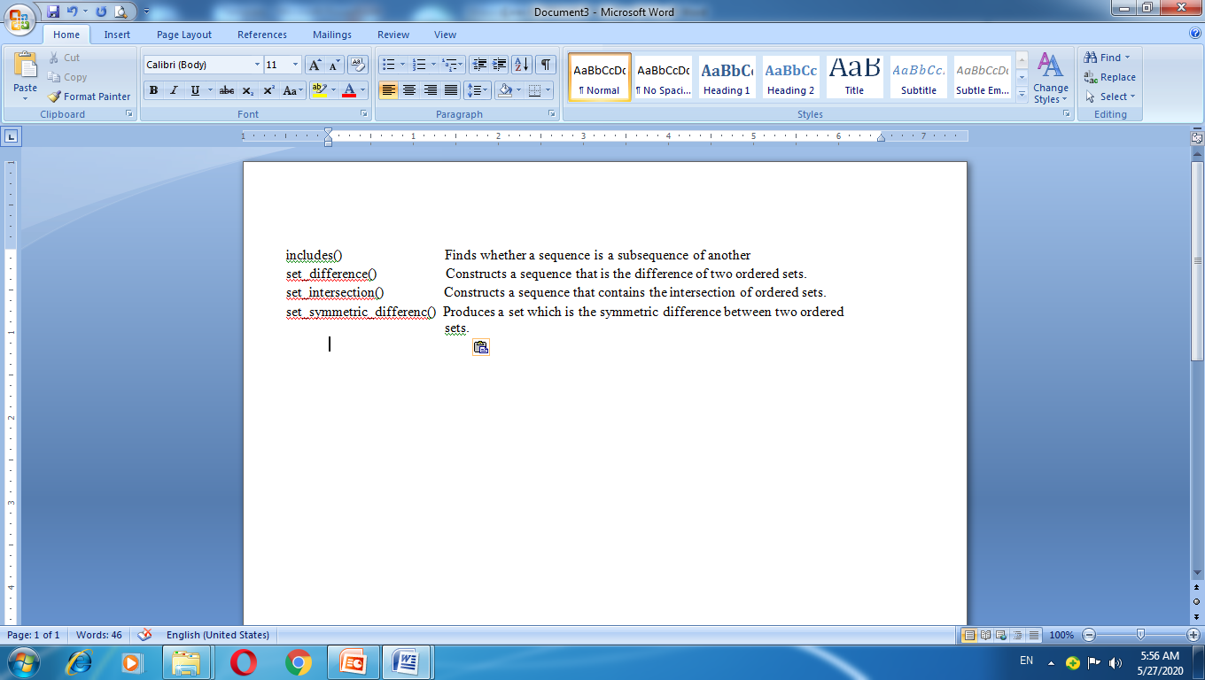
Set algorithms

Slide 32
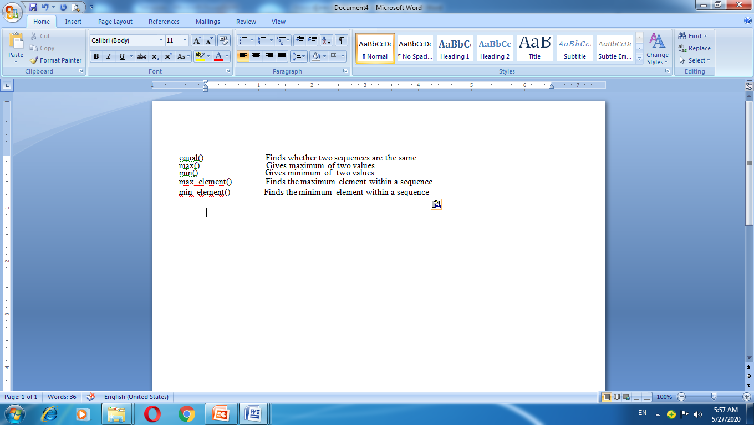
Relational algorithms

Slide 33
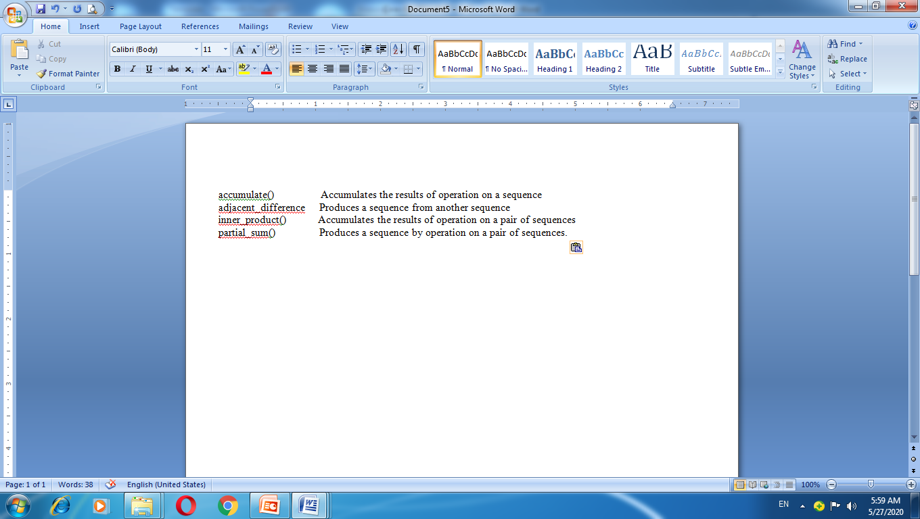
Numeric algorithms

Slide 34
ITERATORS
Behave like pointers and are used to access container elements
They are often used to traverse from one elements to another, a process known as iterating through the container.

Slide 35
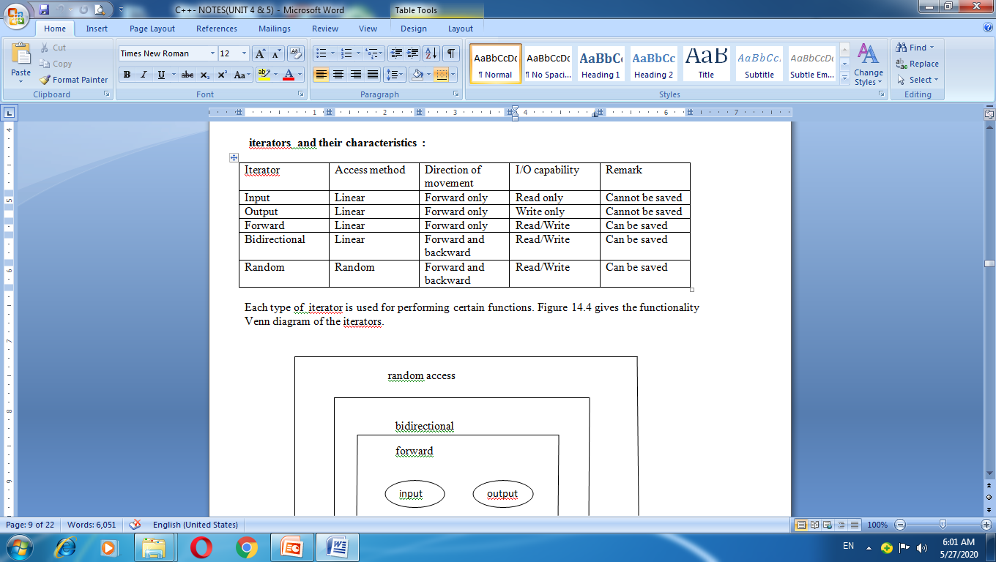

Slide 36
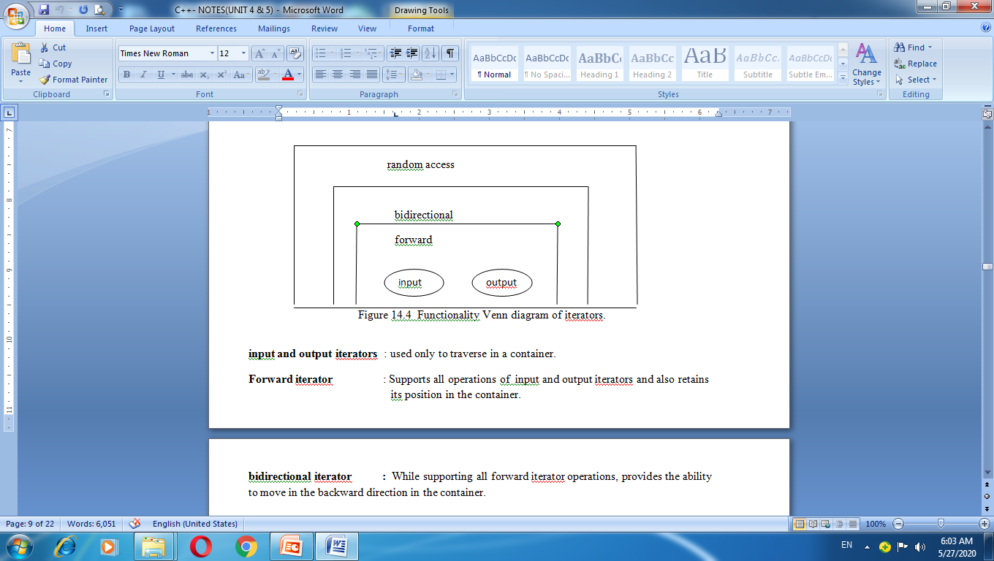

Slide 37
bidirectional iterator : While supporting all forward iterator operations, provides the ability to move in the backward direction in the container.
Random Access : Combines the functionality of bidirectional iterator with an ability to jump to an arbitrary location

Slide 38
APPLICATION OF CONTAINER CLASSES
Three most popular containers namel,
Vector 2. List 3. Map
Vectors :
Most widely used container
It stores elements in contiguous memory locations and
Enables direct access to any element using the subscript operator[]
A vector can change its size dynamically and therefore allocates memory as needed at run time.

Slide 39
Important member functions of the vector class
Function : at()
Task : gives a reference to an element
Function : back()
Task : Gives a reference to the last element
Function : begin()
Task : gives a reference to the first element
Function : capacity()
Task : gives the current capacity of the vector
Function : clear()
Task : Deletes all the elements from the vector

Slide 40
Lists
Another container that is popularly used.
It supports a bidirectional linear list and provides an efficient implementation for deletion and insertion operations.
Unlike a vector, which supports random access.
A list can be accessed sequentially only.
Bidirectional iterators are used for accessing list elements.

Slide 41
Important Member functions of the list class
back() Gives reference to the last element
begin() Gives reference to the first element
clear() Deletes all the elements
empty() Decides if the list is empty or not
end() Gives reference to the end of the list

Slide 42
Maps
A map is sequence of (key, value) pairs where a single value is associated with each unique key
Important member functions of the map class are
begin() Gives references to the first element
clear() Deletes all elements from the map
empty() Decides whether the map is empty or not
end() Gives a reference to the end of the map
erase() Deletes the specified elements.

Slide 43
FUNCTION OBJECTS
It is a function that has been wrapped in a class so that it looks an object. Function objects are often used as arguments to certain containers and algorithms. For example the statement
sort(array, array+5,greater<int>());
uses the function object greater <int> to sort the element contained in array in descending order.
For using function objects we must include <functional> header file.

