Slide 1
Literary Criticism by
M.R.Vijaya bhaarathy
Assistant Professor
Swami Vivekanandha arts & science college vallam , thanjavur.

Slide 2
  Literary criticism is the study evaluation and interpretation of literature.
  Literary criticism is essentially an opinion supported by evidence, relating to theme style, setting or historical or political context.
  The term criticism derives from the Greek term kritikos which was used in the 4th century B.C .it means “ a judge of literature”.

Slide 3
The discipline of interpreting , analyzing, and evaluating literature…… long standing texts with timeless values, values, universal themes & exceptional artistry and power
Interpret:-What does this work of literature mean?
Analyze:- how does this piece of literature WORK?
Evaluate:- what is this works VALUE?

Slide 4
Types of literary criticism
There are many different types of literary criticism, but we’ll be studying these 5 closely.
Formalist
Feminist
Reader response
Archetypal
Marxist

Slide 5
Feminist :
Women’s roles, and how women are portrayed in literature.
Formalist :
Each writing is independent of others no history is used to determine
meaning ; there are no outside connections to other texts.

Slide 6
Historical :-
looks at the time period the literature was written in.
Psychological:-
built on Freud’s theories of unconscious, desires and defenses.
Sociological:-
literature in the cultural, economic and political context in which it is written

Slide 7
literary theory :-
Literary theory is the ideas and methods we use to interpret and analyze literature from a variety of perspectives.
Literary theory is simply the the term used for ‘A Particular way of reading viewing texts” or “ looking at a text from a particular point –of –view (or) reading a text from different perspective

Slide 8
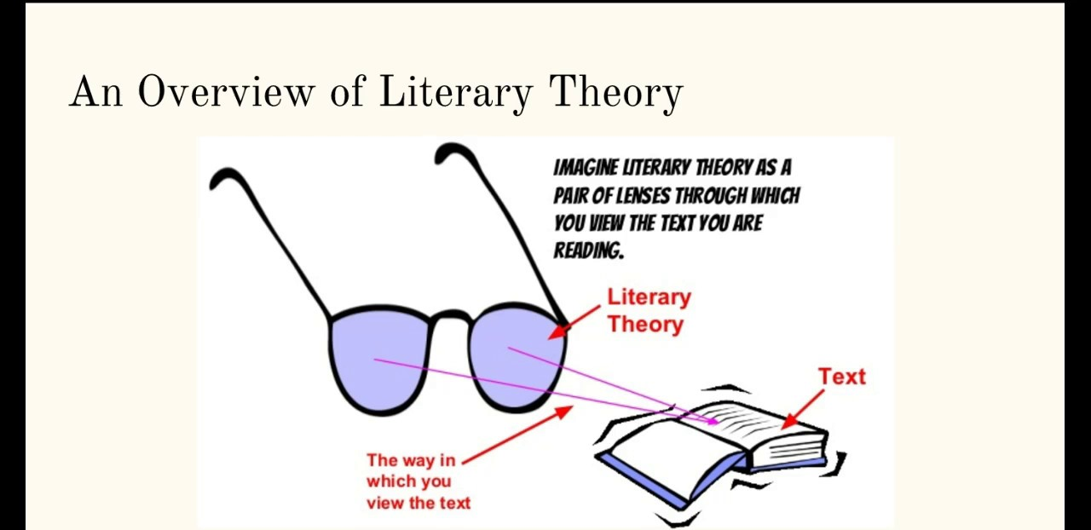

Slide 9
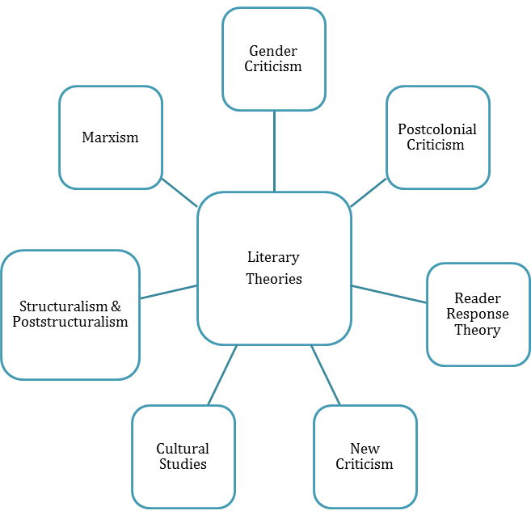

Slide 10
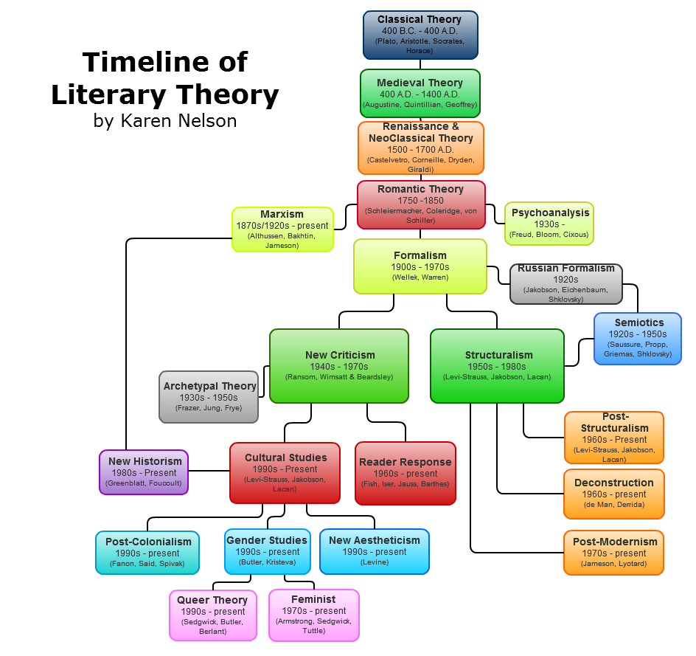

Slide 11
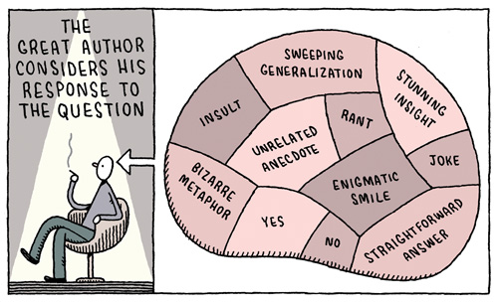

Slide 12
We use literary theory in:-
  Literary theory formulates the relationship between author and work. It does not explain meaning of a literary work but ideas and theories which could result in that literary work. It studies not only the individual and circumstances and overall the culture in which it is written.

Slide 13
Difference between literary theory and literary criticism:
Literary theory can be defined simply as the various methods we use to analyze and understand literature. ... Literary criticism, on the other hand, is the practical application of those theories or methods to particular works of literature--the actual use of a method to better understand a text's meaning.

Slide 14
Father of literary criticism Dryden
Dryden was considered to be the "father of English criticism" by Samuel Johnson precisely because he contributed so much to the ouevre of literary criticism in the canon of English literature.
father of New Criticism I.A. Richards's
1929: I.A. Richards's Practical Criticism: A Study of Literary Judgment. Richards has been called the father of New Criticism. He was one of the first to study literary interpretation as a kind of science.

Slide 15
QUOTES
Our reaction to advertising is really a form of literary criticism
The point of literary criticism in anthropology is not to replace research, but to find out how it is that we are persuasive.
Literary criticism is generally bunk. Nonsense. Usually based on self-serving post-intellectual bullshit.

Slide 16
Strict rules of evidence would destroy psychoanalysis and literary criticism.
I still found literary to be a suspect activity
All good criticism should be judged the way art is. You shouldn’t read it the way you read history or science.
Literary criticism now is all pranks and polemics.
Every literary critic believes he will outwit history and have the last word.

Slide 17
Importance of literary criticism
Appreciation towards a certain literary piece.
Understanding reality from fiction.
Stimulate emotional responses.
Evaluation literary works involves two kinds of judgement:
1.Assessment of quality and value.
2.Assessment of cultural, social and moral values they display.

Slide 18
Literary criticism has probably existed for as long as literature
Later classical and medieval criticism often focused on religious texts, and the several long religious traditions
The reader can focus on an aspect as his interest toward the literary work.

Slide 19
Examples of literary criticism
F. Scott Fitzgerald’s The Great Gatsby
William Golding’s Lord of the Flies
Charlotte Perkins Gilman’s “The Yellow Wallpaper”
Nathaniel Hawthorne’s “Young Goodman Brown”
Victor Fleming’s The Wizard of Oz

Slide 20
Thank you

