Slide 1

IDHAYA COLLEGE FOR WOMEN
KUMBAKONAM
Semester : II
Subject : Marketing Management
Subject code : 16CCBB3
Class : I BBA
Unit : V
Faculty Name : Mrs. Radhika R M.Com,B.Ed.,MBA.,M.Phil, (PhD).
Assistant Professor,
Department of Management,
Idhaya College for Women,
Kumbakonam.

Slide 2
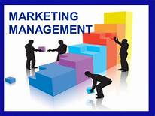

Slide 3
PROMOTION MIX
Meaning
Definition
Promotion mix
Personal selling process
Advertising-objectives, types
Sales promotion, objectives methods
Publicity and public relations

Slide 4
Meaning and Definition
The Promotion Mix refers to the blend of several promotional tools used by the business to create, maintain and increase the demand for goods and services.
The Promotion Mix is the integration of Advertising, Personal Selling, sales Promotion, Public Relations and Direct Marketing.

Slide 5
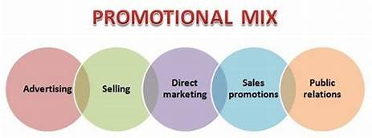

Slide 6
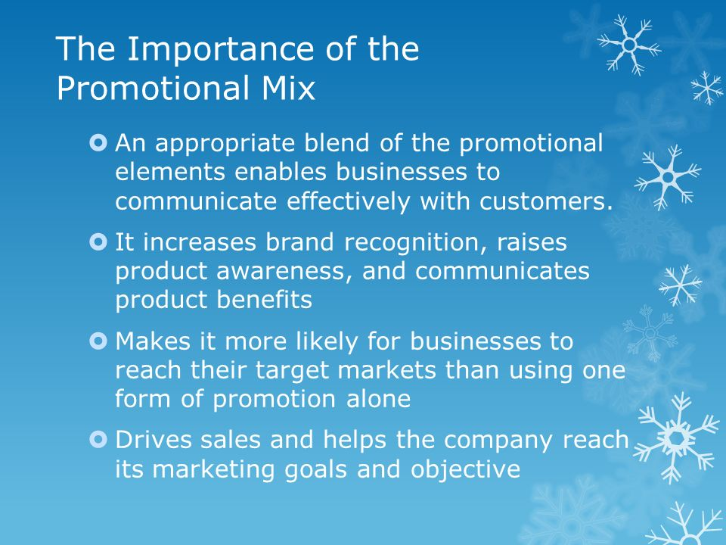

Slide 7
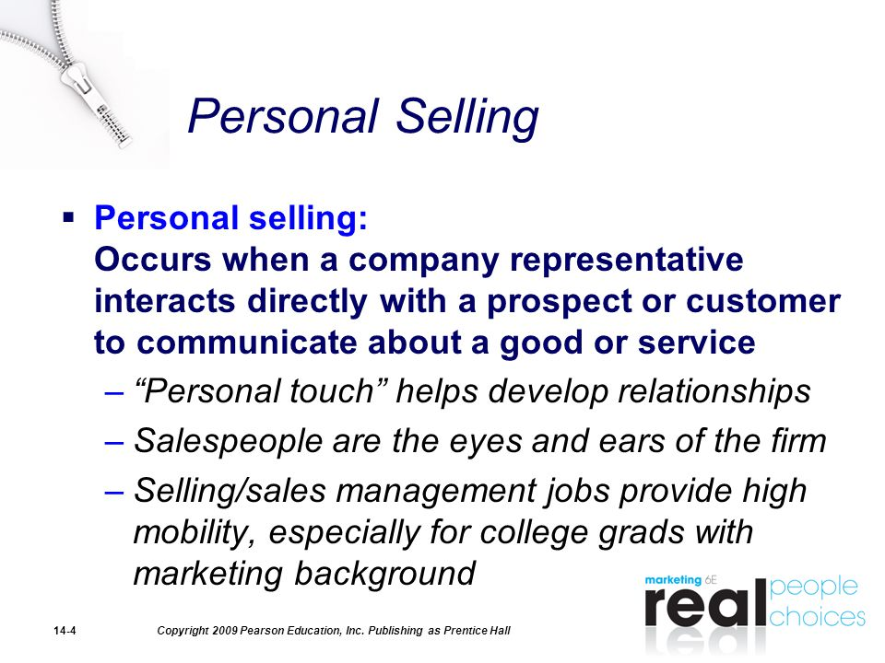

Slide 8
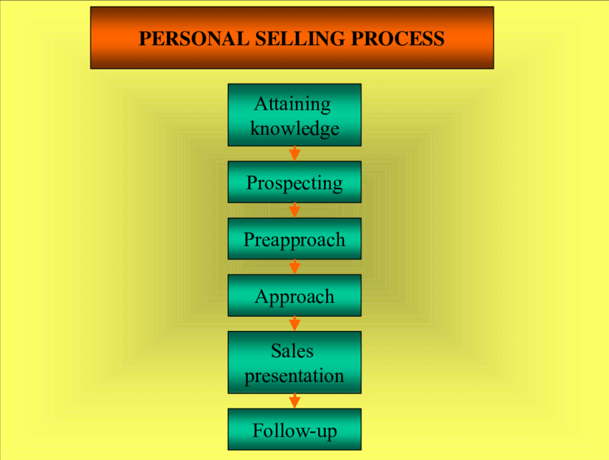
PERSONAL SELLING PROCESS

Slide 9
ADVERTISING
Meaning of Advertising :
Advertising is defined as a form of marketing communication used by companies to promote or sell products and services. In essence, advertising is one of the components or subsets of marketing. The primary goal of advertising is to influence the buying behavior by promoting a product, service or company.

Slide 10
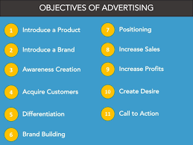
Objectives of advertising

Slide 11
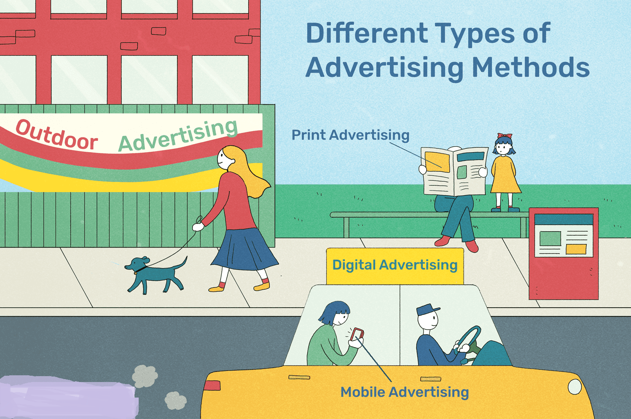

Slide 12
Sales promotion
Meaning:
Sales promotion is the process of persuading a potential customer to buy the product. Sales promotion is designed to be used as a short-term tactic to boost sales – it is rarely suitable as a method of building long-term customer loyalty. Some sales promotions are aimed at consumers.
Definition
Sales promotion is a set of marketing technologies aimed to stimulate the demand in particular products and increase brand awareness.

Slide 13
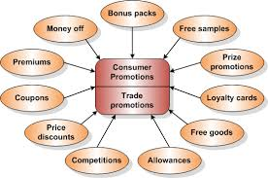
Methods of Sales Promotion

Slide 14
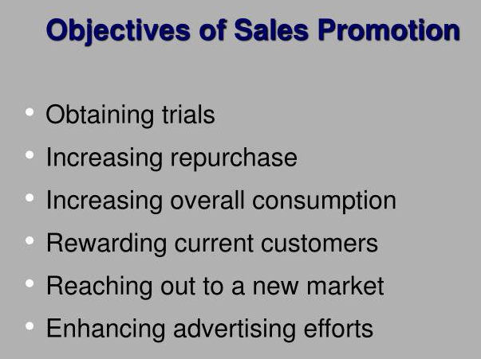

Slide 15
Publicity and Public Relation
Publicity refers to a public relation function, that uses any communication channel to convey news or information about someone or something, through media. Public Relations is a marketing tool, that is used to maintain goodwill and reputation of the company and its product among people.

Slide 16
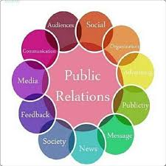
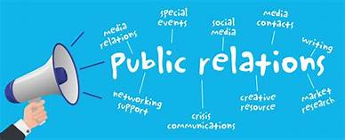
Public Relation
A public relations (PR) strategy may play a key role in an organization's promotional strategy. Similar to the foundational goals of marketing, effective public relations seeks to communicate information to, Launch new products and services. Reposition a product or service.

Slide 17
THANK YOU

