Slide 1
IDHAYA COLLEGE FOR WOMEN, KUMBAKONAM IDHAYA COLLEGE FOR WOMEN, KUMBAKONAM Semester : IV Class : II BBA Subject : Organisational Behaviour Subject Code : 16CCBB7 Topic : 1. Motivation 2. Objectives, Types & Theories of Motivation 3. Stress Management – Sources, Effects & Managing stress Faculty Name : Mrs.G.Sobana,MBA.,MPhil., Assistant Professor, Department of Management, Idhaya College for Women, Kumbakonam.

Slide 2
Motivation
Performance = f(ability X motivation)

Slide 3
Concept & Definitions
Motivation is derived from the word ‘Motive’.
“A motive is an inner state that energizes, activates or moves and directs or channels behaviour towards goals.”
According to the Encyclopedia of Management, “motivation refers to the degree of readiness of an organization to pursue some designated goal and implies the determination of the nature and locus of the forces, including the degree of readiness”.

Slide 4
Objective of Motivation
To exploit the unused potential in people, they are to be motivated.
Needless to say that such exploitation results in greater efficiency, higher production and better standard of living of the people.

Slide 5
Types of Motivation
Positive approach or pull-mechanism or carat
Negative approach or push-mechanism or stick

Slide 6
Positive Approach
People are said to be motivated positively when they are shown a reward and the way to achieve it. Such a reward may be financial or non-financial.
Monetary motivation may include different incentives, wage plans, productive bonus schemes etc.
Non-monetary motivation may include praise for the work, participation in management, social recognition etc.

Slide 7
Negative Approach
By installing fear in the minds of people, one can get the desired work done.
In this method of motivation, fear of consequences of doing something or not doing something keeps the worker in the desired direction.

Slide 8
Theories of Motivation
HOW TO MOTIVATE THE EMPLOYEES?
WHAT ARE THE WAYS TO MOTIVATE THEM?

Slide 9
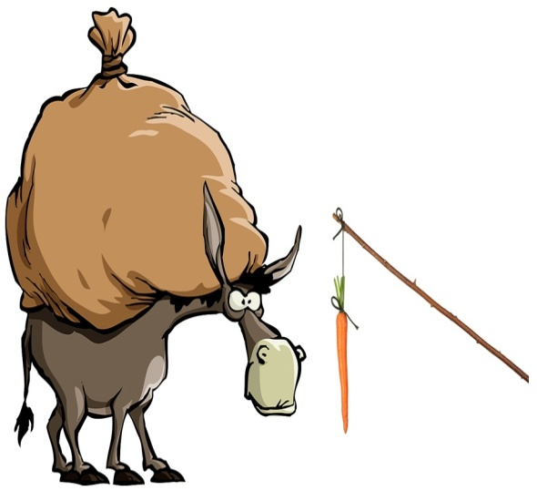
Theories of Motivation
Maslow’s Hierarchy of Needs.
Herzberg’s Two – factor Theory.
Vroom’s Expectancy Theory.
Mc Gregor’s X & Y Theory

Slide 10
Maslow’s Theory of Hierarchy of Needs
Social / Acceptance

Slide 11
Herzberg’s Two – Factor Theory
Maslow’s theory has been modified by Herzberg and he called it two – factor theory of motivation.
According to Herzberg’s,
Dissatisfiers or Maintenance Factors
Satisfiers or Motivational Factors

Slide 12
Herzberg’s Classification of Maintenance & Motivational Factors
Maintenance Factors or Dissatisfiers | Motivational Factors or Satisfiers
Job Context | Job Context
Extrinsic Factor | Intrinsic Factors
Company Policy & Administration | Achievement
Quality of Supervision | Recognition
Relations with Supervisors | Advancement
Peer Relations | Work Itself
Relations with Subordinates | Possibility of Growth
Pay | Responsibility
Job Security
Work Conditions
Status

Slide 13
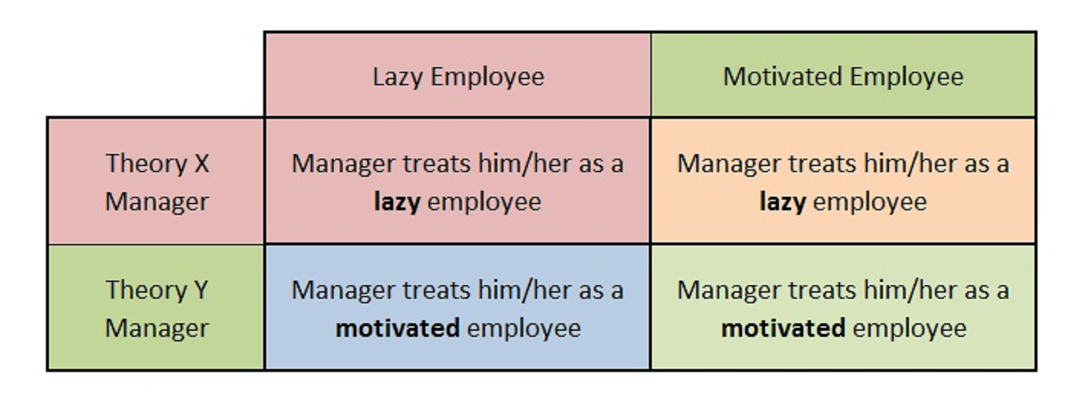
Mc Gregor X & Y Theory
McGregor also believed that self-actualization was the highest level of reward for employees. He theorized that the motivation employees use to reach self-actualization allows them to reach their full potential.

Slide 16
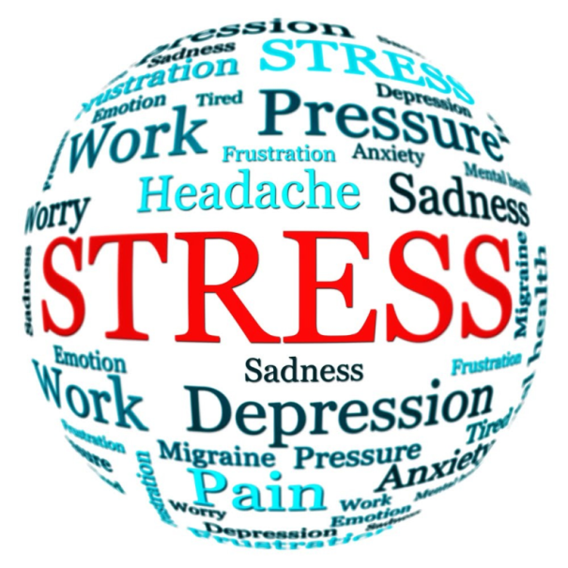
STRESS MANAGEMENT
Stress management is a wide spectrum of techniques and psychotherapies aimed at controlling a person's level of stress, especially chronic stress, usually for the purpose of and for the motive of improving everyday functioning.

Slide 17
SOURCES OF STRESS
Money.
Work.
Family responsibilities.
Health Concerns.

Slide 18
MONEY
The three most significant sources of money related stress were: paying unexpected expenses, paying for essentials, and saving for retirement.
WORK
It might seem obvious that different generations would have different stresses due to their stations in life, but viewing stress through the prism of generations allows for a clearer picture of the future of stress and stress management.

Slide 19
FAMILY : Presenteeism is defined as an employee being physically present at work, but not being fully engaged due to outside stresses. Presenteeism can be difficult to notice, but it can wreak havoc on productivity, and even an organization’s bottom line.
HEALTH CONCERN : Each person’s stress and how it affects them is unique to them, and the ways of dealing with mounting stress vary greatly. The top three symptoms of stress reported were: irritable/angry, nervous/anxious, and lack of interest/motivation. All three symptoms can lead to negative consequences at home, on the job, or in one’s social life.

Slide 20
EFFECTS OF STRESS
Common effects of stress
On your body | On your mood | On your behavior
Headache | Anxiety | Overeating or undereating
Muscle tension or pain | Restlessness | Angry outbursts
Chest pain | Lack of motivation or focus | Drug or alcohol misuse
Fatigue | Feeling overwhelmed | Tobacco use
Change in sex drive | Irritability or anger | Social withdrawal
Stomach upset | Sadness or depression | Exercising less often

Slide 21
MANAGING STRESS

Slide 22
MANAGING STRESS
1. Eat healthily
Eating healthily can reduce the risks of diet-related diseases
There is a growing amount of evidence showing how food affects our mood40 and how eating healthily can improve this
You can protect your feelings of wellbeing by ensuring that your diet provides adequate amounts of brain nutrients such as essential vitamins and minerals, as well as water

Slide 23
2. Be aware of smoking and drinking alcohol
Try not to, or reduce the amount you smoke and drink alcohol
Even though they may seem to reduce tension initially, this is misleading as they often make problems worse
3. Exercise
Try and integrate physical exercise into your lifestyle as it can be very effective in relieving stress
Even just going out and getting some fresh air, and taking some light physical exercise, like going for a walk to the shops can really help

Slide 24
4.Take time out
Take time to relax
Strike the balance between responsibility to others and responsibility to yourself, this can really reduce stress levels
Tell yourself that it is okay to prioritise self-care · Are you needing time out but saying 'I just can't take the time off', if so read more about how taking a break is important for good mental health

Slide 25
5. Be mindful
Mindfulness is a mind-body approach to life that helps us to relate differently to experiences. It involves paying attention to our thoughts and feelings in a way that increases our ability to manage difficult situations and make wise choices
Try to practice mindfulness regularly
Mindfulness meditation can be practiced anywhere at any time
Research has suggested that it can reduce the effects of stress, anxiety and related problems such as insomnia, poor concentration and low moods, in some people

Slide 26
THANK YOU

