Slide 1

IDHAYA COLLEGE FOR WOMEN, KUMBAKONAM
DEPARTMENT OF MANAGEMENT
CLASS : III BBA
SUBJECT NAME : MANAGEMENT CONCEPTS IN THIRUKKURAL
SUBJECT CODE : 16MBEBB2
SEMESTER : VI
UNIT & TOPIC : V & PERSONNEL SELECTION , WELFARE, STAFFING
FACULTY NAME : Mrs. R. DEVA PERSHIYA

Slide 2
PERSONNEL SELECTION
Personnel refers to the people employed by an organization, business, or service.
Personnel selection is the process used for hiring individuals from the pool of job applicants having the required qualifications, knowledge, skills and competence to fill the vacant positions in the organization.

Slide 3
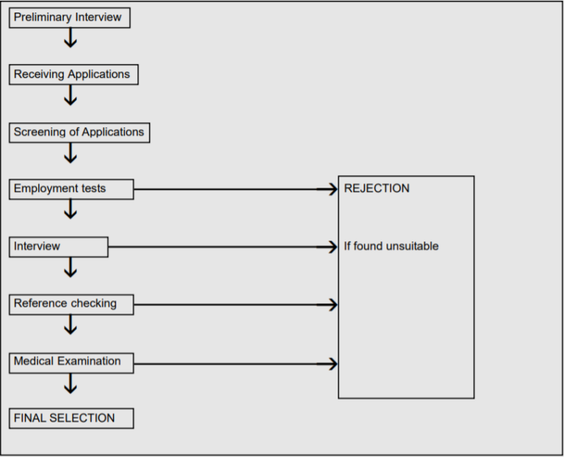
Steps In Personnel Selection

Slide 4
Importance of the Selection Process
Proper selection and placement of employees lead to growth and development of the company. The company can similarly, only be as good as the capabilities of its employees.
The hiring of talented and skilled employees results in the swift achievement of company goals.
Industrial accidents will drastically reduce in numbers when the right technical staff is employed for the right jobs.

Slide 5
Contd..
When people get jobs they are good at, it creates a sense of satisfaction with them and thus their work efficiency and quality improves.
People who are satisfied with their jobs often tend to have high morale and motivation to perform better.

Slide 6
PERSONNEL SELECTION IN VERSE 515
Selection and Employment
No specious fav'rite should the king's commission bear,
But he that knows, and work performs with patient care.
Meaning
(A king's) work can only be accomplished by a man of wisdom and patient endurance; it should not be given to one from mere personal attachment.

Slide 7
PERSONNEL WELFARE
Personnel Welfare means anything done for the comfort and improvement, intellectual or social, of the employees over and above the wages paid which is not a necessity of the industry.
Methods for Personnel Welfare
They may be categorized into three classes, namely:
Economic
Recreational
Facilitative

Slide 8
Economic
(a) Insurance (including group insurance).
(b) Retirement and pension plans.
(c) Health and accident services.
(d) Paid holidays.
(e) Profit sharing.

Slide 9
Contd..
2. Recreational
(a) Sports
(b) Special interest groups such as dramatics, athletic programmes, flying and particular hobbies.
3. Facilitative:
(a) Housing.
(b) Transport.
(c) Educational facilities and library services.
(sick leave, etc.).

Slide 10
Contd..
d) Medical services (including first-aid, hospitalization,
(e) Canteens, cafeterias and lunch wagons (Eating facilities).
(f) Company (cheap) stores.
(g) Discounts on purchases of company products.
(h) Rest-rooms and locker-rooms.
(i) Legal and financial counselling.

Slide 11
Advantages of Personnel Welfare
(1) Improved Industrial Relations
(2) Increase in the General Efficiency and Income
(3) High Morale
(4) Creation of Permanent Labour Force
(5) Improvement in the Mental and Moral Health
(6) Change in the Outlook of Employers and
(7) Social Benefits.

Slide 12
PERSONNEL WELFARE IN VERSE 520
Chapter 52 - Selection and Employment
Let king search out his servants' deeds each day;
When these do right, the world goes rightly on its way.
Meaning
A king should daily examine the conduct of his servants; if they act in right way, then the whole world will act in right way.

Slide 13
STAFFING
Staffing is an operation of recruiting the employees by evaluating their skills, knowledge and then offering them specific job roles accordingly.
Staffing includes the following function:
Identifying the requirement of workforce and its planning.
2. Recruitment and selection of appropriate personnel for new jobs or for positions which may arise as a result of existing employees leaving the organisation.
3. Planning adequate training for development and growth of workforce.
4. Deciding on compensation, promotion and performance appraisals for the workforce.

Slide 14
Importance of Staffing
Helps for the efficient performance of other functions like planning, organizing and control functions.
To get the optimum output
To determine in advance the manpower requirements
To describe the significance and importance which it attaches to the personnel working in the enterprise.

Slide 15
Staffing in verse 517
Chapter 52 - Selection and Employment
'This man, this work shall thus work out,' let thoughtful king command;
Then leave the matter wholly in his servant's hand.
Meaning
After having considered, “A man can accomplish this, by these means", a king will leave the discharge of his duty completely to that man. This is how thoughtful king assign the task to the servant knowing him completely. This is how a person should be selected for employment.

Slide 16
Characteristics of Staffing
Staffing has the following characteristics
1. People-Centered
Staffing can broadly view as people-centered function and therefore it is relevant for all types of organization. It is concerned with categories of personnel from top to bottom of the organization.

Slide 17
Contd..
2. Human Skills
Staffing function is mainly concerned with different types of training and development of human resource and therefore the managers should use human relation skill in providing guidance and training to the subordinates. If the staffing function is performed properly, then the human relations in the organization will be cordial and mutually performed in an organized manner.

Slide 18
Contd..
3. Continuous Function
Staffing function is to be performed continuously which is equally important for a new and well-established organization. Since in a newly established organization, there has to be recruitment, selection, and training of personnel. As we compare that, the organization which is already a running organization, then at that place every manager is engaged in various staffing activities.

Slide 19
Contd..
4. Responsibility of Manager
Staffing is the basic function of management which involves that the manager is continuously engaged in performing the staffing function. They are actively associated with the recruitment, selection, training, and appraisal of his subordinates. Therefore the activities are performed by the chief executive, departmental managers and foremen in relation to their subordinates.

Slide 20
THE END

