Slide 1

IDHAYA COLLEGE FOR WOMEN KUMBAKONAM
COMPUTER NETWORKS
BCA - VI Semester
SUB.CODE – 16SCCCA8
PART 2 – UNIT III - V

Slide 2
UNIT – III
Network Layer
It is responsible for the source to destination delivery of a packet across multiple networks.
If two systems are attached to different networks with devices like routers, then N/W layer is used.

Slide 3
Packet Switching
A packet contains three major fields:
  The header, the message, and redundancy check bits
  Most popular technique uses cyclic redundancy checks (CRCs)
  CRC is nothing more than a set of parity bits that cover overlapping fields of message bits
It has Datagram and Virtual Circuit Packet Switching

Slide 4
Datagram Packet Switching
Each packet is routed independently through network
It is also called connectionless packet-switching
Routers in the internet are packet switches that operate in datagram mode
Virtual Circuit Packet Switching
Virtual Circuit packet switching involves the establishment of a fixed path, often called a virtual circuit or a connection

Slide 5
Internet Protocol Version 4 (IPv4)
Internet Protocol version 4 uses 32-bit logical address.
Internet Protocol being a layer-3 protocol (OSI) takes data Segments from layer-4 (Transport) and divides it into packets.
IP packet encapsulates data unit received from above layer and add to its own header information.

Slide 6
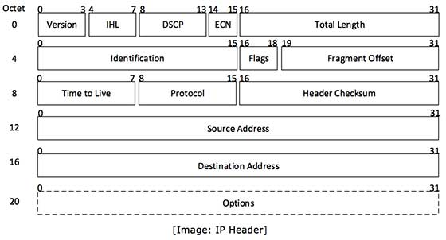
Internet Protocol Version 4 (IPv4) (Cont…)

Slide 7
Internet Protocol Version 4 (IPv4) (Cont…)
IP header includes many relevant information including Version Number, which, in this context, is 4. Other details are as follows −
Version − Version no. of Internet Protocol used (e.g. IPv4).
IHL − Internet Header Length; Length of entire IP header.
DSCP − Differentiated Services Code Point; this is Type of Service.
ECN − Explicit Congestion Notification; It carries information about the congestion seen in the route.
Total Length − Length of entire IP Packet (including IP header and IP Payload).

Slide 8
Internet Protocol Version 4 (IPv4) (Cont…)
Fragment Offset − This offset tells the exact position of the fragment in the original IP Packet.
Time to Live − To avoid looping in the network, every packet is sent with some TTL value set, which tells the network how many routers (hops) this packet can cross. At each hop, its value is decremented by one and when the value reaches zero, the packet is discarded.
Protocol − Tells the Network layer at the destination host, to which Protocol this packet belongs to, i.e. the next level Protocol. For example protocol number of ICMP is 1, TCP is 6 and UDP is 17.

Slide 9
Internet Protocol Version 4 (IPv4) (Cont…)
IPv4 supports three different types of addressing modes.
Unicast Addressing Mode
  In this mode, data is sent only to one destined host.
Broadcast Addressing Mode
  In this mode, the packet is addressed to all the hosts in a network segment.
Multicast Addressing Mode
  This mode is a mix of the previous two modes, i.e. the packet sent is neither destined to a single host nor all the hosts on the segment.

Slide 10
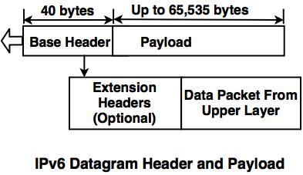
Internet Protocol Version 4 (IPv6)
The IPv6 packet is shown in the diagram. Each packet is composed of base header and the payload. The payload consists of two fields, optional extension headers and the data from upper layer.

Slide 11
Routing Algorithms
In order to transfer the packets from source to the destination, the network layer must determine the best route through which packets can be transmitted.
The routing protocol is a routing algorithm that provides the best path from the source to the destination. The best path is the path that has the "least-cost path" from source to the destination.
Routing is the process of forwarding the packets from source to the destination but the best route to send the packets is determined by the routing algorithm.

Slide 12
UNIT – IV
Transport Layer
The transport layer is the fourth layer from the bottom in the OSI reference model.
It is responsible for message delivery from process running in source computer to the process running in the destination computer.
Transport layer does not perform any function in the intermediate nodes.
It is active only in the end systems.

Slide 13
Introduction
Data Link Layer is responsible for delivery of frames between two neighboring nodes over a link.
  This is called node-to-node delivery.
Network Layer is responsible for delivery of datagrams between two hosts.
  This is called host-to-host delivery.
Transport Layer is responsible for delivery of entire message from one process running on source to another process running on destination.
  This is called process-to process delivery.

Slide 14
Transport Layer Design Issues
The transport layer delivers the message from one process to another process running on two different hosts.
Thus, it has to perform number of functions to ensure the accurate delivery of message.
The various functions of transport layer are:
  Establishing, Maintaining & Releasing Connection
  Addressing
  Data Transfer
  Flow Control
  Error Control
  Congestion Control

Slide 15
Transport Layer Design Issues (Cont…)
Establishing, Maintaining & Releasing Connection:
  The transport layer establishes, maintains & releases end-to-end transport connection on the request of upper layers.
  Establishing a connection involves allocation of buffers for storing user data, synchronizing the sequence numbers of packets etc.
  A connection is released at the request of upper layer.

Slide 16
Transport Layer Design Issues (Cont…)
Addressing:
  In order to deliver the message from one process to another, an addressing scheme is required.
  Several process may be running on a system at a time.
  In order to identify the correct process out of the various running processes, transport layer uses an addressing scheme called port number.
  Each process has a specific port number.

Slide 17
Transport Layer Design Issues (Cont…)
Data Transfer:
  Transport layer breaks user data into smaller units and attaches a transport layer header to each unit forming a TPDU (TransPort Layer Data Unit).
  The TPDU is handed over to the network layer for its delivery to destination.
  The TPDU header contains port number, sequence number, acknowledgement number, checksum and other fields.

Slide 18
Transport Layer Design Issues (Cont…)
Flow Control:
  Like data link layer, transport layer also performs flow control.
  However, flow control at transport layer is performed end-to-end rather than node-to-node.
  Transport Layer uses a sliding window protocol to perform flow control.

Slide 19
Transport Layer Design Issues (Cont…)
Error Control:
  Transport layer also provides end-to-end error control facility.
  Transport layer deals with several different types of errors:
    Error due to damaged bits.
    Error due to non delivery of TPDUs.
    Error due to duplicate delivery of TPDUs.
    Error due to delivery of TPDU to a wrong destination.

Slide 20
Transport Layer Design Issues (Cont…)
Congestion Control:
  Transport layer also handles congestion in the networks.
  Several different congestion control algorithms are used to avoid congestion.
Transport Layer Services
Transport layer protocols can provide two types of services:
  Connection Oriented Service
  Connectionless Service

Slide 21
Transport Layer Services (Cont…)
Connection Oriented Service:
  In connection oriented service, a connection is first established between sender and the receiver.
  Then, transfer of user data takes place.
  At the end, connection is released.
  The connection oriented service is generally reliable.
  Transport layer protocols that provide connection oriented service are TCP and SCTP (Stream Control Transmission Protocol).

Slide 22
Transport Layer Services (Cont…)
Connectionless Service:
  In the service, the packets are sent from sender to receiver without the establishment of connection.
  In such service, packets are not numbered.
  The packets may be lost, corrupted, delayed or disordered.
  Connectionless service is unreliable.
  Transport layer protocol that provides this service is UDP.

Slide 23
Elements of Transport Protocols
Addressing:
  In order to deliver data from one process to another, address is required.
  In order to deliver data from one node to another, MAC address is required.
  Such an address is implemented at Data Link Layer and is called Physical Addressing.

Slide 24
Elements of Transport Protocols (Cont…)
Addressing (Cont.):
  In order to deliver data from one network to another, IP address is required.
  Such an address is implemented at Network Layer and is called Logical Addressing.
  Similarly, in order to deliver data from a process running on source to process running on destination, transport layer defines the Service Point Address or Port Numbers.

Slide 25
Elements of Transport Protocols (Cont…)
Port Numbers:
  Each communicating process is assigned a specific port number.
  In order to select among multiple processes running on a destination host, a port number is required.
  The port numbers are 16-bit integers between 0 and 65,535.

Slide 26
Elements of Transport Protocols (Cont…)
Port Numbers (Cont.):
  Port numbers are assigned by Internet Assigned Number Authority (IANA).
  IANA has divided the port numbers in three categories:
    Well Known Ports: The ports ranging from 0 to 1023. For e.g.: HTTP: 80, SMTP: 25, FTP: 21.
    Registered Ports: The ports ranging from 1024 to 49,151. These are not controlled by IANA.
    Dynamic Ports: The ports ranging from 49,152 to 65,535. These can be used by any process.

Slide 27
Elements of Transport Protocols (Cont…)
Socket Address:
  Socket address is a combination of IP address and port number.
  In order to provide communication between two different processes on different networks, both IP address and port number, i.e. socket address is required.

Slide 28
Elements of Transport Protocols (Cont…)
Multiplexing & Demultiplexing:
  A network connection can be shared by various applications running on a system.
  There may be several running processes that want to send data and only one transport layer connection available, then transport layer protocols may perform multiplexing.
  The protocol accepts the messages from different processes having their respective port numbers, and add headers to them.

Slide 29
Elements of Transport Protocols (Cont…)
Multiplexing & Demultiplexing (Cont.):
  The transport layer at the receiver end performs demultiplexing to separate the messages for different processes.
  After checking for errors, the headers of messages are dropped and each message is handed over to the respective processes based on their port numbers.

Slide 30
Elements of Transport Protocols (Cont…)
Connection Establishment:
  Before communicating, the source device must first determine the availability of the other to exchange data.
  Path must be found through the network by which the data can be sent.
  This is called Connection Establishment.

Slide 31
Elements of Transport Protocols (Cont…)
Connection Establishment (Cont.):
  Connection establishment involves Three-Way Handshaking mechanism:
    The source sends a connection request packet to the destination.
    The destination returns a confirmation packet back to the source.
    The source returns a packet acknowledging the confirmation.

Slide 32
Elements of Transport Protocols (Cont…)
Connection Release:
  Once all of the data has been transferred, the connection must be released.
  It also requires a Three-Way Handshaking mechanism:
    The source sends a disconnect request packet to the destination.
    The destination returns a confirmation packet back to the source.
    The source returns a packet acknowledging the confirmation.

Slide 33
Transport Layer Protocols
Transport layer provides two types of services:
  Connection Oriented Service
  Connectionless Service
For this, transport layer defines two different protocols:
  Transmission Control Protocol (TCP)
  User Datagram Protocol (UDP)

Slide 34
Transmission Control Protocol
Transmission Control Protocol (TCP) is a connection oriented protocol that provides reliable services between processes on different hosts.
It uses the services of lower layer which provide connectionless and unreliable service.

Slide 35
Transmission Control Protocol (Cont…)
The basic features of TCP are:
  It provides efficient method for numbering different bytes of data.
  It provides stream data transfer.
  It offers reliability.
  It provides efficient flow control.
  It provides full duplex operation.
  It provides multiplexing.
  It provides connection oriented service.

Slide 36
TCP Segment
TCP segment is the unit of data transferred between two processes.
Each TCP segment consists of two parts:
  Header Part
  Data Part

Slide 37
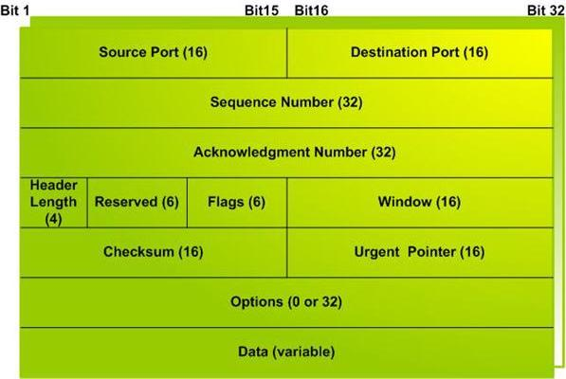
Format of TCP Segment

Slide 38
Format of TCP Segment (Cont…)
Source Port:
  It indicates the port number of a source process. It is of 2 bytes.
Destination Port:
  It indicates the port number of destination process. It is also 2 bytes.
Sequence Number:
  It specifies the number assigned to the current message. It is of 4 bytes.

Slide 39
Format of TCP Segment (Cont…)
Acknowledgement Number:
  It indicates the sequence number of the next byte of data. It is of 4 bytes.
Header Length:
  It indicates number of words in the TCP header. It is a 4 bit field.
Reserved:
  This 6 bit field is reserved for future use.

Slide 40
Format of TCP Segment (Cont…)
Flags:
  This 6 bit field consists of 6 different flags:
    UGR (Urgent Pointer)
    ACK (Acknowledgement)
    PSH (Request for Push)
    RST (Reset the Connection)
    SYN (Synchronize)
    FIN (Final or Terminate the Connection)

Slide 41
Format of TCP Segment (Cont…)
Window:
  It specifies the size of sender’s receiving window, i.e., the buffer space available for incoming data. It is of 2 bytes.
Checksum:
  This 16-bit field contains the checksum.
Urgent Pointer:
  This 16-bit field is valid only if urgent pointer in flags is set to 1.

Slide 42
Format of TCP Segment (Cont…)
Options:
  It contains the optional information in the TCP header. It is of 32 bytes.
Data:
  This field contains the upper layer information. It is of variable size.

Slide 43
User Datagram Protocol
User Datagram Protocol (UDP) is a connectionless, unreliable transport protocol.
Like TCP, UDP also provides process-to-process communication.
Unlike TCP, it does not provide flow control and error control mechanisms.
It is connectionless, therefore, it transfers data without establishing a connection.

Slide 44
User Datagram Protocol (Cont…)
The various features of UDP are:
  It provides connectionless transport service.
  It is unreliable.
  It does not provide flow control and error control.
  It is less complex and is simple than TCP, and easy to implement.
  User datagrams (packets) are not numbered.

Slide 45
UDP Datagram
A datagram is the unit of data transferred between two processes.
Each UDP datagram consists of two parts:
  Header Part
  Data Part.

Slide 46
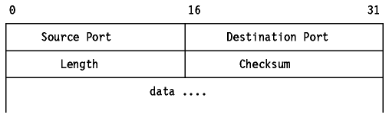
Format of UDP Datagram

Slide 47
UDP Datagram
Source Port:
  It indicates the port number of source process. It is of 16 bits.
Destination Port:
  This 16 bit field specifies the port number of destination process.

Slide 48
UDP Datagram
Length:
  It specifies the total length of the user datagram (header + data). It is of 16 bits.
Checksum:
  The contains the checksum, and is optional. It is also of 16 bits.

Slide 49
UNIT – V
Application Layer
The application layer is the “only layer” of the OSI reference model that interacts directly with the users and the applications.
The application layer is the topmost layer in the OSI reference model and is also known as layer seven or the last layer.
The application layer provides network services to all the network-based applications by providing them with an interface that they can utilise for all their network-based communications.

Slide 50
Application Layer (Cont…)
Actual requests for any kind of data input and output process are initiated at the application layer only.
Application layer interacts with the presentation layer in two ways :
  Application layer either receives data from the presentation layer.
  Application layer sends data to the presentation layer.

Slide 51
Application Layer Services
Email services
File transfer services
Network management services.
Web surfing and many more services that need network access.

Slide 52
Application Layer Protocols
HTTP (Hyper Text Transfer Protocol)
DNS (Domain Name System)
FTP (File Transfer Protocol)
TFTP (Trivial File Transfer Protocol)
SMTP (Simple Mail Transfer Protocol)
Telnet
SNMP (Simple Network Management Protocol)

Slide 53
Important Questions
2 Marks
What is flow control?
What is error control?
What is check sum?
Write short note on stop & wait.
What is piggy backing?
What is shortest path routing?
What is multicast routing?
What is fragmentation?
What is firewall?

Slide 54
Important Questions
2 Marks (Cont…)
What is IP Address?
What is subnet?
What are datalink layer issues?
What is domain name?
Explain email.
What is message transfer?
What is http?

Slide 55
Important Questions
5 Marks
Explain token bucket algorithm
Explain firewalls
Explain quality of services
Explain MIME
Explain jitter control
Explain leaky bucket algorithm
Explain TCP window
Explain TCP congestion control
Explain TCP timers

Slide 56
Important Questions
10 Marks
Explain routing algorithms
Explain IPV4 addressing
Explain IPV6 addressing
Explain UDP
Explain data link layer protocols
Explain client server mechanism
Explain TCP services
Explain WWW

Slide 57
Thank You
Mrs. V.Rathika, M.S.,M.Phil., (Ph.D.,)
Assistant Professor,
Department of Computer Applications,
Idhaya College for Women,
Kumbakonam

