Slide 1

IDHAYA COLLEGE FOR WOMEN
KUMBAKONAM – 612 001
DEPARTMENT OF PHYSICS
SEMESTER | : | VI
CLASS | : | III PHYSICS
SUBJECT- INCHARGE | : | Mrs. R. SASIREKABAI
SUBJECT NAME | : | MICROPROCROSESSOR & ‘C’ PROGRAMMING
SUBJECT CODE TOPIC | : : | 16SMBEPH2 ARCHITECTURE OF INTEL 8085

Slide 2
INTRODUCTION OF INTEL 8085
The Intel 8085 ("eighty-eighty-five") is an 8-bit microprocessor produced by Intel and introduced in March 1976. It is a software-binary compatible with the more-famous Intel 8080 with only two minor instructions added to support its added interrupt and serial input/output features.
Manufacturers: Intel
Used in computers: IBM System/23

Slide 3
IMPORTANCE OF INTEL 8085
The 8085 microprocessor is an 8-bit general purpose microprocessor which is capable to address 64k of memory. This processor has forty pins, requires +5 V single power supply and a 3-MHz single-phase clock. The ALU perform the computing function of microprocessor.
Accumulator is an 8-bit register that is part of ALU. This register is used to store 8-bit data & in performing arithmetic & logic operation. Flags are programmable. They can be used to store and transfer the data from the registers by using instruction. And registers are used to storage purposes normally program counter ,stack are used as storage registers.

Slide 4
INTEL 8085 COMPONENTS
8085 is pronounced as "eighty-eighty-five" microprocessor. It is an 8-bit microprocessor designed by Intel in 1977 using NMOS technology.
It has the following configuration −
8-bit data bus
16-bit address bus, which can address upto 64KB
A 16-bit program counter
A 16-bit stack pointer
Six 8-bit registers arranged in pairs: BC, DE, HL
Requires +5V supply to operate at 3.2 MHZ single phase clock
It is used in washing machines, microwave ovens, mobile phones, etc.

Slide 5
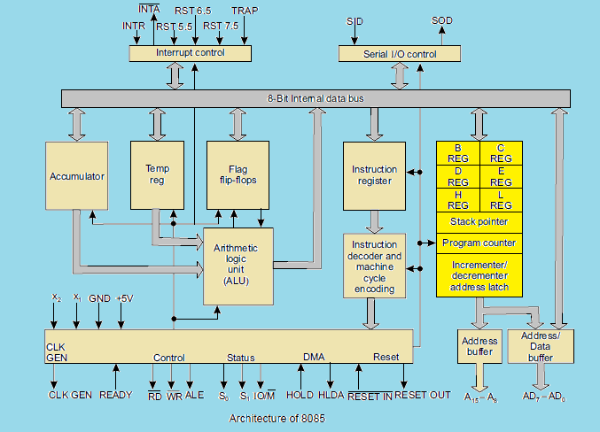
INTEL 8085 ARCHITECHTURE

Slide 6
8085 Microprocessor – Functional Units
8085 consists of the following functional units −
Accumulator
It is an 8-bit register used to perform arithmetic, logical, I/O & LOAD/STORE operations. It is connected to internal data bus & ALU.
Arithmetic and logic unit
As the name suggests, it performs arithmetic and logical operations like Addition, Subtraction, AND, OR, etc. on 8-bit data.
General purpose register
There are 6 general purpose registers in 8085 processor, i.e. B, C, D, E, H & L. Each register can hold 8-bit data.
These registers can work in pair to hold 16-bit data and their pairing combination is like B-C, D-E & H-L.
Program counter
It is a 16-bit register used to store the memory address location of the next instruction to be executed. Microprocessor increments the program whenever an instruction is being executed, so that the program counter points to the memory address of the next instruction that is going to be executed.
Stack pointer
It is also a 16-bit register works like stack, which is always incremented/decremented by 2 during push & pop operations.

Slide 7
Temporary register
It is an 8-bit register, which holds the temporary data of arithmetic and logical operations .
Flag register
It is an 8-bit register having five 1-bit flip-flops, which holds either 0 or 1 depending upon the result stored in the accumulator.
These are the set of 5 flip-flops −
Sign (S)
Zero (Z)
Auxiliary Carry (AC)
Parity (P)
Carry (C)
Its bit position is shown in the following table −
D7 | D6 | D5 | D4 | D3 | D2 | D1 | D0
S | Z |  | AC |  | P |  | CY

Slide 8
Instruction register and decoder
It is an 8-bit register. When an instruction is fetched from memory then it is stored in the Instruction register. Instruction decoder decodes the information present in the Instruction register.
Timing and control unit : It provides timing and control signal to the microprocessor to perform operations. Following are the timing and control signals, which control external and internal circuits −
Control Signals: READY, RD’, WR’, ALE
Status Signals: S0, S1, IO/M’
DMA Signals: HOLD, HLDA
RESET Signals: RESET IN, RESET OUT
Interrupt control : As the name suggests it controls the interrupts during a process. When a microprocessor is executing a main program and whenever an interrupt occurs, the microprocessor shifts the control from the main program to process the incoming request. After the request is completed, the control goes back to the main program.
There are 5 interrupt signals in 8085 microprocessor: INTR, RST 7.5, RST 6.5, RST 5.5, TRAP.
Serial Input/output control : It controls the serial data communication by using these two instructions: SID (Serial input data) and SOD (Serial output data).
Address buffer and address-data buffer : The content stored in the stack pointer and program counter is loaded into the address buffer and address-data buffer to communicate with the CPU. The memory and I/O chips are connected to these buses; the CPU can exchange the desired data with the memory and I/O chips.

Slide 9
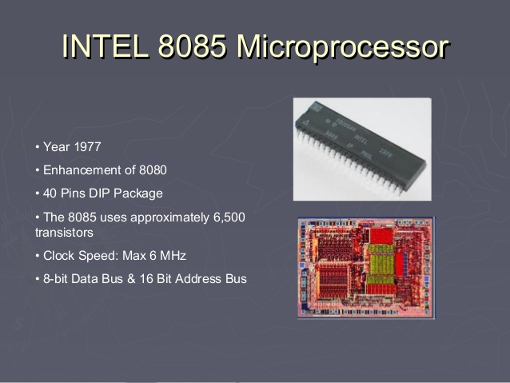

Slide 10
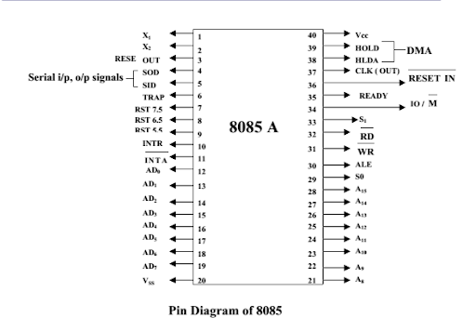
PIN CONFIGURATION OF INTEL 8085

Slide 11
8085 Pin description
Higher Order Address pins- A₁₅ – A₈
The address bus has 8 signal lines A8 – A15 which are unidirectional.
Lower Order Address/ Data Pins- AD₇-AD₀
These are time multiplexed pins and are de-multiplexed using the pin ALE
So, the bits AD0 – AD7 are bi-directional and serve as A0 – A7 and D0 – D7 at the same time.
During the execution of the instruction, these lines carry the address bits during the early part, then during the late parts of the execution, they carry the 8 data bits.
In order to separate the address from the data, we can use a latch to save the value before the function of the bits changes.
Control Pins – RD, WR
These are active low Read & Write pins
Status Pins – ALE, IO/M (active low), S₁, S₀
  ALE (Address Latch Enable)-Used to de-multiplex AD₇-AD₀
  IO/M – Used to select I/O or Memory operation
  S₁,S₀ – Denote the status of data on data bus

Slide 12
Interrupt Pins – TRAP, RST7.5, RST 6.5, RST 5.5, INTR, INTA
  These are hardware interrupts used to initiate an interrupt service routine stored at predefined locations of the system memory.
Serial I/O pins – SID (Serial Input Data), SOD (Serial Output Data)
  These pins are used to interface 8085 with a serial device.
Clock Pins- X₁, X₂, CLK(OUT)
  X₁, X₂– These are clock input pins. A crystal is connected between these pins such that crystal= 2f₈₀₈₅f_{crystal}= crystal frequency & f₈₀₈₅ = operating frequency of 8085
  CLK(OUT) – This is an auxiliary clock output source
  where Reset Pins – Reset In (active low), Reset Out
  Reset In is used to reset 8085 whereas Reset Out can be used to reset other devices in the system
DMA (Direct Memory Access) pins – HOLD, HLDA
  These pins are used when data transfer is to be performed directly between an external device and the main memory of the system.
Power Supply Pins – +V_{CC}, V_{SS}

Slide 13
The features of 8085 include:
It is an 8-bit microprocessor i.e. it can accept, process or provide 8-bit data. ...
It operates on a single +5V power supply connected at Vcc.
It operates on clock cycle with 50% duly cycle.
It has on chip clock generator this internal clock generator requires tuned circuit like LC.

Slide 14
APPLICATIONS OF INTEL 8085
The use of Microprocessor I toy, entertainment equipment and home applications is making them entertaining full of features. The use of Microprocessor is more widespread and popular.
Now the Microprocessor used in,
Calculators,
Accounting system,
Game machine,
Complex industrial controllers,
Traffic light control,
Data acquisition system,
Military applications,
Communication systems.

Slide 15


