Slide 1

IDHAYA COLLEGE FOR WOMEN
KUMBAKONAM – 612 001
DEPARTMENT OF PHYSICS
SEMESTER | : | VI
CLASS | : | III PHYSICS
SUBJECT- INCHARGE | : | Mr. N. MAHENDRAN
SUBJECT NAME | : | COMMUNICATION PHYSICS
SUBJECT CODE TOPIC | : : | 16SMBEPH3 UNIT - V

Slide 2
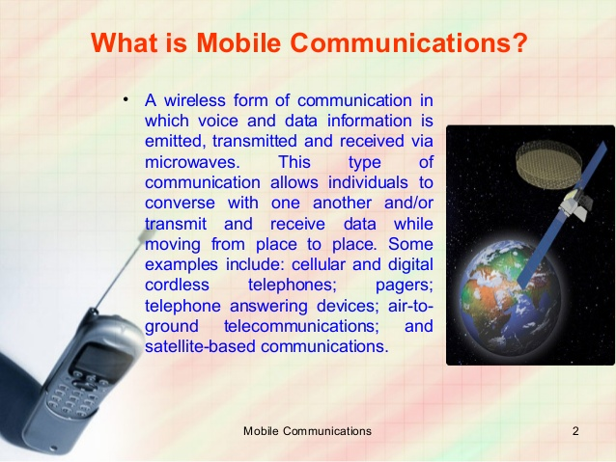
Mobile
A mobile phone, cellular phone, cell phone, cellp hone or hand
phone, sometimes shortened to simply mobile, cell or just phone,
is a portable telephone that can make and receive calls over
a radio frequency link while the user is moving within a telephone
service area.
The radio frequency link establishes a connection to the switching
systems of a mobile phone operator, which provides access to
the public switched telephone network (PSTN).

Slide 3
MOBILE COMMUNICATION:
Mobile Communication is the use of technology that allows us to
communicate with others in different locations without the use of any
physical connection (wires or cables). Mobile communication makes our life
easier, and it saves time and effort.
A mobile phone (also called mobile cellular network, cell phone or hand
phone) is an example of mobile communication (wireless communication). It
is an electric device used for full duplex two way radio telecommunication
over a cellular network of base stations known as cell site.

Slide 4
Mobile Network
A cell site, cell tower, or cellular base station is a cellular-enabled mobile device site where antennas and electronic communications equipment are placed—typically on a radio mast, tower, or other raised structure—to create a cell (or adjacent cells) in a cellular network.

Slide 5
Codes in the Mobile Phone
Mobile phones have special codes associated with them. These include.
Electronic Serial Number (ESN) -Unique 32-bit number programmed in the phone.
Mobile Identification Number (MIN) – 10 digit number derived from the phone’s number.
System Identification Code (SID) – unique 5 digit number that is assigned to each carrier by the FCC.

Slide 6
Mobile Communication Protocols:
Any device that does not need to remain at one place to carry out its functions is a mobile
device.
laptops, smartphones and personal digital assistants are some examples of mobile
devices. Due to their portable nature, mobile devices connect to networks wirelessly.
Mobile devices typically use radio waves to communicate with other devices and
networks.
Mobile communication protocols use multiplexing to send information. Multiplexing is
a method to combine multiple digital or analog signals into one signal over the data
channel.
This ensures optimum utilization of expensive resource and time. At the destination
these signals are de-multiplexed to recover individual signal.

Slide 7
WIRELESS APPLICATION:
Wireless application protocol (WAP) is a communications protocol that is used for wireless data access through most mobile wireless networks.
WAP enhances wireless specification interoperability and facilitates instant connectivity between interactive wireless devices (such as mobile phones) and the Internet.

Slide 8
VSAT:
Very small aperture terminal (VSAT) is a data transmission technology used for many types of data management and in high-frequency trading.
VSAT can be used in place of a large physical network as it bounces the signal from satellites instead of being transported through physical means like an ethernet connection.
Because the signal needs to bounce, there can be a latency issue that wouldn't exist with a physical network. However, most users feel this is the price you pay for remote access and less infrastructure, and consider it a fair trade.
Weather can adversely impact the efficacy of a VSAT network.

Slide 9
Advantages
VSAT networks have a big advantage when it comes to deployment.
The ground station is communicating with satellites, there is less infrastructure required to
service remote locations.
This was one of the reasons Walmart chose VSAT as it started out heavily leveraged to rural
America where telecommunications infrastructure was less dense than in the cities.
This has made VSAT networks an ideal choice for providing connectivity to remote work sites
like exploratory drilling sites that need to relay daily drill logs back to headquarters.
VSAT is also independent of local telecommunications networks, making it an ideal system
to back up wired systems and reduce business recovery risk.
If the wired network goes down, a business can still go on using the VSAT network.

Slide 10
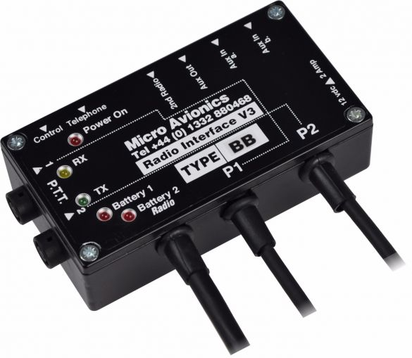

Slide 11
The GSM radio interface
The radio interface is the between the mobile station and the fixed.
It is one of the most important interfaces of the GSM system
one of the main objectives of GSM is roaming.
Therefore in order to obtain a complete compatibility between mobile
stations and networks of different manufactures and operators the
radio interface.

Slide 12
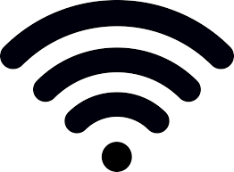
WiFi
Wi-Fi is the name of a wireless networking technology that uses radio waves to provide wireless high-speed Internet and network connections. A common misconception is that the term Wi-Fi is short for "wireless fidelity," however this is not the case. Wi-Fi is simply a trademarked phrase that means IEEE 802.11x.

Slide 13
Application of Mobile and Wireless Communications
Education
Wireless technology is an ideal application of colleges and
school.
Teachers can also distribute handouts directly to students
who have brought their own wireless devices to class.

Slide 14
All about Modems
Modems used different characteristics of wave to correspond
to the 0s and 1s digital data.
Modems uses an RJ-11 connection to a Phone wall outlet.
Half-duplex transmit in one direction only.
Full-duplex transmit in both directions at Once.

Slide 15
Video on demand (VOD)
Video on demand (VOD) is a video media distribution system
that allows users to access video entertainment without a
traditional video entertainment device and without the
constraints of a typical static broadcasting schedule.
In the 20th century, broadcasting in the form of over-the-air
programming was the commonest form of media
distribution.

Slide 16
FAX
Fax (short for facsimile), sometimes called telecopying or telefax (the latter short
for telefacsimile), is the telephonic transmission of scanned printed normally to a telephone
number connected to a printer or other output device.
The original document is scanned with a fax machine (or a telecopier), which processes the
contents (text or images) as a single fixed graphic image, converting it into a bitmap, and then
transmitting it through the telephone system in the form of audio-frequency tones.
The receiving fax machine interprets the tones and reconstructs the image, printing a paper
copy.

Slide 17
RADIO PAGING
The Radio paging service has been defined as, Radio paging system is a non-speech, one-way personal selective calling system with alert, and also with defined message such as numeric and alphanumeric messages.
ADVANTAGES:
Reduces memory usage as opposed to pure paging.
Share individual pages by copying page table entries.

Slide 18
3G-NETWORK
3G is kind of like “Wi-Fi everywhere,” meaning it provides Internet access via the same radio towers that provide voice service to your mobile phone. (FYI, 4G is the same thing, just faster.) Ah, but not all devices are equipped to access 3G service. The Kindle Fire and Nook Colour, for example, are Wi-Fi-only

Slide 19
Thank you

