Slide 1
IDHAYA COLLEGE FOR WOMEN, KUMBAKONAM
Semester: II
Subject: Marketing Management
Subject Code: P16MBA9
Unit: V
Class: I MBA
Topic: 1. Marketing Strategies
2. Service Marketing
3. Consumerism & Consumer Protection
4. Evaluating & Controlling Marketing Performance 5. Direct Selling, Direct Marketing
Faculty Name: Dr. Chitra Isac, M.B.A., M. Phil., S.E.T., Ph. D.,
Head- Department of Management

Slide 2
Content
Marketing Strategies
Tools for Competitive Differentiation of Product
Strategies for Competitors – Leaders, challenges, follower & niches
Marketing of Services
Consumerism and Consumer Protections,
Evaluating & Controlling Marketing Performance
Direct Selling, Direct Marketing.

Slide 3
Objective & Learning Outcome
Objective:
To understand the marketing strategies, concept of service marketing and consumers protections laws
Learning Outcome:
To have understood the marketing theories for strategic marketing, concept of service marketing, direct selling and direct marketing and consumers protection

Slide 4
Marketing Strategies
Game Plan
Prospective Consumers
Customers
Elements
The company’s value proposition
Key brand messaging
Data on target customer demographics

Slide 5
Product Differentiation
Marketing strategy -to distinguish a company's products or services - the competition.
Elements
identifying and communicating the unique qualities
highlighting the distinct differences
developing a strong value proposition to make a product or service attractive
creates a competitive advantage
ultimately build brand awareness
Examples of differentiated products might include
the fastest high-speed internet service or
the most gas-efficient electric vehicle on the market today

Slide 6
Types of Product Differentiation
Price
The lowest price to attract buyers that are cost-conscious–Costco,
The higher prices to emphasize that it's a luxury product and worth it–such as a luxury car.
Performance and Reliability
Reliable and offer long-term value are often touted as better than the competition- increased performance
Location and Service
For smaller, local companies -local business high-quality service or product - higher price versus national brands.

Slide 7
Market Differentiation

Slide 8
The four quadrants of the BCG matrix
The placement is based on market growth and market share.
DOGS
Dogs are products with low growth and low market share- viewed as a waste -do not produce enough of a profit to justify the investment.
QUESTION MARKS
Question Marks, also known as “Problem Child,” are products in a high growth market with low market shares -it is unclear which way they will swing- raise to star or decline to dog
STARS
Products that are Stars have a high market share in high-growth markets- potential to become market leaders→ Cash Cows
CASH COWS
Cash Cows are products that have a high market share in low-growth market. These are products that drive revenue for your business.
This matrix is decision making matrix

Slide 9
Niche Marketing
Advertising Strategy - unique target market- this strategy focuses exclusively on one group
Elements of Uniqueness
Geographic area
Lifestyle
Occasion
Profession
Style
Culture
Activity or habits
Behaviour
Demographic
Need
Feature reduction or addition

Slide 10
Service Marketing
Definition and characteristics of Services
The American Marketing Association defines services as - “Activities, benefits and satisfactions which are offered for sale or are provided in connection with the sale of goods.”

Slide 11
Service Marketing
Characteristics :
Intangibility
Heterogeneity/Variability
Perishable
Inseparability of production and consumption

Slide 12
Types of Services
Core Services: A service that is the primary purpose of the transaction. eg: a haircut or the services of lawyer or teacher.
Supplementary Services: Services that are rendered as a corollary to the sale of a tangible product. Eg: Home delivery options offered by restaurants above a minimum bill value.

Slide 13
Classification of Services
A. Consumer Service Marketing
B. Industrial Service Marketing
Food Service
Hotels and Motel
Personal Care Services
Medical and Surgical Services
Educational Services
Household Services
Automobile Services
Entertainment Services
Transport Services
Communication Services
Insurance Services
Financial Services
Personal Security Services.
Engineering Services
Warehouse Services
Advertising and Promotional Services
Office Services
Management Consultancy Services
Marketing Research Services
Manpower Selection and Training

Slide 14
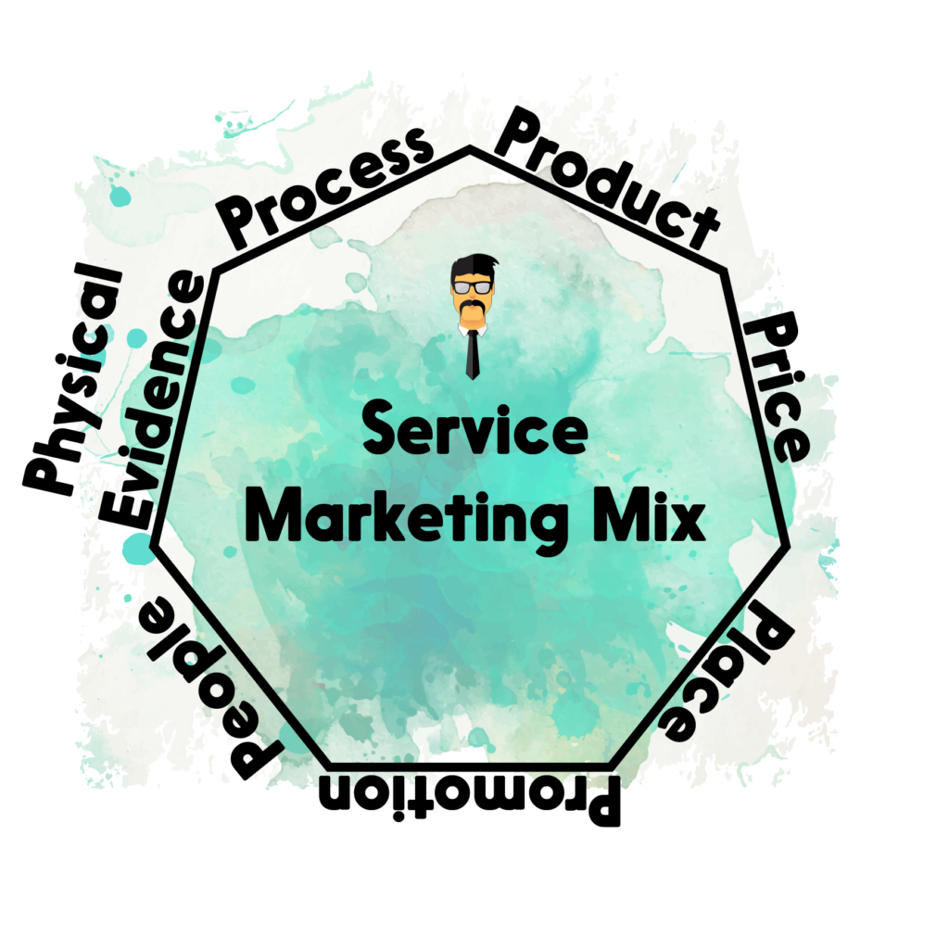
Service Marketing Mix 7 Ps of Service Marketing

Slide 15
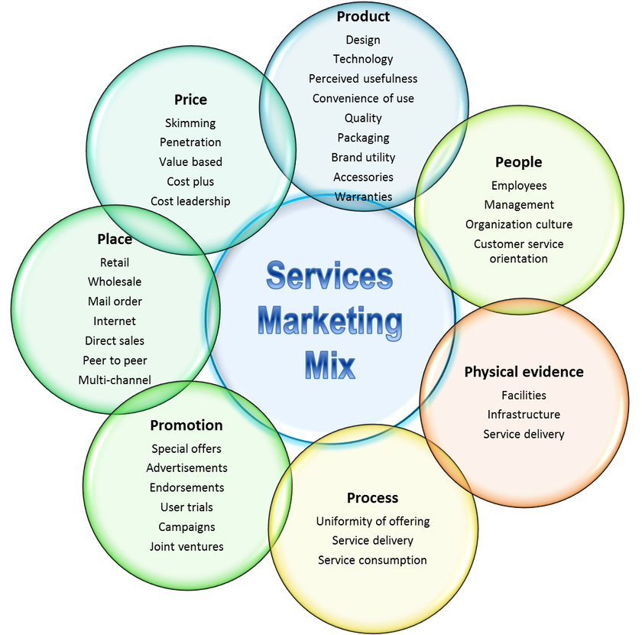

Slide 16
Consumerism
Social force designed to protect consumer interests in the market place by organising consumer pressures on business.
Consumerism challenges the very basis of the marketing concept.

Slide 17
Four important Premises of the Marketing Concept- Consumerism
According to P.F. Druckers, consumerism
(i) It is assumed that consumers know their needs
(ii) It is assumed that business really cares about those needs and knows exactly how to find about them.
(iii) It is assumed that business does provide useful information that precisely matches product to needs.
(iv) It is presumed that product and services really fulfill customer expectations as well as business promises.

Slide 18
Consumerism
protest of consumers against unfair business practices and business industries.
Aims
to eliminate those unfair marketing practices like: misbranding, spurious products,
unsafe products, adulteration,
fictitious pricing, planned obsolescence,
deceptive packaging, false and misleading
advertisements, defective warranties, hoarding, profiteering, black-marketing,
short weights and measures etc.

Slide 19
Consumer dissatisfaction and Remedial Efforts
Consumerism covers the following areas of
(i) Removal or reduction of discontent and dissatisfaction generated in the exchange relationships between buyers and sellers in the market.
(ii) Consumerism has interest in protecting consumers from any organization with which there is an exchange relationship.
(iii) Modern consumerism also takes keen interests in environmental matters affecting the quality of life.

Slide 20
Social Demand of Marketing
deliver a rising standard of living to those who want better and enriched quality of life for all citizens
will inspire marketers to make greater progress in enhancing marketing efficiency and
honouring ethical and moral values in production and pricing.

Slide 21
Consumer Protection
is the practice of safeguarding buyers of goods and services, and the public, against unfair practices in the marketplace.
measures are often established by law

Slide 22
8 basic rights of consumers
Right to safety
Right to choose
Right to be informed
Right to consumer education
Right to be heard
Right to Seek redressal

Slide 23
Consumer Protection Act, 1986
1-2-1b Any Person who use the Goods tith The approval of the Buyer is a Consumer
When a person buys goods, they may be used by his family members, relatives and friends. Any person who is making actual use of the goods may come across the defects in goods.

Slide 24
Consumer Protection in India.
In order to protect the consumers from exploitation and to save them from adulterated and substandard goods and deficient services the Consumer Protection Act came into force on 15th April, 1986 and it applies to the whole of India except the State of Jammu and Kashmir

Slide 25
Direct Selling
selling products directly to the consumer in a non-retail environment. Instead, sales occur at home, work, online, or other non-store locations.
Types of Direct Selling
Single-level Direct Sales
Host or Party-Plan Sales
Multi-level Marketing (MLM)

Slide 26
Direct Marketing
Direct marketing is a type of advertising campaign -postal mail, telemarketing, point of sale, direct mail marketing
Consumer response is measurable:

Slide 27
Direct Marketing...
Characteristics
1. A Set of Database
2. Addressing the Listed Customers
3. Direct Action Related
4. Specific Emphasis
Types
1. Direct Mail Marketing:
2. Catalogue Marketing
3. Telemarketing

Slide 28
Media used for Direct Marketing
Email Marketing,
Online Marketing,
Mobile,
Telemarketing,
Voicemail Marketing

Slide 29
Reference
https://www.investopedia.com/terms/m/marketing-strategy.asp
https://www.investopedia.com/terms/p/product_differentiation.asp
https://www.webfx.com/internet-marketing/bcg-matrix.html
https://www.managementstudyguide.com/definition-and-characteristics-of-services.htm
https://www.managementstudyguide.com/seven-p-of-services-marketing.htm
https://bbamantra.com/types-of-services/ (types of SM)
http://www.legalservicesindia.com/article/1739/Consumer-Protection-Law-In-India.html (consumer protection)

