Slide 1
IDHAYA COLLEGE FOR WOMEN
KUMBAKONAM – 612 001
DEPARTMENT OF PHYSICS
SEMESTER | : | II
CLASS | : | I M.Sc PHYSCIS
SUBJECT- INCHARGE | : | Mrs. T. KAVITHA
SUBJECT NAME | : | ELECTRO MAGNETIC THEORY
SUBJECT CODE | : | P16PY21
TOPIC | : | WAVE GUIDE AND ITS APPLICATIONS

Slide 2
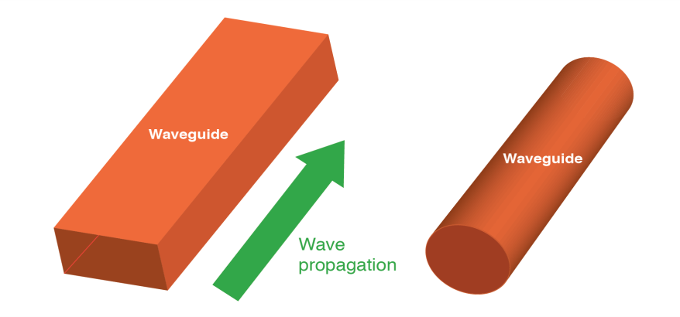
Concept of WAVEGUIDE
A hollow metallic tube of uniform cross section for transmitting electro magnetic waves by successive reflections from inner walls of the tube is called Waveguide.

Slide 3
Waveguide may be used to carry energy between pieces of equipments.
Waveguides are made from Copper, Aluminium.
These metals are extruded into long rectangular or circular pipes.
TYPES OF WAVE GUIDE
1.RECTANGULAR WAVEGUIDE
2.CIRCULAR WAVEGUIDE

Slide 4
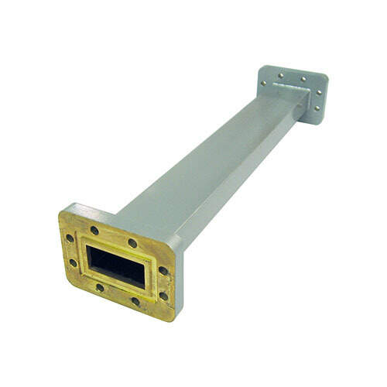
RECTANGULAR WAVEGUIDE
Dominant mode is TE10
Supports TE and TM waves but not TEM waves
There is only one conductor
Bands between 1GHz to above 220 GHz

Slide 5
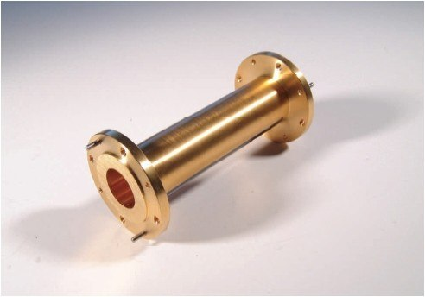
CIRCULAR WAVEGUIDE
The dominant mode is TE11
The highest possible bandwidth allowing only a single mode to propagate.

Slide 6
TYPES OF MODES TE(Transverse Electric )MODE
Electric field perpendicular to direction of propagation
Magnetic components are in the direction of propagation
TE modes have no electric field in direction of propagation
TE mode is subdivided into TE10,TE11,TE20,TE01 The dominant mode is TE11

Slide 7
TM(Transverse Magnetic )MODE
Magnetic field perpendicular to direction of propagation
Electric components are in the direction of propagation
TE modes have no magnetic field in direction of propagation
TM mode is subdivided into TM11,TM21

Slide 8
TEM MODE
Both electric and magnetic field perpendicular to direction of propagation
TEM mode is subdivided into TM11,TM21

Slide 9
Rectangular waveguide
Mode | Cut-off Wavelength(λ_{c}) | Cut-off Frequency( f_{c})
TE₁₀ | 2a | ( 1/(με)^{0.5} ) (1/(2a))
TE₁₁, M₁₁ | (2ab)/(a² + b²)^{0.5} | ( 1/(με)^{0.5} ) ((a² + b²)^{0.5}/(2ab))
TE₂₀ | a | ( 1/(με)^{0.5} ) (1/a)
TE₀₁ | 2b | ( 1/(με)^{0.5} ) (1/(2b))

Slide 10
Circular waveguide
Mode | Cut off Wavelength(λ_{c}) | Cut-off Frequency( f_{c})
TE₁₁ | 1.706d | ( 1/(με)^{0.5} ) (1/(1.706d))
TM₀₁ | 1.306d | ( 1/(με)^{0.5} ) (1/(1.306d))
TE₂₁ | 1.028d | ( 1/(με)^{0.5} ) (1/(1.028d))
TM₁₁ | 0.820d | ( 1/(με)^{0.5} ) (1/(0.820d))

Slide 11
APPLICATIONS
To reduce Attenuation loss.
Can operate only above certain frequencies
Short and medium distance broad band communication

Slide 12
CAVITY RESONATOR
And its applications

Slide 13
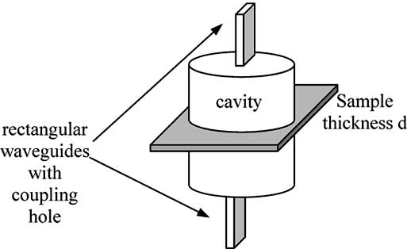
Concept of CAVITY RESONATOR
An electronic device consisting of a space usually enclosed by metallic walls within which resonant electromagnetic fields may be excited and extracted for use in microwave systems.

Slide 14
TYPES of CAVITY RESONATOR
Regulated Cavity Resonator.
Un Regulated Cavity Resonator.
Co-axial Cavity Resonator.
Capacitive Cavity Resonator.
Inductive Cavity Resonator.
Waveguide Cavity Resonator.
Reentrant Cavity Resonator.

Slide 15
APPLICATIONS of CAVITY RESONATOR
Waveguides are used at the highest frequencies to transmit power and signals. Similarly, cavity resonators are employed as tuned circuits at such frequencies.
Cavity resonators are widely used as the frequency determining element in microwave oscillators.

