Slide 1
IDHAYA COLLEGE FOR WOMEN
KUMBAKONAM – 612 001
DEPARTMENT OF PHYSICS
SEMESTER | : | IV
CLASS | : | II M.Sc., PHYSICS
SUBJECT- INCHARGE | : | Mrs. R. SASIREKABAI
SUBJECT NAME | : | NANOPHYSICS
SUBJECT CODE TOPIC | : : | P16PYE5 PRINCIPLE, WORKING, ADVANTAGES AND DISADVANTAGES OF SEM & TEM

Slide 4
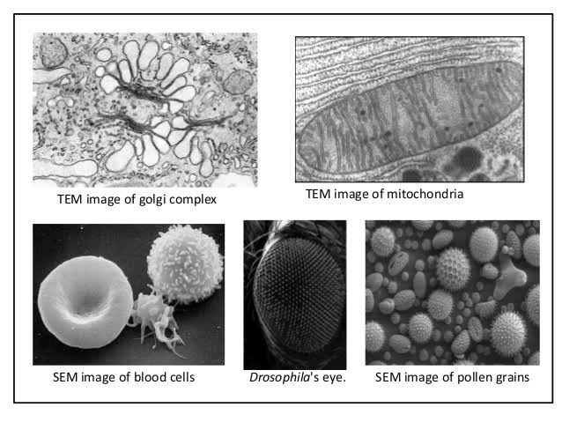

Slide 5
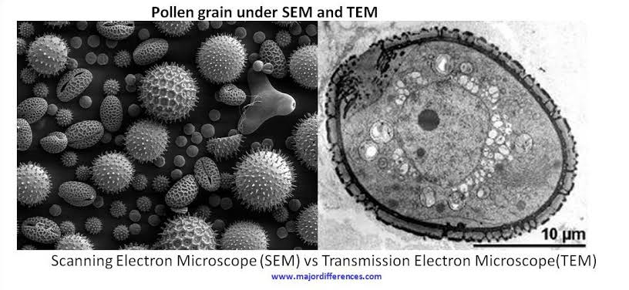

Slide 6
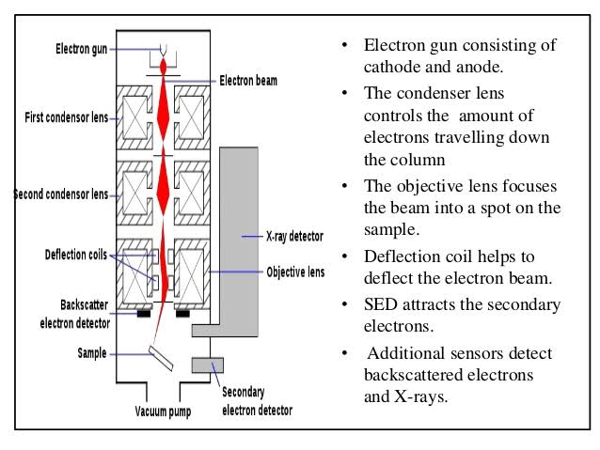
WORKING OF SEM

Slide 12
