Slide 1
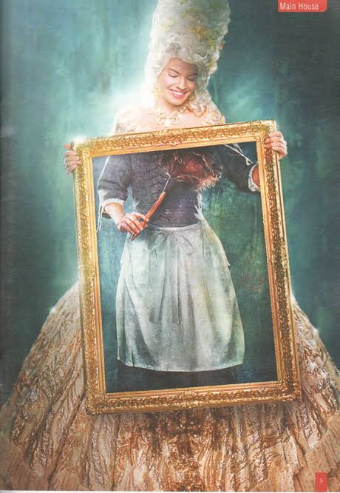

She stoops to conquer
Oliver goldsmith

Slide 2
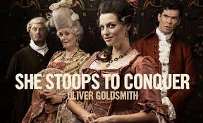
SHE STOOPS TO CONQUER
THE TITLE JUSTIFICATION

Slide 3
introduction
‘’SHE STOOPS TO CONQUER’’ is one of the best plays to be written during the restoration era. Goldsmith’s she stoops to conquer is still part of the comic play after more than 200 years, providing a combination of good-humoured comedy and satire on social affections.
The play was first performed at Convent Garden Theatre in London on March 15,1773.
It’s known for broad humour, innocent wit, and frank good nature. It was well received by the audience.
This comic masterpiece mocked the simple morality of sentimental comedies.
It has become one of the most popular comedies in English Literary History.

Slide 4

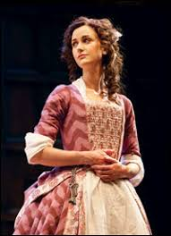
Main title
The Main title of the play which is SHE STOOPS TO CONQUER, refers the trick of its heroine to conquer her lover by,
stooping to the play the role of a BARMAID ,
after the role of a poor relation of the Hardcastle's family.

Slide 5
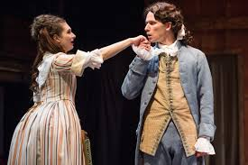
‘’SHE’’ in the tittle refers to the heroine,
KATE who is a daughter of a rich man from the upper-middle class.
Here she is stooping by playing the role of the barmaid.
Actually stoops is the main action of the play is,
‘’the heroine stoops to win the hero over emotionally and to gain
his heart and his love to make him love her’’.

Slide 6
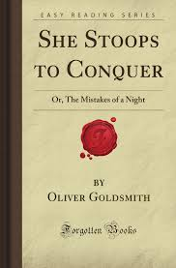
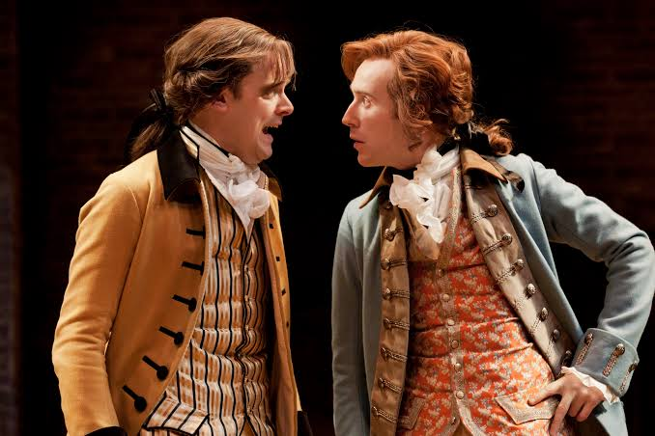
Sub-title
The subtitle which is the ‘’THE MISTAKES OF A NIGHT’’ refers to the several mistakes that Marlow committed during the course of a single night starts from early afternoon to midnight.

Slide 7

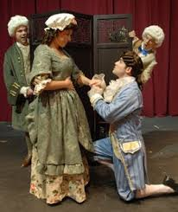
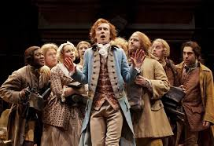
HIS MISTAKES
He mistakes Kate is to be a barmaid,
Also mistakes her to be a poor relation to the family,
The House itself, in which he is going to spend one night, to be an inn.
The owner of the house, Mr. Hardcastle to be an inn-keeper.

Slide 8


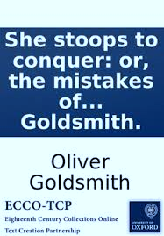
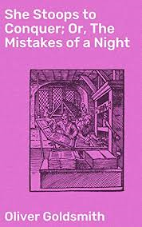
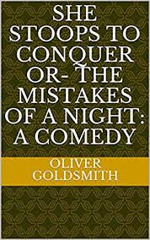
reference to the two titles
We have reference to the TWO TITLES in the play:
I STOOPED TO CONQUER’’ by KATE. This expression is a reference to the Main title of the play.
‘’THE MISTAKES OF THE NIGHT shall be crowned with a merry morning; so,boy,take her, and as you have been mistaken in the mistress, my wish is that you may never be mistaken in the wife’’. by MR. HARDCASTLE. Here the subtitle is mentioned.

Slide 9

In this play, however the heroine is taking the device of pretending to be of a social class by playing the two roles: a barmaid and a poor relative to the family. Actually, she succeeds at the end of the play to conquer the hero's heart by doing so. In fact there is a real need to stooping here because Marlow, the hero, has a problem in his personality that he is shy in front of ladies of higher classes. Therefore she comes to play her two roles and comes down to a lower position in order to make him courageous to talk to her as a lady; In this way, she gains his love and, at the same time, she helps him to overcome his personality problem.

Slide 10
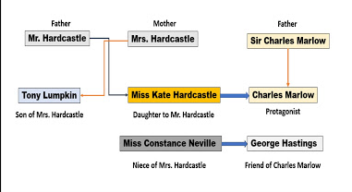
CHARACTERS

Slide 11
conclusion
The play appears to be a very skilfully constructed. The playwright carefully attends to the matter of exposition. Thus, Miss. Hardcastle stoops to be a barmaid ton conquer the bashfulness and reserve of Marlowe.
Thus the tittle of the play more than justified.

Slide 12
THANK YOU

Slide 13
PRESENTED BY:
E.GANGA
II B.A ENGLISH

