Slide 1
PYGMALION
TOPIC: CHARACTERS

Slide 2
PYGMALION
GEORGE BERNARD SHAW

Slide 3
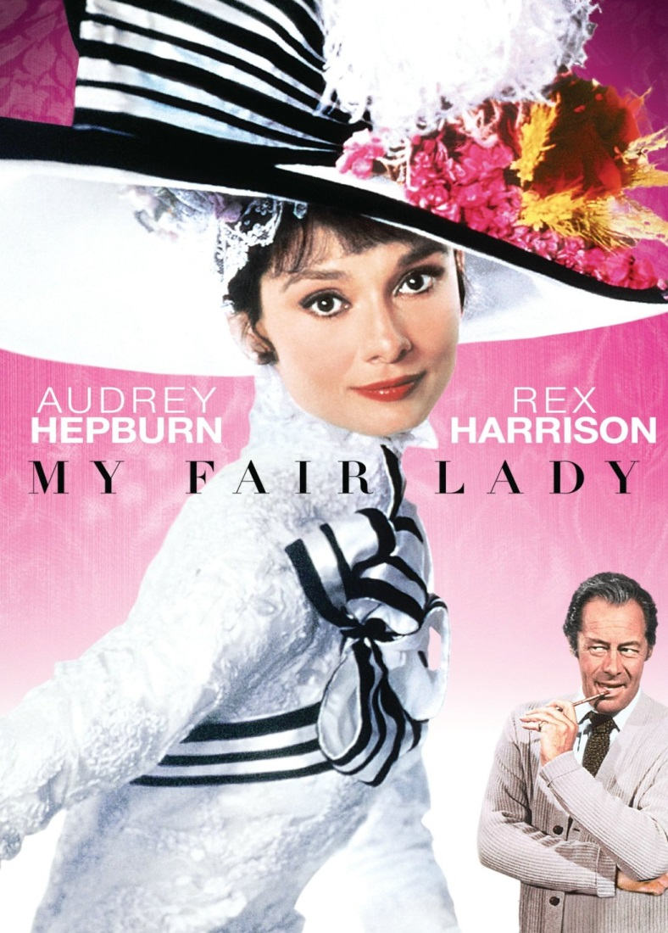
PYGMALION
SHAW’s most famous play PYGMALION was first performed in 1913.
In 1956, the musical version of Pygmalion called ‘’My Fair Lady ‘’ was staged.
And in 1964, the film starring Audrey Hepburn was released. The film went on to win ‘’Eight Oscars‘’ including Best Picture.

Slide 4
PYGMALION: INTRODUCTION
In this play, George Bernard Shaw uses humor and lively characterization to explore how
Language,
Class structure,
Education,
Gender
influence how people are seen by society.

Slide 5
The TWO Main CHARACTERS are;
ELIZA DOOLITTLE
—a poor but proud flower girl with a cockney accent.
HENRY HIGGINS
—an arrogant and insensitive linguistics professor.

Slide 6
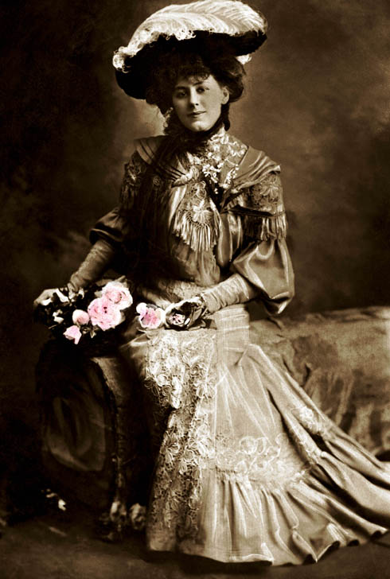
Higgins decides to take the girl on as a professional challenge.
He boasts to his associate Colonel Pickering that with six months of lessons, Eliza could be passed off as a duchess.

Slide 7
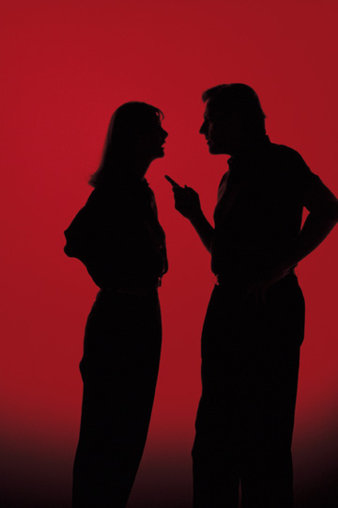
THE PLAY
Although Eliza wants to learn, there is tension between her and Higgins.
She also wants to be treated with respect, as a person.
Higgins, however, persists in treating her as a project and an object.

Slide 8
MAJOR CONFLICT
Conflicts
Status Divide
Gender Relations
Self Consciousness
Social Snobbery

Slide 9
Major Conflict
Status Divide
The Nature of class structure
Upper Class: Higgins, Colonel Pickering, Mrs. Higgins, Mrs. Clair and Freddy Eynsford Hill.
Middle Class: Mrs. Pierce represent “middle-class morality” alone. In many ways that is also a quality of Higgins’ and Col. Pickering’s class.
Lower Working Class: Eliza, Alfred Doolittle and his never seen but often heard about “wife.” and Eliza’s step-mother.

Slide 10
CHARACTERS

Slide 11
ELIZA DOOLITTLE
Role
Significance
Conflict
Relationship
Protagonist, poor flower girl who wishes to be rich and happy
Daughter of Alfred, experiment subject to Higgins and Pickering, possibly means more to Higgins
Cannot change her inner characteristics to suit the newly changed outer appearance. Argues with Higgins on this subject
Is able to stay true to herself and to not conform to please society.

Slide 12
MR. HIGGINS
Role
Significance
Conflict
Relationship
Antagonist, Professor of phonetics and tries to teach Eliza the proper ways of society.
Friend to pickering, wishes to be friends with Eliza
He tries to change Eliza&amp;apos;s personality but she wont let him. He also has a hard time understanding women.
His actions show that no one can change another&amp;apos;s character

Slide 13
COL. PICKERING
Role
Significance
Conflict
Relationship
Another researcher of phonetics
Friend to Higgins, and a friend to Eliza(like father)
Trying to get Eliza and Higgins to understand each other
He did not change his morals to suit Higgins&amp;apos; needs

Slide 14
MRS. PEARCE
Role
Significance
Conflict
Relationship
Motherly figure, and Housekeeper
Protector of Eliza, and keeps Higgins in line
Has trouble in trying to reason with Higgins
Is a role model to Eliza

Slide 15
MR.FREDDY HILL
Role
Ideal image of a man at the time (to Eliza)
Relationship
has feelings for Eliza over time, they marry
Conflict
Argues with the people of his society on his choice of Eliza.
Significance
Gives hope to Eliza

Slide 16
ALFRED DOOLITTLE
Eliza&amp;apos;s father
Job = dustman
Drunkard
Elderly but vigorous, expressive voice
His face is free from fear and conscience

Slide 17
• Expresses his feelings freely → wonderful talker
• Lazy (Doolittle=”do little”)
• Doesn&amp;apos;t want much money, just enough to enjoy his life
• Does not try to improve his life
Relationship with Eliza: Used to beat and neglect her
(Illegitimate daughter)
Sudden interest → could make out money of the situation

Slide 18
• Henry&amp;apos;s mother
• High class- Great character, intelligent, charming, Wealthy and independent
• Accepts people as they are.
• Calm → take control of every situation
• Ideal mother: wise, tolerant, caring and understanding
MRS.HIGGINS

Slide 19
• Treats her son like a naughty child
• Knows how ambitious her son is, so she sympathies with Eliza
Role in the play: Reasonable: shows her disapproval for the experiment
Model for Eliza in her new surroundings
Mediator between Eliza and Higgins
Expresses the common sense, responsible view

Slide 20
CLARA EYNSFORD HILL
• Upper middle class
• Aggressive, disrespectful, selfish, impulsive, pathetic
• Behaves badly
• Not married
→ she has not recognized that Eliza was the flower girl at first
Function in the play: → Shaw is mocking the social pretensions from the upper and upper-middleclass, which prevents them form facing up to reality

Slide 21
Mrs. Eynsford Hill
Freddy’s mother
Upper middle class
Means the same things as Clara but in a more polite way
Treats Freddy like a child
Gives ”too much”-wants to keep up appearances
Bored and ashamed of her daughter&amp;apos;s reactions
Her hopes shattered when her son marries Eliza, the poor flower girl.

Slide 22
NEPOMMUCK
• Old student of Higgins → teaches English now
• Is ask by the ambassador&amp;apos;s wife to find out more about Eliza
• Thinks Eliza is a foreigner because of her perfect accent
• Tells the ambassador&amp;apos;s wife that Eliza is a hungerian princess
• Is chocked when Higgins that Eliza comes from the London gutter

Slide 23
THANK YOU!

