Slide 1
Laser
Presented By:
G.Senthilkumar
HOD & Asst Prof.of Physics
Swami Dayananda College of Arts & Science Manjakkudi

Slide 2
Introduction OF LASER
L – LIGHT
A – AMPLIFICATION
S – STIMULATED
E – EMISSION
R - RADIATION

Slide 3
Basic idea
Consider a group of atoms exposed stream of photons, each with energy hυ. Let us assume two energy levels E1 and E2 of an atom.
  During transition from one energy state to another, the light is absorbed (or) emitted by particles. Under this action, 3 processes can occur.
  They are,
    Stimulated absorption
    Spontaneous emission
    Stimulated emission

Slide 4
Mechanisms of Light Emission
For atomic systems in thermal equilibrium with their surrounding, the emission of light is the result of:
Absorption
And subsequently, spontaneous emission of energy
There is another process whereby the atom in an upper energy level can be triggered or stimulated in phase with the an incoming photon. This process is:
Stimulated emission
It is an important process for laser action
Therefore 3 process of light emission:
Absorption
Spontaneous Emission
Stimulated Emission

Slide 5
Atoms and molecules can absorb photons, making a transition from a lower level to a more excited one.
Excited level
This is, of course, absorption.
Energy
Ground level

Slide 6
Induced absorption
Let us consider two energy level having energy E1 & E2 resp.
The atom will remain in ground state unless some external stimulant is applied to it.
When an EM wave i.e photon of particular freq fall on it , there is finite probability that atom will jump form energy state E1 to E2.
E2
photon
E1

Slide 7
Excited atoms emit photons spontaneously.
When an atom in an excited state falls to a lower energy level, it emits a photon of light.
Excited level
Energy
Ground level
Molecules typically remain excited for no longer than a few nanoseconds. This is often also called fluorescence or, when it takes longer, phosphorescence.

Slide 8
Spontaneous emission
Consider an atom in higher state (E2).
It can decay to lower energy level by emitting photon.
Emitted photon have energy hv=E2-E1.
Life time of excited state is 10⁻⁹sec.
E2
Photon
hv=E2-E1
E1

Slide 9


Stimulated emission
There are meta-stable state i.e. transition from this state is not allowed acc to selection rule.
There life time is 10⁻³ sec.
Atom in this state can’t jump to lower state at there own.
When an photon of suitable freq arrive it make the atom in meta-stable unstable.
The emitted photon is in coherence with incident photon.
Metastable state(10⁻³sec)
Incident photon
Emitted
Photon coherent

Slide 10
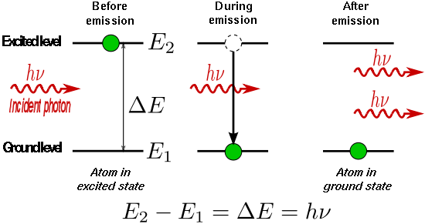
Stimulated Emission
The stimulated photons have unique properties:
  In phase with the incident photon
  Same wavelength as the incident photon
  Travel in same direction as incident photon

Slide 11

Laser Fundamentals
The light emitted from a laser is monochromatic, that is, it is of one color/wavelength. In contrast, ordinary white light is a combination of many colors (or wavelengths) of light.
Lasers emit light that is highly directional, that is, laser light is emitted as a relatively narrow beam in a specific direction. Ordinary light, such as from a light bulb, is emitted in many directions away from the source.
The light from a laser is said to be coherent, which means that the wavelengths of the laser light are in phase in space and time. Ordinary light can be a mixture of many wavelengths.
These three properties of laser light are what can make it more hazardous than ordinary light. Laser light can deposit a lot of energy within a small area.

Slide 12
Incandescent vs. Laser Light
Many wavelengths
Multidirectional
Incoherent
Monochromatic
Directional
Coherent

Slide 13
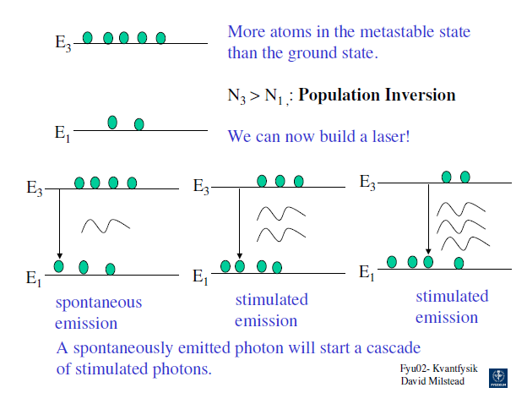
Population Inversion
The process by which the population of a particular higher energy state is made more than that of a specified lower energy state is called population inversion.
N₂ > N₁

Slide 14
Boltzmann Population Factors
In the absence of collisions,
molecules tend to remain
in the lowest energy state
available.
Collisions can knock a mole-
cule into a higher-energy state.
The higher the temperature,
the more this happens.
Low T
High T
3
3
Energy
Energy
2
2
1
1
Molecules
Molecules
In equilibrium, the ratio of the populations of two states is:
N₂ / N₁ = exp(–ΔE/k_{B}T ), where Δ E = E₂ – E₁ = hυ
As a result, higher-energy states are always less populated than the ground state, and absorption is stronger than stimulated emission.

Slide 15

Pump Source
A pump is basic energy source for a laser. It gives energy to various atoms of laser medium & excites them . So that population inversion can take place & it is maintained with time. The excitation of atom occur directly or through atom or atom collision.
There is various type of pump depending upon nature of medium .Examples: electric discharges, flash-lamps, arc lamps and chemical reactions.
The type of pump source used depends on the gain medium.

Slide 16

PUMPING
Optical Pumping
Electrical discharge method
Inelastic atom – atom collision
Direct Conversion
Chemical process

Slide 17
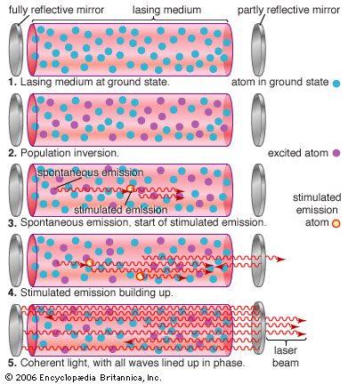

PRINCIPLE OF LASER ACTION
Due to stimulated emission the photons multiply in each step giving rise to an intense beam of photons that are coherent and moving in the same direction . Hence the Light Is Amplified by Stimulated Emission of Radiation

Slide 18
Components of LASER
PUMP.
ACTIVE MEDIUM.
OPTICAL RESONATOR.
A pump is basic energy source for a laser. It gives energy to various atoms of laser medium & excites them . So that population inversion can take place & it is maintained with time. The excitation of atomoccur directly or through atom or atom collision.
There is various type of pump depending upon nature of medium
When energy is given to laser medium a small fraction of medium shows lasing action. This part of laser medium is called Active centers. For examples in ruby laser Cr⁺⁺⁺ is active center, in He-Ne laser Ne are active centers.
It is an set up used to obtain amplification of stimulated photons, by oscillating them back & forth between two extreme limits. Consist of:
Two plane or concave mirrors placed co-axially.
One mirror is reflecting & other is partially reflecting.

Slide 19
Laser Components
Optical Resonator
Output
Beam
Active
Medium
High Reflectance
Mirror (HR)
Output Coupler
Mirror (OC)
Excitation Mechanism

Slide 20
Optical Resonator
Two parallel mirrors placed around the gain medium.
Light is reflected by the mirrors back into the medium and is amplified .
The design and alignment of the mirrors with respect to the medium is crucial.
Spinning mirrors, modulators, filters and absorbers may be added to produce a variety of effects on the laser output.

Slide 21
Lasing Action
Energy is applied to a medium raising electrons to an unstable energy level.
These atoms spontaneously decay to a relatively long-lived, lower energy, meta-stable state.
A population inversion is achieved when the majority of atoms have reached this meta-stable state.
Lasing action occurs when an electron spontaneously returns to its ground state and produces a photon.
If the energy from this photon is of the precise wavelength, it will stimulate the production of another photon of the same wavelength and resulting in a cascading effect.
The highly reflective mirror and partially reflective mirror continue the reaction by directing photons back through the medium along the long axis of the laser.
The partially reflective mirror allows the transmission of a small amount of coherent radiation that we observe as the “beam”.
Laser radiation will continue as long as energy is applied to the lasing medium.

Slide 22

Lasing Action Diagram
Excited State
Spontaneous Energy Emission
Energy Introduction
Metastable State
Stimulated Emission of Radiation
Ground State

Slide 23
The Laser
A laser is a medium that stores energy, surrounded by two mirrors.
A partially reflecting output mirror lets some light out.
I₀
I₁
I₃
Laser medium with gain, G
I₂
R = 100%
R < 100%
A laser will lase if the beam increases in intensity during a round trip:
that is, if
Usually, additional losses in intensity occur, such as absorption, scattering, and reflections. In general, the laser will lase if, in a round trip:
Gain > Loss This called achieving Threshold.

Slide 24
Laser Systems
fast
Metastable state
slow
Population inversion
slow relaxation
efficient pumping
Fast relaxation
FOUR LEVEL LASER

Slide 25
FOUR LEVEL LASER:
STEP 1- PUMPING: atoms are excited to higher energy level by providing energy from ext. source.
STEP 2- POPULATION INVERSION:
atom via radiation less decay, decays to meta-stable state and hence population inversion take place.
STEP 3- LASER ACTION: atom from meta-stable state decays to lower state by stimulated emission and hence laser action take place.
STEP 4- BACK TO GROUND STATE:
atom from excited state decays to lower state by spontaneous emission.

Slide 26
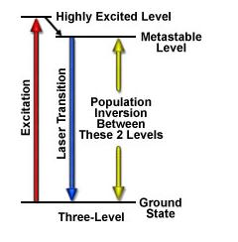
Three-level Laser System
Initially excited to a short-lived high-energy state .
Then quickly decay to the intermediate meta-stable level.
Population inversion is created between lower ground state and a higher-energy metastable state.

Slide 27
Two-level Laser System
Unimaginable
as absorption and stimulated processes neutralize one another.
The material becomes transparent.

Slide 28
Two-level Laser System
E_{m}, N_{m}
E_{m}, N_{m}
E_{n}, N_{n}
E_{n}, N_{n}
Even with very a intense pump source, the best one can achieve with a two-level system is
excited state population = ground state population

Slide 29
Two, three & four level System
It took laser physicists a while to realize that four-level systems are best.
Two-level system
Three-level system
Four-level system
Fast decay
Fast decay
Pump Transition
Pump Transition
Laser Transition
Laser Transition
Laser Transition
Pump Transition
Fast decay
At best, you get equal populations. No lasing.
If you hit it hard, you get lasing.
Lasing is easy!

Slide 30
Laser Class
Laser can be classified on the basis of their active region and their output. According to active mediums we have....
Solid state lasers
Gas lasers
Semiconductor lasers
Liquid dye lasers
Excimer lasers
According to output we have………..
Continuous – wave Laser
Pulsed Laser

Slide 31
Ruby Laser
Introduction
A ruby laser is a solid-state laser that uses a synthetic ruby crystal as its gain medium.
It was the first type of laser invented, and was first operated by Theodore H. "Ted" Maiman at Hughes Research Laboratories on 1960-05-16 .
The ruby mineral (corundum) is aluminum oxide with a small amount(about 0.05%) of chromium which gives it its characteristic pink or red color by absorbing green and blue light. The ruby laser is The ruby laser is used as a pulsed laser, producing red light at 694.3 nm. After receiving a pumping flash from the flash tube, the laser light emerges for as long as the excited atoms persist in the ruby rod, which is typically about a millisecond.

Slide 32
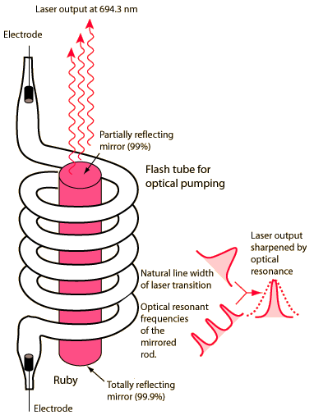

Slide 33
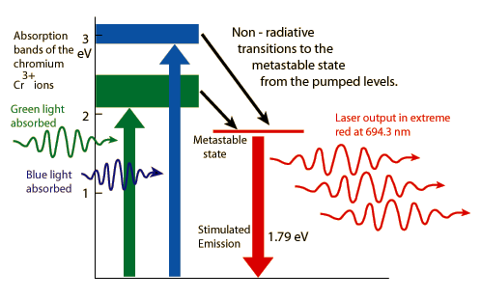
Working of ruby laser
Ruby laser is based on three energy levels. The upper energy level E3 I short-lived, E1 is ground state, E2 is metastable state with lifetime of 0.003 sec.

Slide 34
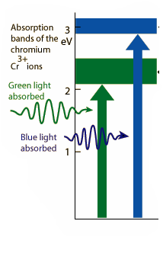
When a flash of light falls on ruby rod, radiations of wavelength 5500 are absorbed by Cr3+ which are pumped to E3.

Slide 35

The ions after giving a part of their energy to crystal lattice decay to E2 state undergoing radiation less transition.
Metastable state
In meta-stable state , the concentration of ions increases while that of E1 decreases. Hence, population inversion is achieved.

Slide 36


A spontaneous emission photon by Cr³⁺ ion at E2 level initiates the stimulated emission by other Cr³⁺ ions in meta-stable state
Metastable state

Slide 37
Applications of Ruby laser
Ruby lasers have declined in use with the discovery of better lasing media. They are still used in a number of applications where short pulses of red light are required. Holographers around the world produce holographic portraits with ruby lasers, in sizes up to a metre squared.
Many non-destructive testing labs use ruby lasers to create holograms of large objects such as aircraft tires to look for weaknesses in the lining.
Ruby lasers were used extensively in tattoo and hair removal

Slide 38
Drawbacks of Ruby laser
The laser requires high pumping power because the laser transition terminates at the ground state and more than half of ground state atoms must be pumped to higher state to achieve population inversion.
The efficiency of ruby laser is very low because only green component of the pumping light is used while the rest of components are left unused.
The laser output is not continuous but occurs in the form of pulses of microseconds duration.
The defects due to crystalline imperfection are also present in this laser.

Slide 39
Helium-Neon laser
Laser medium is mixture of Helium and Neon gases in the ratio 10:1
Medium excited by large electric discharge, flash pump or continuous high power pump
In gas, atoms characterized by sharp energy levels compared to solids
Actual lasing atoms are the Neon atoms
Pumping action
Electric discharge is passed through the gas
Electrons are accelerated, collide withs He atoms and excite them to higher energy levels

Slide 40
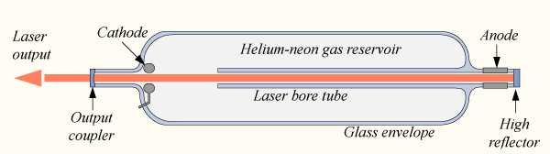
He-Ne lasers are normally small, with cavity lengths of around 15 cm up to 0.5 m.
The optical cavity of the laser typically consists of a plane, high-reflecting mirror at one end of the laser tube, and a concave output coupler mirror of approximately 1% transmission at the other end.
Electric discharge pumping is used.
Optical output powers ranging from 1 mW to 100 mW.

Slide 41
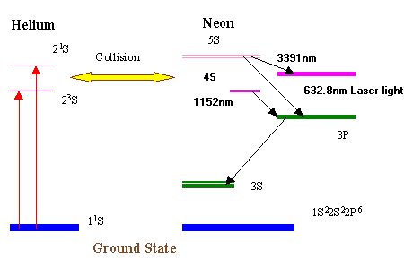
Energy level diagram
Working of he-ne laser

Slide 42
Applications of he-ne laser
It is used in laboratories to perform experiments.
It is used in optical communication without fibre for moderate distance.
It is used to produce holograms.
Advantages of he-ne laser
Operates in a continuous-wave mode.
It has stability of frequency.
No cooling is required.
Less expensive.

Slide 43
Semiconductor Diode laser
Homo-junction Semiconductor Laser
Introduction
It is a solid state semiconductor laser
P-N junction diode made from single crustal of GaAs .
Direct conversion method is used for pumping.
It has output wavelength 8300 to 8500 A⁰
The output power is 1mW.

Slide 44
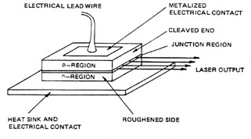
Construction of Laser Diode
P-N junction made from a single crystalline material gallium Arsenide (GaAs).
P-region is doped with germanium and N-region is doped with tellurium.
Thickness of P-N junction is about 1 μm.
End faces of junction diode are well polished and parallel to each other. So, they act as a optical resonator.
Electrodes are fitted on upper and lower surfaces.

Slide 45
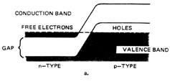
Working of laser diode
In semiconductor materials, electrons may have an energy within certain bands. The lower region is called the valence band and represents the energy states of bound electrons. The upper region is called the conduction band and represents the energy states of free or conduction electrons. Electrons may have energies in either of these bands, but not in the gap between the bands.

Slide 46

Working of laser diode continued…
When a forward voltage is applied to the diode, the energy levels are caused to shift. Under these conditions there is a significant increase in the concentration of electrons in the conduction band near the junction on the n-side and the concentration of holes in the valence band near the junction on the p-side. The electrons and holes recombine (conduction band electrons move into empty valence band states) and energy is given off in the form of photons. The energy of the photon resulting from this recombination is equal to that associated with the energy gap. This energy is often in the form of electromagnetic radiation. In laser diode this light energy is transmitted out through the sides of the junction region. In semiconductor lasers the junction forms the active medium, and the reflective ends of the laser material provide feedback.

Slide 47
Advantages of semiconductor laser
Very small in Dimension.
High efficiency
Operated at low power
It can have continuous or pulsed output.
Applications of semiconductor laser
In fibre optic communication.
It can be used to heal the wounds by means of infrared radiation.
It can be used as a relief to kill the pain.

Slide 48
Semiconductor Diode laser
Hetro-junction Semiconductor Laser
Introduction
P-N junction diode made from different layers.
Direct conversion method is used for pumping.
It has output of wavelength nearly 8000 A⁰
The output power is of continuous wave form.

Slide 49
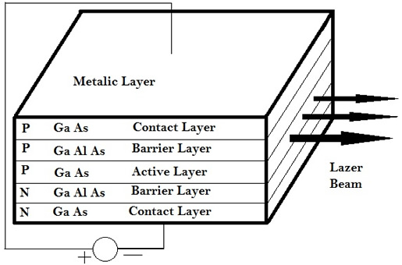
Construction of Laser Diode
A hetro-junction semiconductor laser consists of five layers. Third acts as a active region.
The second layer is P-type semiconductor GaAlAs and fourth layer is n-type semiconductor GaAlAs.
The end faces of 2nd and 4th layer are well polished and parallel to each other to act as an optical resonator.
Two electrodes are fixed on the top and bottom layer of the crystal.

Slide 50
Working of hetro-junction s/c Diode laser
Working of Hetro-junction semiconductor is same as homo-junction laser diode.
Advantages of hetro-junction s/c diode laser
It produces continuous wave output.
The power output is very high.
disAdvantages of hetro-junction s/c diode laser
It is difficult to grow different layers of P-N junction.
The cost of the laser is high

Slide 51
Comparison chart for all the lasers
Characteristics | Ruby laser | He-Ne laser | Semiconductor (Ga-As) laser
Type | solid state laser | Gas laser | Semiconductor laser
Active medium | Al₂O₃ | Mixture of Helium and Neon in the ratio 10:1 | P-N junction diode
Active centre | Chromium (Cr³⁺ ions) | Neon | Recombination of electrons & holes
Pumping method | Optical pumping | Electrical pumping | Direct pumping
Nature of output | Pulsed | Continuous waveform | Pulsed (or) continuous wave form
wavelength | 6943 A⁰ | 6328 A⁰ | 8300A⁰ - 8600A⁰

Slide 52
CO₂ ( Carbon dioxide ) LASER
Principle :
The transition between the rotational and vibrational energy levels lends to the construction of a molecular gas laser. Nitrogen atoms are raised to the excited state which in turn deliver energy to the CO₂ atoms whose energy levels are close to it. Transition takes place between the energy levels of CO₂ atoms and the laser beam is emitted.
Type | : | Molecular gas laser
Active Medium | : | Mixture of CO₂, N₂, He or H₂O vapour
Active Centre | : | CO₂
Pumping Method | : | Electric Discharge Method
Optical Resonator | : | Gold mirror or Si mirror coated with Al
Power Output | : | 10 kW
Nature of Output | : | Continuous or pulsed
Wavelength Emitted | : | 9.6 μm or 10.6 μm
Characteristics :

Slide 53
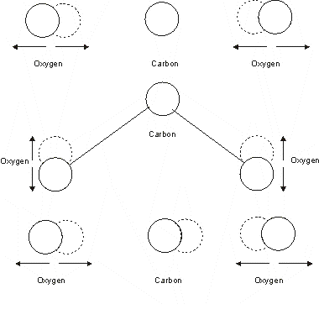
A carbon dioxide (CO₂) laser can produce a continuous laser beam with a power output of several kilowatts while, at the same time, can maintain high degree of spectral purity and spatial coherence.
In comparison with atoms and ions, the energy level structure of molecules is more complicated and originates from three sources: electronic motions, vibrational motions and rotational motions.
Modes of vibration in CO₂
Symmetric | C - stationary O - vibrates simultaneously along molecular axis
Bending | C & O vibrate perpendicular to molecular axis
Asymmetric Stretching | C & O atoms vibrate in opposite directions along molecular axis

Slide 54
As the electric discharge is passed through the tube, which contains a mixture of carbon dioxide, nitrogen and helium gases, the electrons striking nitrogen molecules impart sufficient energy The energy level diagram of vibrational – rotational energy levels with which the main physical processes taking place in this laser.
o raise them to their first excited vibrational-rotational energy level.
This energy level corresponds to one of the vibrational - rotational level of CO₂ molecules, designated as level 4.
Collision with N₂ molecules, the CO₂ molecules are raised to level 4.
The lifetime of CO₂ molecules in level 4 is quiet significant to serve practically as a metastable state.

Slide 55
Hence, population inversion of CO₂ molecules is established between levels 4 and 3, and between levels 4 and 2.
The transition of CO₂ molecules between levels 4 and 3 produce lasers of wavelength 10.6 microns and that between levels 4 and 2 produce lasers of wavelength 9.6 microns.
The He molecules increase the population of level 4, and also help in emptying the lower laser levels.
The molecules that arrive at the levels 3 and 2 decay to the ground state through radiative and collision induced transitions to the lower level 1, which in turn decays to the ground state.
The power output of a CO₂ laser increases linearly with length. Low power (upto 50W) continuous wave CO₂ lasers are available in sealed tube configurations.

Slide 56
Application of CO₂ Laser
Because of the high power levels available (combined with reasonable cost for the laser), CO₂ lasers are frequently used in industrial applications for cutting and welding, while lower power level lasers are used for engraving.
They are also very useful in surgical procedures because water (which makes up most biological tissue) absorbs this frequency of light very well. Some examples of medical uses are laser surgery and skin resurfacing ("laser facelifts", which essentially consist of vaporizing the skin to promote collagen formation). Also, it could be used to treat certain skin conditions such as hirsuties papillaris genitalis by removing embarrassing or annoying bumps, podules, etc. Researchers in Israel are experimenting with using CO₂ lasers to weld human tissue, as an alternative to traditional sutures.
The common plastic poly (methyl methacrylate) (PMMA) absorbs IR light in the 2.8–25 µm wavelength band, so CO₂ lasers have been used in recent years for fabricating microfluidic devices from it, with channel widths of a few hundred micrometers.
Because the atmosphere is quite transparent to infrared light, CO₂ lasers are also used for military rangefinding using LIDAR techniques.
CO₂ lasers are used in the Silex process to enrich uranium.
The Soviet Polyus was designed to use a megawatt carbon-dioxide laser as an orbit to orbit weapon to destroy SDI satellites.

Slide 57
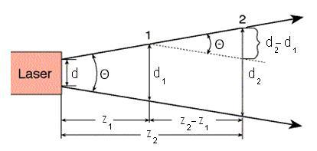


Beam divergence:
The light emitted by a laser is confined to a rather narrow cone. But, when the beam propagates outward, it slowly diverges or fans out. For an electromagnetic beam, beam divergence is the angular measure of the increase in the radius or diameter with distance from the optical aperture as the beam emerges.
The divergence of a laser beam can be calculated if the beam diameter d₁ and d₂ at two separate distances are known. Let z₁and z₂ are the distances along the laser axis, from the end of the laser to points “1” and “2”.
Usually, divergence angle is taken as the full angle of opening of the beam. Then,
Half of the divergence angle can be calculated as
Where w₁ and w₂ are the radii of the beam at z₁ and z₂.
Like all electromagnetic beams, lasers are subject to divergence, which is measured in milliradians (mrad) or degrees. For many applications, a lower-divergence beam is preferable.

Slide 58
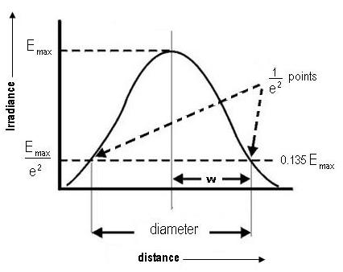

Spot size:
Spot size is nothing but the radius of the beam itself. The irradiance of the beam decreases gradually at the edges.
The distance across the center of the beam for which the irradiance (intensity) equals 1/e² of the maximum irradiance (1/e² = 0.135) is defined as the beam diameter. The spot size (w) of the beam is defined as the radial distance (radius) from the center point of maximum irradiance to the 1/e² point.
Gaussian laser beams are said to be diffraction limited when their radial beam divergence is close to the minimum possible value, which is given by
Where λ is the wavelength of the given laser and w₀ is the radius of the beam at the narrowest point, which is termed as the beam waist.

Slide 59

Coherence length
Coherence length is the propagation distance over which a coherent wave (e.g. an electromagnetic wave) maintains a specified degree of coherence. Wave interference is strong when the paths taken by all of the interfering waves differ by less than the coherence length. A wave with a longer coherence length is closer to a perfect sinusoidal wave.
The coherence length is approximated by
Where
c is the speed of light in a vacuum,
n is the refractive index of the medium, and
Is the bandwidth of the source.

Slide 60
Thank you

