Slide 1
HISTORY OF ENGLISH LITERATURE-II

Slide 2
PERIODICAL ESSAY
The periodical Essay was the unfamiliar product of the 18th century social life and its conditions.
It is called “periodical” because it was not published in book form but was published in journals and magazine which appeared “periodically’, i.e the improvement of the manners and morals of the people.

Slide 3
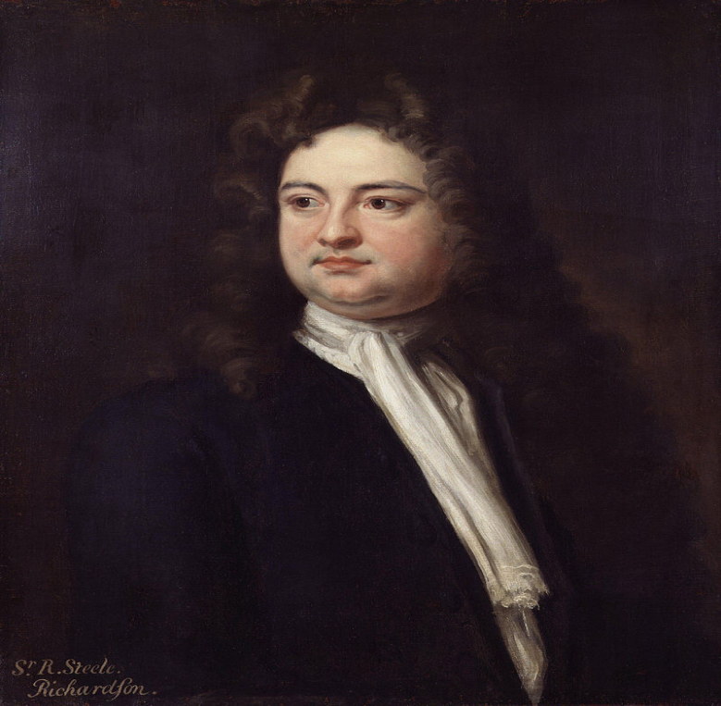
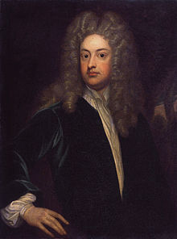
Steel & Addison
STEEL
ADDISON

Slide 4
Steele & Addison
In May 1707, Richard Steel was appointed Gazetter, the conception of the Tatler dawned upon him.
His object in bringing of out was “to publish a paper which should observe upon the manners of the pleasurable as well as the busy part of mankind”, that is, to exhibit contemporary manners with a view to amusing and instructing his readers.

Slide 5
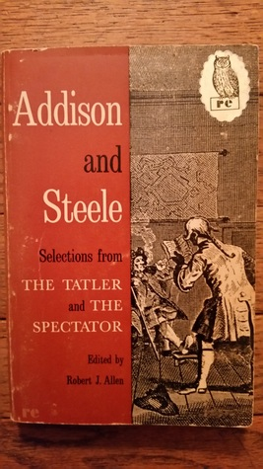
In 1711, The Tatler came to an end, and The Spectator, a joint effort by Joseph Addison and Richard

Slide 6
cont…
In the new magazine politics and news, as such were ignored; it was a literary magazine, pure and simple, and its entire contents consisted of a single light essay.
It is in the incomparable Spectator papers that Addison shows himself most “worthy to be remembered”.
He contributed the majority of its essays, and in its first number appears this description of the Spectator.

Slide 7
Thank you
ABINAYA. A
Asst.Professor Of English
BON SECOURS COLLEGE FOR WOMEN

