Slide 1
FUNCTION OF Management
R. DEVI ., M.A., M.Phil.,
Assistant Professor Department of History
Bon Secours college for women, Thanjavur

Slide 2
INTRODUCTION
Management has been described as a social process involving responsibility for economical and effective planning & regulation of operation of an enterprise in the fulfilment of given purposes. Different experts have classified functions of management.
According to George & Jerry, “There are four fundamental functions of management i.e. planning, organizing, actuating and controlling”.
According to Henry Fayol, “To manage is to forecast and plan, to organize, to command, & to control”. Whereas Luther Gullick has given a keyword ’POSDCORB’ where P stands for Planning, O for Organizing, S for Staffing, D for Directing, Co for Co-ordination, R for reporting & B for Budgeting. But the most widely accepted are functions of management given by KOONTZ and O’DONNEL i.e. Planning, Organizing, Staffing, Directing and Controlling.
For theoretical purposes, it may be convenient to separate the function of management but practically these functions are overlapping in nature i.e. they are highly inseparable.

Slide 3
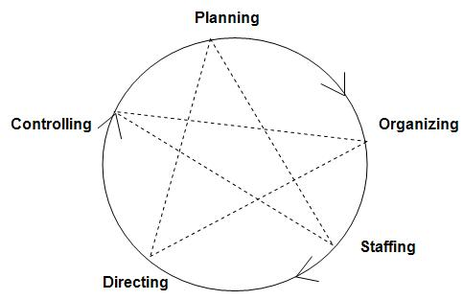
Functions of Management

Slide 4
PLANNING
It is the basic function of management. It deals with chalking out a future course of action & deciding in advance the most appropriate course of actions for achievement of pre-determined goals. According to KOONTZ, “
Planning is deciding in advance - what to do, when to do & how to do. It bridges the gap from where we are & where we want to be”. A plan is a future course of actions. It is an exercise in problem solving & decision making.
Planning is determination of courses of action to achieve desired goals. Thus, planning is a systematic thinking about ways & means for accomplishment of pre-determined goals. Planning is necessary to ensure proper utilization of human & non-human resources. It is all pervasive, it is an intellectual activity and it also helps in avoiding confusion, uncertainties, risks, wastages etc.

Slide 5
ORGANIZING
It is the process of bringing together physical, financial and human resources and developing productive relationship amongst them for achievement of organizational goals. According to Henry Fayol, “To organize a business is to provide it with everything useful or its functioning i.e. raw material, tools, capital and personnel’s”. To organize a business involves determining & providing human and non-human resources to the organizational structure. Organizing as a process involves:
  Identification of activities.
  Classification of grouping of activities.
  Assignment of duties.
  Delegation of authority and creation of responsibility.
  Coordinating authority and responsibility relationships.

Slide 6
STAFFING
It is the function of manning the organization structure and keeping it manned. Staffing has assumed greater importance in the recent years due to advancement of technology, increase in size of business, complexity of human behaviour etc. The main purpose o staffing is to put right man on right job i.e. square pegs in square holes and round pegs in round holes. According to Kootz & O’Donell, “Managerial function of staffing involves manning the organization structure through proper and effective selection, appraisal & development of personnel to fill the roles designed un the structure”. Staffing involves:
  Manpower planning (estimating man power in terms of searching, choose the person and giving the right place).
  Recruitment, Selection & Placement.
  Training & development
  Remuneration
  Performance appraisal
  Promotions & Transfer.

Slide 7
DIRECTING
It is that part of managerial function which actuates the organizational methods to work efficiently for achievement of organizational purposes. It is considered life-spark of the enterprise which sets it in motion the action of people because planning, organizing and staffing are the mere preparations for doing the work. Direction is that inert-personnel aspect of management which deals directly with influencing, guiding, supervising, motivating sub-ordinate for the achievement of organizational goals. Direction has following elements:
  Supervision
  Motivation
  Leadership
  Communication

Slide 8
CONTROLLING
It implies measurement of accomplishment against the standards and correction of deviation if any to ensure achievement of organizational goals. The purpose of controlling is to ensure that everything occurs in conformities with the standards. An efficient system of control helps to predict deviations before they actually occur. According to Theo Haimann, “Controlling is the process of checking whether or not proper progress is being made towards the objectives and goals and acting if necessary, to correct any deviation”. According to Koontz & O’Donell “Controlling is the measurement & correction of performance activities of subordinates in order to make sure that the enterprise objectives and plans desired to obtain them as being accomplished”. Therefore controlling has following steps:
  Establishment of standard performance.
  Measurement of actual performance.
  Comparison of actual performance with the standards and finding out deviation if any.
  Corrective action.

Slide 9


