Slide 1
Presented by
P.Manicka Jothi
Assistant Professor
Dept of Social Work
Bon Secours college for women, Thanjavur

Slide 19
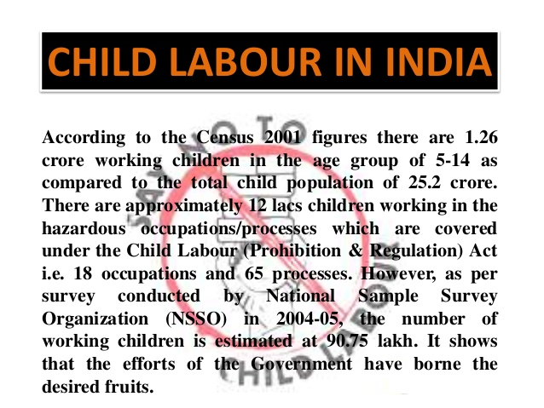

Slide 26
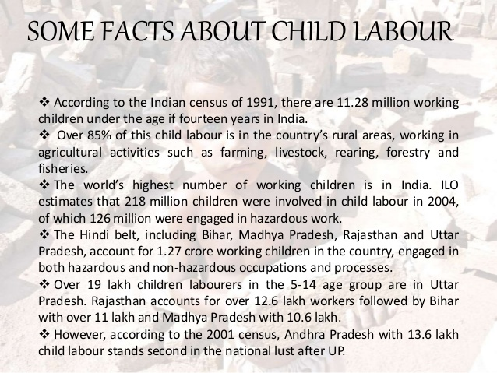

Slide 28
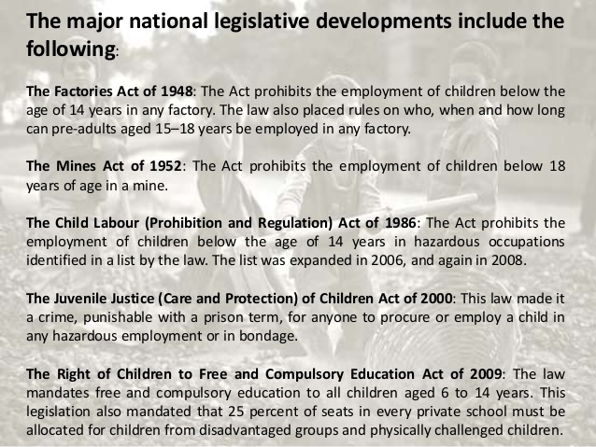

Slide 29
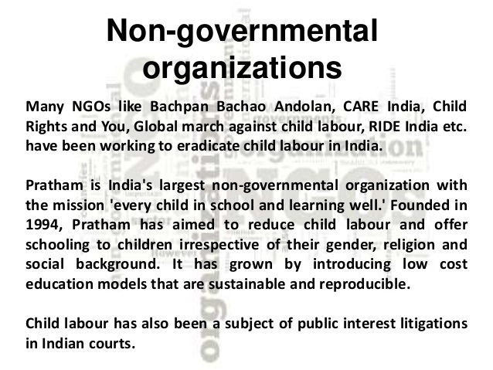

Slide 31
Untouchablity

Slide 36
Thank You

