Slide 1
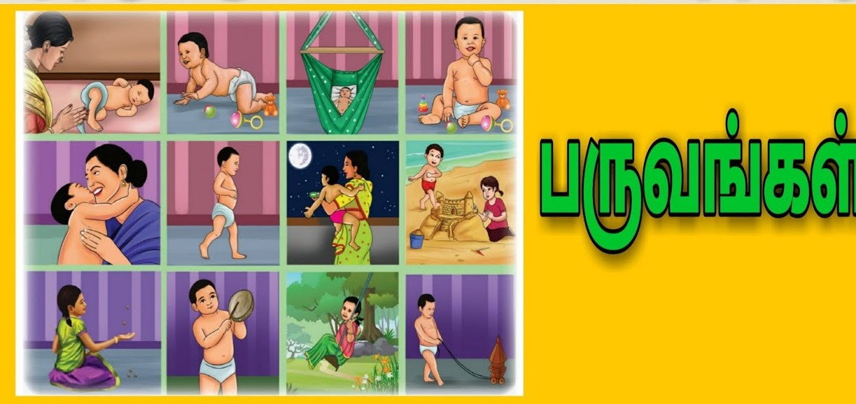
rpw;wpyf;fpak;
Kidtu; uh. gpupah
cjtpNguhrpupau;> jkpo;j;Jiw
ghd; nrf;fu;]; kfspu; fy;Y}up
jQ;rhT+u;

Slide 2
,yf;fpaq;fs; tiffs;
jkpo; nkhopapy; gy;NtW ,yf;fpaq;fs; fhzg;gLfpd;wd. mtw;iw nghJthf gpd;tUkhW tifg;gLj;jyhk;.
jkpo; ,yf;fpak;
rq;f ,yf;fpak;
ePjp ,yf;fpak;
fhg;gpa ,yf;fpak;
gf;jp ,yf;fpak;
rpw;wpyf;fpak;
,f;fhy ,yf;fpak;

Slide 3
jkpo; ,yf;fpa tifapy; rpw;wpyf;fpak; xd;W vd;gij ehk; mwpayhk;. rpw;wpyf;fpak; 96 tifg;gLk;.
Kjd; Kjypy; rpw;wpyf;fpak; vd;gJ gpuge;jk; vd;w nrhy;yhy; toq;fg;gl;L te;jJ. gpuge;jk; vd;gJ rk];fpUj nkhop nrhy; MFk;. gpuge;jk; vd;w nrhy;ypd; nghUs; ed;F fl;lg;gl;lJ mjhtJ ed;F ,aw;wg;gl;lJ. vd;gJ nghUs;gLk;. rpWgpuge;jk; vd;gJ rpw;wpyf;fpak; vd;w nrhy;yhy; miof;fg;gl;lJ.

Slide 4
rpw;wpyf;fpak; tpsf;fk;
fhg;gpak; Nghd;W fij njhlu;r;rp ,y;yhky; jdpjdp vz;zq;fs; jdpjdp czu;Tfs; jdpj;jdp ghly;fs; mike;J VNjh xU tifapy; njhlu;e;J tUtJ rpw;wpyf;fpak; vd;gu;.
rpw;wpyf;fpak; ghly; vz;zpf;if mbfspy; RUq;fpajhf miktJ.
mfg;nghUs; my;yhJ Gwg;nghUspy; VNjDk; xU Jiwiag; gw;wpajhf mikAk;.
,iwtd; kd;dd; ts;sy; Qhdf;Futu; rhjhuz kf;fs; KjypNahUs; xUtiu jiytuhf nfhz;L ghlg;gLk; ,yf;fpa tif.
mwk;.nghUs; ,d;gk; tPL vDk; ehd;F cWjpg; nghUs;fSs; VNjDk; xd;iw gw;wp $Wtjhf mikAk;.
gy;NtW tifahd ahg;G mikg;Gfshy; ghlg;gLk;.
,t;tifapy; J}J cyh gps;isj;jkpo; fyk;gfk; Nfhit FwtQ;rp Nghd;w gytif ,yf;fpaq;fs; rpw;wpyf;fpak; vd;w tifikAs;slq;Fk;.

Slide 5
gps;isj;jkpo;
gps;isj; jkpo; ,yf;fzk;
Fotp kUq;fpDk; fpotJ MFk;
( njhy;fhg;gpa E}w;gh Gwk;.24
gps;isj;jkpo; vd;gJ jkpo; ,yf;fpaj;jpy; toq;Fk; rpw;wpyf;fpa tiffspy; xd;W Gytu;fs; jhd; tpUk;gpa nja;tq;fs; Gytu; muru>; rka rhupau;fs;> mtu;fSf;F cfe;jtu;fs; MfpNauiuf; Foe;ijahf cUtfpj;J fw;gid gy mikag; ghlg;gLtJ gps;isj;jkpohFk;.
gps;isj;jkpo; ,uz;L tifg;gLk;
1. Mz;ghy; gps;isj;jkpo;
2. ngz;ghy; gps;isj;jkpo

Slide 6
gps;isj; jkpo; E}y;fs;
FNyhj;Jq;fd; gps;isj;jkpo; E}y; Kjy; E}yhFk;. fp.gp 12k; E}w;whz;ilr; Nru;e;jJ FNyhj;Jq;f Nrhoid ghl;Lilj; jiytdhf nfhz;L ghlg;gl;lJ. gpd; FkuFUguu;> kfhtpj;Jthd;> kPdhl;rp Re;juk; gps;is Kjyhd Gytu;fshy; gps;isj;jkpo; tsu;r;rp mile;jJ. ,JtiuAk; Ke;E}Wf;Fk; Nkw;gl;l gps;isj;jkpo; E}y;fs; cs;sd.

Slide 7
gUtq;fs; tpsf;fk;
jkpou; gz;ghl;by; Kjy; ,uz;L jpq;fs;fs; Foe;ijfis ntspapy; nfhz;L tu khl;lhu;fs;. vdNt gps;isj;jkpo; Kd;W khjk; Kjy; ,Ugj;njhU khjk; tiuahd Foe;ijapd; tho;f;if fhyj;ij gj;J gUtq;fshf gpupj;J fhz;gtu; xt;nthU gUtj;Jf;Fk; gj;Jg;ghly;fs; tPjk; mikj;Jg;ghlg;gLtJ tof;F.

Slide 8
Foe;ijapd; %d;whk; khjk; njhlq;fp ,Ugj;Njhuhk; khjk; tiu gj;J gUtq;fis mikj;Jg; ghLtJ tof;fk;
“ gps;isg;ghl;Nl njs;spjpd; fpsg;gpd;
%d;W Kjhyh %Nto; msTk;
Md;w jpq;fspy; miwFtu; epiyNa”
( gd;dpU ghl;bay;)

Slide 9
VO gUtq;fs; ,Ughyu;fSf;Fk; nghJthd gUtq;fs; MFk;.
3-k; jpq;fs; fhg;G gUtk;
5-k; jpq;fs; nrq;fPiu gUtk;
7-k; jpq;fs; jhyhl;L gUtk;
9-k; jpq;fs; rg;ghzp gUtk;
11-k; jpq;fs; Kj;jk; gUtk;
13-k; jpq;fs; tUif gUtk;
15-k; jpq;fs; - mk;Gyp gUtk;

Slide 10
nghJthf gps;isj;jkpo; gpwg;G Kjy; G+g;G va;Ak; tiu ngz;fSf;Fk;. Mz;fs; gjpdhW taJ tiug; ghlg;gLfpwJ.
Mz;fSf;Fupa gUtq;fs;
rpw;wpy;
rpWgiw
rpWNju;
ngz;fSf;Fupa gUtq;fs;
ePuhly;
mk;khid
Cry;

Slide 11
fhg;Gg; gUtk;
gps;isj;jkpo; ,yf;fpaj;jpy; Kjy; gUtk; fhg;Gg;gUtk; MFk;. gps;isj;jkpo; ,yf;fpak; rpwf;fTk; jpUkhy; Kjy; Kg;gj;J Kf;Nfhb Njtu;fs; <whfg; gy flTsUk; Foe;ijiaf; fhf;FkhW Ntzbg;ghLtJ fhg;Gg;gUtk;.

Slide 12
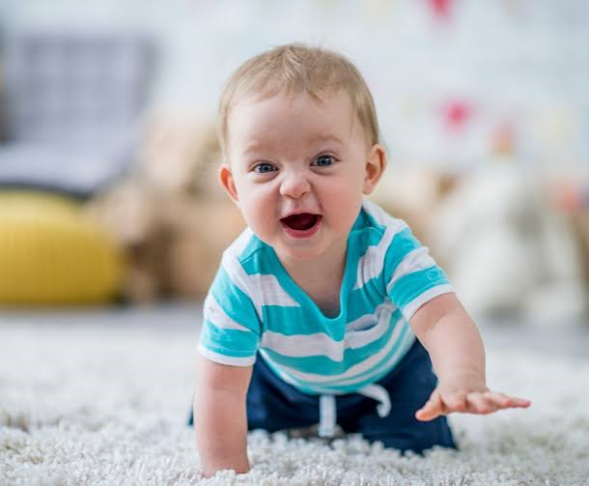
nrq;fPiug; gUtk;
,uz;lhk; gUtk; nrq;fPiug; gUtkhFk;. Foe;ijapd; Ie;jhk; jpq;fspy; epfo;tjhFk.; ,JFoe;ijapd; koiyia tpl ,dpikahd nghUs; njhpahj Xiria vOg;Gk; gUtk; MLf nrq;fPiu vdg;ghLtjhy; Foe;ij xUfhiy cau;j;jpAk; xU fhiy klf;fpAk; ,U iffisAk; epyj;jpy; Cd;wp Kfj;ij NkNy cau;j;jp MLk; gUtk.;

Slide 13
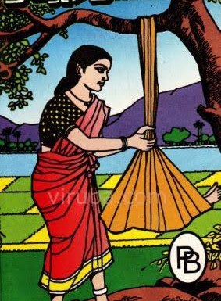
jhyg;gUtk;
Gps;isj;jkpo; %d;whk; gUtk; jhyg;gUtk; MFk;. Vohk; jpq;fspy; epfo;tjhFk;. jhy; vd;gJ ehf;F ehf;if mirj;J jhyl;L ghb Foe;ijia J}q;f itg;gJ.

Slide 14
rg;ghzp gUtk;
Foe;ijapd; xd;gjhk; jpq;fspy; epfo;tJ. Foe;ij cl;fhu njhlq;fpa gpwF kfpo;r;rpahy; if nfhl;Ljy; ifahl;Ljy; Nghd;w tpisahl;Lfs; Foe;ijaplk; ,ay;ghf Njhd;Wk; ,U iffisAk; Nru;j;J xyp vOg;Gjy; rg;ghzp gUtk; MFk;.

Slide 15
Kj;jg;gUtk;
Foe;ijapd; gjpndhuhk; jpq;fspy; epfo;tJ ,g;gUtk;. Kj;jg;gUtk; rpwe;jg;gUtkhf fUjg;gLfpwJ. Foe;ijia kbapy; J}f;fp itj;J mjd; kyupDk; nky;ypa ,jo;fshy; Kj;jk; ngw;W kfpo;jNy Kj;jg;gUtk; MFk;.

Slide 16
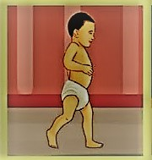
tUif gUtk;
Foe;ijapd; gjpd;%d;whk; jpq;fspy; epfo;tjhFk;. ,jid thuhid vd;Wk; Nghw;Wtu;. Jj;jpj; jj;jpj; jsu;eil ,l;L tUk; Foe;ijia mUfpy; tUf tUf vd miof;Fk; gUtk; MFk;.

Slide 17
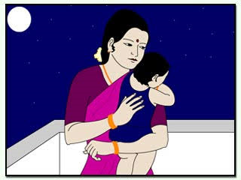
mk;Gypg; gUtk;
Foe;ijapd; gjpide;jhk; jpq;fspy; epfOk;. tpz;zpy; re;jpuid Foe;ijAld; tpisahl tUkhW miof;Fk; gUtNk mk;Gypg; gUtk;> rhk> Ngj> jz;lk;> jhdk; vd;w Kiwapy; epyit miog;gu;.

Slide 18
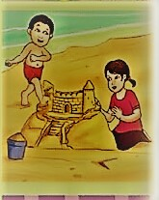
Rpw;wpy; rpijj;jy;
Foe;ijapd; gjpNdok; jpq;fspy; ,g;gUtk; ghlg;gLtjhFk;. ngz;gps;isfs; fl;ba rpw;wpiy Mz;Foe;ijfs; rpijf;f ngz;Foe;ijfs; vk; rpw;wpiy rpijf;f Ntz;lhk; vd Ntz;Lk; Kfkhf ghlg; gLtNj ,g;gUtk; MFk;.

Slide 19
rpWgiw Koq;fy;
Foe;ijapd; gj;njhd;gjhk; jpq;fspy; epfo;tjhFk;. ,g;gUtj;jpy; xyp ,dgq;fs; Foe;ijia kpfTk; <u;f;Fk; Mjyhy; rpW giw Kjypatw;iwf; nfhl;bf; nfhz;L tpisahLk; gUtk; MFk.;

Slide 20
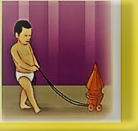
rpWNju;g;gUtk;
Foe;ijapd; ,uz;lhk; tajpy; epfo;tjhFk;. kuj;jhyhd rpwpa Njupid cUl;b kfpOk;gb Foe;ijia Ntz;bg;ghLtJ ,g;gUtk; kl eil gapYk; gUtj;jpy; cs;s Foe;ijapd; eilg;gapw;r;rpf;F cjTk; nghUl;L rpW Njupid Xl;b kfpor; nra;tu;.

Slide 21
ePuhly;
ngz; Foe;ijapd; gj;njhd;gjhk; jpq;fspy; epfo;tJ ,g;gUtkhFk;. Foe;ijia ePu; epiyfspy; ePuhl Ntz;bg;ghLk; gUtkhFk;

Slide 22
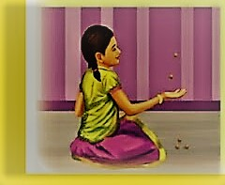
foq;F
ngz; Foe;ijfs; foq;F fha;fs; nfhz;L xd;wd; gpd; xd;whf NkNy vupe;J ifahy; gpbj;J tpisahLk; tpisahl;L MFk;.

Slide 23
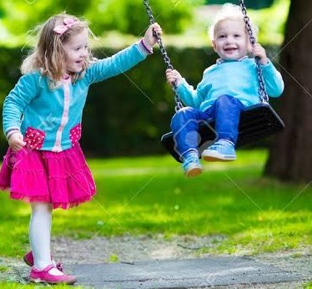
Cry;
Foe;ijia CQ;ryhb kfpOk; gb Ntz;Lk; gUtNk Cry; gUtk; Foe;ij CQ;rypy; mku;j;jp jhjpau; KjyhNdhu; Foe;ijapd; rpwg;Gfis vLj;Jiuj;J CQ;riy Ml;b Foe;ijia kfpo;tpg;gu;.

Slide 24
,iwtidNah ,iwtid xj;j rpwg;Gila khdpliuNah rpW Foe;ijahf ghtpj;J mtu;fs; Nky; ghly;fs; ghLtJ gps;isj;jkpo; ,yf;fpak; MFk;.
Foe;ijAk; moF> jkpOk; moF> mofhd Foe;ijia mofhd jkpopy; ghlg;gLk; ,e;j gps;isj;jkpo; ,yf;fpak; NguoF kpf;fJ. Vd;gij czuyhk;.

