Slide 1
Definition of History and Historiography
Dr.AGHALYA.,M.A.,M.Ed.,M.PHIL.,Ph.D.,
Head & Asst.Professor
Department of History
Bon Secours College for Women
Thanjavur

Slide 2
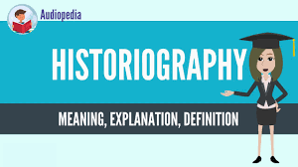

Slide 3
Introduction
History is the study of life in society in the past, in all its aspect, in relation to present developments and future hopes.
It is the story of man in time, an inquiry into the past based on evidence.
Indeed, evidence is the raw material of history teaching and learning.
It is an Inquiry into what happened in the past, when it happened, and how it happened.

Slide 4
Introduction
It is an inquiry into the inevitable changes in human affairs in the past and the ways these changes affect, influence or determine the patterns of life in the society.
History is, or should be an attempt to re-think the past. Collingwood (1945) is particularly interested in this concept of history.
History aims at helping students to understand the present existing social, political, religious and economic conditions of the people.
Without the knowledge of history we cannot have the background of our religion, customs institutions, administration and so on.

Slide 5
Introduction
The teaching of history helps the students to explain the present, to analyze it and to trace its course.
Cause and effect relationship between the past and the present is lively presented in the history.
History thus helps us to understand the present day problems both at the national and international level accurately and objectively.
In this unit we will be dealing with meaning, nature and scope of history, aims and objectives of teaching history at secondary level and values of teaching history.

Slide 6
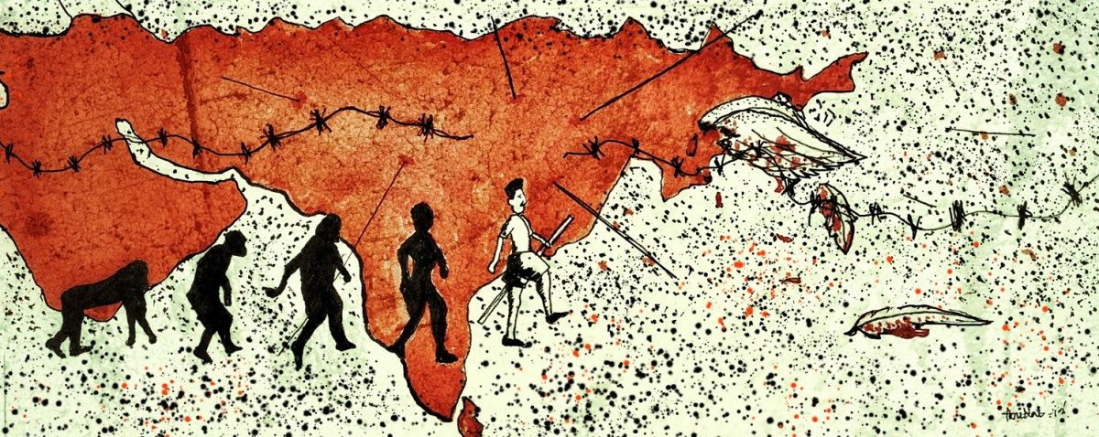

Slide 7
Objectives
The student will be able to:
Define History
Explain the nature of History
Describe the scope of History
Explain the aims and objectives of teaching History at Secondary level
Describe the values of teaching History

Slide 8
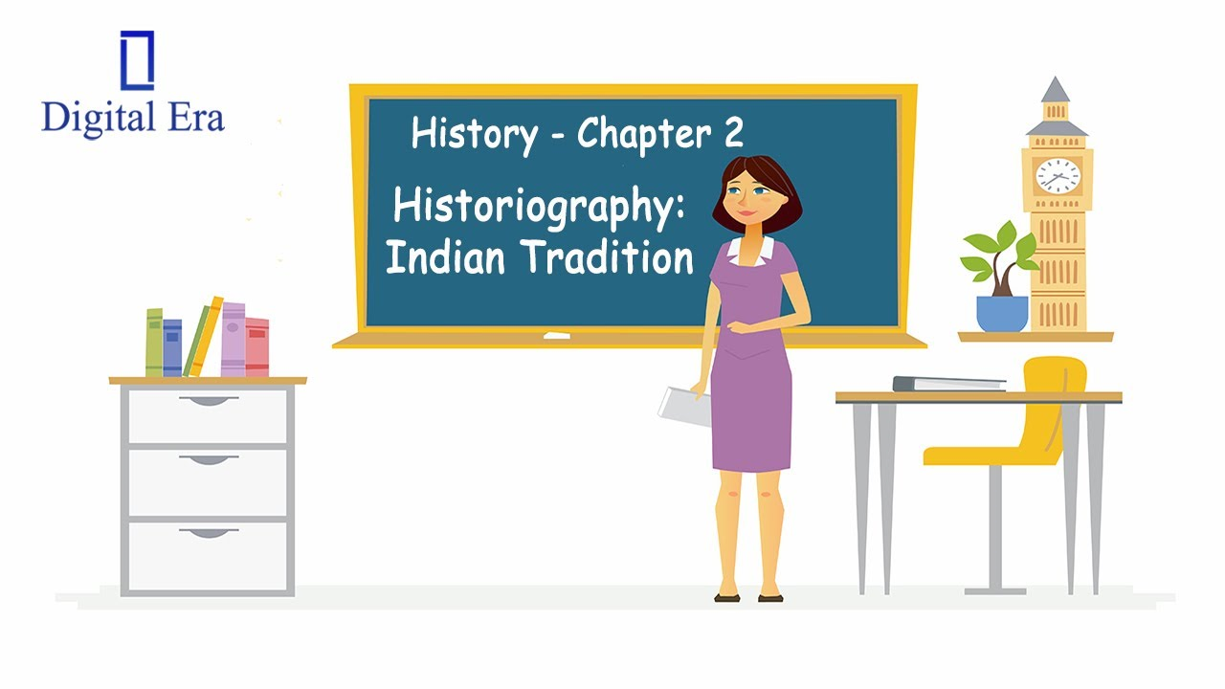

Slide 9
Concept of History
History is the analysis and interpretation of the human past enabling us to study continuity and changes that are taking place over time.
It is an act of both investigation and imagination that seeks to explain how people have changed over time.
Historians use all forms of evidence to examine, interpret, revisit, and reinterpret the past.

Slide 10
Concept of History
These include not just written documents, but also oral communication and objects such as buildings, artifacts, photographs, and paintings.
Historians are trained in the methods of discovering and evaluating these sources and the challenging task of making historical sense out of them.
History is a means to understand the past and present.

Slide 11
Concept of History
The different interpretations of the past allow us to see the present differently and therefore imagine—and work towards—different futures.
It is often said to be the “queen” or “mother” of the social sciences.
It is the basis of all subjects of study which fall under the category of Humanities and Social Sciences.
It is also the basis of the study of philosophy, politics, economics and even art and religion.
No wonder, it is considered an indispensible subject in the complete education of man.

Slide 12
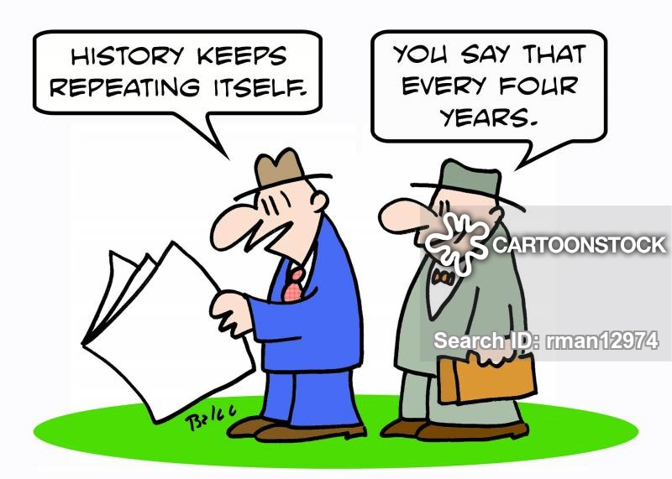

Slide 13
Defining history
The origin of the word History is associated with the Greek word ‘Historia’ which means ‘information’ or ‘an enquiry designed to elicit truth’.
History has been defined differently by different scholars. Following definitions indicate the meaning and scope of History.

Slide 14
Defining history
Burckhardt: “History is the record of what one age finds worthy of note in another.”
Henry Johnson: “History, in its broadest sense, is everything that ever happened.”

Slide 15
Defining history
Smith,V.S: “The value and interest of history depend largely on the degree in which the present is illuminated by the past.”
Rapson: “History is a connected account of the course of events or progress of ideas.”

Slide 16
Defining history
NCERT: “History is the scientific study of past happenings in all their aspects, in the life of a social group, in the light of present happenings.”
Jawaharlal Nehru: “History is the story of Man’s struggle through the ages against Nature and the elements; against wild beasts and the jungle and some of his own kind who have tried to keep him down and to exploit him for their own benefit.”

Slide 17
Defining history
The above definitions explain History as a significant records of events of the past, a meaningful story of mankind depicting the details of what happened to man and why it happened. Mainly it deals with the human world.

Slide 18


