Slide 1
GANDHI-IRWIN PACT
Dr.AGHALYA.,M.A.,M.Ed.,M.PHIL.,Ph.D.,
Head & Asst.Professor
Department of History
Bon Secours College for Women
Thanjavur

Slide 2
INTRODUCTION
The rejection of demands put forward by Mahatma Gandhi in Delhi Manifesto led to Lahore Congress session.
Later, under the civil disobedience movement, Gandhi put forward 11 demands and gave an ultimatum of January 31, 1930, to accept or reject.
In July 1930 the viceroy, Lord Irwin, suggested a round table conference and reiterated the goal of dominion status.

Slide 3
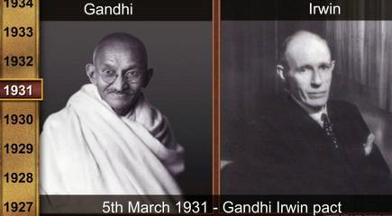

Slide 4
Gandhi-Irwin Pact.
On January 25, 1931, Gandhi and all other members of the Congress Working Committee (CWC) were released from jail unconditionally.
The CWC authorised Gandhi to initiate discussions with the viceroy Lord Irwin.
Later a pact was signed in Delhi, which came to be known as Delhi-Pact or Gandhi-Irwin Pact.

Slide 5
Background of Gandhi-Irwin Pact
The Second Round Table Conference was to be held in 1931 in London.
In 1930, the Salt Satyagraha was conducted and India and Gandhi received worldwide attention.
The British government in India was criticised for its unjust treatment of Indians.
Gandhi and many other leaders were imprisoned along with thousands of Indians.

Slide 6
Background of Gandhi-Irwin Pact
Lord Irwin wanted the issue to come to an end.
So, Gandhi was released from prison in January 1931.
The then Congress President Sardar Vallabhai Patel authorised Gandhi to hold talks with Lord Irwin.
Accordingly, Gandhi met Irwin and held negotiations. It was for the first time that the two were meeting as ‘equals’.

Slide 7
Features of Gandhi-Irwin Pact
The Indian National Congress (INC) agreed to take part in the Round Table Conference.
The INC would stop the civil disobedience movement.
Withdrawal of all ordinances that curbed the activities of the Congress.

Slide 8
Features of Gandhi-Irwin Pact
Withdrawal of all prosecutions except those involving violent crimes.
Release of those who were arrested for taking part in the civil disobedience movement.
Removal of the salt tax.

Slide 9
Result of Gandhi Irwin Pact
The INC participated in the Second Round Table Conference which was held in 1931 during September – December.
The government agreed to withdraw all ordinances.
It agreed to release all political prisoners to save those involved in violence.
It agreed to allow peaceful picketing of liquor and foreign cloth shops.
It agreed to revoke the ban on the INC.

Slide 10
Result of Gandhi Irwin Pact
It agreed to restore the confiscated properties of the Satyagrahis.
It agreed to permit the collection of salt by people near the sea coasts.
It agreed to forego fines not yet collected.
It agreed to the lenient treatment of all government servants who had resigned from service in the wake of the civil disobedience movement.

Slide 11
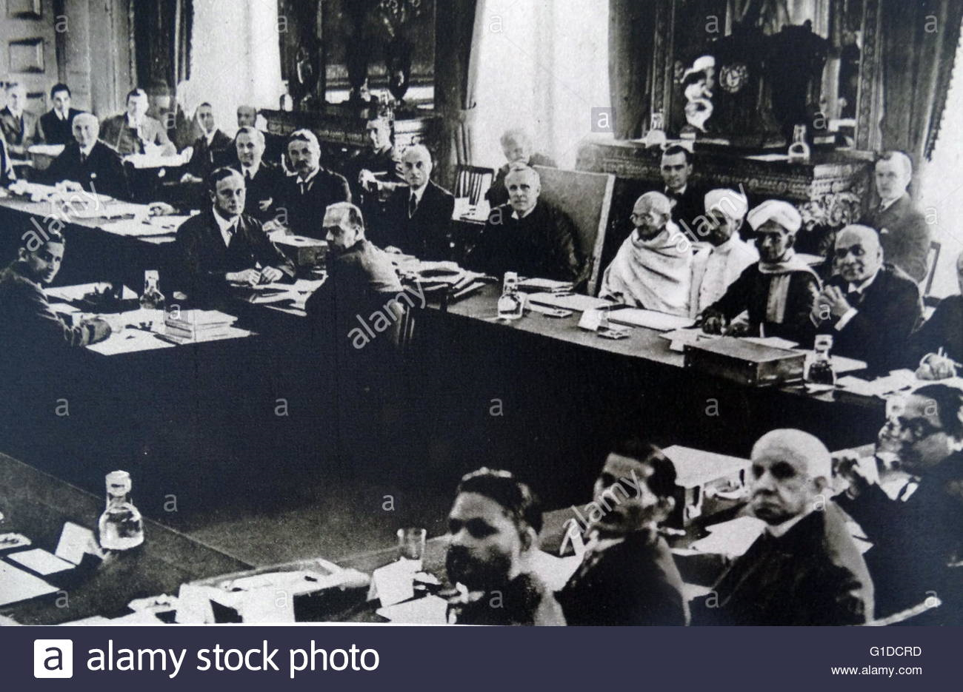
THANK YOU

