Slide 1
INDIAN INDEPENDENCE ACT 1947
Dr.AGHALYA.,M.A.,M.Ed.,M.PHIL.,Ph.D.,
Head & Asst.Professor
Department of History
Bon Secours College for Women
Thanjavur

Slide 2
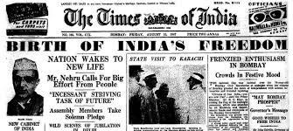

Slide 3
INTRODUCTION
Lord Mountbatten (India’s last viceroy) proposed a plan in May 1947 according to which provinces were to be declared independent successor states with the power to choose whether to join the constituent assembly or not.

Slide 4
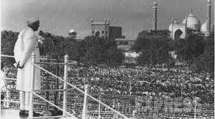

Slide 5
Mountbatten Plan Background
Lord Mountbatten came to India as the last Viceroy and was assigned the task of a speedy transfer of power by the then British Prime Minister Clement Atlee.
In May 1947, Mountbatten came up with a plan under which he proposed that the provinces be declared independent successor states and then be allowed to choose whether to join the constituent assembly or not. This plan was called the ‘Dickie Bird Plan’.
Jawaharlal Nehru, when apprised of the plan, vehemently opposed it saying it would lead to balkanisation of the country. Hence, this plan was also called Plan Balkan.
Then, the viceroy came up with another plan called the June 3 Plan. This plan was the last plan for Indian independence. It is also called the Mountbatten Plan.

Slide 6
Mountbatten Plan Background
The June 3 Plan included the principles of partition, autonomy, sovereignty to both nations, right to make their own constitution.
Above all, the Princely States such as Jammu and Kashmir were given a choice to either join India or Pakistan. The consequences of these choices would affect the new nations for decades to come.
This plan was accepted by both the Congress and the Muslim League. By then, the Congress had also accepted the inevitability of the partition.
This plan was put into action by the Indian Independence Act 1947 which was passed in the British Parliament and received the royal assent on 18 July 1947.

Slide 7
Provisions of the Mountbatten Plan
British India was to be partitioned into two dominions – India and Pakistan.
The constitution framed by the Constituent Assembly would not be applicable to the Muslim-majority areas (as these would become Pakistan). The question of a separate constituent assembly for the Muslim-majority areas would be decided by these provinces.
As per the plan, the legislative assemblies of Bengal and Punjab met and voted for the partition. Accordingly, it was decided to partition these two provinces along religious lines.
The legislative assembly of Sind would decide whether to join the Indian constituent assembly or not. It decided to go with Pakistan.

Slide 8
Provisions of the Mountbatten Plan
A referendum was to be held on NWFP (North-Western Frontier Province) to decide which dominion to join. NWFP decided to join Pakistan while Khan Abdul Gaffar Khan boycotted and rejected the referendum.
The date for the transfer of power was to be August 15, 1947.
To fix the international boundaries between the two countries, the Boundary Commission was established chaired by Sir Cyril Radcliffe. The commission was to demarcate Bengal and Punjab into the two new countries.
The princely states were given the choice to either remain independent or accede to India or Pakistan. The British suzerainty over these kingdoms was terminated.

Slide 9
Provisions of the Mountbatten Plan
The British monarch would no longer use the title ‘Emperor of India’.
After the dominions were created, the British Parliament could not enact any law in the territories of the new dominions.
Until the time the new constitutions came into existence, the Governor-General would assent any law passed by the constituent assemblies of the dominions in His Majesty’s name. The Governor-General was made a constitutional head.
On the midnight of 14th and 15th August 1947, the dominions of Pakistan and India respectively came into existence. Lord Mountbatten was appointed the first Governor-General of independent India and M .A. Jinnah became the Governor-General of Pakistan.

Slide 10
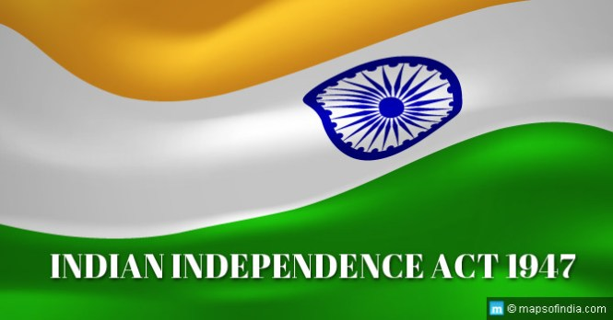
THAHK YOU

