Slide 1
GROUP WORK PRACTICE
IN INDUSTRIAL SETTING
S. Delphina Mary
Assistant Professor
Department of Social Work
Bon Secours College for Women
Thanjavur

Slide 2


Slide 3
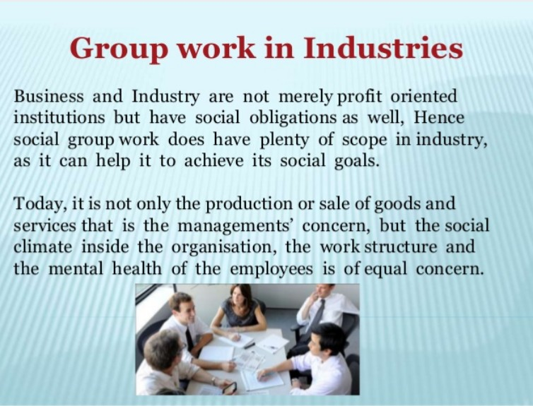

Slide 4
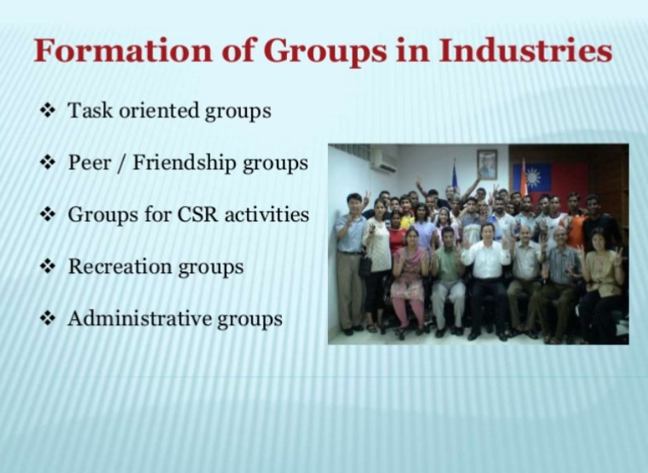

Slide 5
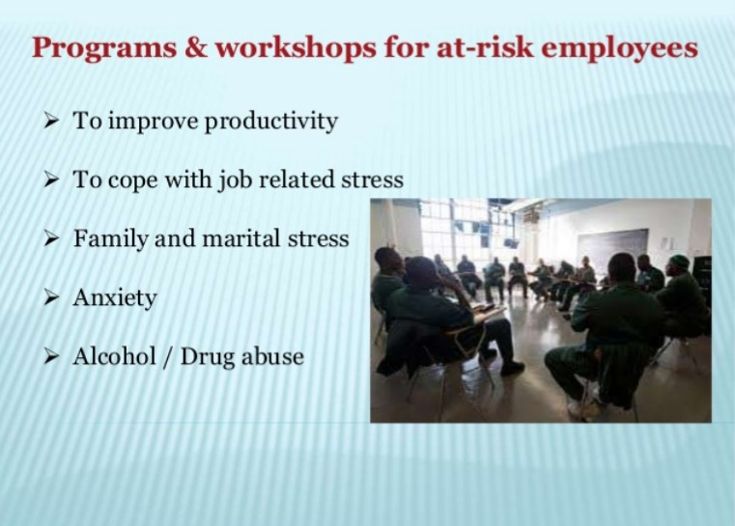

Slide 6
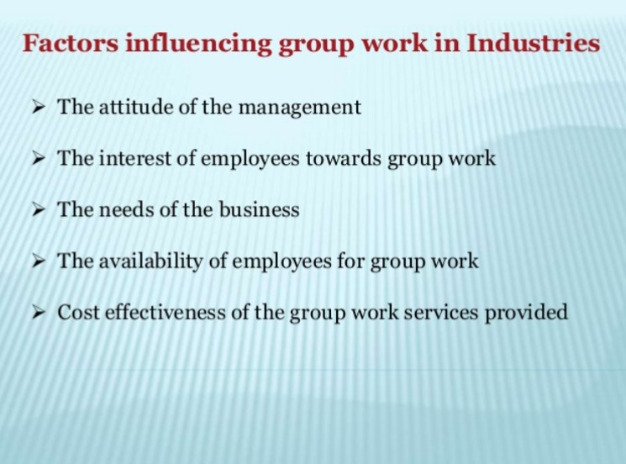

Slide 7
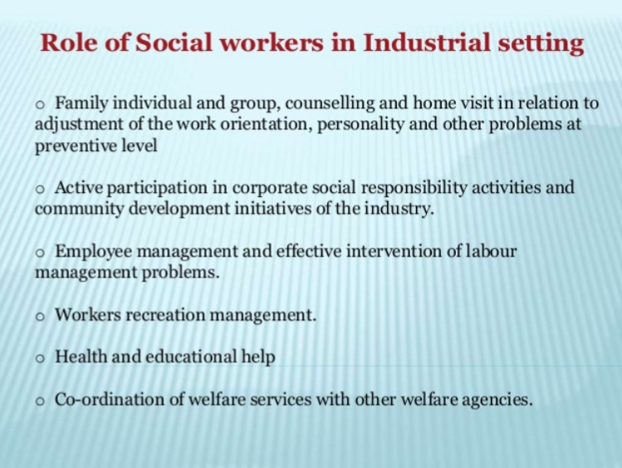

Slide 8


