Slide 1
INTRODUCTION TO PHOTOSHOP
BY:
MS.K.GAYATHRI,
ASSISTANT PROFESSOR,
DEPARTMENT OF COMPUTER SCIENCE,
BON SECOURS COLLEGE FOR WOMEN,
THANJAVUR

Slide 2
What is Adobe Photoshop?
Photoshop is the leading professional image-editing program, released by Adobe. Photoshop is useful for both creating and editing images to be used in print or online. Easy to use, but full of high-quality features, Photoshop is the best choice for any image manipulation job.

Slide 3
Using Photoshop
PowerPoint or Presentations
Publications and layouts
  Hand-out, brochures
World Wide Web
  Graphics for web, web designs, navigations

Slide 4
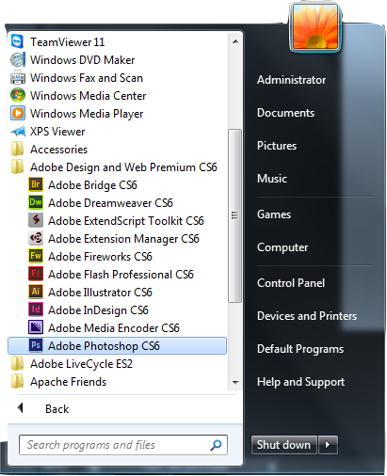
Starting with Photoshop
Click the "Start" menu and go to the "Programs" folder. You will see an "Adobe Design and web premium CS6" folder with "Photoshop" inside; click this icon.

Slide 5
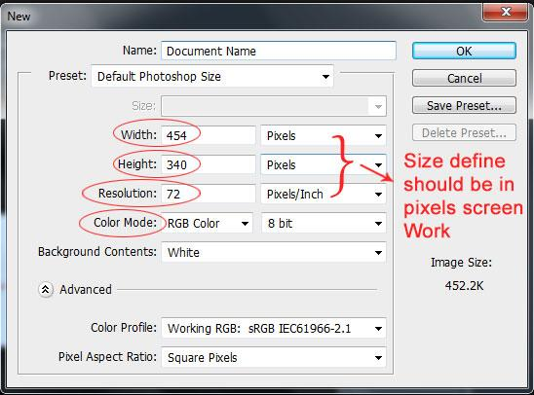
New Page
Under the File Menu, select New. The New file controls window appears.
In the Name box, type postcard. In the Image Size area, set the Width, Height and Resolution as follows:
Width: 454 pixels
Height: 340 pixels
Resolution: 72 pixels/inch
Color Mode: RGB Color

Slide 6
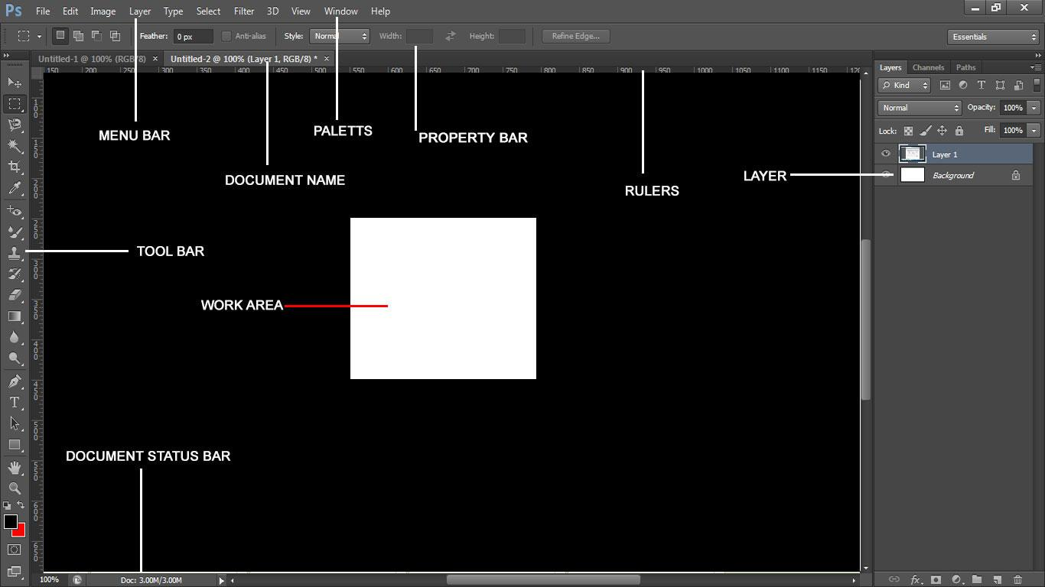
Photoshop Interface

Slide 7
Menu Bar
Elements supports drop-down menus, like just about every other program you launch. The menus are logically constructed and identified to provide commands for working with your pictures (including many commands that you don’t find supported in tools and on panels).

Slide 8

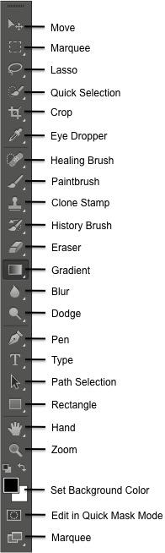
The Toolbox
The toolbox contains many of the tools you will be working with in Photoshop. This contains tools for working with Object or Images in Photoshop.

Slide 9
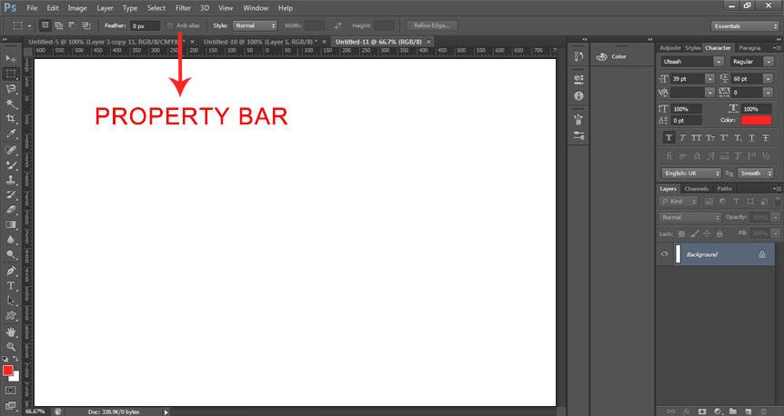
The Property bar
When the highlight bar appears, I'll release my mouse button and Photoshop .... Let's say I want the Properties panel in the second column to be grouped in with ...

Slide 10
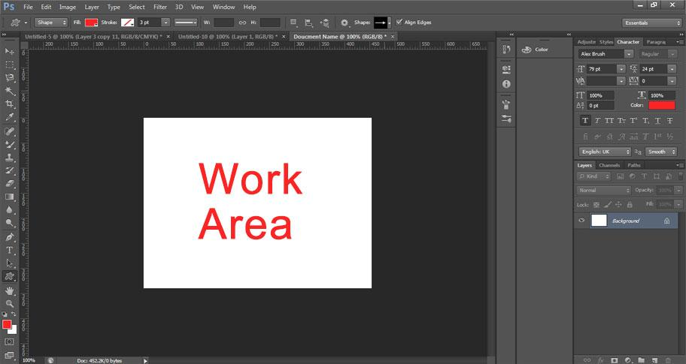
The Document Work Area
The document work area consists of the application toolbar, the open document, and the page sorter. From open documents on the work area, you can add, delete, and rearrange pages in documents, and you can rename problems.

Slide 11
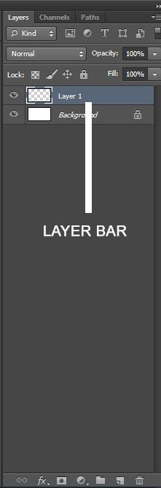
Layer Panel
One of Photoshop’s most powerful features is the ability to create and use multiple layers with in the same image. A layer is literally what it sounds like: one layer on top of another, all of which can be edited independently of each other and laid on top of or beneath one another, and then later combined to form a single, flat image.

Slide 12
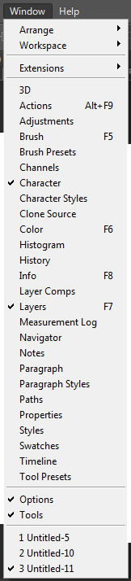
Windows Panels
Learn how to navigate and use the Adobe Photoshop workspace. ... workspaces, or create custom workspaces by moving and manipulating windows and panels.

Slide 13
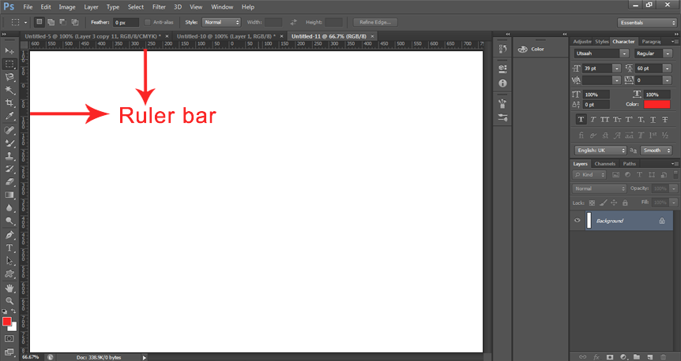
The Rulers
In Adobe Photoshop, use the Ruler tool to position images or elements precisely. ... and drag the line out of the image, or click Clear in the tool options bar.

Slide 14
THANK YOU

