Slide 1
Creation of Table in Ms Access
Dr.C.SAFFINA
Assistant Professor of Commerce (CA)
Bon Secours College for Women , Thanjavur

Slide 2
INTRODUCTION TO MS ACCESS
Ms Access is a database management tool that enables one to have good command of data collected.
It enables to:
Retrieve
sort
summarize and
report results speedily and effectively.
It can combine data from various files through creating relationships, and can make data entry more efficient and accurate.

Slide 3
CONTI…..
Microsoft Access (MS Access) enables one to manage all important information from a single database file.
Within the file, one can use
• Tables to store your data.
• Queries to find and retrieve specific data of interest.
• Forms to view, add, and update data in tables.
• Reports to analyze or print data in a specific layout.

Slide 4
MS ACCESS FILES SAVED WITH extension.mdb
Data access pages to view or update, the data. In MS Access, data is stored once in one table, but can be viewed from multiple locations.
When the data is updated in a Table, Query or Form, it is automatically updated everywhere it appears Establishment of Ms Access database.
All Ms Access databases files are saved with extension .mdb

Slide 5
METHODS OF CREATING A DATABASE IN MS ACCESS
Microsoft Access provides three methods to create a database
Database Wizard (though easy, the wizard offers limited options to customize the database).
Using a template (This method works best if one can find and use a template that closely matches the specific requirements).
Creating a database directly (This is the most flexible method, but it requires one to define each database element separately).

Slide 6
RECORDS & FIELDS IN A TABLE
Tables are the data storage facilities in Ms Access.
Each table contains rows called records and columns called fields. A record is a collection of facts about a particular animal or event.
Each record in a table should be unique.
To distinguish one record from another, tables can contain a primary key field.

Slide 7
DATA TYPES IN MS ACCESS
One important setting for fields is the data type, which could be a
number,
text,
currency,
and date/time.
The data type limits and describes the kind of information in the field.

Slide 8
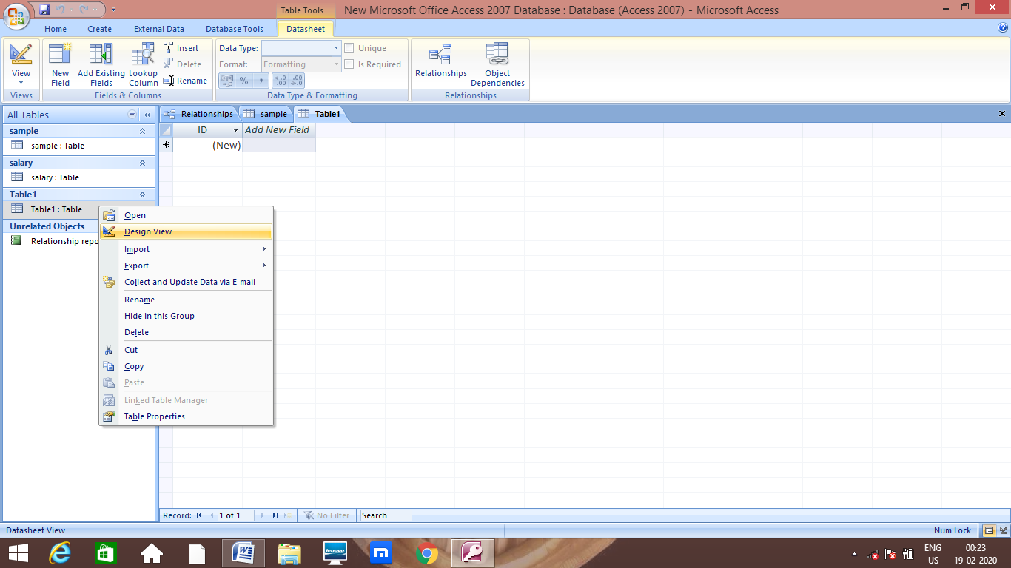
Creation of Table Using Design view in Ms Access

Slide 9
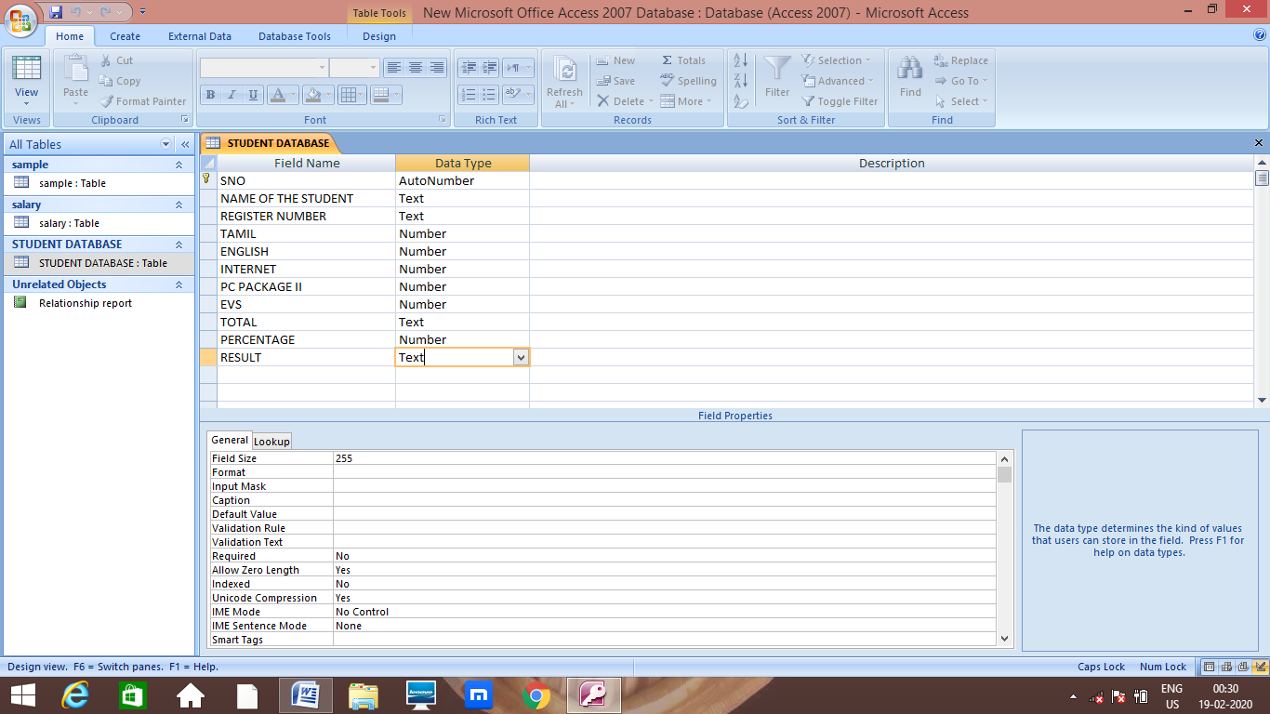
CREATING FIELD NAME AND ITS DATA TYPES FOR STUDENT DATABASE

Slide 10
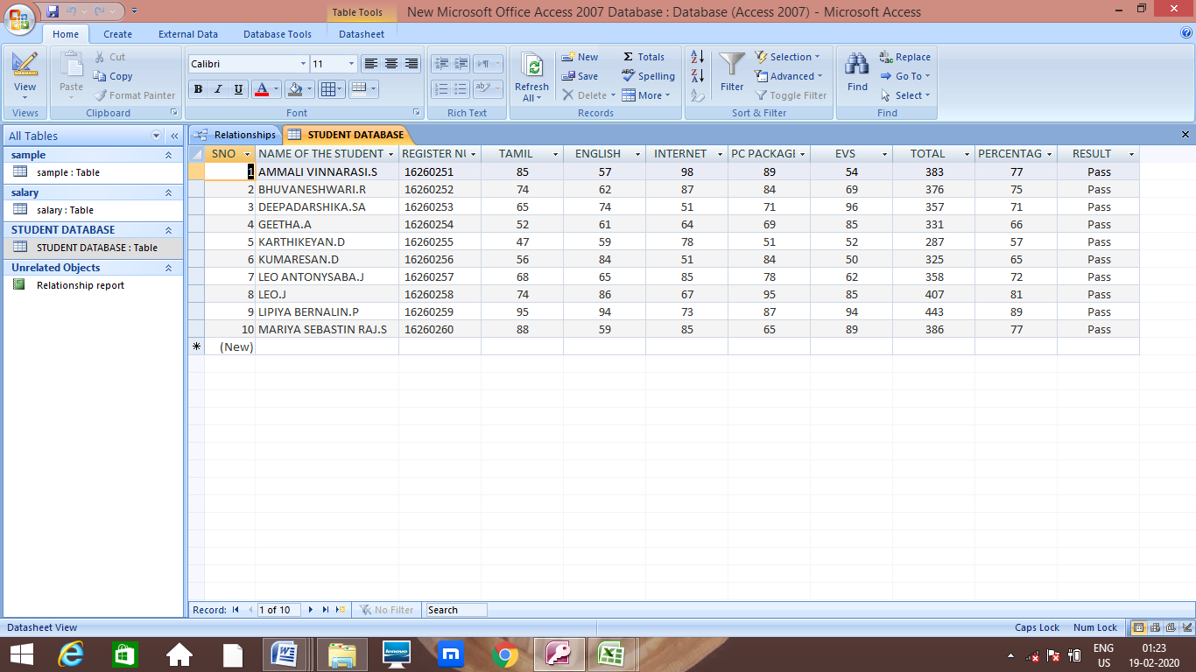
CREATED STUDENT DATABASE IN MS ACCESS

Slide 11
CONCLUSION
MS Access provides a great database development tool through simple user friendly graphical user interface. It has many advantages over MS Excel or other spreadsheet applications .Access is most popular for its tables, forms and queries. It is relatively simple application to create databases for personal use or for a use of a small group.

Slide 12
THANK YOU

