Slide 1
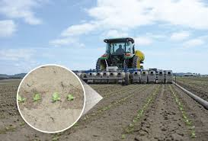
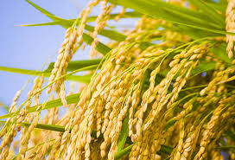
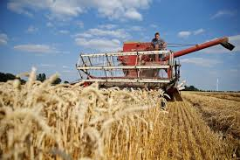
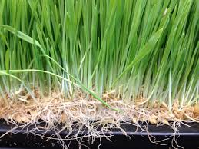
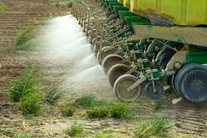
Production
M. Maria Jessica

Slide 2
CONTENTS
MEANING
DEFINITION
VARIOUS PROCESS
CONCLUSION

Slide 3
Production
In Economics – It is used for creation of those goods and services which have an exchange value.
In Economic utilities – Procedure utility, time utility and place utility.
Factors of production – land, labour, capital and organisation.
Modern Economics – Enterprise has come to occupy a very important role in production so as to deal with that on a separate footing as an agent of production.

Slide 4
CONTD…
DEFINITION:
According to Hicks, “ is any activity directed to the satisfaction of other people’s wants through exchange”.
Man cannot produce matters so as to make it more useful for human consumption.
The aim of the producer is to maximize his profit.

Slide 5
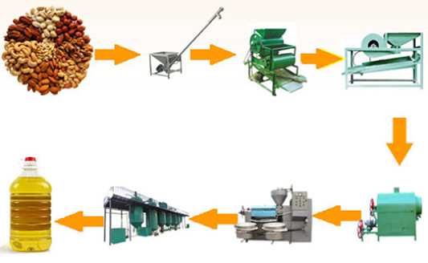
Production includes various processes to add utility to natural resources for gaining more satisfaction form them by:
Changing the form of natural resources.
For Example: Manufacturing Process .– Form or Procedure Utility.

Slide 6
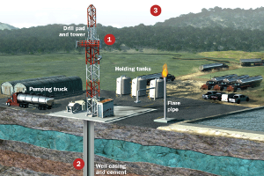
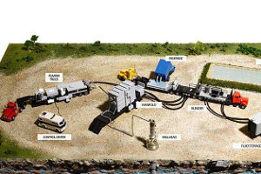
CONTD…
Changing the place of the resource.
For Example: Extraction from earth, transportation. – Place Utility.

Slide 7
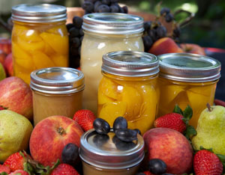
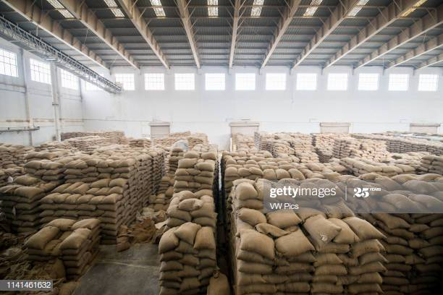
CONTD…
Making available materials at times when they are not normally available.
For Example: Storage of food grain, Canning of Fruits.- Time Utility .

Slide 8
Production does not include:
Domestic work which refers to any work done by a family member out of affection.
Voluntary services which refer to any service performed out of patriotic feelings to improve society’s welfare.
Goods for self – consumption which refer to those goods which are not sold in market to earn income.

Slide 9
Conclusion
Production is a very important activity which leads to prosperity of a nation.
Welfare of the society improves with the production process.
The quantity and quality of production determines the standard of living of the people.
In developed nations, there are efficient and sufficient productive resources.
In developing countries like India, production process is very important since population has crossed one billion mark and resources are scarce.

Slide 10
Meaning
Utility – Usefulness or Value or Convenience
Domestic – National
Patriotic - Nationalistic
Prosperity – Success or Wealth
Resources – Capitals or Incomes or Funds
Scarce – Rare or Limited
Thank You…..

