Slide 1
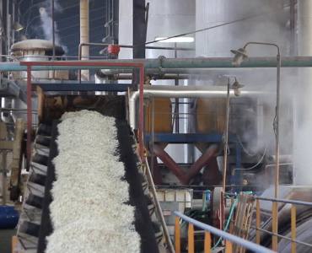
PRODUCTION FUNCTION
Mrs. M. Maria Jessica
PG and Research Department Of Commerce
Bon Secours College For Women, Thanjavur

Slide 2
Contents
Meaning
Definition
Types
Features
Assumptions
Uses

Slide 3





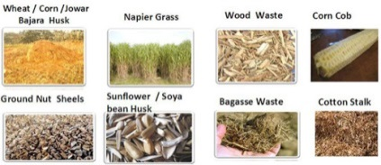
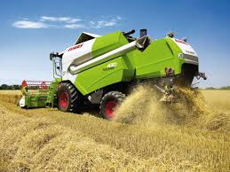

Meaning of Production Function
The functional relationship between physical inputs and physical outputs of a firm is known as “Production Function”
Physical Input
Physical output
Food
Shelter
Clothing
Cellphone
Computer
Bike , Car, etc..
Land
Labour
Capital
Organizational Skill
Raw Materials
Technology

Slide 4
Definition
L.R.KLEIN
“The production function is a
technical or engineering relation
between input and output. As long
as the natural laws of technology
remain unchanged, the production
Function remain unchanged”.

Slide 5
Types of Production Function
Short - Run
It is refers to production will increase when more units of variables factors are used with fixed factors.
Long - Run
It is refers to production will increase when all factors are increased in the same proportion.

Slide 6
Features
Substitutability
Factors of production or inputs are substitutes of one another;
that gives rise to the law of variable proportions.
Factors of production are also complementary to one another;
that gives rise to the principles of returns to scale.
Complementary

Slide 7
Contd…
Specificity
It reveals that the inputs are specific to the production of a particular product.
Examples: Machines and equipment's, specialized workers and raw materials
Time Factor
In the production function, variation in total output by varying the quantities of all inputs is possible only in the long run whereas the variation in total output by varying the quantity of single input may be possible even in the short run.

Slide 8
Assumptions
- It is related to a particular unit of time.
The technical knowledge during that period of time remains constant.
- The factors of production are divisible into most viable units.
The producer is using the best techniques available.

Slide 9

Uses
It has immense utility to the managers and executives in decision – making at the formal level. It aids in two ways:
  How to obtain the optimum output from a given set of inputs.
  How to obtain a given output from the minimum set of inputs.
  Production function helps in making long – run as well as short – run decisions.

