Slide 1
PRODUCTION
Mrs. M. Maria Jessica
PG & Research Department of commerce
Bon Secours college for women, Thanjavur

Slide 2
CONTENTS
MEANING
DEFINITION
CLASSIFICATION OF LARGE – SCALE ECONOMIES
TYPES OF DISADVANTAGES OR DISECONOMIES

Slide 3
Economies of Scale
MEANING:
Economies of scale would mean lowering of costs of production by way of producing in bulk.
DEFINITION:
According to the prof. Stigler defines economies of scale as synonymous with returns to scale. As the scale of production is increased, up to a certain point, one gets economies of scale.
Economies – Lower Costs.

Slide 4
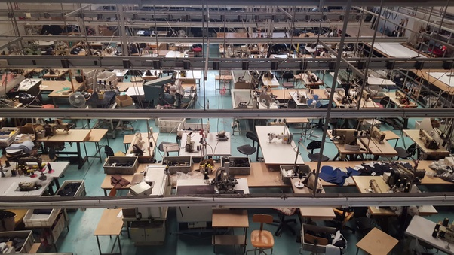
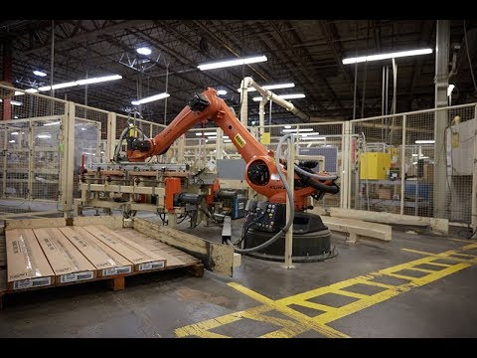
EXAMPLE FOR ECONOMIES OF SCALE
A cost of manufacturer:
- Rs. 100 for one unit
- Rs. 180 for two units
- Rs. 240 for three units and so on.
Such that the average cost per unit decreases as the production volume increases.

Slide 5
Economies of large – scale production classified by Marshall into two categories :
Internal Economies
External Economies
Technical
Managerial
Marketing
Financial
Risk Bearing
Labour
Transport and Storage
Economies of concentration / localisation.
Economies of information
Economies of Disintegration

Slide 6
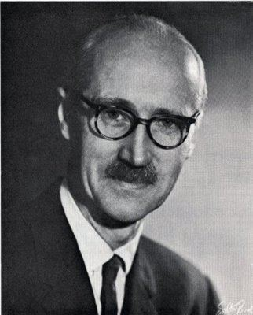
INTERNAL ECONOMIES
Cairncross
“ Internal economies are those which are open to a single factory, or a single firm independently of the action of other firms. These results from an increase in the scale of output of a firm and cannot be achieved unless output increases”.

Slide 7
The internal economies arise because of the actions of an individual firm to economise its cost. They can be discussed as under:
I) Technical Economies
These involves use of bigger and better types of machines to improve the technique of production. It thereby reduces the cost and enjoy the use of superior techniques. This is further subdivided into:
a) Economies of superior techniques
b) Economies of increased dimensions
c) Economies of linked processes

Slide 8
Contd…
II) Managerial Economies
This arises for various reasons, the most important being:
a) Specialization of management
b) Mechanization of managerial function
III) Marketing or Commercial Economies
Refers to such reduction in the cost of production in the cost of production which is secured by the purchase of inputs at the lowest price and the sale of final goods at the highest possible price.
a) Economies of purchase
b) Economies of sale

Slide 9
Contd..
iv) Financial Economies – It refers to advantages secured by a firm in matters of finance.
v) Risk – bearing Economies - This may be secured in matters of risk as large firms are in a position to bear risk.
a) Output
b) Market
c) Sources of supply
d) Process of manufacture
vi) Labour Economies – As the scale of production is expanded, there arises many labour economies, like new inventions, specialization, time – saving production, etc.
vii) Economies of Transport and storage - A firm producing on large scale enjoys these economies.

Slide 10
External Economies
  It refers to all those benefits which occur to all the firms operating in a given industry.
  Generally, this occurs due to the expansion of industry and other facilities expanded by the government.
  According to Prof. Cairncross has defined “ as those benefits which are shared in by a number of firms or industries when the scale of production in any industry increases”. External economies are external to the firm.

Slide 11
Contd…
Economies of concentration / localisation
- labour
- Financial
- Transport and storage
- Marketing
II) Economies of information
- when a firm is located in an isolated area, it is difficult for it to know the market conditions.

Slide 12
Contd…
III) Economies of Disintegration / by products
- Localisation or concentration of industry gives rise to economies of disintegration.
- One single firm does not produce enough wastage or by – products to enables some specialized firm to make use of them.

Slide 13
TYPES DISECONOMIES/ DISADVANTAGES OF SCALE
Internal Diseconomies
External Diseconomies
Technical
Financial
Risk bearing
Managerial
Production
Marketing
Pollution
Strains of infrastructure
High Factor Prices

Slide 14
INTERNAL DISECONOMIES
Meaning:
It implies to all those factors which raise the cost of production of a particular firm when its output increases beyond the certain limit. They are internal to the firm.
Definition:
“Internal diseconomies which enable the firm to produce less efficiently at large levels of output”.

Slide 15
External Diseconomies
External diseconomies are not suffered by a single firm but by the firms operating in a given industry.
It arises to a firm in the form of rise in unit costs because of expansion of an industry.
They are external costs that spill over into the cost of other firms.
These diseconomies arise due to much concentration, and location of industries beyond a certain stage.
These leads to increased demand for transport, competition increases, and prices of raw material and other factors of production increase.

Slide 16
Significance of Economies of Scale
The foremost significance of economies of scale is that it plays an important role in determining the nature of the industry i.e., increasing cost industry, constant cost industry or decreasing cost industry.
Helps in the analysis of cost of production.

Slide 17
THANK YOU

