Slide 1
Winding up of a company
M. Maria Jessica

Slide 2
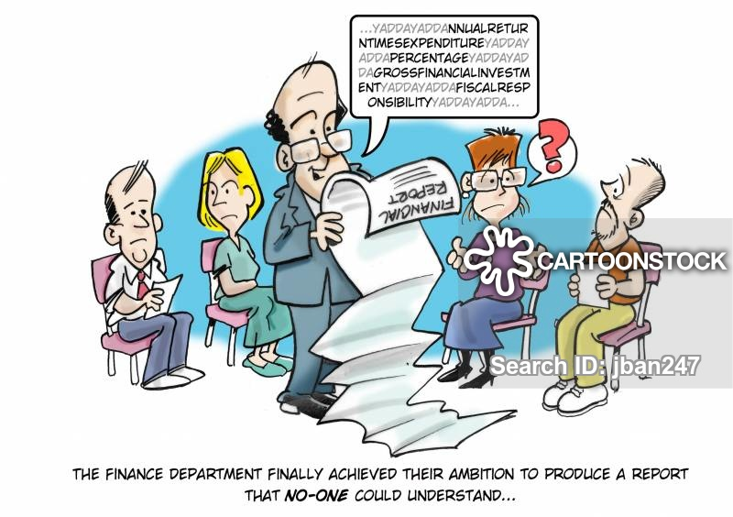
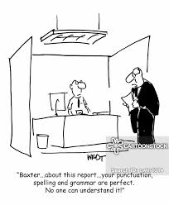
DUTIES OF LIQUIDATOR

Slide 3
Cont....
1. Proceedings in winding up [Secs.451 (1) and (3)]:
He must conduct equitably and impartially all proceedings in the winding up according to the provisions of the law.
2. Reports [ Sec. 455 (1)]:
i) preliminary report ( to be submitted under Sec. 454)
- as to the amount of the capital issued, subscribed, and paid-up, and the estimated amount of assets and liabilities.
- if the company has failed, as to the cause of the failure; and
- whether, in his opinion, further inquiry is desirable as to any matter relating to the promotion, formation, or failure of the company, or the conduct of business thereof.

Slide 4
Cont…
ii) Additional reports:
- The Official liquidator may, if he thinks fit, make further reports stating the manner in which the company was promoted or formed.
- He may further state if any fraud has been committed by any person in company’s promotion or formation, or since the formation thereof.
- He may also state any other matters which it is desirable to bring to the notice of the court.
- If in any further report the official liquidator states that a fraud has been committed, the court shall have the further powers provided in Sec.478 as to the public examination of promoters and officers.

Slide 5
Cont…
3. Custody of company’s property (Sec. 456):
-The liquidator or provisional liquidator shall take into his custody and control the property of the company.
4. Exercise and control of liquidator’s powers (Sec. 460):
- Any direction by the creditors or contributories at any general meeting shall override any directions given by the committee of inspection.
5. Meeting of creditors and contributories [Sec. 460 (3)]:
- He shall be bound to summon such meeting, at such times, as the creditors or contributories may, by resolution, direct, or whenever requested in writing to do so by not less than one tenth in value of the creditors or contributories, as the case may be.
6. Directions from the court:
- The Liquidator may apply to the court for directions in relation to any particular matter arising in winding up.

Slide 6
Cont…
7. PROPER BOOKS (SEC. 461):
The Liquidator shall keep proper books for making entries or recording minutes of the proceedings at meetings and such other matters as may be prescribed. Any creditor or contributory may, subject to the control of the court, inspect any such books personally or by his agent.
8. AUDIT OF ACCOUNTS (SEC. 462):
He must , at least twice in each year, present to the court an account of his receipts and payments as liquidator. The account must be in the prescribed form and must be made in duplicate.
9. APPOINTMENT OF COMMITTEE OF INSPECTION (SEC. 464):
The court may at the time of making an order for the time making an order for the winding up of a company, or at any time thereafter, direct that there shall be appointed a committee of inspection to act with the liquidator.

Slide 7
10. PENDING LIQUIDATION (SEC. 551)
The liquidator shall, within 2 months of the expiry of each year from the commencement of winding up, file a statement duly audited by a qualified auditor of the company, with respect to the proceedings in, and position of, the liquidation.
The statement shall be filled –
In the case of a winding up by the court, in court; and
In the case of a voluntary winding up, with the registrar.
Thank you………………

