Slide 1
ORGANIZATIONAL BEHAVIOUR
ARULMANI.R
ASSISTANT PROFESSOR
BON SECOURS COLLEGE FOR WOMEN

Slide 2
DEFINATION
Organizational behaviour is to understand, predicting and controlling human behaviour at work.

Slide 3
AUTOCRATIC MODEL
Only management decides right or wrong
Obedient orientation of employees
Useful approach

Slide 4
CUSTODIAL MODEL
Employee dependence on the organization
Emphasizes reward
Promotes employee satisfaction

Slide 5
SUPPORTIVE MODEL
Support employee job performance
Management life style reflects support
Creates sense of participation
Limited application

Slide 6
COLLEGIAL MODEL
Creates favorable working climate
Foster team work
Fulfillments of employees

Slide 7
GOALS OF OB
Explain individual and group behaviour
Predict certain behavioural response to change
Control behaviour

Slide 8
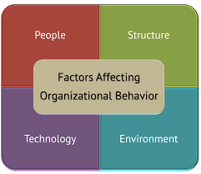
ELEMENTS OF OB

Slide 9
Contributing Disciplines to the Organization Behaviour Field are
Psychology
Sociology
Social Psychology
Economics
Anthropology
Political Sciences

Slide 10
PERCEPTION
Perception may be defined as a process by which individual organize and interpret their sensory impression in order to give meaning to their environment.
S.P. Robbins

Slide 11
THANK YOU

