Slide 1
Operations Research Transportation Problem
Dr.T.Sivakami
Assistant Professor
PG& Research Department of Management Studies
Bon Secours College for Women,Thanjavur

Slide 2
Objective of TRANSPORTATION PROBLEM
The objective is to minimize the cost of distributing a product from a number of sources (e.g. factories) to a number of destinations (e.g. warehouses) while satisfying both the supply limits and the demand requirement.

Slide 3
Methods of Transportation Problem
Determine a starting basic feasible solution, using any one of the following three methods
North West Corner Method
Least Cost Method
Vogel Approximation Method

Slide 4
North West Corner Method:
The method starts at the North West (upper left) corner cell of the table (variable x₁₁).
Step -1: Allocate as much as possible to the selected cell, and adjust the associated amounts of capacity (supply) and requirement (demand) by subtracting the allocated amount.
Step -2: Cross out the row (column) with zero supply or demand to indicate that no further assignments can be made in that row (column). If both the row and column becomes zero simultaneously, cross out one of them only, and leave a zero supply or demand in the uncrossed out row (column).
Step -3: If exactly one row (column) is left uncrossed out, then stop. Otherwise, move to the cell to the right if a column has just been crossed or the one below if a row has been crossed out. Go to step -1.

Slide 5
Example 1: Luminous lamps has three factories - F₁, F₂, and F₃ with production capacity 30, 50, and 20 units per week respectively. These units are to be shipped to four warehouses W₁, W₂, W₃, and W₄ with requirement of 20, 40, 30, and 10 units per week respectively. The transportation costs (in Rs.) per unit between factories and warehouses are given below.
Warehouse / Factory | W1 | W2 | W3 | W4 | supply
F1 | 1 | 3 | 1 | 4 | 30
F2 | 3 | 3 | 3 | 1 | 50
F3 | 4 | 2 | 5 | 9 | 20
Demand | 20 | 40 | 30 | 10

Slide 7
Total Transportation Cost =(1X20)+(3X10)+(3X30)+(2X20)+(5X10)+(9X10)
=20+30+90+40+50+90
=Rs 320

Slide 8
Least –Cost Method

Slide 10
Total Cost=(8X50)+(6X5)+(3X35)+(3X20)+(9X40)
=400+35+105+60+360
=Rs 960

Slide 11
Vogel Approximation Method
Step 1: For each row (column) with strictly positive capacity (requirement), determine a penalty by subtracting the smallest unit cost element in the row (column) from the next smallest unit cost element in the same row (column).
Step 2: Identify the row or column with the largest penalty among all the rows and columns. If the penalties corresponding to two or more rows or columns are equal we select the topmost row and the extreme left column.
Step 3: We select X_{ij} as a basic variable if C_{ij} is the minimum cost in the row or column with largest penalty. We choose the numerical value of X_{ij} as high as possible subject to the row and the column constraints. Depending upon whether a_{i} or b_{j} is the smaller of the two i^{th} row or j^{th} column is crossed out.
Step 4: The Step 2 is now performed on the uncrossed-out rows and columns until all the basic variables have been satisfied.

Slide 12
Consider the following transportation Problem

Slide 13
Now, compute the penalty for various rows and columns which is shown in the following table

Slide 14
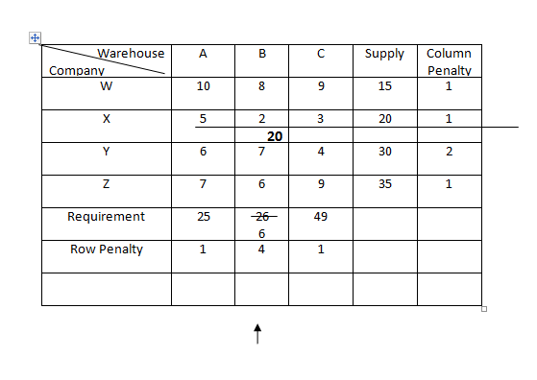
Look for the highest penalty in the row or column, the highest penalty occurs in the second column and the minimum unit cost in this column is c₂₂=2. Hence assign 20 to this cell and cross out the second row This is shown in the following table:

Slide 15
Look for the highest penalty in the row or column, the highest penalty occurs in the Third column and the minimum unit cost in this column is c₂₃=4. Hence assign 30 to this cell and cross out the second row This is shown in the following table

Slide 16
Look for the highest penalty in the row or column, the highest penalty occurs in the First column and the minimum unit cost in this column is c₂₁=7. Hence assign 25 to this cell and cross out the first column. This is shown in the following table

Slide 17
Look for the highest penalty in the row or column, the highest penalty occurs in the First column and the minimum unit cost in this column is c₂₁=6. Hence assign 6 to this cell and cross out the first column. This is shown in the following table

Slide 18
In this table there is no highest penalty in the row or column, so, We assign 15 in to the first cell and cross out the first Row. This is shown in the following table

Slide 19
Here We assign the balance value 4 in to the first cell and then calculate the total Cost.

Slide 20
Total Transportation Cost =(2X20)+(4X30)+(7X25)+(6X6)+(9X15)+(9X4)
=40+120+175+36+135+36
=RS 542

Slide 21
Thank U

