Slide 1
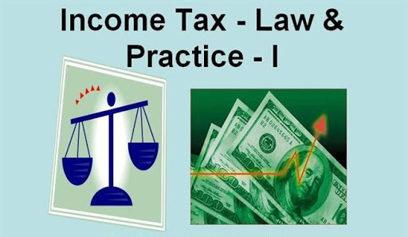
Income from Salary
Coordinator
Dr. D. Heena Cowsar
Assistant professor of Commerce
Bon Secours College for Women, Thanjavur
Affiliated to Bharathidasan University

Slide 2
Slide 1: Introduction
Tax is charged on the total income of an Assessee as per income tax act of 1961. Under Sec 5 basis for computation of total income is charged.
Salary income of an employee is to be computed in accordance with the provisions laid down in sections 15, 16 and 17.

Slide 3
Slide 2:How salary is defined
The term salary includes
Wages
Any Annuity or Pension
Any Gratuity
Any fees, Commission, Perquisites or profit in lieu of Salary or in addition to salary
Any Advance salary
Any payment received by an employee in respect leave not availed by him during service.
The total sum accredited to the credit of the employee recognised Provident fund to the extent chargeable to tax
Transferred balance in a recognised Provident fund to the extent it is chargeable
Amount credited by the central Government or any employer to the employee under notified pension schemes as mentioned in 80CCD

Slide 4
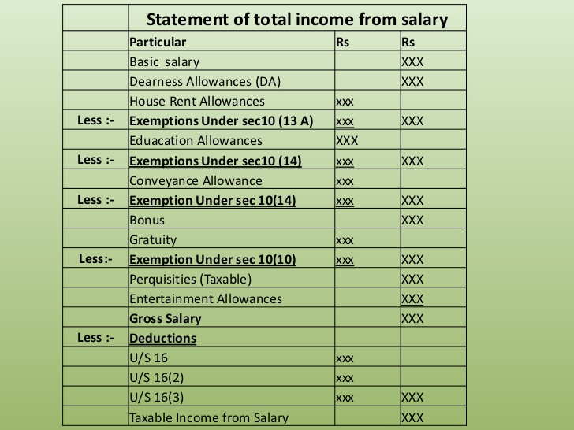
Slide 4:Format to compute Salary

Slide 5
Slide5:Allowances
Fully Taxable allowances
Dearness Allowance: The allowance is paid to the employees to cope with inflation.
Entertainment Allowance: This is an allowance that is provided to the employees to reimburse the expenses which are incurred on the hospitality.
Overtime Allowance: Overtime allowance is the allowance which is paid to the employees for working above the regular work hours.
City Compensatory Allowance: This allowance is paid to those employees who move to urban cities.
Project Allowance: When an employer provides an allowance to the employees to meet the project expenses.
Tiffin/Meals Allowance: Employees may be provided with meal allowances in some cases.
Cash Allowance: Employer may also provide cash allowance in some cases like for marriage or holiday purposes.

Slide 6
Slide 6: Partly Taxable allowances
House Rent Allowance: It is the allowance that an employer pays to his employee for accommodation.
Entertainment allowance
Special allowances like allowance for travel, uniform, research allowance etc.
Special allowance to meet personal expenses like children’s education allowance, children hostel allowance etc.

Slide 7
Slide 7: Non Taxable allowances
Allowances that is paid to the Govt. servants abroad: When the government employee of India are paid allowances when they are serving abroad.
Sumptuary allowances: Sumptuary allowances which are paid to the judges of HC and SC are not taxed.
Allowance paid by UNO: Allowances which is received by the employees of UNO are fully exempt from tax.
Compensatory allowance paid to judges: When a judge receives a compensatory allowance, it is also not taxable.

Slide 8
Slide 8: Perquisites
Perquisites are those payments which are received by an employee from the employer over and above the salary.
Perquisites that are taxable for all the employees:
Rent free accommodation
Club fee payments
Movable assets
Concession in accommodation rent
Interest-free loans
Educational expenses
Insurance premium paid on behalf of employees

Slide 9
Slide 9: Perquisites that are taxable only to specified employees
Free gas, electricity etc. for domestic purpose
Concessional transport facility
Concessional educational expenses
Payment made to gardener, sweeper and attendant.
Perquisites that are exempt from tax
Medical benefits
Health Insurance Premium
Leave travel concession
Staff Welfare Scheme
Car, laptop etc. for personal use

Slide 10
Slide 11: House Rent Allowance (HRA)
Meaning: The employer does not provide rent- free accommodation, but instead makes a provision to pay some amount in cash, so that the employee may be compensated to some extent as far as rent is concerned. The amount of cash paid is known as House Rent Allowance. Out of the total H.R.A. received, an amount equal to the minimum of the following three items is exempted from tax u/s 10(13A).
Taxable/ Exempted HRA
Taxable HRA |  | Least of the following are the Exempted HRA
Actual HRA received | xxx | Actual HRA | xxx
Less: Exempted amount of HRA | xxx | Rent Paid- 10% of salary* | xxx
Taxable HRA | xxx | 40% or 50% of Salary** | xxx
 |  | Which ever less is exempted | Xxx
Note: *Salary= Basic Pay + DA (forming part)+ Fixed Percentage of Commission ** 50% of Salary for Delhi, Mumbai, Kolkatta and Chennai and 40% in others

Slide 11
Slide 12: Entertainment Allowances
It is an amount paid to the employees for the purpose of hospitality of the customers.
Government employees can claim tax exemption for the entertainment allowance under section 16 (ii) This deduction is allowed only to a Government employee.
Non-Government employees shall not be eligible for any deduction on account of any entertainment allowance received by them.
In case of entertainment allowance, an Assessee is not entitled to any exemption but he is entitled to a deduction under section 16(ii) from gross salary.
Therefore, the entire entertainment allowance received by any employee is added in computation of the gross salary.
The Government employee is, then, entitled to deduction from gross salary under section 16(ii) on account of such entertainment allowance to the extent of minimum of the following 3 limits.
For Government Employee |  | For Non Government Employee
Actual entertainment allowance received during the previous year. | xxx | No Deductions U/S 16(II) Full Gross amount is taxable
20% of his salary exclusive of any allowance, benefit or other perquisite. | xxx
Absolute limit | Rs. 5000
Which ever less is exempted | xxx
Note: Only Basic Salary pay is to be considered

Slide 12
Slide 13: Gratuity Sec10(10)
Gratuity is a payment made by the employer to an employee in appreciation of the past services rendered by the employee.
Gratuity can either be received by:
(a) the employee himself at the time of his retirement; or
(b)the legal heir on the event of the death of the employee.
Gratuity received by an employee on his retirement is taxable under the head "Salary" whereas gratuity received by the legal heir of the deceased employee shall be taxable under the head "Income from other sources".
However, in both the above cases, according to section 10(10) gratuity is exempt up to a certain limit. Therefore, in case gratuity is received by employee, salary would include only that part of the gratuity which is not exempt under section 10(10) is discussed in the Table
Government employees & employees of local authority | Non Government Employees: Least of the following Exempted
 | Employees covered under Gratuity Act. |  | Employees not covered under Gratuity Act.
 | Actual Gratuity received | xxx | Actual Gratuity received | xxx
 | Absolute limit (Rs. ) | 1000000 | Absolute limit (Rs. ) | 1000000
 | 15 days salary *for every year of completed services | xxx | ½ Months Average Salary* for every year of completed service | xxx
Fully Exempt
 | Which ever less is exempted | xxx | Which ever less is exempted | Xxx
Note: 1. Salary 2. | Last Month Salary (Basic+ DA+ % of Commission) *15 Days = Consider15/26 |  | *Average Salary: Last 10 Months Salary (Basic+ DA (FP)+ % of Commission)

Slide 13
Slide 14: Pension (Sec 17 (1)(ii)
Pension is a payment made by the employer after the retirement/death of the employee as a reward for past service.
Pension is normally paid as a periodical payment on monthly basis but certain employers may also allow an employee to forgo a portion of the pension and receive a lump sum amount by surrendering such portion of pension. This is known as commutation of pension.
The pension may be fully or partly commuted i.e. in lieu of the pension, a lump sum payment is made to the employee.
Uncommuted pension i.e. the periodical pension: It is fully taxable to both government or non-government.
Exemption of Commuted Pension U/s 10(10A)
Employee Status | Gratuity Received / Not Received | Exemptions related to Commuted Pension
Government Employee | Gratuity may received or may not received | Fully Exempted
Non Government Employee | Gratuity Received | 1/3 of the Full pension* is Exempted
 | Gratuity not received | 1/2 of the Full pension* is Exempted
Full Pension = Commuted + Uncommuted Pension.

Slide 14
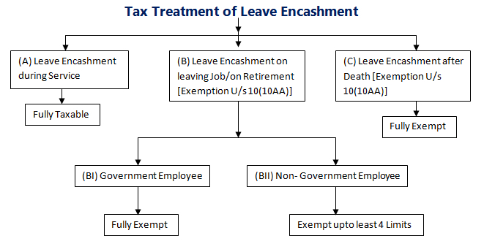
Slide 15: Leave Encashment
Under employment, generally, an employee is granted casual leaves, medical leaves and privileged leaves or earned leaves. He can accumulates his medical leaves and privileged leaves and can avail such leaves in subsequent years.
An employee can even encash his accumulated privileged/earned leaves and can get salary for the said period of leave. Such receipt of salary by an employee from his employer in lieu of his accumulated leaves is called “Leave Encashment”.
Such encashment can be done by an employee either during the service or at the time of leaving job due to retirement or any other reason. However, in case of death of an employee, the salary for his/her accumulated leave is given to his/her legal heirs.

Slide 15
Slide 16 : How to calculate exemptions for leave Salary
For Government Employees | For Non Government Employees (including Local authority & Public Sector Undertakings)
Fully Exempted | Actual leave Salary Received | xxx
 | 10 months Average Salary | xxx
 | Absolute Limit (Rs.) | 300000
 | Salary* for unutilized eligible leave (consider 30 days per year)** | xxx
 | Which ever less is exempted | xxx
 | *Salary = Average Salary
 | ** If the company gives less than 30 days then that should be considered

Slide 16
Slide 17: Provident Fund (PF)
It is a scheme where employee contributes some part of money from his salary as savings in form of Provident fund.
Similarly the employer will also contributes the corresponding the same amount towards employees Provident fund.
The interest earned out of this contribution is also credited to his account
Employee can also obtain loan from the PF account.
The accumulated some of money will be paid at the time of retirement
Types of Provident fund
1. Statutory Provident Fund 2. Recognised Provident Fund
3. Unrecognised Provident Fund 4. Public Provident Fund
Statutory PF: it is formed to promote saving habit among government employees, It is followed by Government, Semi government, railways, Local authorities, Insurance companies etc | Recognised PF It is fund maintained by industrial undertakings & Banks Both the employer & Employee contribute
Unrecognised PF: It is not recognised by the commissioner of IncomeTax. Both the employer & Employee contribute | Public PF The other 3 types of Provident fund are for salaried people, this for promoting saving habit of not salaried employees This is for self employed people like doctor, lawyers, accountants, professionals etc.

Slide 17
Slide 18: Tax treatment of Provident fund
Sl. No | Particulars | SPF | RPF | URPF | PPF
1 | Employees Contribution | Fully Deducted U/s 80C | Fully Deducted U/s 80C | Deduction U/s 80C is not applicable | Fully Deducted U/s 80C
2 | Employers Contribution | Fully exempted | Employers contribution over 12% of employees salary is Taxable | Not Taxable | No contribution by the employer
3 | Interest | Fully exempted | Interest over 9.5% is taxable | Not Taxable | Not Taxable
4 | Lump sum amount received on Retirement | Not Taxable | Exempted * | Employees Contribution- Not taxable Interest on Employees Contribution- Other sources Employers Contribution & Interest on it – Taxable under Salary. | Not Taxable
* Exempted to those employees who saves for a period of 5years or more

Slide 18
Slide 19: Deductions U/s16
The income chargeable under the head “Salaries” is computed after making the following deductions under Section 16. It comprises of 3 deductions
Standard Deduction ;
Entertainment Allowance Deduction ; and
Professional Tax .
Standard Deduction [Sec. 16(i)/(ia)] - Standard deduction is Rs. 40,000 ; or the Amount of Salary, whichever is Lower.
Entertainment Allowance Deduction
Professional Tax- Professional Tax or Tax on Employment, levied by a State under article 276 of the Constitution, is Allowed as Deduction.
Deduction is available only in the year in which professional tax is paid.
If the professional tax is paid by the employer on behalf of an employee, it is first included in the salary of the employee as a “perquisite” and then the same amount is allowed as deduction on account of “professional tax” from gross salary.
There is no monetary ceiling under the Income-tax Act. Under article 276 of the Constitution, a State Government cannot impose more than Rs. 2,500 per annum as professional tax. Under the Income-tax Act, whatever professional tax is paid during the previous year, is deductible.
For Government Employee |  | For Non Government Employee
Actual entertainment allowance received during the previous year. | xxx | No Deductions U/S 16(II) Full Gross amount is taxable
20% of his salary exclusive of any allowance, benefit or other perquisite. | xxx
Absolute limit (Rs. ) | 5000
Which ever less is exempted | xxx

Slide 19
Slide 20: Deduction u/s 80C
Amount saved and deposited by the employee or Assessee in following savings schemes shall qualify for deduction u/s 80C.
Sl. No | Particulars | Amount
1 | Amount deposited by the employee in SPF | xxx
2 | Amount deposited by the employee in RPF | xxx
3 | Amount deposited by the employee in PPF | xxx
4 | Payment of Life Insurance Premium 20% of capital sum assured if policy is issued before 1-4-2012 10% of capital sum assured if policy is issued during 2012-13 15% of capital sum assured if policy is issued on or after 1-4-2013 | xxx xxx xxx
5 | Contribution towards non commuted deferred annuity | xxx
6 | Deposits made in Unit Linked Insurance Plan (ULIP) | xxx
7 | Amount invested in National Savings Certificates—VIlI Issue or IX issue. | xxx
8 | Amount paid to LIC under Jeevan Dhara, Jeevan Akshay Policies. | xxx
9 | Amount deposited with National Housing Bank | xxx
10 | Amount deposited with an authority engaged in Housing Development or Town or Rural Development. | xxx
11 | Amount deposited or invested in Equity Linked Saving Scheme (ELSS) | xxx
12 | Repayment of house building loan. | xxx
13 | Payment of Tuition fees. | xxx
14 | Amount paid as subscription to equity shares or debentures. | xxx
15 | Amount paid as subscription to units of a mutual fund. | xxx

